Slide 1
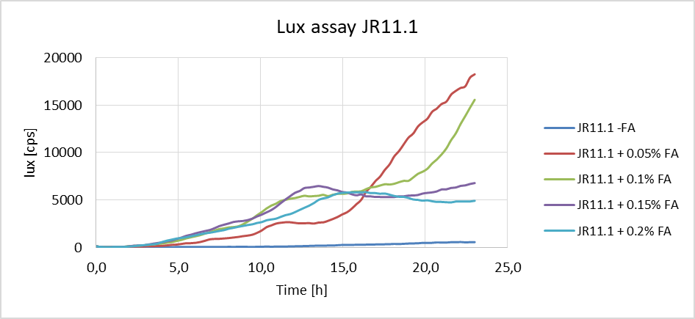
Supplementary Figure 2. Expression of PfaeB-lux is induced by ferulic acid in a concentration dependent manner. Expression of the lux reporter gene in strain JR11.2 was measured in a lux assay, using MM with fructose as C-source with the addition of different concentrations (0 %-0.2 %) of ferulic acid (FA). Luminescence and OD₆₀₀ and were measured every 15 min for 24 h at 30 °C.

