Slide 1
Supplemental data
Fig. S1-1
A
Stand ACSF
ACSF + 8 mM Ba²⁺
NMDA 100 μM
NMDA 100 μM
C | 2’ | 5’ | 10’ | 30’ | 60’ | C | 2’ | 5’ | 10’ | 30’ | 60’
Time (min)
pCREB
CREB
B
Conditioned medium
Conditioned medium
+ 8 mM Ba²⁺
NMDA 100 μM
NMDA 100 μM
C | 2’ | 5’ | 10’ | 30’ | 60’ | C | 2’ | 5’ | 10’ | 30’ | 60’
Time (min)
pCREB
CREB

Slide 2
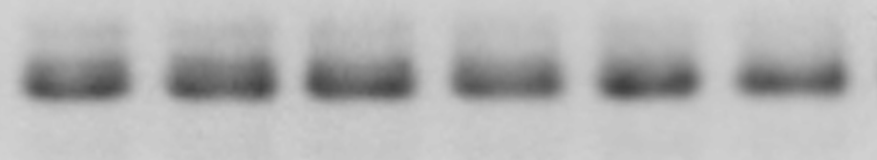
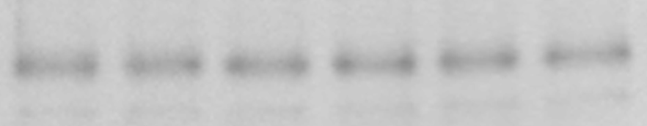

Fig. S3-1
A
Standard ACSF
B
Time
(min)
60 | 62 | 65 | 70 | 90 | 120
ACSF (Ca²⁺ / Mg²⁺free)
Time
(min)
60 | 62 | 65 | 70 | 90 | 120
pCREB
pCREB
CREB
CREB
C
ACSF (Mg²⁺ free)
D
ACSF (Ca²⁺ free)
Time
(min)
60 | 62 | 65 | 70 | 90 | 120
Time
(min)
60 | 62 | 65 | 70 | 90 | 120
pCREB
pCREB
CREB
CREB
E
ACSF (Ca²⁺ free)
1 hour
2 hours
 |  | + |  |  | +
 | + |  |  | +
+ |  |  | +
9 mM Mg²⁺
3 mM Mg²⁺
1 mM Mg²⁺
pCREB
CREB
F
Ca²⁺ free ACSF for 2 hrs, back to conditioned medium for 30’, then time course of NMDA
NMDA 20 uM
NMDA 100 uM
C | 2’ | 5’ | 10’ | 30’ | 60’ | C | 2’ | 5’ | 10’ | 30’ | 60’
Time (min)
pCREB
CREB

Slide 3
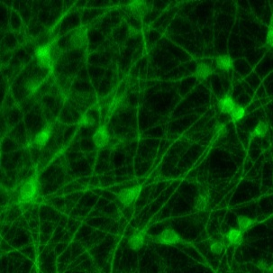
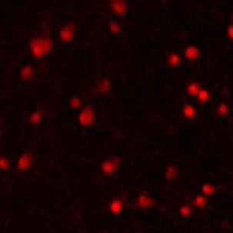
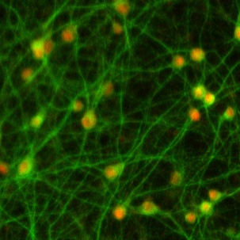
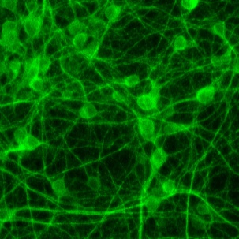
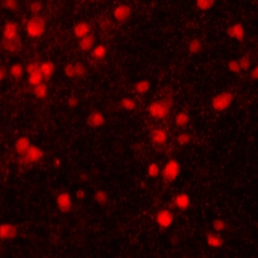
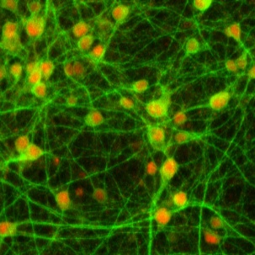
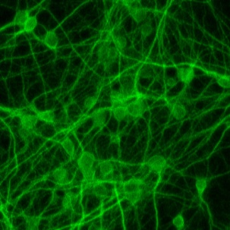
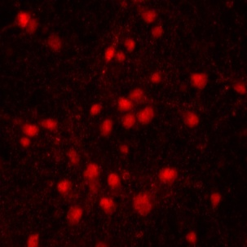
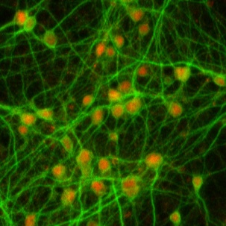
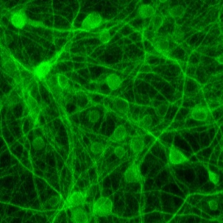
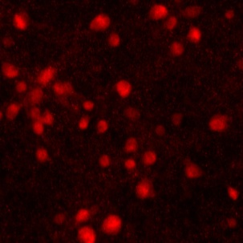
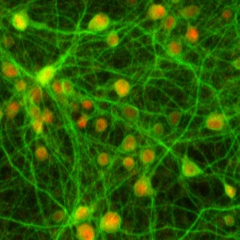
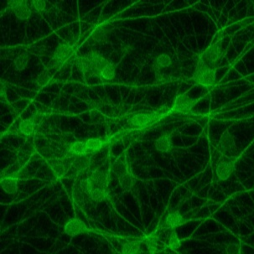
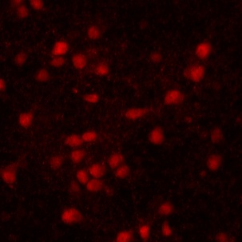
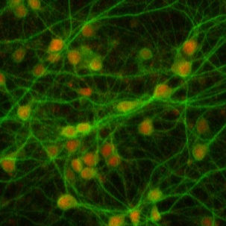
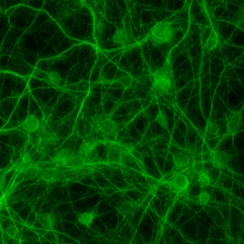
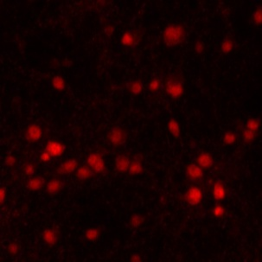
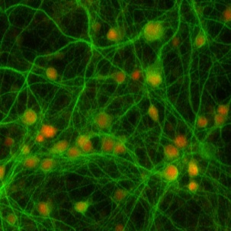
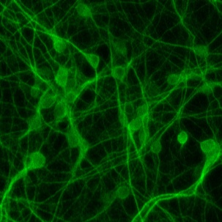
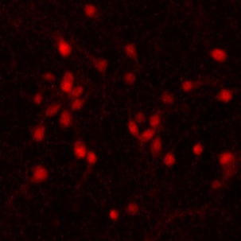
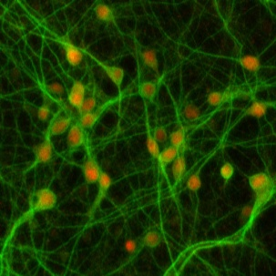
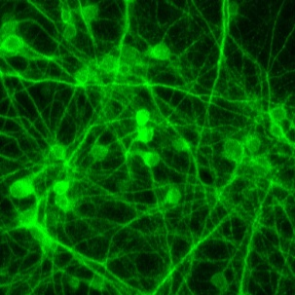
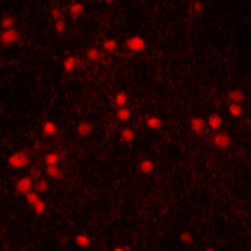
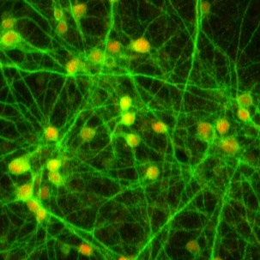
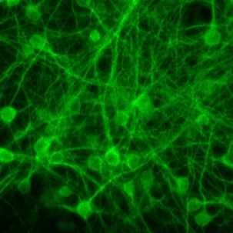
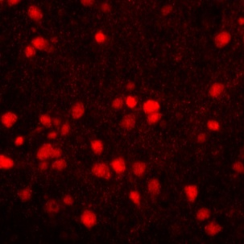
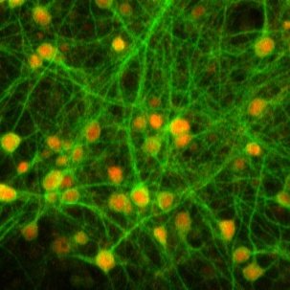
Fig. S3-2
MAP2
NeuN
Merge
Conditioned
medium
Standard
ACSF
1 Hour
Standard
ACSF
2 Hour
ACSF
Ca²⁺ /Mg²⁺ free
1 Hour
ACSF
Ca²⁺ /Mg²⁺ free
2 Hour
ACSF
Mg²⁺ free
1 Hour
ACSF
Mg²⁺ free
2 Hour
ACSF
Ca²⁺ free
1 Hour
ACSF
Ca²⁺ free
2 Hour

Slide 4
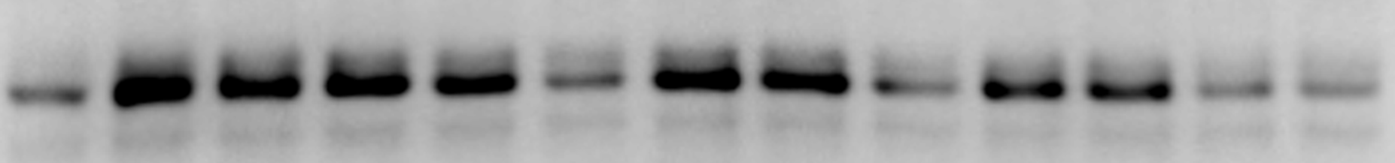
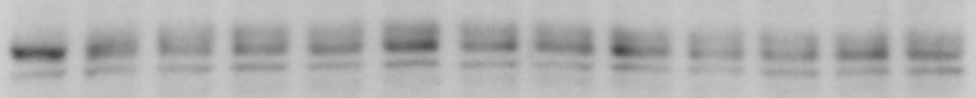
Fig. S4-1
A
Ca²⁺ free ACSF
Naltriben 20 μM
C 2’ 5’ 10’ 30’ 60’
pCREB
CREB
B
ACSF (Ca²⁺ free, 1 mM Mg²⁺ )
ACSF (Ca²⁺ free, 1 mM Mg²⁺ )
NMDA (μM)
0 100 20 100 20 0
NMDA (μM)
0 100 20 100 20 0
- | - | - | + | + | +
Cyclopiazonic acid
- | - | - | + | + | +
Dantrolene
pCREB
pCREB
CREB
CREB
- | - | - | + | + | +
Ruthenium Red
- | - | - | + | + | +
Thapsigargin
pCREB
pCREB
CREB
CREB
- | - | - | + | + | +
TEA
- | - | - | + | + | +
TTX
pCREB
pCREB
CREB
CREB
C
ACSF (Ca²⁺ free, 1 mM Mg²⁺ )
ACSF (Ca²⁺ free, 1 mM Mg²⁺ )
NMDA (μM)
0 100 20 100 20 0
NMDA (μM)
0 100 20 100 20 0
STO609 (CaMKK inhibitor)
pCREB
- | - | - | + | + | +
KN93 (CaMKII inhibitor)
- | - | - | + | + | +
CREB
pCREB
- | - | - | + | + | +
PD0325901 (MEK inhibitor)
CREB
pCREB
- | - | - | + | + | +
LY292004 (PI3K inhibitor)
CREB
pCREB
- | - | - | + | + | +
KT5720 (PKA inhibitor)
CREB
pCREB
- | - | - | + | + | +
SB415286 (GSK inhibitor)
CREB
pCREB
- | - | - | + | + | +
PD98059 (MAPK inhibitor)
CREB
- | - | - | + | + | +
pCREB
SP600125 (JNK inhibitor)
CREB
pCREB
- | - | - | + | + | +
Wortmannin (PI3K inhibitor)
CREB
pCREB
CREB

Slide 5
Supplemental data
Movie 1. MP4 in separate file

