Slide 1
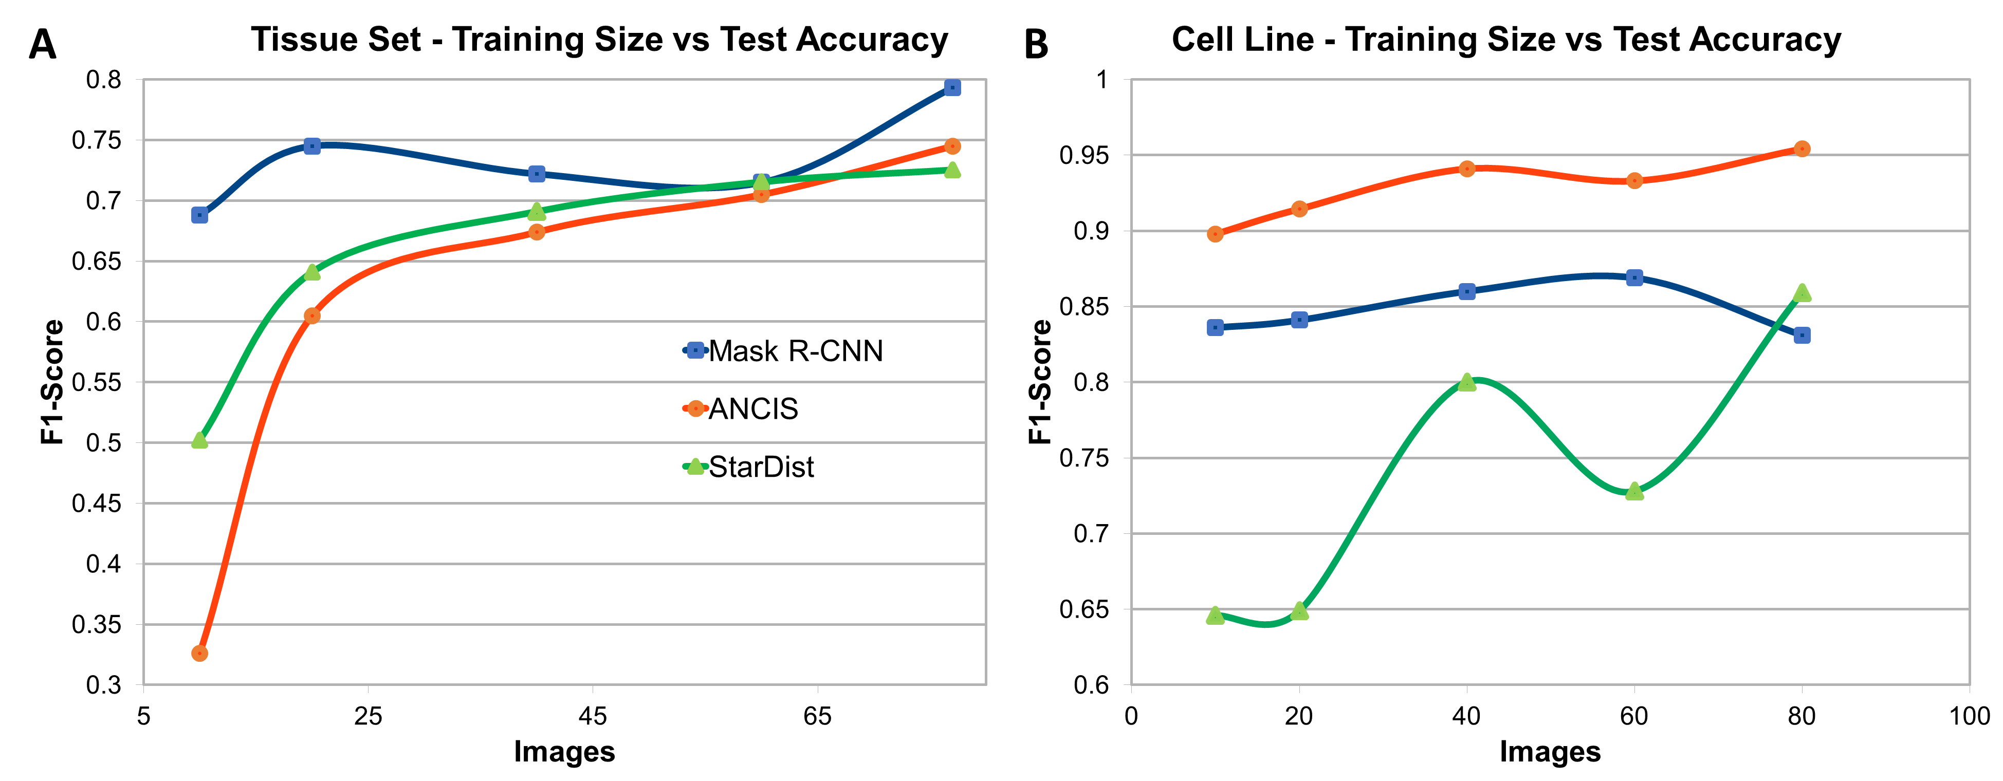
Supplementary Figure 3. Test accuracy versus number of images in the training set. Training set size had a distinct effect on test accuracy when conducting training for each of the three networks on the colon tissue dataset (A) and the cell line A dataset (discrete nuclear texture) (B). All networks demonstrate a general improvement in accuracy with number of images, with exceptions. In the tissue set, the Mask R-CNN test accuracy fluctuated, although the largest training set still provided the best accuracy. When training the cell line dataset, it was StarDist that fluctuated, while Mask R-CNN performed best when trained on 60 images rather than the maximum number.

