Slide 1
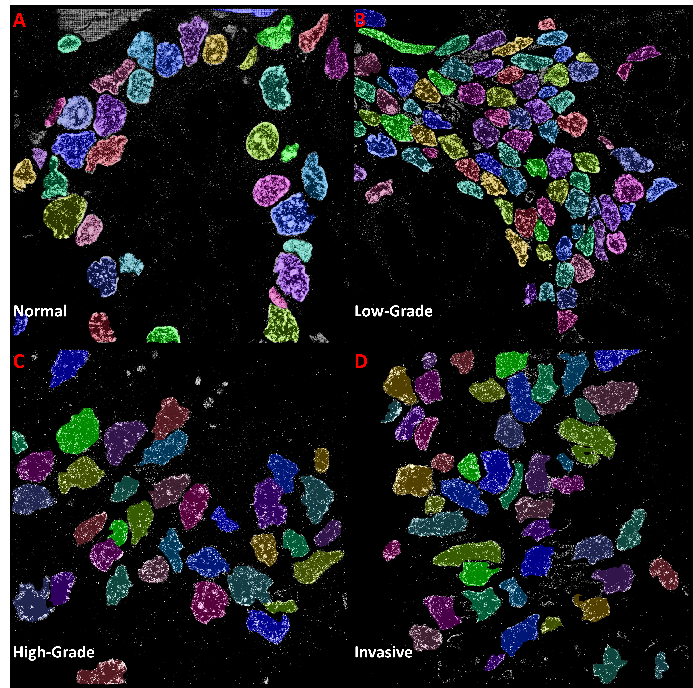
Supplementary Figure 4. Example Mask R-CNN segmented STORM images of colon tissue at normal and various pathological states. States include (A) normal healthy tissue, (B) a low-grade dysplasia, (C) a high-grade dysplasia, and (D) an invasive adenocarcinoma. Results for the normal state were the most accurate, followed by low-grade, high-grade and invasive cancer. This demonstrates a decrease in test accuracy with decreasing nuclear cohesion. Segmentation was conducted using Mask R-CNN trained on the STORM colon tissue dataset.

