Slide 1
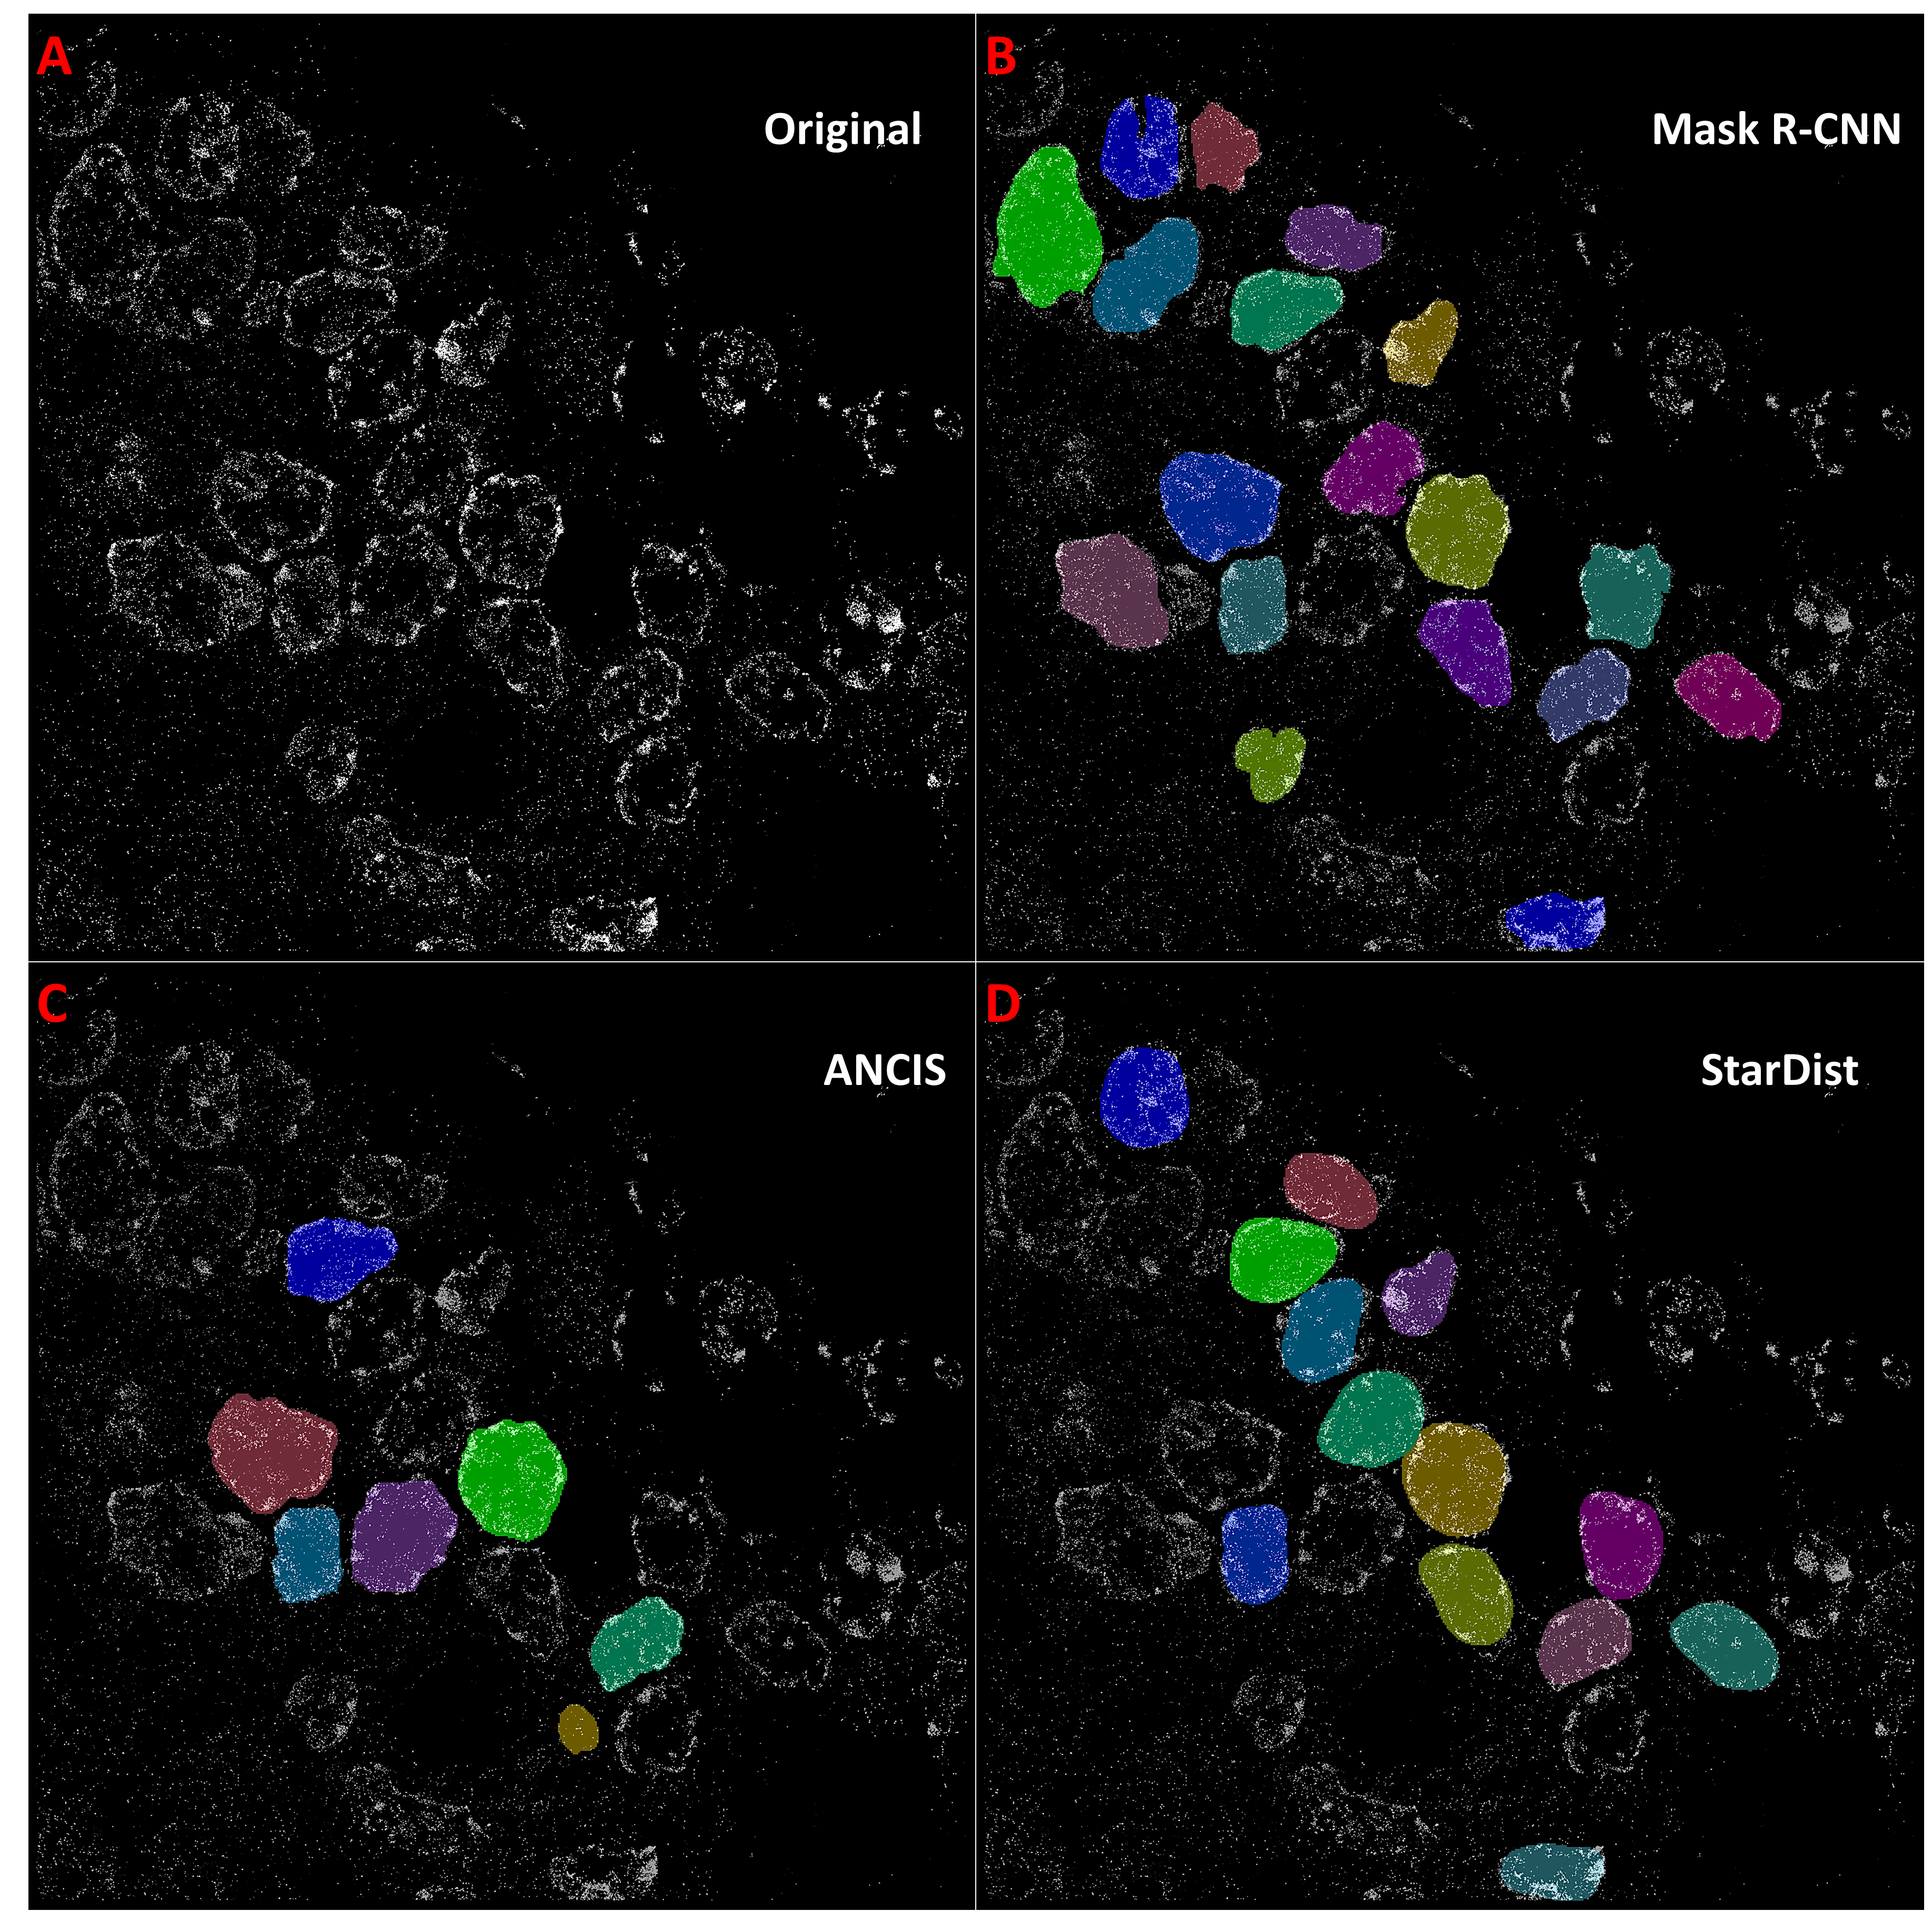
Supplementary Figure 5. Nuclei segmentation on STORM images from prostate tissue dataset. Segmentation of prostate tissue images using models which were pre-trained on the STORM colon tissue dataset. The original STORM image of prostate tissue (A) was segmented using (B) Mask R-CNN, (C) ANCIS and (D) StarDist networks. All three networks had multiple false negatives, however boarder placement appeared fairly accurate on the true positives. Mask R-CNN performed the best on this tissue dataset.

