Slide 1
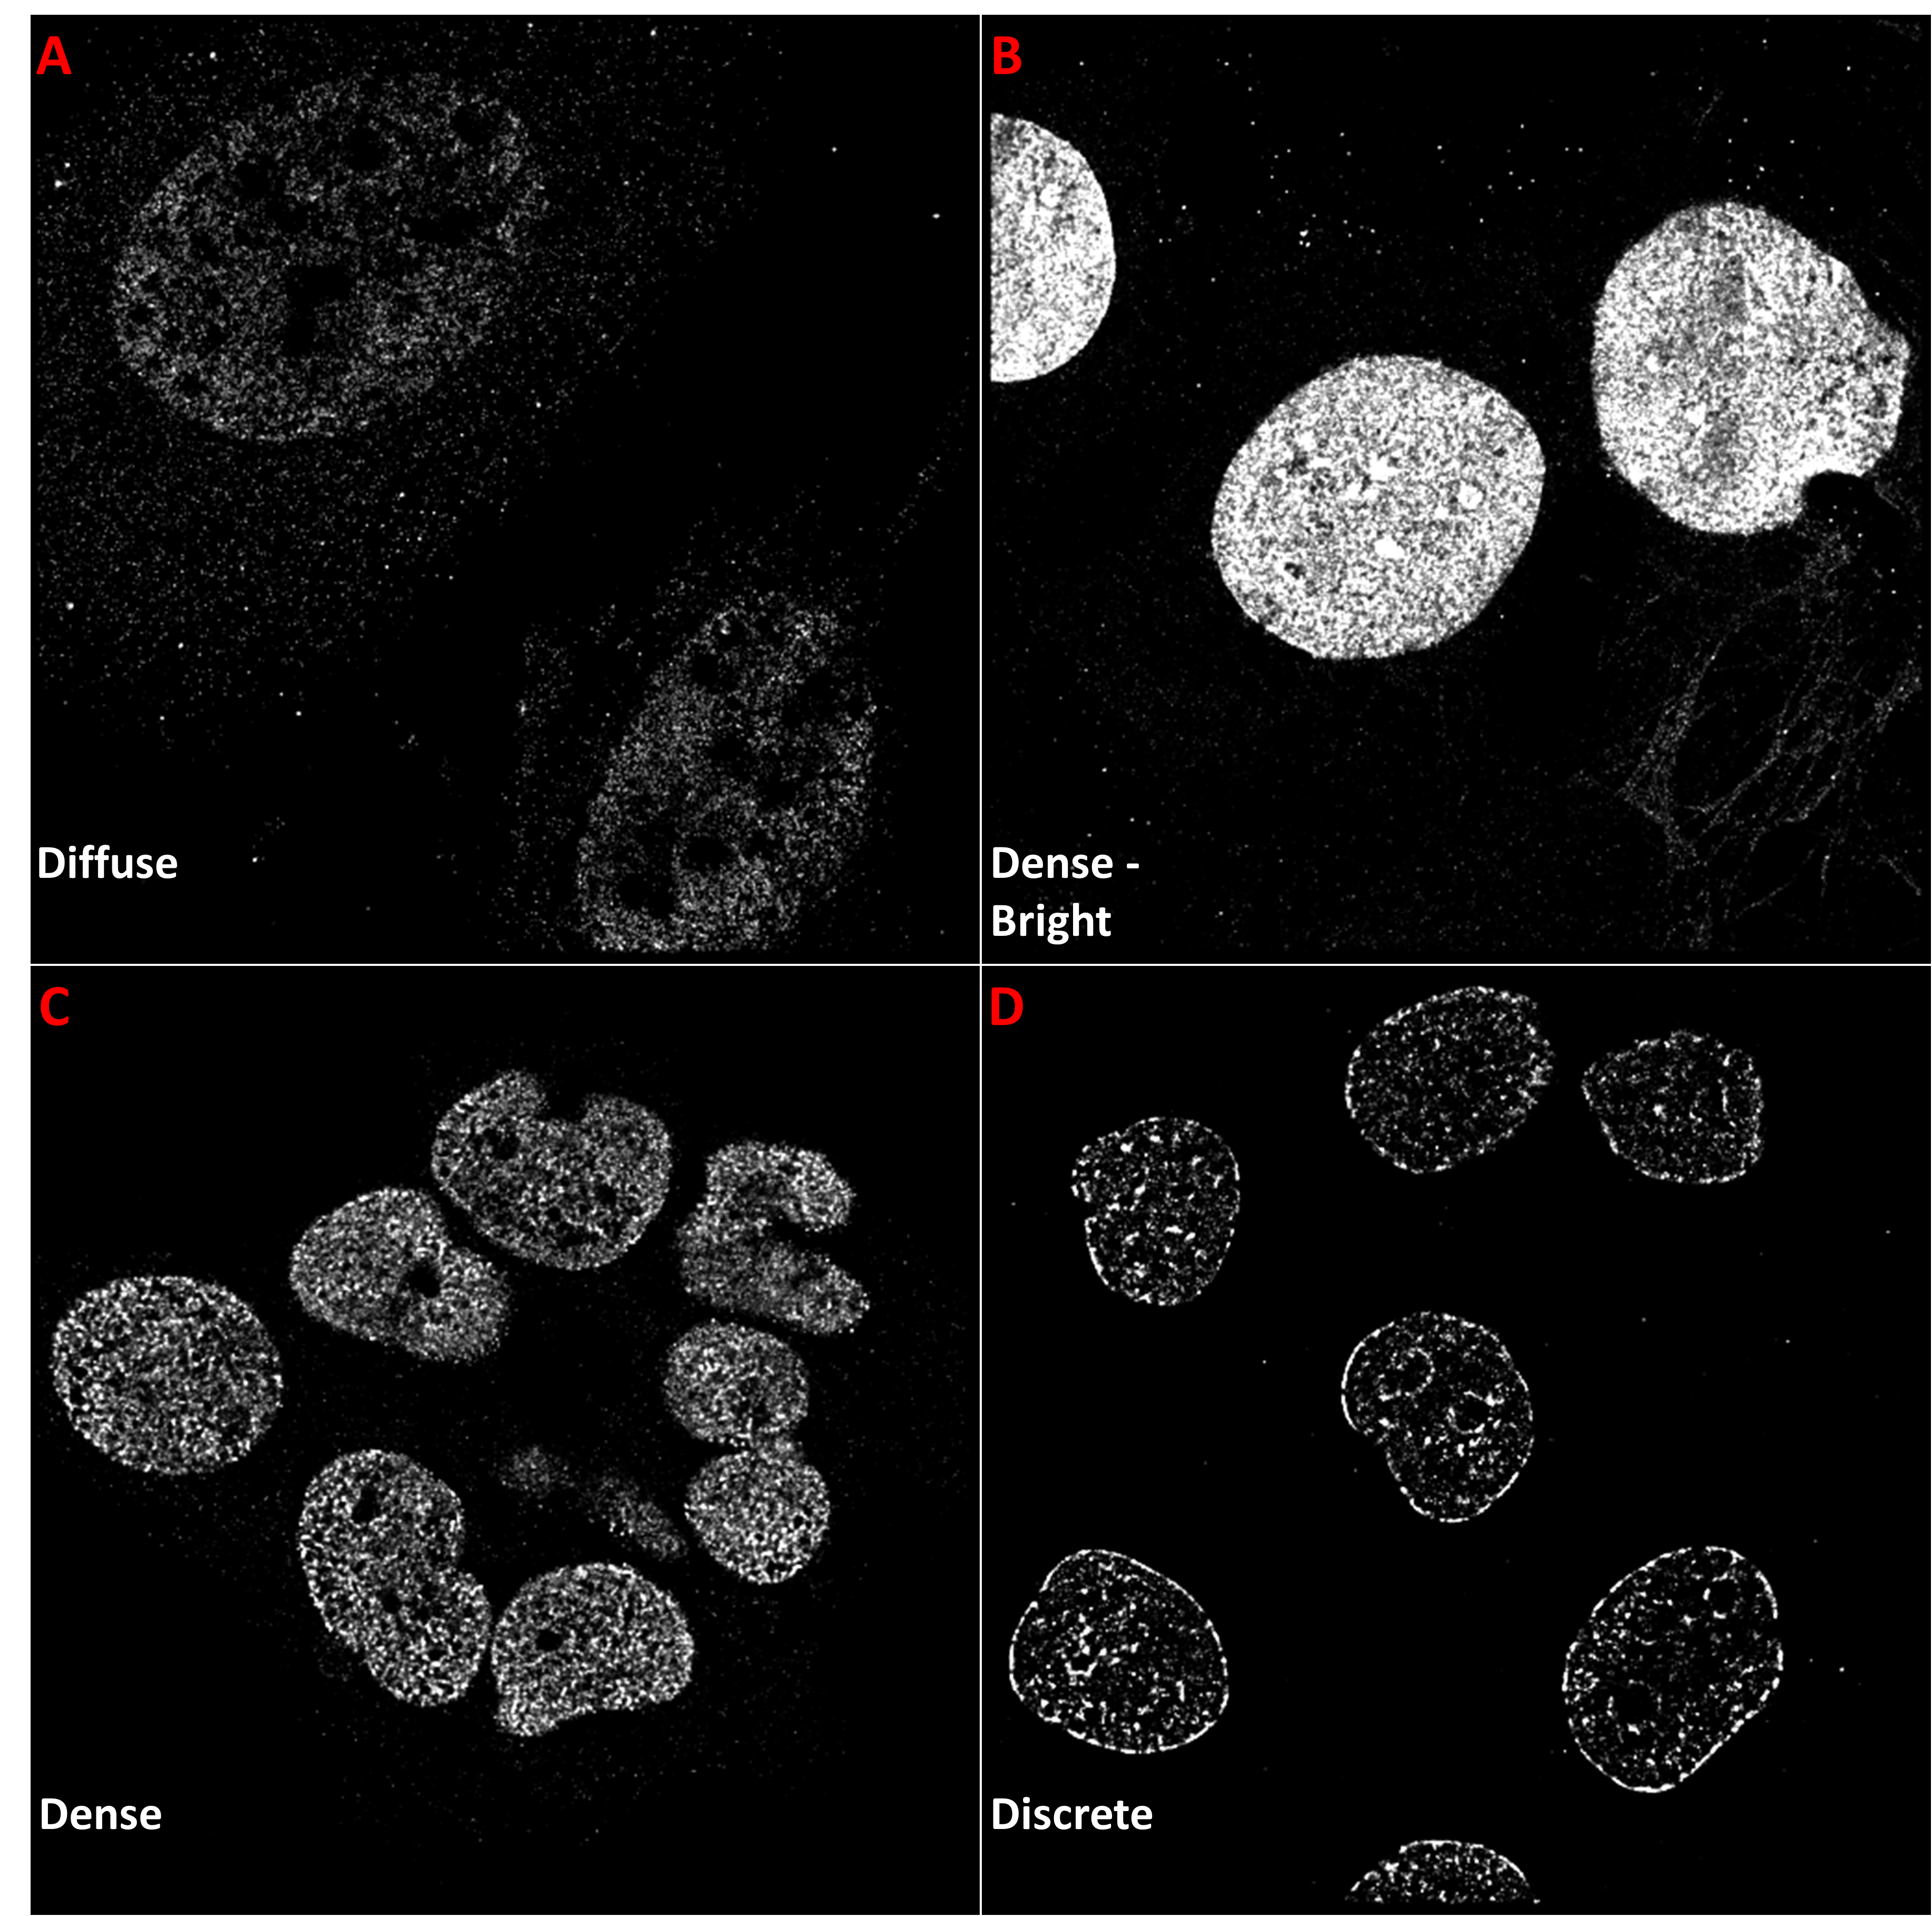
Supplementary Figure 8. Example cell line images, each expressing different textures. Textures include a dim, diffuse pattern (active form of RNA polymerase II in 3T3 cells) (A), more densely placed labels (DNA in 3T3 cells) (B) and (H3K4me3 in HK2 cells) (C), and discrete labels (H3K27me3 in CA1h cells) (D).

