Slide 1
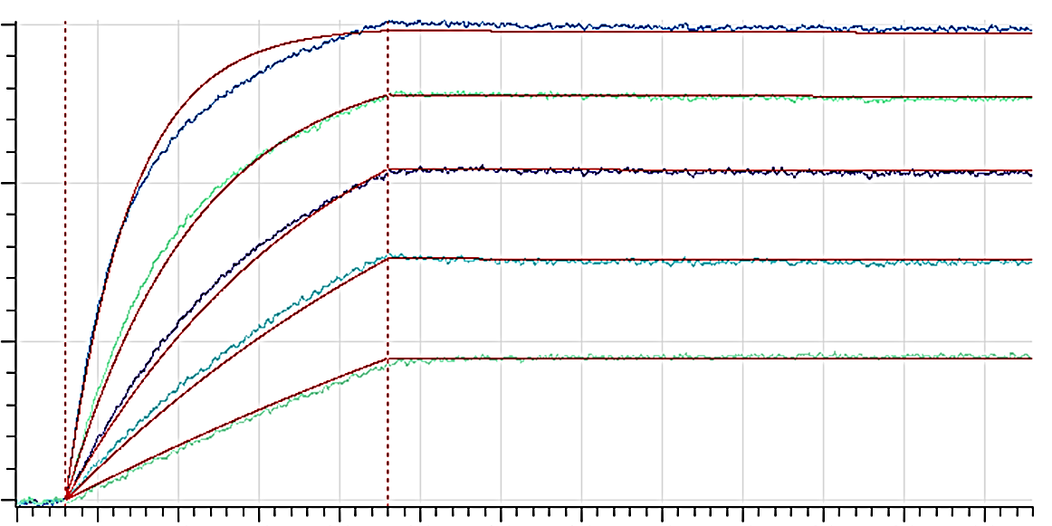
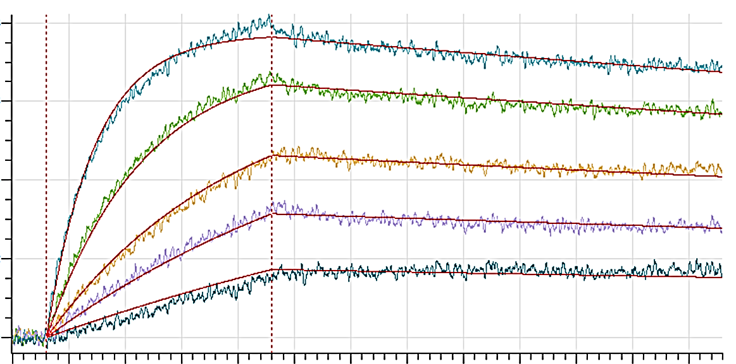
A
0.3
25 nM
12.5 nM
0.2
6.3 nM
nm
3.1 nM
0.1
1.6 nM
0
0
100
200
300
400
500
600
B
Time (sec)
0.08
25 nM
0.06
12.5 nM
nm
0.04
6.3 nM
0.02
3.1 nM
1.6 nM
0
0
100
200
300
400
500
600
Time (sec)
Figure S2

