Slide 1
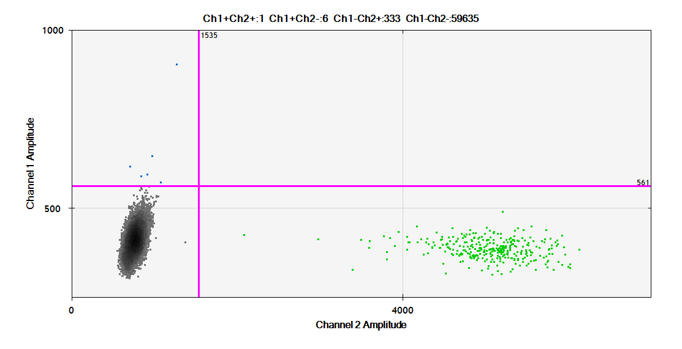
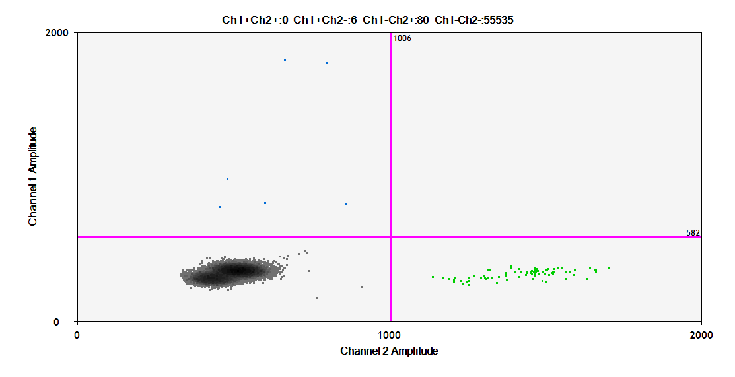
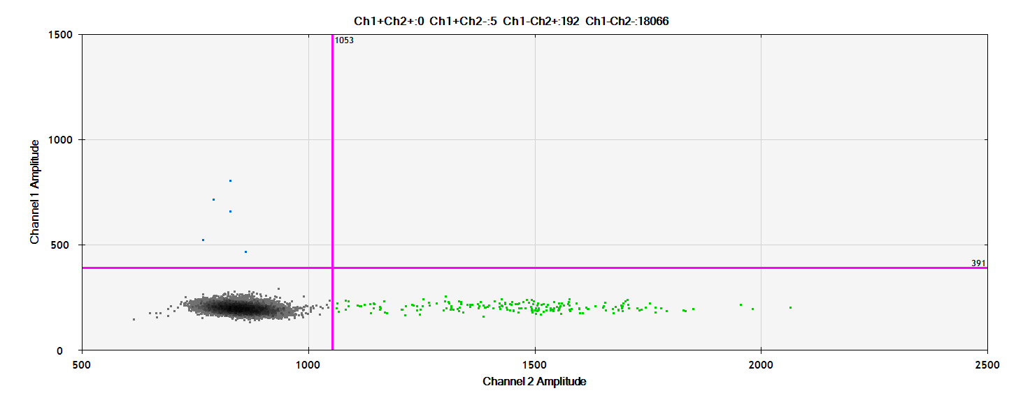
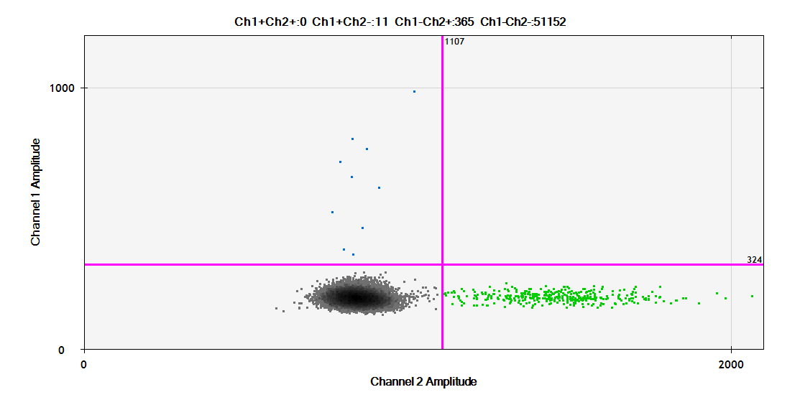
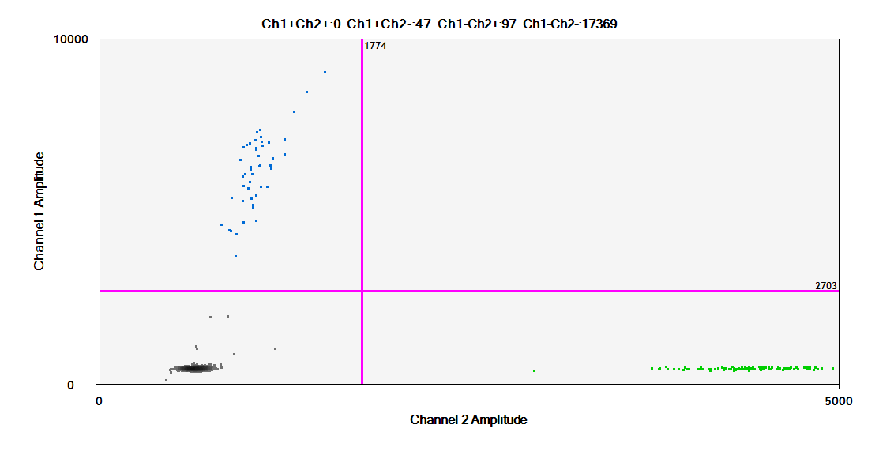
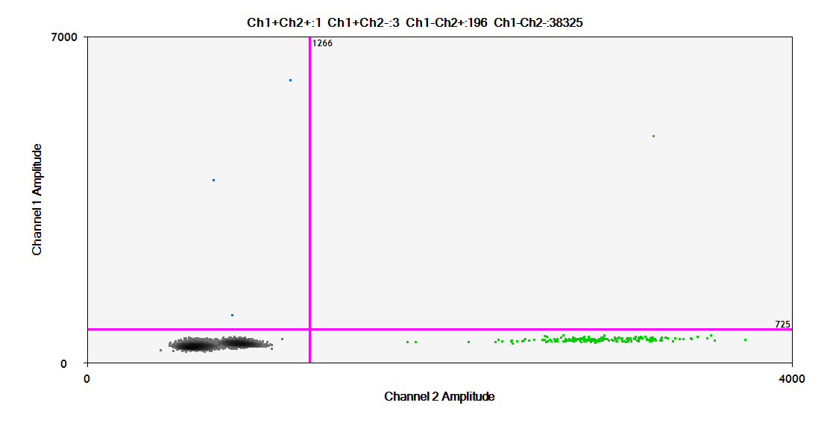
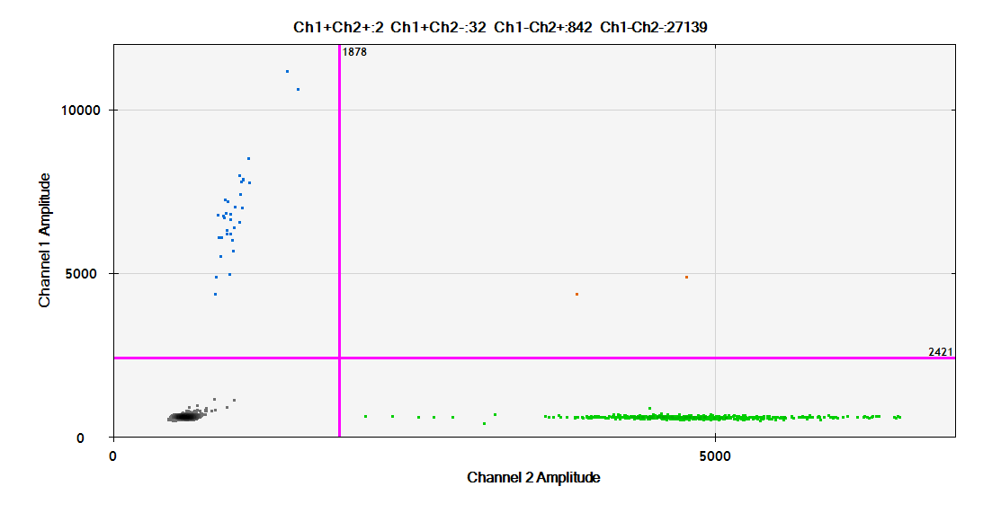
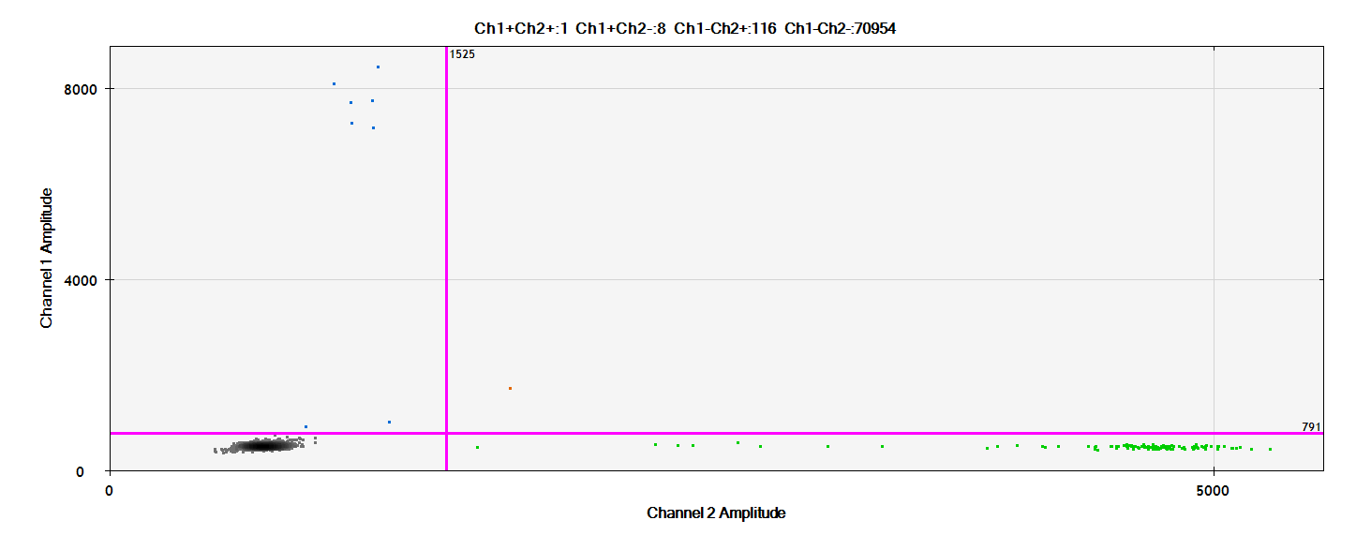
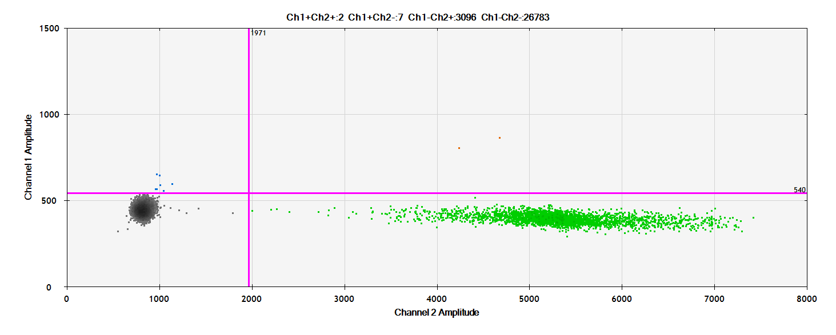
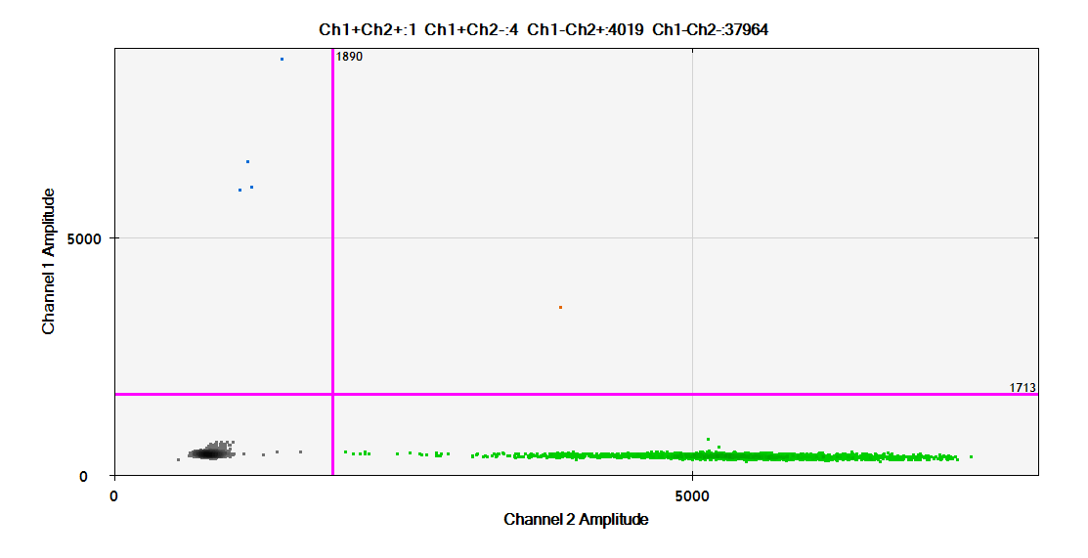
A. UM cohort
43 42 41 40
6000
0
6000
0
1000
0
1000
0
0 2000
0 2000
36 33 32 31
0 5000
0 5000
1000
0
6000
0
6000
0
1000
0
Mutated loci (FAM channel)
0 5000
0 2000
0 2000
0 4000
30 29 28 27
6000
0
6000
0
6000
0
6000
0
22 21
0 5000
0 5000
0 5000
0 5000
6000
0
6000
0
0 5000
0 5000
Wild type loci (HEX channel)

Slide 2
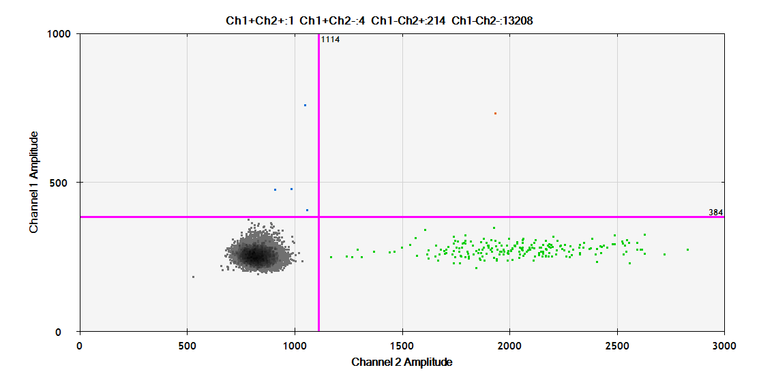
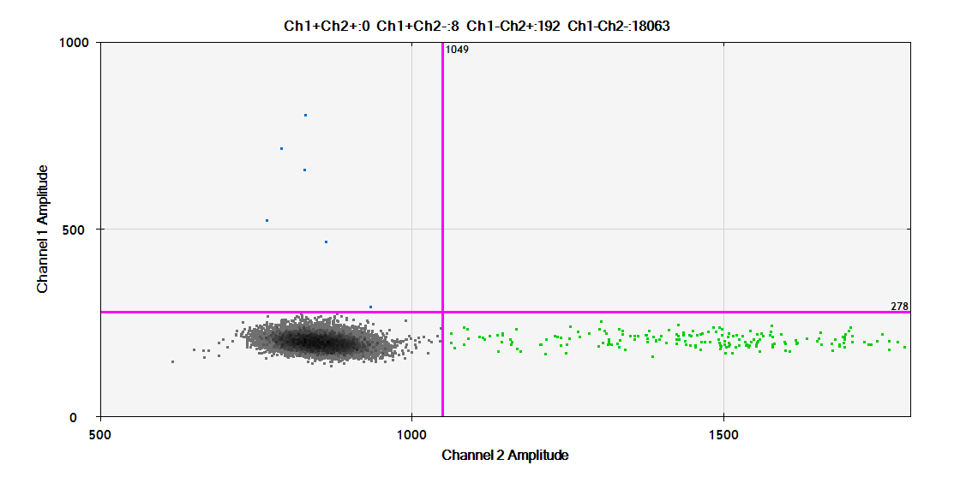
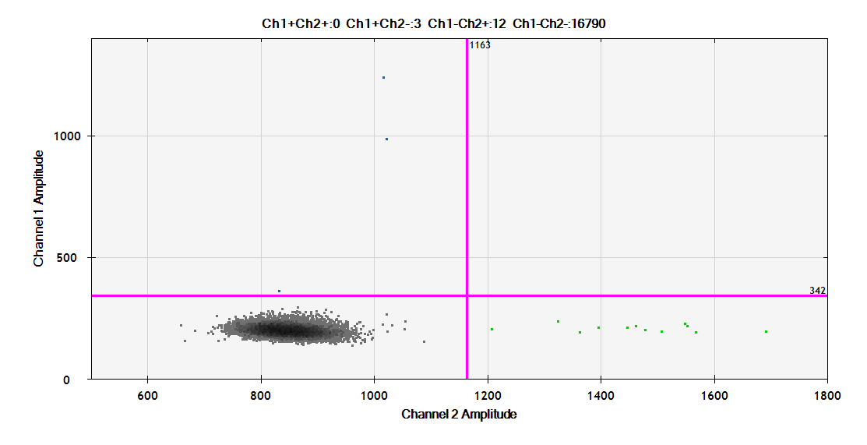
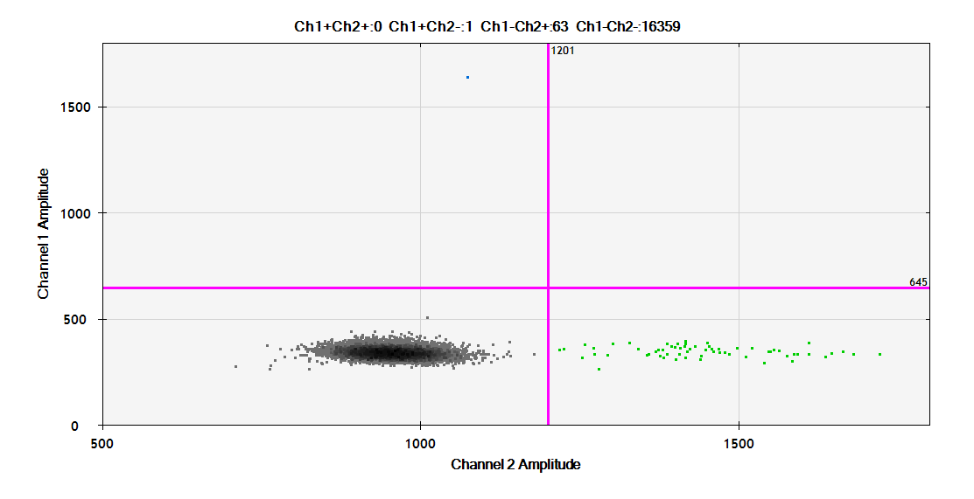
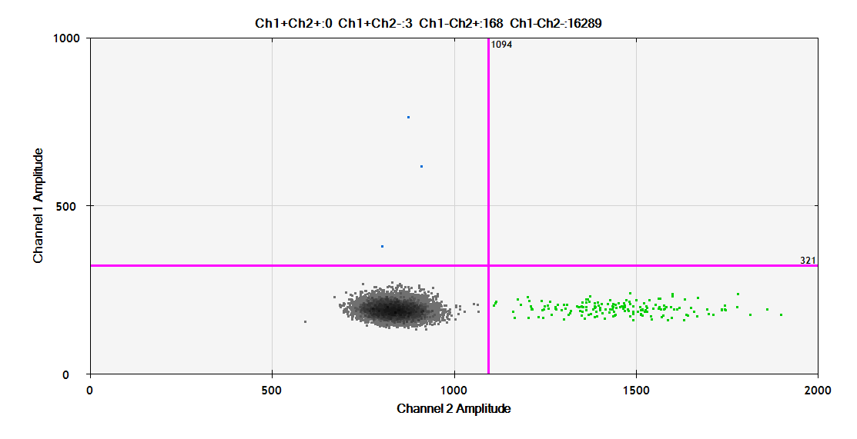
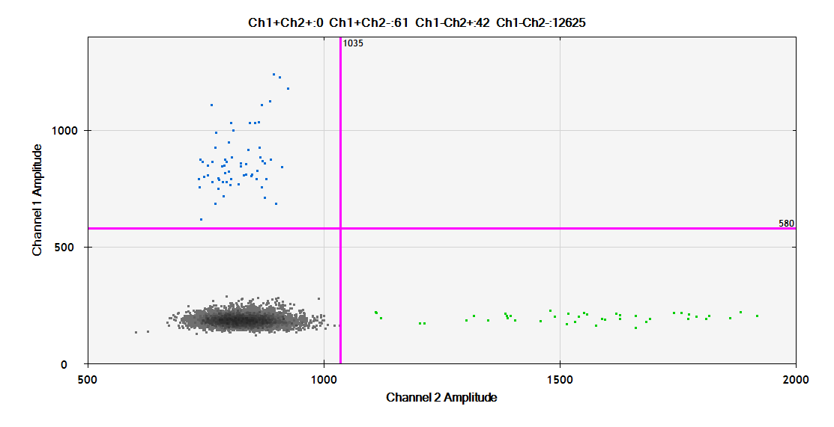
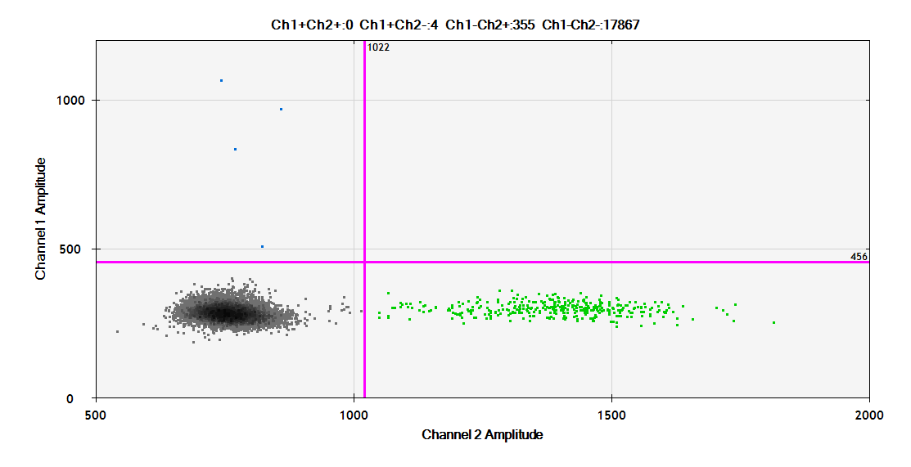
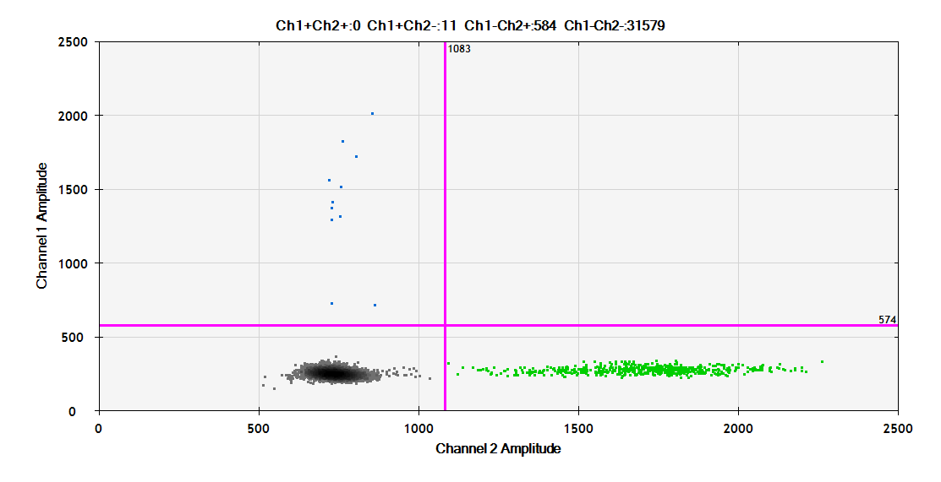
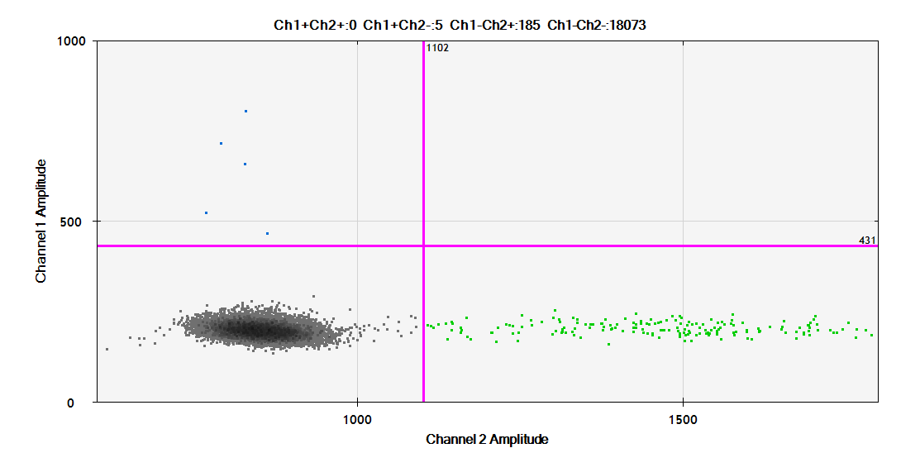
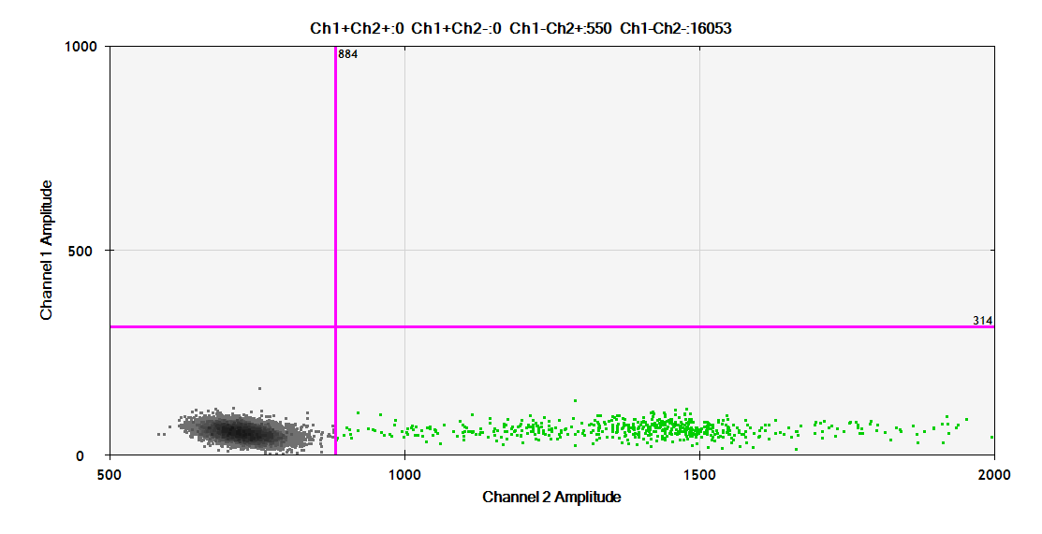
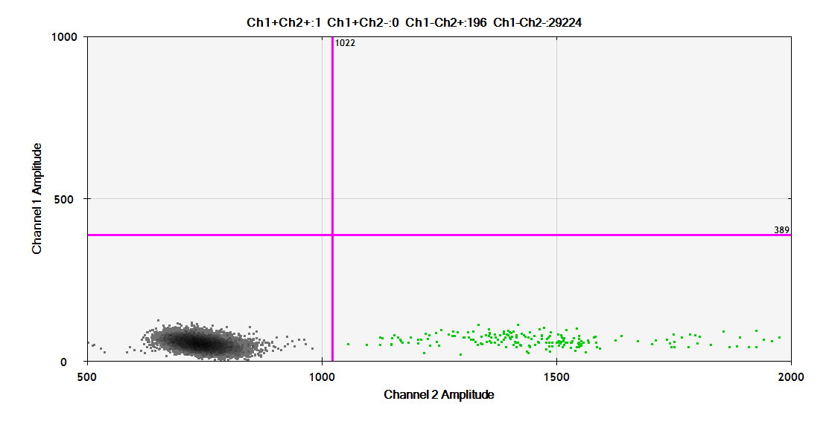
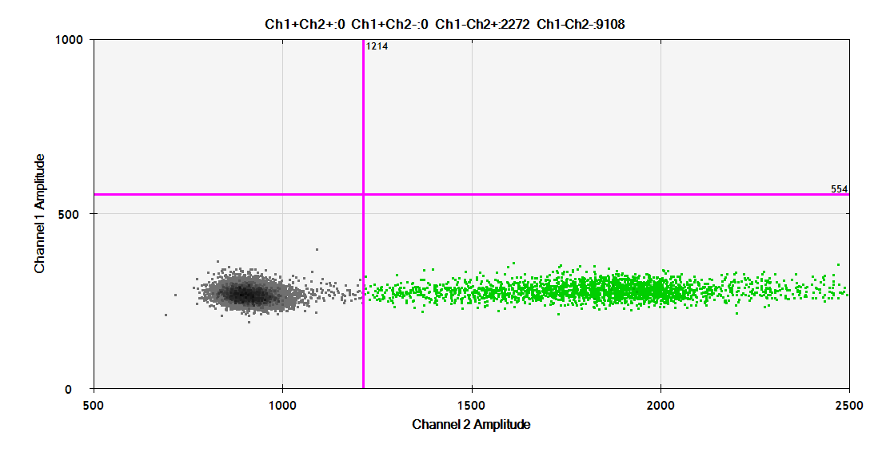
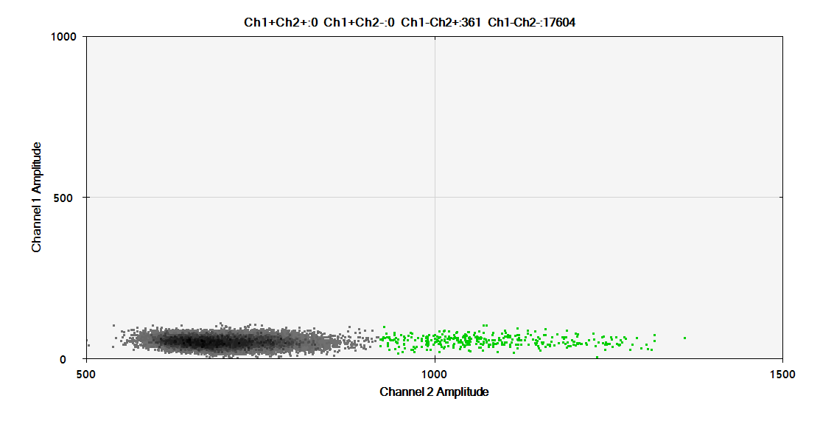
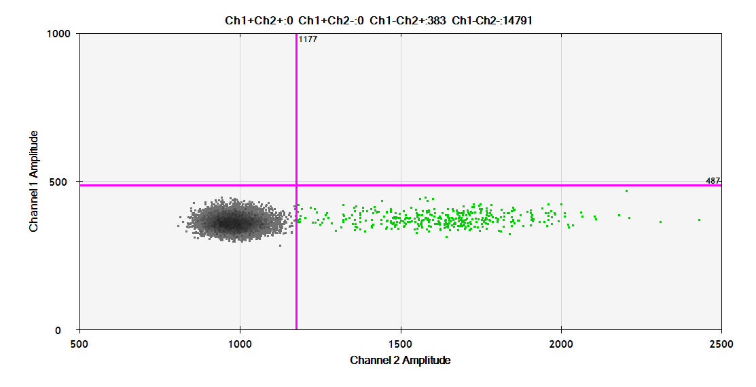
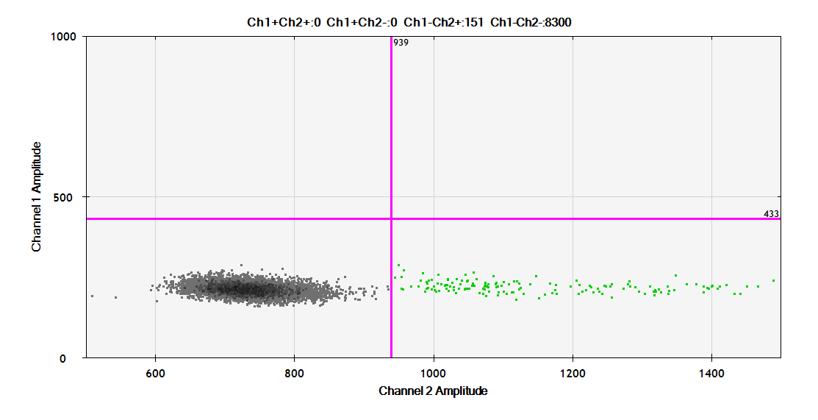
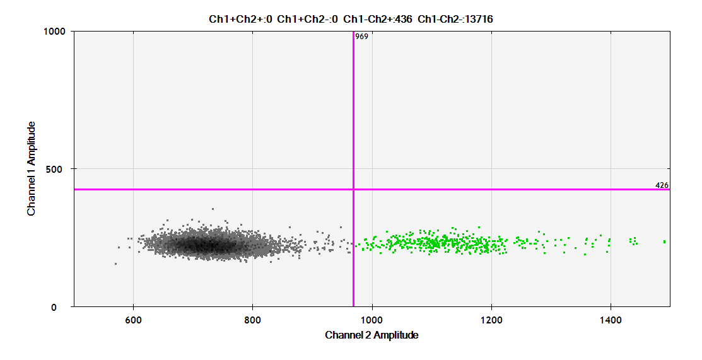
B. Nevus cohort
45 38 37 35
1000
0
1000
0
1000
0
1000
0
1000 2000
1000 2000
1000 2000
1000 2000
34 25 24 23
1000
0
1000
0
1000
0
1000
0
1000 2000
1000 2000
1000 2000
1000 2000
Mutated loci (FAM channel)
20 12 11 10
1000
0
1000
0
1000
0
1000
0
1000 2000
1000 2000
1000 2000
1000 2000
09 08 07 06
1000
0
1000
0
1000
0
1000
0
1000 2000
1000 2000
1000 2000
1000 2000
Wild type loci (HEX channel)

Slide 3
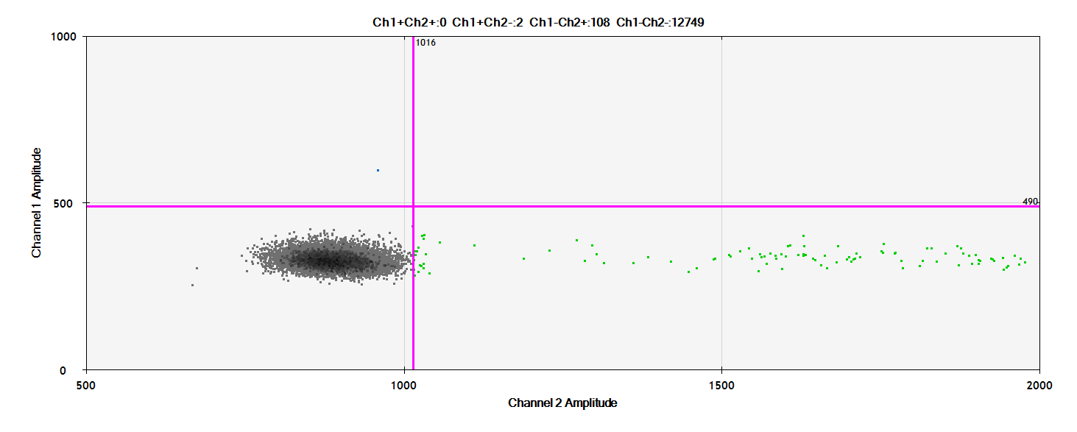
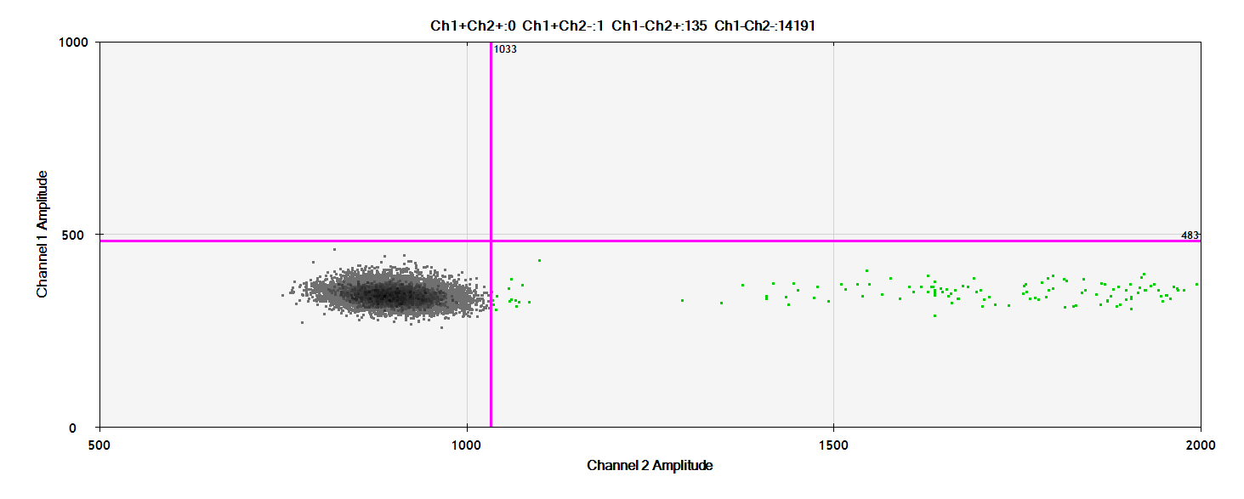
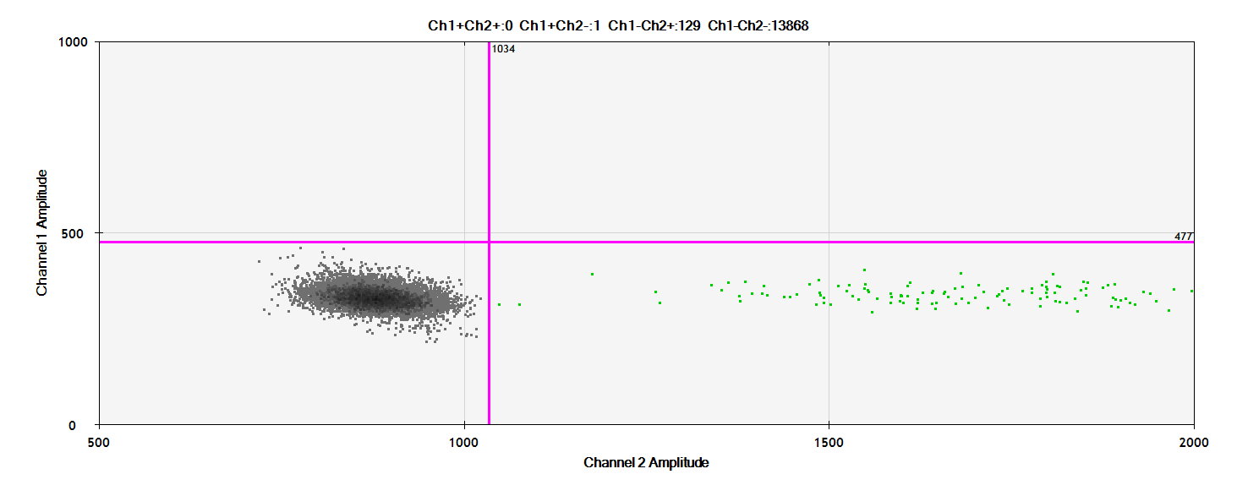
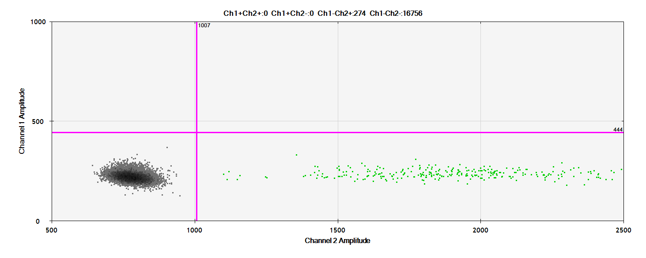
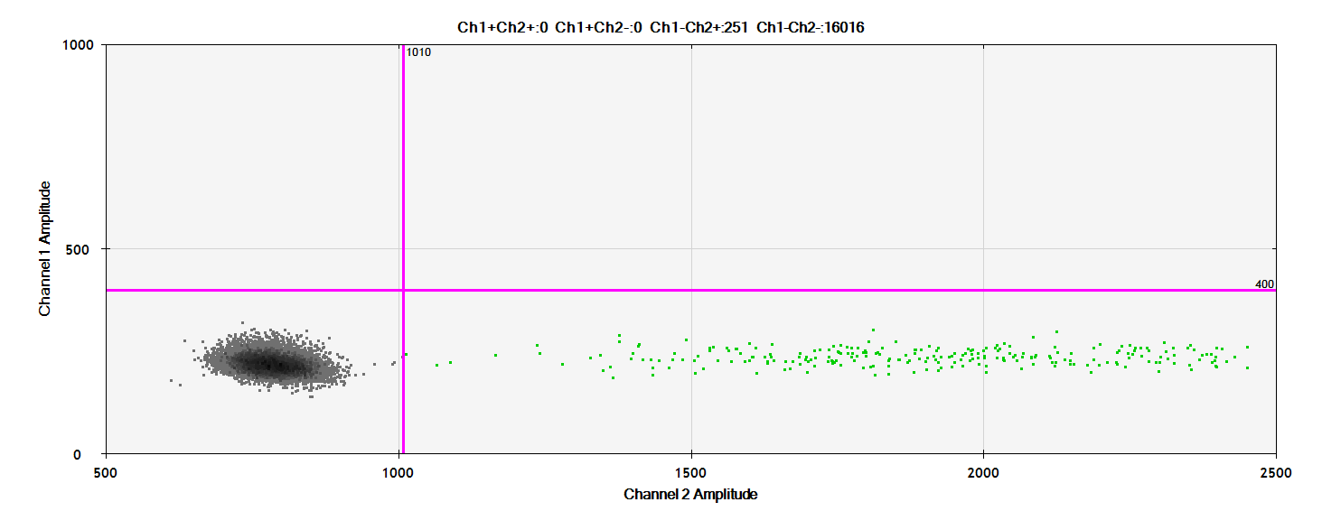
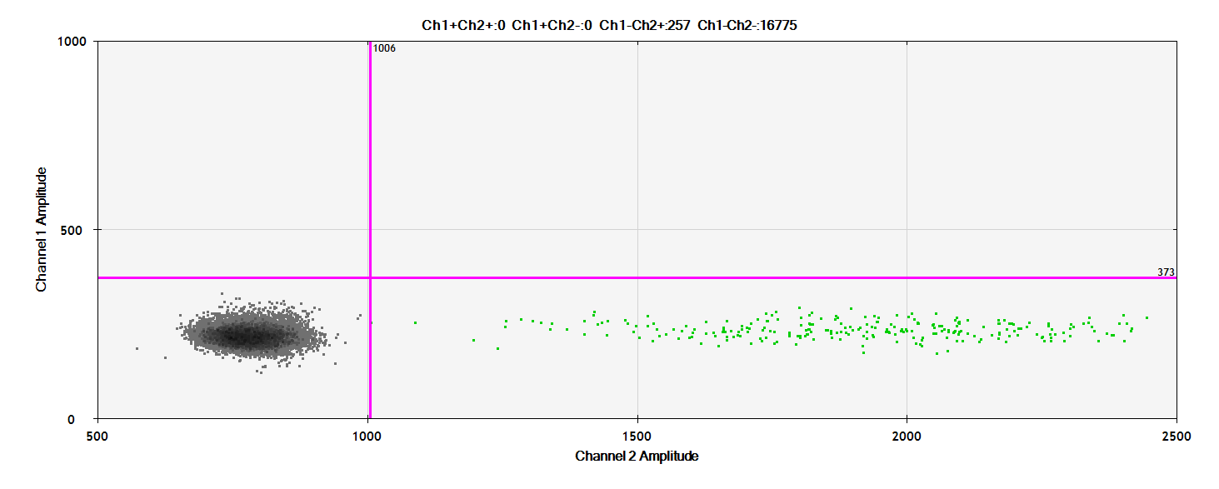
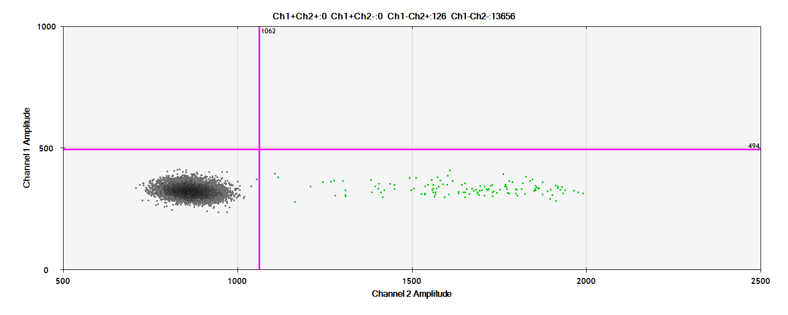
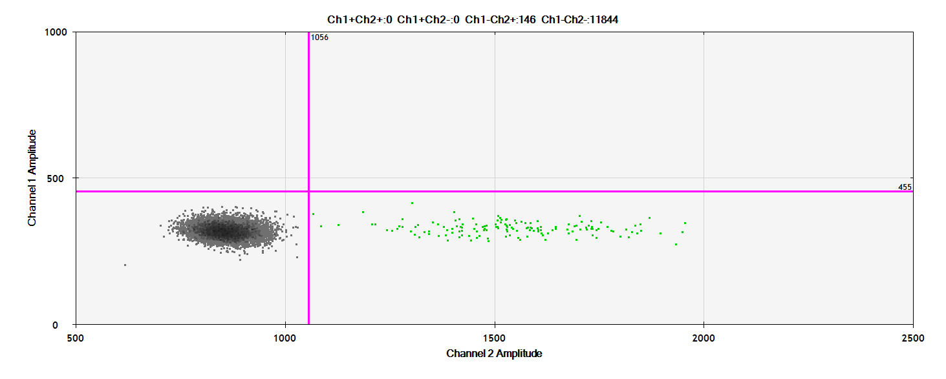
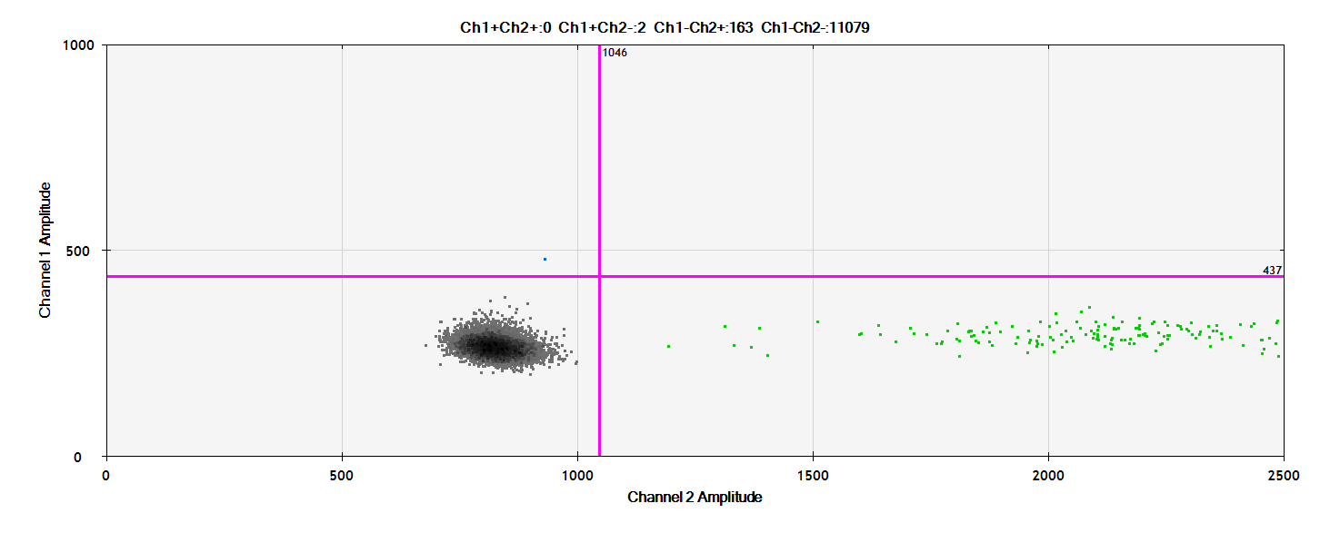
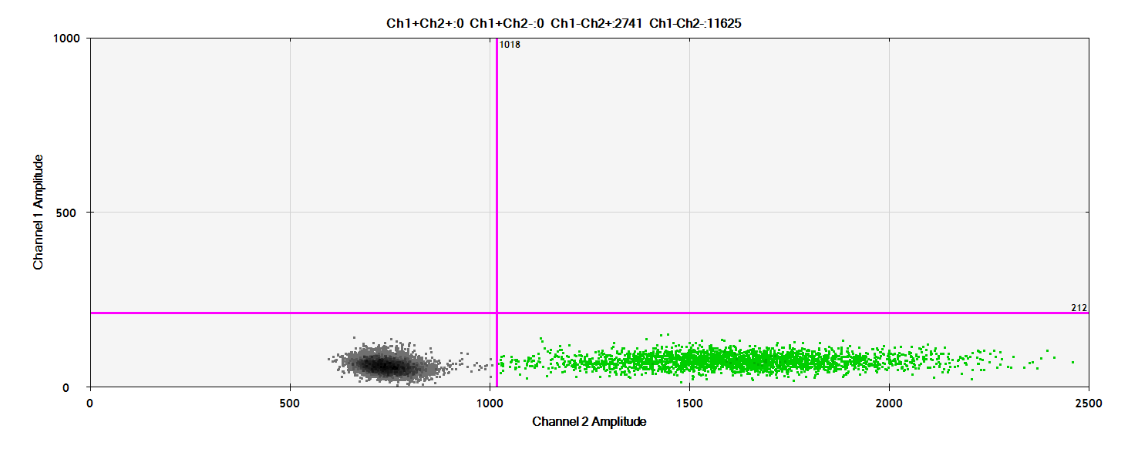
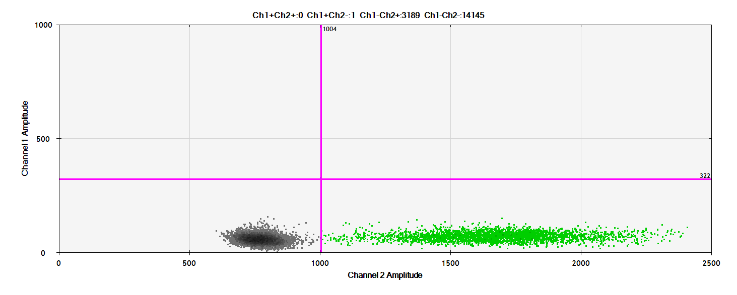
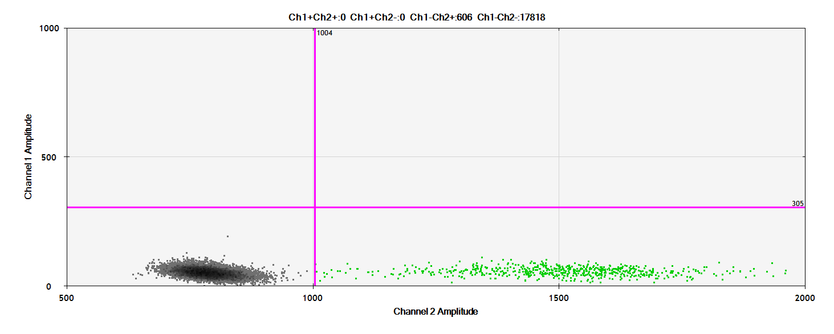
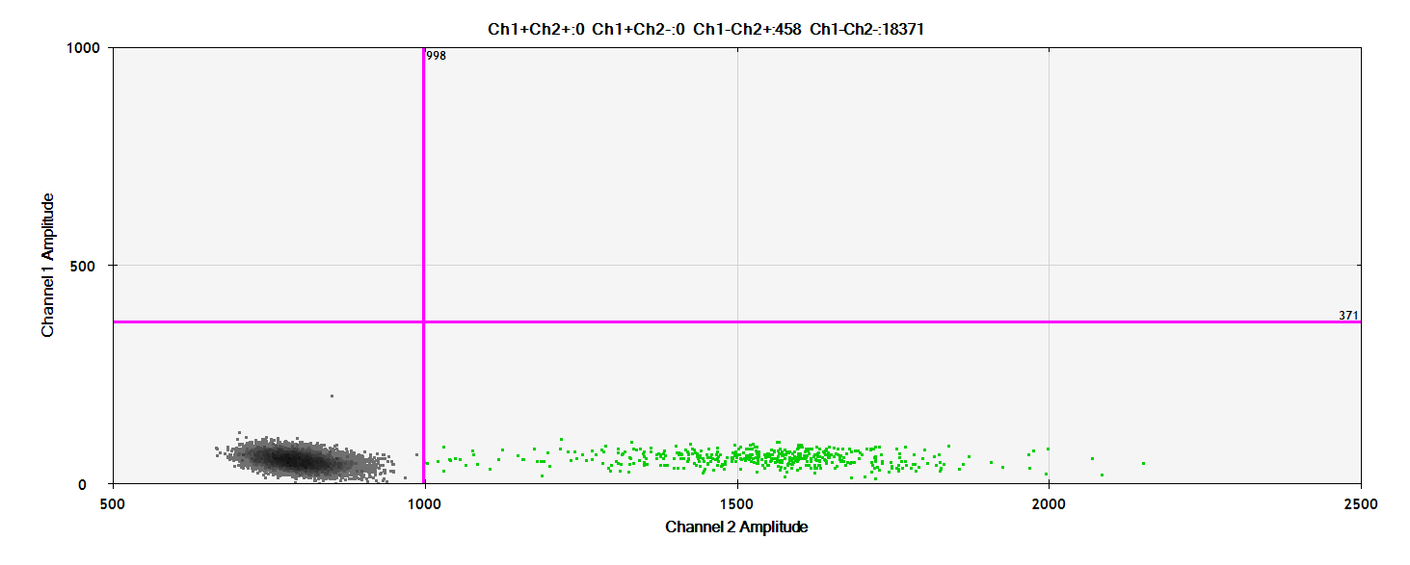

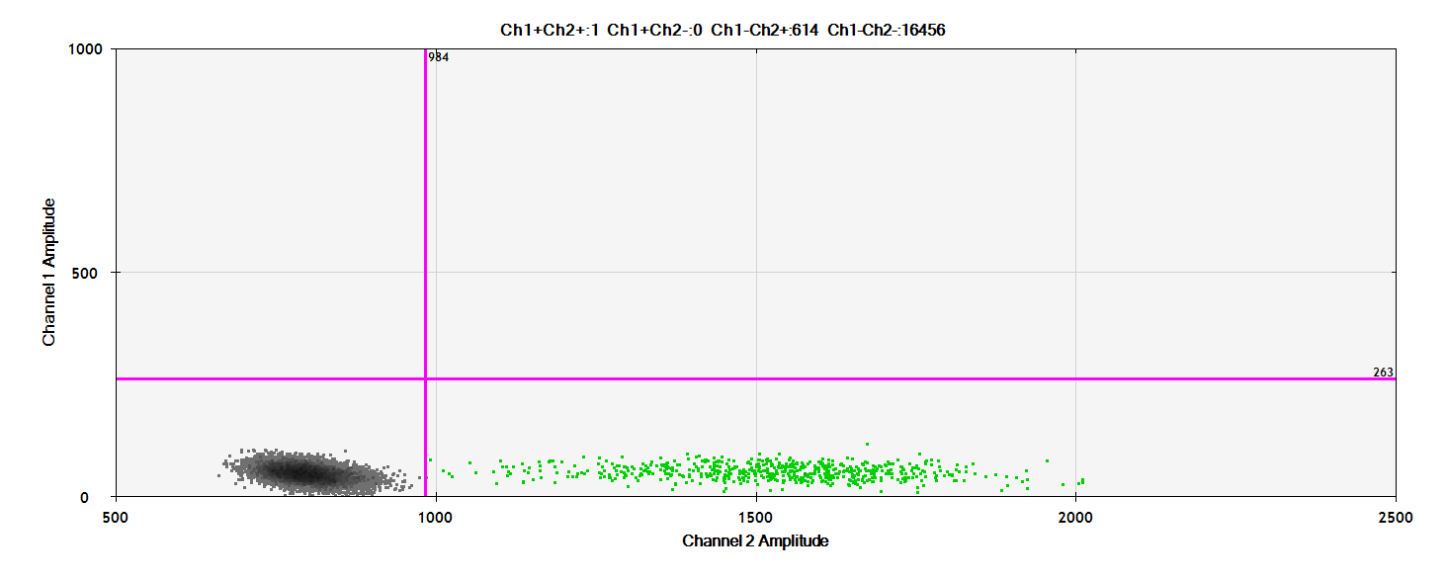
C. Control cohort
1000
0
55 54 53 52
1000
0
1000
0
1000
0
1000 2000
1000 2000
1000 2000
1000 2000
1000
0
51 50 49 48
1000
0
1000
0
1000
0
Mutated loci (FAM channel)
1000 2000
1000 2000
1000 2000
1000 2000
1000
0
44 19 18 16
1000
0
1000
0
1000
0
1000 2000
1000 2000
1000 2000
1000 2000
1000
0
15 14 13
1000
0
1000
0
1000 2000
1000 2000
1000 2000
Wild type loci (HEX channel)

