Slide 1
Bringing Netflix technology to video narratives of experiences of breast surgery: helping women navigate the information tsunami
Health Experiences Research Canada www.healthexperiences.ca
Ilja Ormel, Charles Onu, Mona Magalhaes, Donna Stern, Donna Tataryn, Rosanna Faria, Debbie Josephson, Linda Tracey, Susan Law
DIPEx International, Eynsham Hall (November 22, 2019)

Slide 2
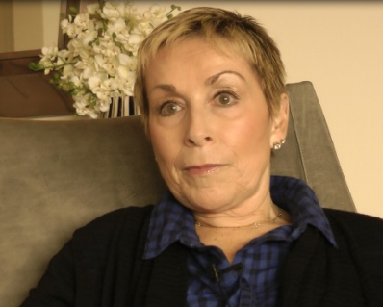
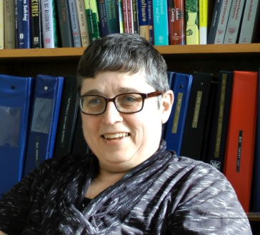
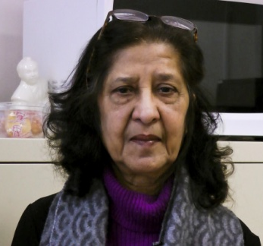
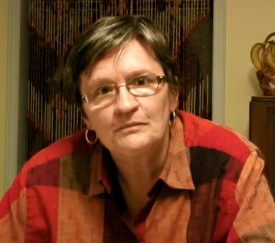
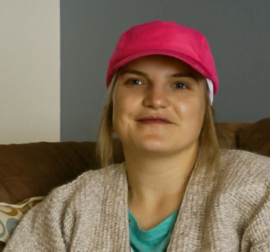
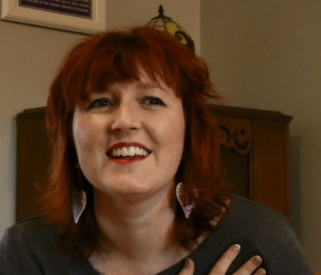
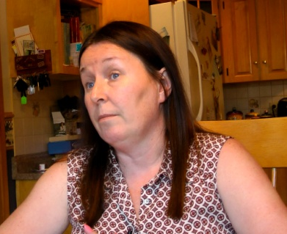
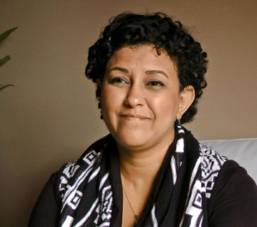
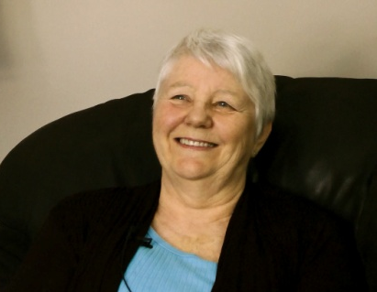
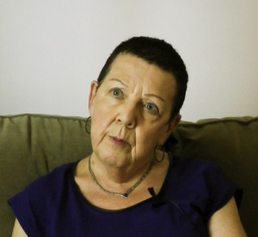
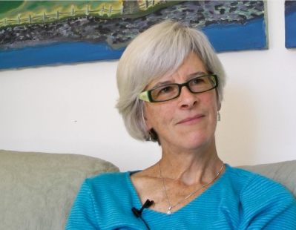
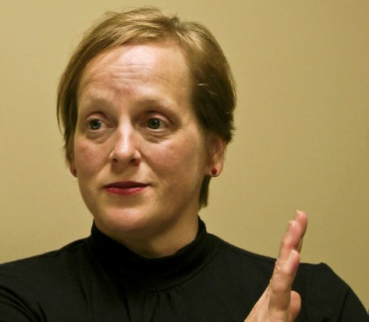
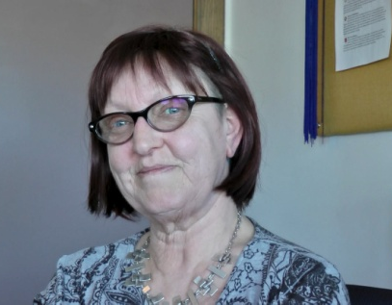
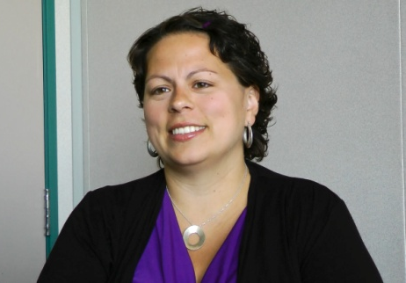
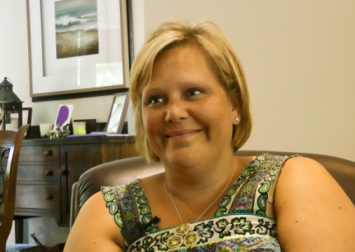
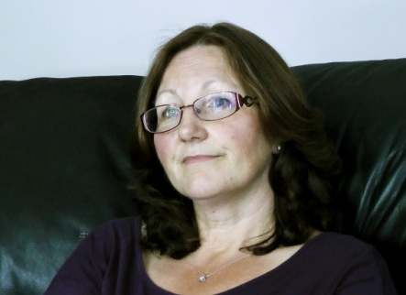
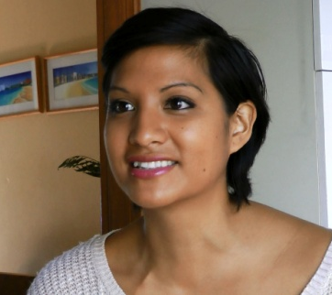
Participant | Number (36 in total)
Video | 26 (74%)
Audio | 7 (20%)
Text | 2 (6%)
Withdrew | 1 (<1%)
Notes:
35-50 in-depth semi-structured interviews - Maximum variation sample
- At home or place of convenience - Support from a Advisory Panel

Slide 3
Aim
To develop and test an online ‘app’ that provides access to video narratives of other women’s experiences of breast surgery, using an existing database of personal experiences and ‘netflix’ type e-technology
Quebec Breast Cancer Foundation (QBCF) Behind every surgery, there is a story. Women sharing their experiences to help others prepare for breast surgery ($156,000 CAN)

Slide 4
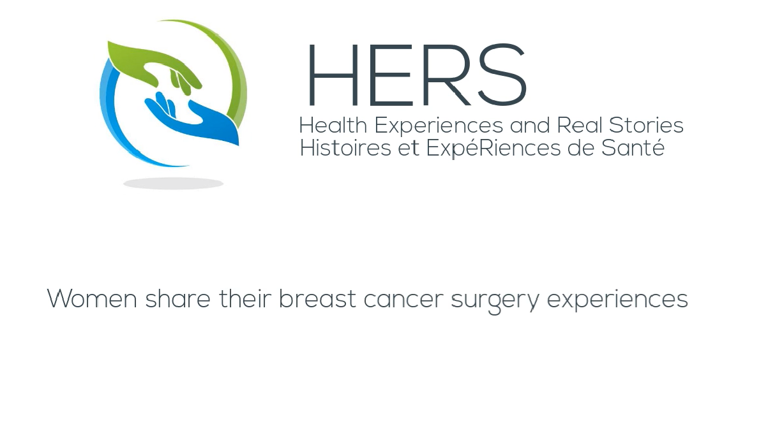

Slide 5
Phase 1: Assessment of women’s (narrative) information needs while preparing for breast cancer surgery
Secondary analysis of qualitative interviews
Participants: women diagnosed with breast cancer (n=35)
Objective: To better understand women’s experiences in relation to information during the surgery phase.
Focus group discussions (2)
Participants: women with breast cancer (n=11)
Focus: Women’s information needs, kind of information used, preferences for HERS app, feedback on design features app.
Phase 2: Data collection and preparation contents HERS app
Interviews women with DCIS
Participants: women with Ductal Carcinoma in Situ (n=4)
Focus: Collect surgery experiences of women with DCIS
Creation database
Selection of over 175 appropriate video, audio and text clips from the interviews, upload to a protected Youtube channel.
Phase 3: Evaluation
Focus group test session
Participants: women with breast cancer (n=6)
Focus: Test breast cancer app and contents

Slide 6
Topics (11) | Sub topics (25) | Filter: Treatment phase
About surgery | Preparing for surgery | Before surgery
Surgery options | Lumpectomy vs mastectomy | Before surgery
 | Single vs double mastectomy | Before surgery
Lymph nodes | Lymph nodes (sentinel node biopsy) | Surgery
Lymphedema | Treating Lymphedema | After surgery
Lumpectomy | Preparing for a lumpectomy | Before surgery
 | Lumpectomy results | After surgery
 | Recovering from a lumpectomy | After surgery
 | Clear/unclear margins | Surgery
Mastectomy | Preparing for mastectomy | Before surgery
 | Mastectomy results | After surgery
 | Recovering from mastectomy | After surgery
Drains | Recovering from mastectomy | After surgery
Reconstruction | Types of reconstruction | Reconstruction
 | Creating Nipples and Areola | Reconstruction
 | Considerations around reconstruction | Reconstruction
 | No reconstruction | Reconstruction
 | Relationship with surgeons | Reconstruction
 | Considerations around reconstruction | Reconstruction
Prosthesis | Prosthesis | Reconstruction
Impact on life | Body image / Sexuality / Emotions | Impact on life
 | Children | Impact on life
Advice for others
Notes:
Page surgery, reconstruction, surgery, talking to children about cancer, sexuality, femininity and intimacy, treatment for lymphedema,

Slide 7


Recommender System
User profile
(age, marital status, profession)
Speaker profile
(age, marital status, profession)
User interest
(phase, topic selections or keywords)
Video content
(phase, topic selections)

Slide 9
Components of recommendation
Content-based matching
  Recommend videos from women with similar characteristics
  Recommend videos on topics selected by user
Collaborative filtering
  Videos related to relevant videos by user
  Videos related to relevant videos by similar users
Diversity
  Recommend videos rated as relevant
  Videos that ‘should’ be seen

Slide 10



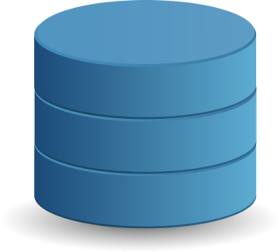
System structure of breast cancer app
User authentication. Requests for videos. User Ratings
Mobile App
Recommendation Engine
(web service)
Video recommendations. List of topics, phases, speakers
Fetch video by unique key
video keys
links between videos and filters (phases, topics, speakers)
authenticate user
save ratings & other behaviour
Database

Slide 11
Considerations
No text to introduce the subject - videos with an introduction text
‘Merged’ videos
‘Like’ button (relevant?)
Localized – app should be such that local resource information can be registered

Slide 12
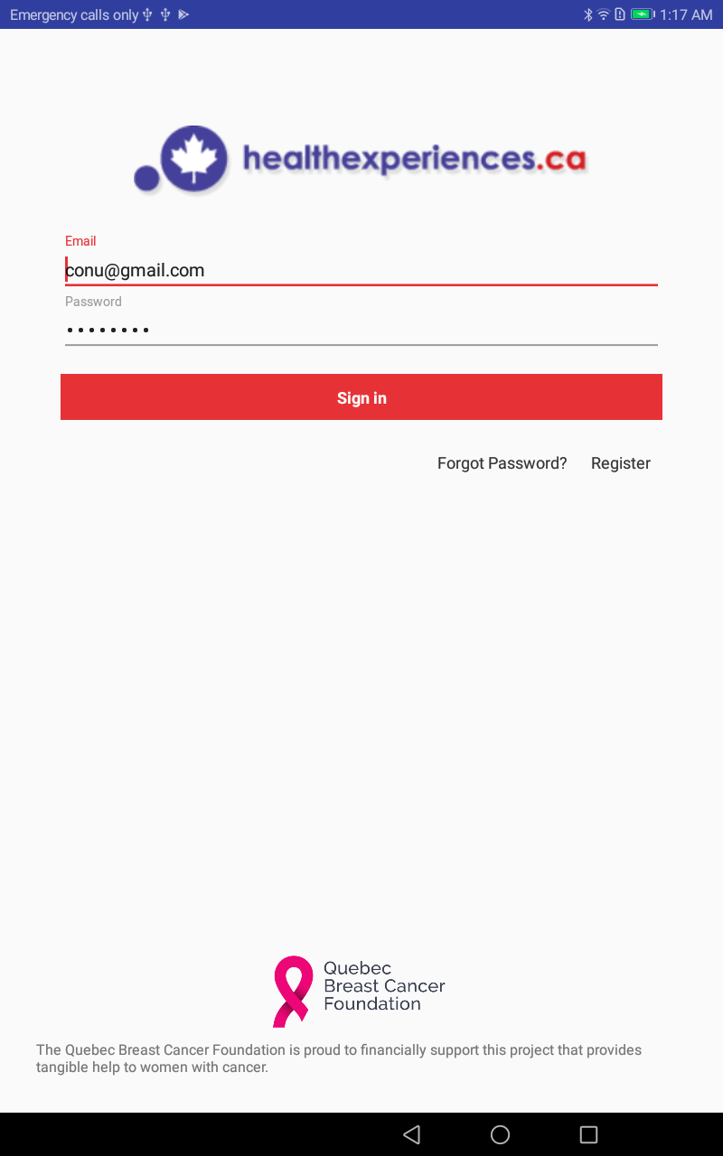
HERS app (Health Experiences and Real Stories)

Slide 13
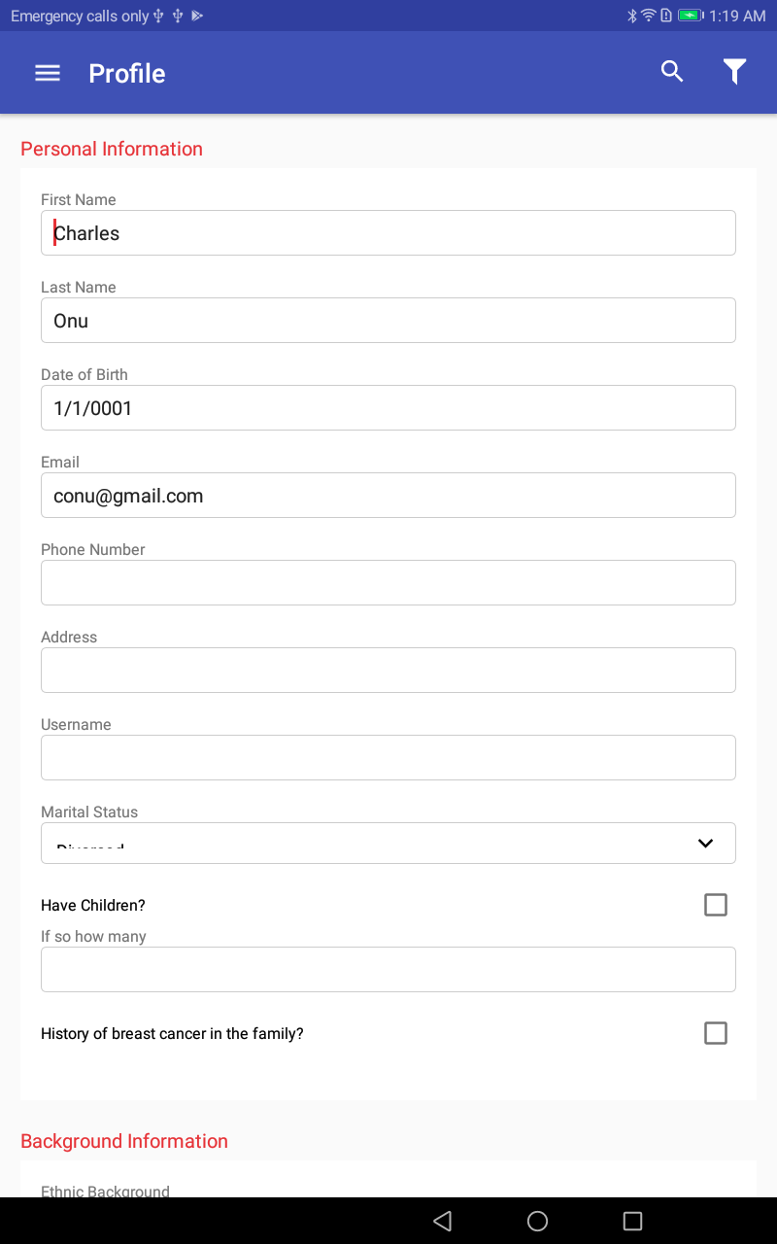

Slide 14
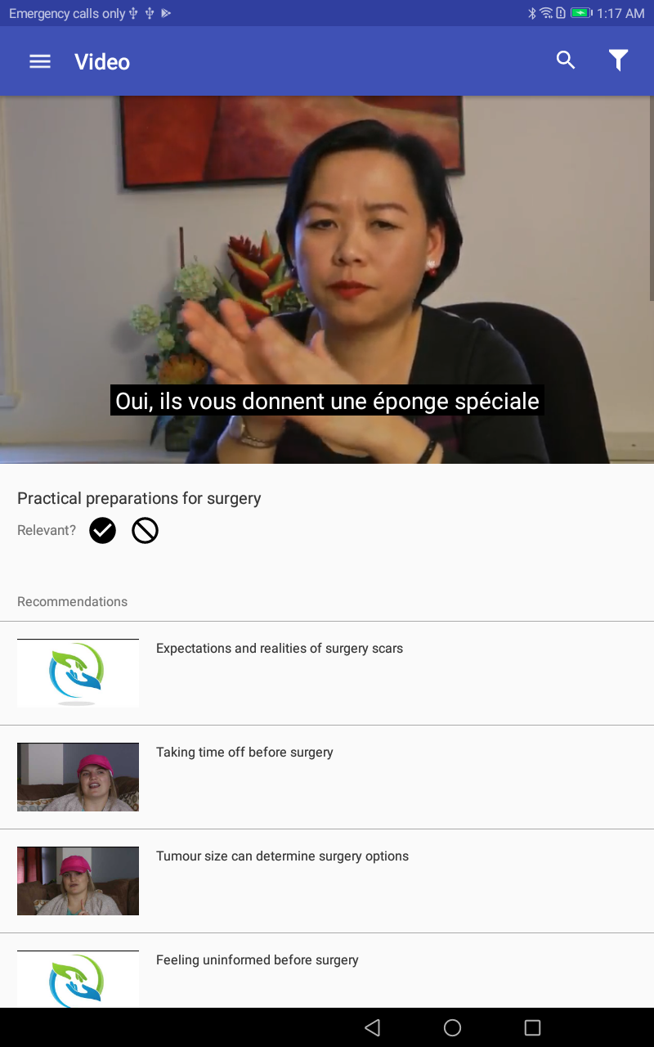

Slide 15
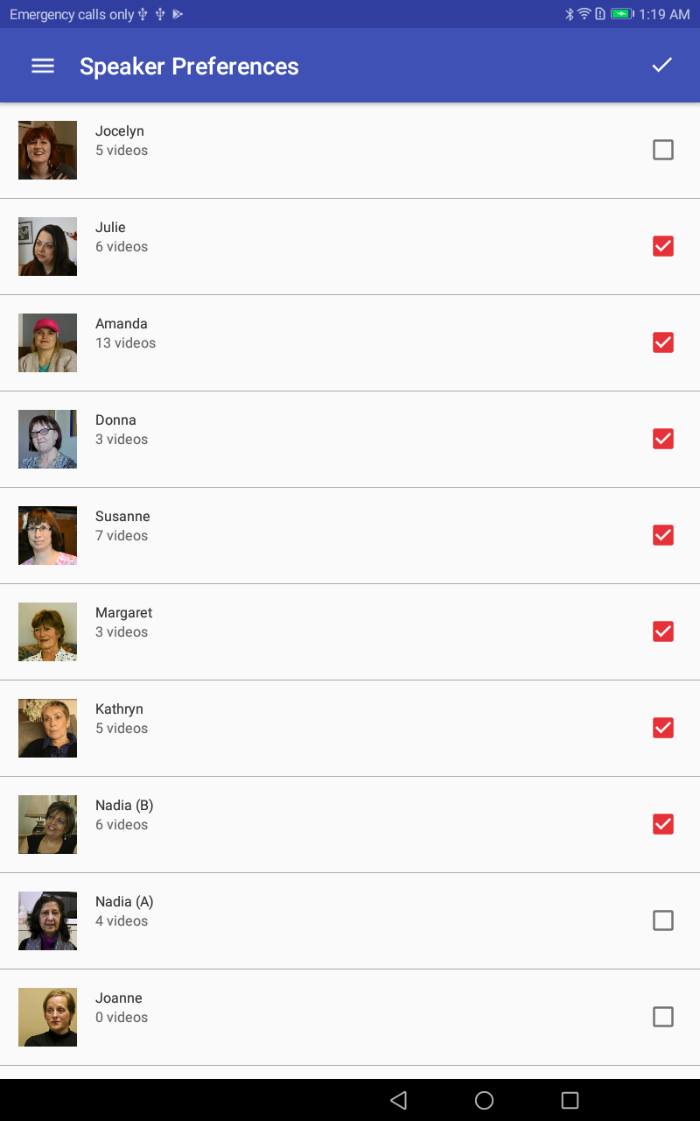

Slide 16
Evaluation
Test results survey: feeling less overwhelmed, easy to find information, feeling less lonely/isolated
Qualitative data: certain clips may help patients be better prepared for ‘surprises’, help with info that wasn’t retained, videos realistic
Risk of women wanting to stay too long – need to warn them
“I think the objectivity of the resources complements the subjectivity of the testimonials perfectly.”

Slide 17
Current state and analytic potential
App developed on an Android platform only (tablets - firefox)
Currently ‘on the shelf’ and available for further development and testing
We have established a structure and platform that can be used to host different types of content, different selection criteria, rapid mechanism for updates/changes
Easy to add and remove clips
Possible to combine user data with viewing history (age, ethnicity, children) to identify patterns / what videos were popular? Why?
Sufficient volume and variation within topics?

Slide 18
Possible developments
High number of users from France and USA for the Canadian website
Add video clips from other collections (e.g. Japan, UK, USA, Germany) – relevance to Canadian immigrants, relevance to other countries?
Add other filters such as pre-existing knowledge, information needs (basic, advanced)
Consider the balance across process, outcome and experience narratives within this collection

Slide 19
Questions?
Thank you!
info@healthexperiences.ca

Slide 20
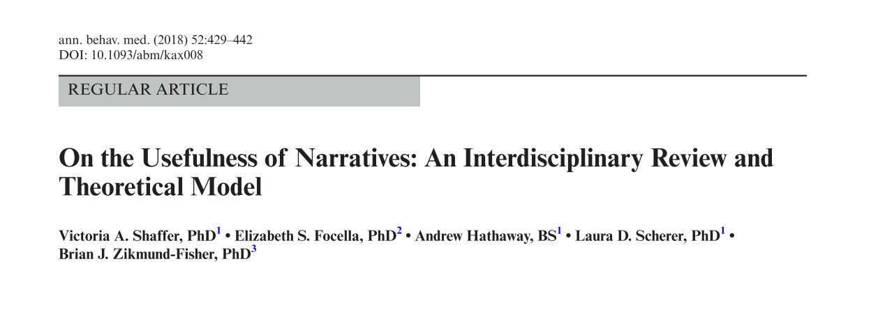
Impact of narratives
Notes:
Schaffer developed a narrative taxonomy for three different kind of narratives; a process, experience and outcome narrative. The authors argue that for each different kind of application (information tool, decision aid, behaviour change information) it should be considered to include or exclude certain types of narratives. For example for an information tool it is suggested to include narratives about the process or experience but exclude narratives that speak about the outcome .

Slide 21
Question* | Strongly agree | Average biomedical | Average app
I feel better informed after viewing the resources. | 5 | 4.2 | 4.2
I had a lot of my questions answered by the resources/this app. | 5 | 3.8 | 4.0
Looking at the resources/site raised more questions for me than it answered. | 1 | 3.2 | 3.8
I better understand the information I need to prepare for the next steps in treatment or stages of the illness. | 5 | 3.8 | 4.0
There was so much information here, I felt overwhelmed. | 1 | 3.4 | 3.8
I was able to easily find the information I was looking for . | 5 | 4 | 4.4
The resources made me feel less lonely or isolated. | 5 | 4 | 4.4
If a friend or family member were in a similar position, would you recommend the resources/this app to her? | 5-definitely would | 4.6 | 4.8
I have a better understanding of where to seek information about BC and surgery. | 5 | 4.4 | 4.2
It was difficult for me to relate to the information/the stories in the resources/this resource. | 5 | 1.6 | 1.6
The information on this app will not help me feel more confident discussing my questions and concerns with my doctor(s). | 5 | 1.4 | 1.4
  *Adaptation from eHIQ

