Slide 1
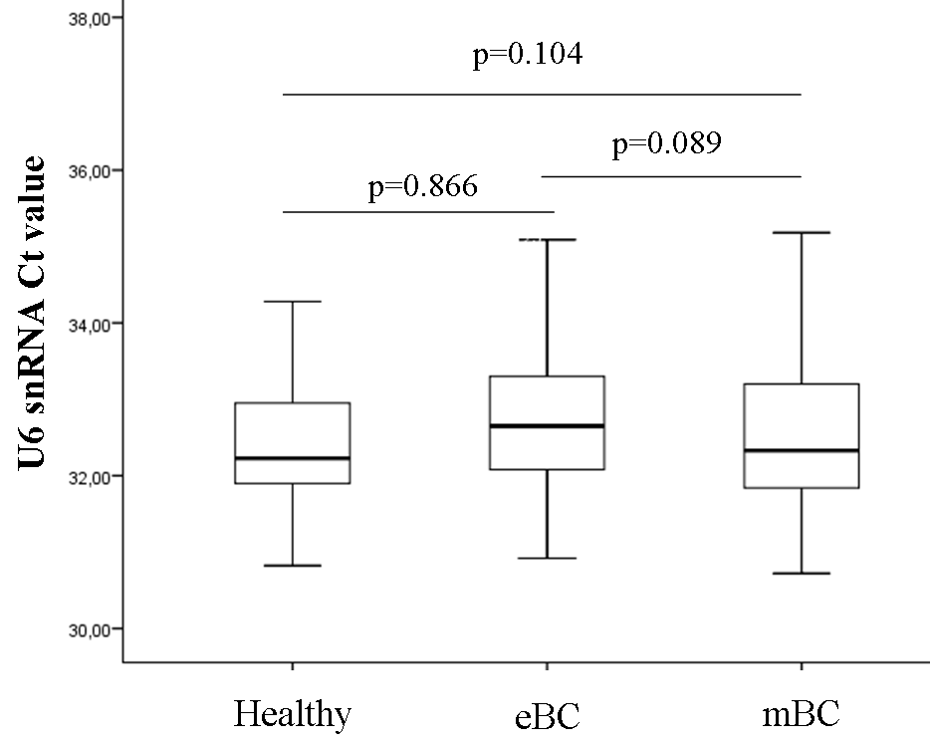
Figure S1. U6 snRNA expression levels between healthy donors and breast cancer patients. Mann Whitney test was used to determine statistically significant differences and the results were displayed on box plots. The p value is shown.

