Slide 1
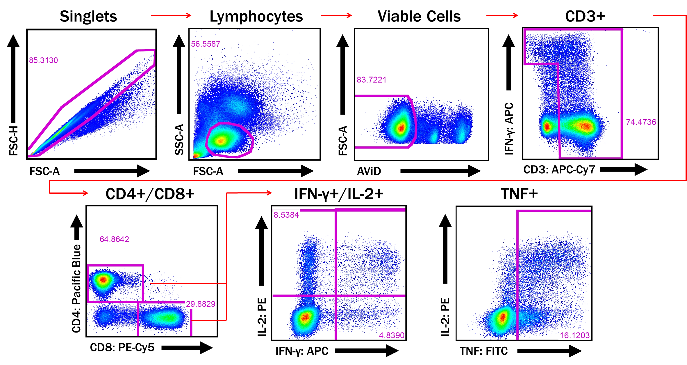
Supplementary file 1: Gating strategy for the study participants

Slide 2
Supplementary file 2: Number of subjects (%) with >0.05% Ag85B CD8⁺ DMSO-subtracted ICS Response

Slide 3
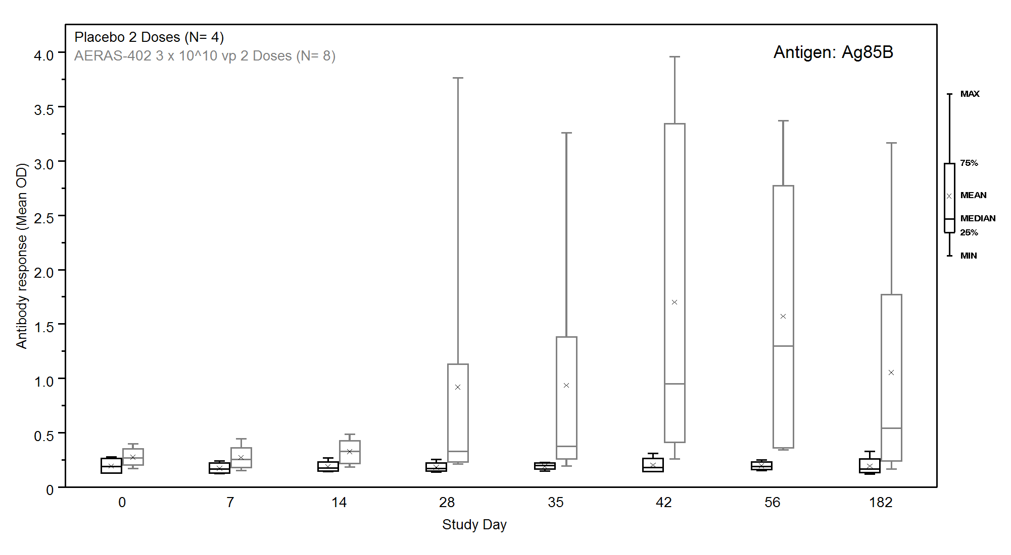
Supplementary file 3: Ag85B Antibody ELISA Responses
Partisipants received two doses of the AERAS-402 vaccine (grey bars, n=8) and placebo (black bars n=4). Samples for measurement of anti-Ag85B antibodies at study days 0, 7, 14, 28, 35, 42, 56, and 182.

