Slide 1
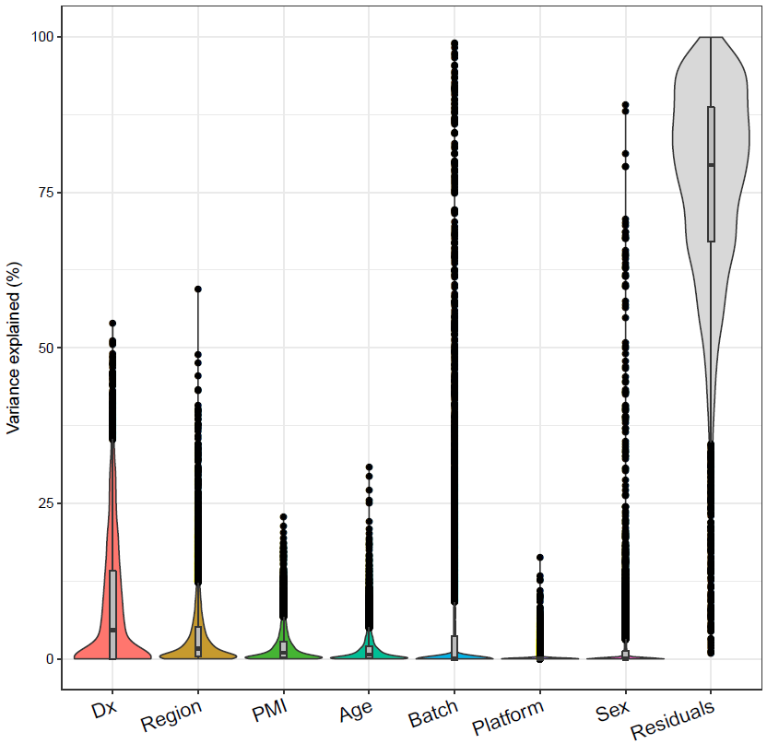
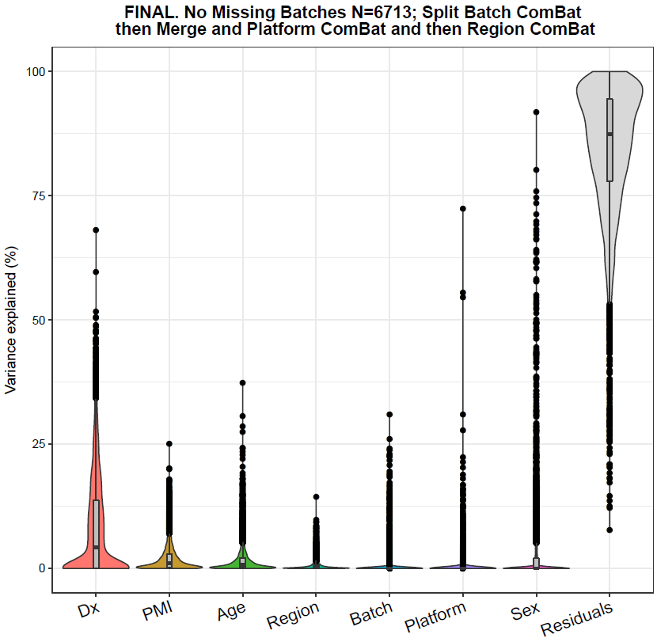
Covariate distribution before Combat
Covariate distribution after Combat
Figure S1

Slide 2
Figure S2

Slide 3
Figure S3

Slide 4
M20-royalblue*
p=3.4e-07 n=129
M28-skyblue
p=0.0011 n=23
M8-pink
p=0.34 n=248
M24-gray60*
p=0.0027 n=150
M11-greenyellow*
p=1.2e-6 n=219
M24-darkgray
p=0.062 n=106
M21-darkred
p=0.075 n=127
Figure S4
M25-orange*
p=8e-4 n=87
M27-white
p=0.15 n=67
M23-darkturquoise
p=0.0078 n=107
M13-salmon
p=0.071 n=215
M16-lightcyan*
p=0.00021 n=173
M4-yellow
p=0.095 n=351
M18-lightgreen
p=0.037 n=149
M14-cyan*
p=2.6e-7 n=208
M7-black*
p=0.0062 n=252
M6-red*
p=0.006 n=269
M2-blue
p=0.11 n=480
M19-darkorange*
p=0.00011 n=82
M9-magenta*
p=0.0065 n=232
M3-brown*
p=0.0038 n=370
M10-purple*
p=3.2e-10 n=223
M22-darkgreen*
p=5.7 e-6 n=118
M12-tan*
p=3.3e-7 n=218
M19-lightyellow*
p=0.016 n=140
M15-midnightblue*
p=4.1e-7 n=207
M1-turquoise*
p=7.1e-5 n=807
M5-green
p=0.12 n=298

Slide 5
Figure S5
Overlap of CTE/FTD-MAPT TMT Modules with Cell subtype proteome profile
Microglia
Neuron
Endothelial
Astrocytes
Oligo. 3 subtypes
Oligo. precursor
Mature Oligos.
Oligos. Newly Formed

Slide 6
Figure S6

