Slide 1
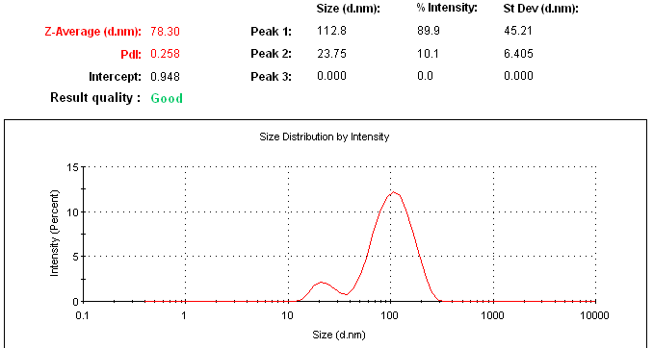

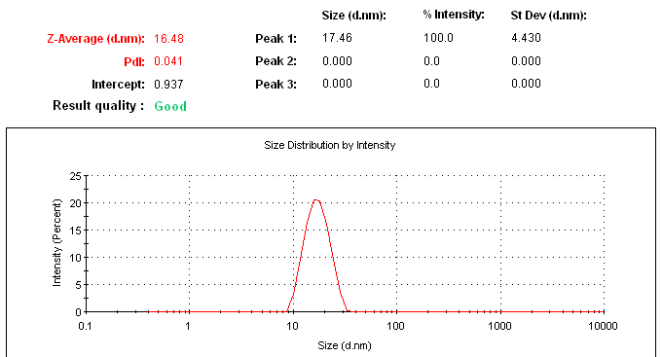

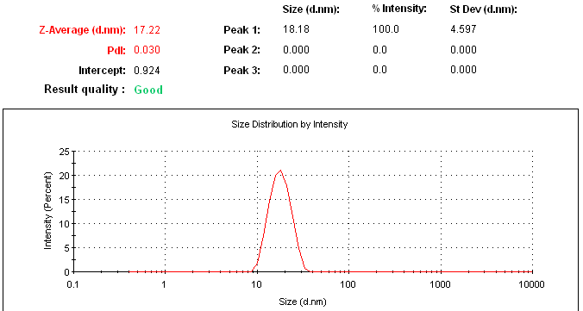
Time 0 min
Time 30 min
Time 120 min
Time 1440 min
Fig. S1
Time 360 min

Slide 2
EDR
EDR
EDR
A
B
C
EDR
EDR
EDR
D
E
F
Fig. S2

Slide 3
Flow character | CI | HR | AR
Excellent | ≤10 | 1.00–1.11 | 25–30
Good | 11–15 | 1.12–1.18 | 31–35
Fair | 16–20 | 1.19–1.25 | 36–40
Passable | 21–25 | 1.26–1.34 | 41–45
Poor | 26–31 | 1.35–1.45 | 46–55
Very poor | 32–37 | 1.46–1.59 | 56–65
Very, very poor | >38 | >1.60 | >66
Table S1

Slide 4
Mathematical models to determine the release kinetic
Model | Equation | Description
First order | Q_{t} = ln Q₀ +K₁t | Q_{t}: amount of drug dissolved in time t, Q₀: initial amount of drug in the solution, t: time, Q∞: amount of drug dissolved in time ∞. K_{1,} K₀, K_{C}, K_{H}, K_{K} are the rate constants for first order, zero order, Hixson–Crowell, Higuchi-matrix and Korsmeyer–Peppas resepctively.
Zero order | Q_{t} = Q₀ + K₀t
Hixson–Crowell | Q^{1/3}₀ − Q^{1/3}t = K_{C}t
Higuchi-matrix | Q_{t} = K_{H} t^{1/2}
Korsmeyer–Peppas | Q_{t}/Q∞ = K_{K} t^{n}
Table S2

Slide 5


Release profiles comparison
Dissimilarity factor (f1) |  | n: sampling number, Rj and Tj: percent dissolved of the reference and test products at each time point j,
Similarity factor (f2)
Table S3

Slide 6
Formulation | Medium | 0 h |  | 6 h |  | 24 h
 |  | Droplet size (nm) | PDI | Droplet size (nm) | PDI | Droplet size (nm) | PDI
L-NLNS | Water | 16.25 ± 3.53 | 0.04 ±0.015 | 17.51 ± 2.32 | 0.04 ±0.013 | 18.82 ± 4.61 | 0.04 ±0.019
 | SGF (pH 1.2) | 18.48 ± 2.15 | 0.04 ± 0.014 | 17.09 ± 3.63 | 0.04 ± 0.019 | 19.68 ± 3.13 | 0.05 ± 0.015
 | SIF (pH 6.8) | 17.28 ± 2.84 | 0.04 ± 0.019 | 18.45 ± 3.25 | 0.05 ± 0.011 | 20.21 ± 3.96 | 0.05 ± 0.011
S-NLNS | Water | 75.25 ± 4.57 | 0.07 ±0.01 | 75.56 ± 2.91 | 0.07 ±0.01 | 75.34 ± 3.12 | 0.07 ±0.01
 | SGF (pH 1.2) | 72.58 ± 3.13 | 0.07 ±0.01 | 73.51 ± 2.42 | 0.07 ±0.01 | 72.94 ± 4.56 | 0.07 ±0.01
 | SIF (pH 6.8) | 76.73 ± 2.94 | 0.07 ±0.01 | 76.45 ± 3.51 | 0.07 ±0.01 | 77.02 ± 2.49 | 0.07 ±0.01
Table S4

Slide 7
Ratio (L-NLNS: Aerosil® 200) | CI (%) | HR | AR | Flow character
1:0.4 | 45.83 ± 2.42 | 1.85 ± 0.07 | 66.68 ± 4.52 | Very, very poor
1:0.6 | 31.57 ± 1.13 | 1.45 ± 0.04 | 47.32 ± 3.13 | Poor
1:0.8 | 14.38 ± 1.92 | 1.17 ± 0.05 | 34.92 ± 3.20 | Good
1:1 | 9.67 ± 1.10 | 1.11 ± 0.03 | 27.19 ± 2.82 | Excellent
Table S5

Slide 8
Dilution | 0 h |  | 6 h |  | 24 h
 | Droplet size (nm) | PDI | Droplet size (nm) | PDI | Droplet size (nm) | PDI
200 | 86.52 ± 4.57 | 0.07 ±0.01 | 87.78 ± 3.21 | 0.07 ±0.01 | 87.16 ± 4.82 | 0.07 ±0.01
400 | 82.84 ± 2.52 | 0.07 ±0.01 | 81.10 ± 3.58 | 0.07 ±0.01 | 82.61 ± 3.19 | 0.07 ±0.01
600 | 79.14 ± 1.91 | 0.07 ±0.01 | 79.58 ± 2.56 | 0.07 ±0.01 | 79.81 ± 2.99 | 0.07 ±0.01
800 | 76.63 ± 2.83 | 0.07 ±0.01 | 76.20 ± 4.81 | 0.07 ±0.01 | 76.16 ± 4.80 | 0.07 ±0.01
Table S6

Slide 9
Formulation | Medium | First order | Zero order | Hixson–Crowell | Higuchi-matrix | Korsmeyer–Peppas
EDR suspension | SGF | 0.987 | 0.7005 | 0.9948 | 0.9127 | 0.9234
 | SIF | 0.5591 | 0.3794 | 0.4886 | 0.6347 | 0.7859
L-NLNS | SGF | 0.8302 | 0.6271 | 0.96 | 0.864 | 0.877
 | SIF | 0.9876 | 0.6963 | 0.991 | 0.9101 | 0.9209
S-NLNS | SGF | 0.9578 | 0.5325 | 0.8166 | 0.8023 | 0.863
 | SIF | 0.9709 | 0.5177 | 0.8435 | 0.7771 | 0.8639
Table S7

