Slide 1
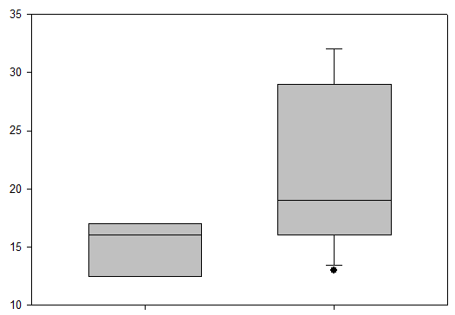
SUPPLEMENTARY FIGURE 3
p <0,05
RT-PCR SARS CoV-2 Ct values
Non-vaccinated infected residents
BNT162b2 vaccinated infected residents

