Slide 1
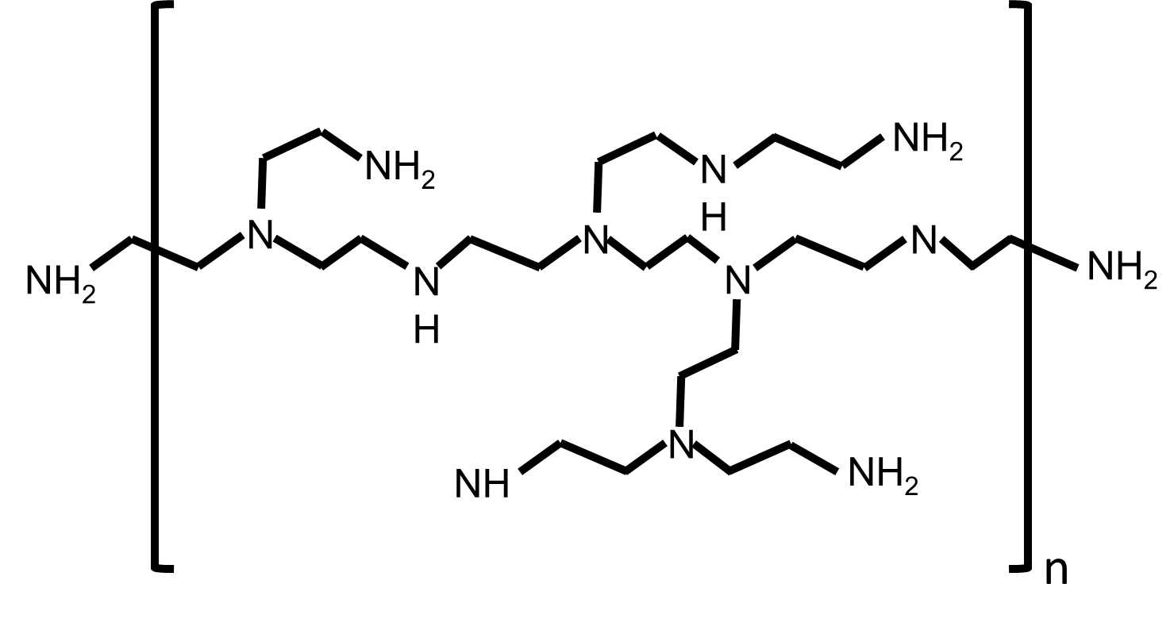
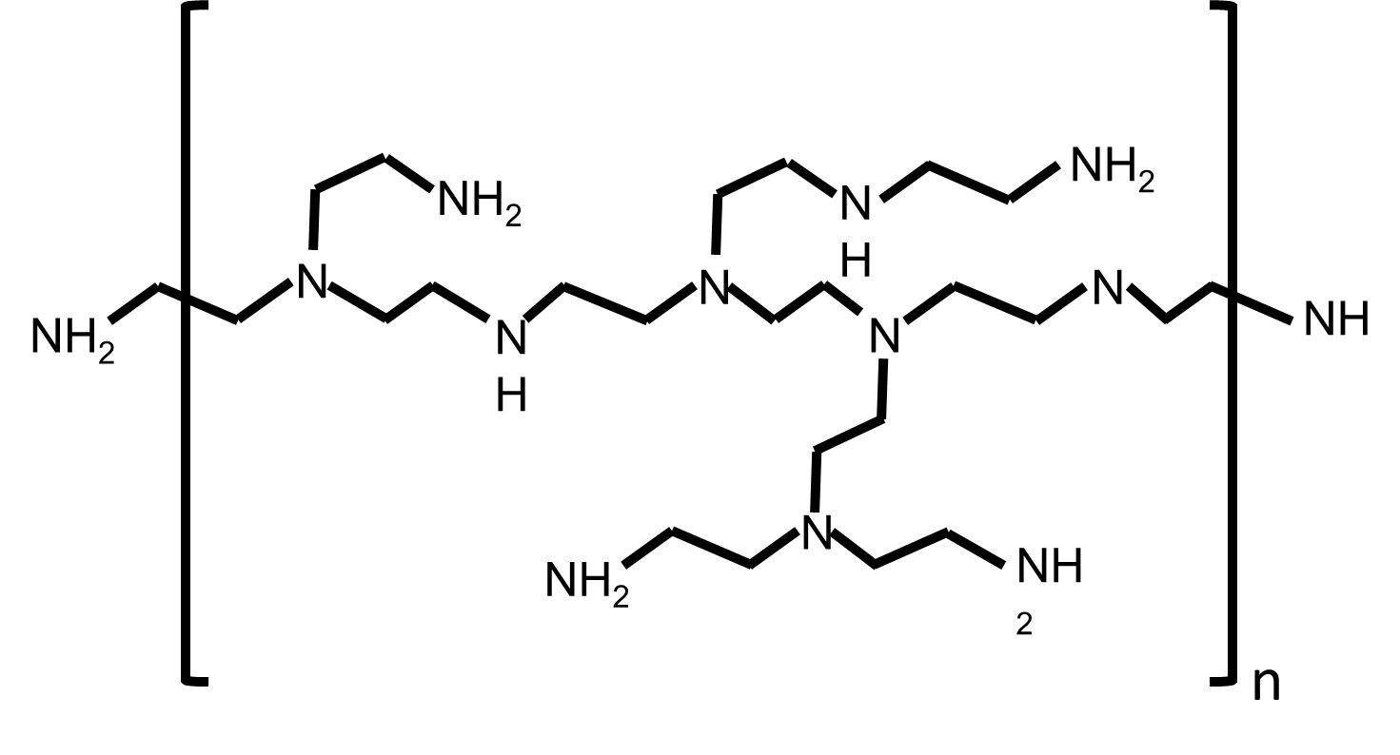
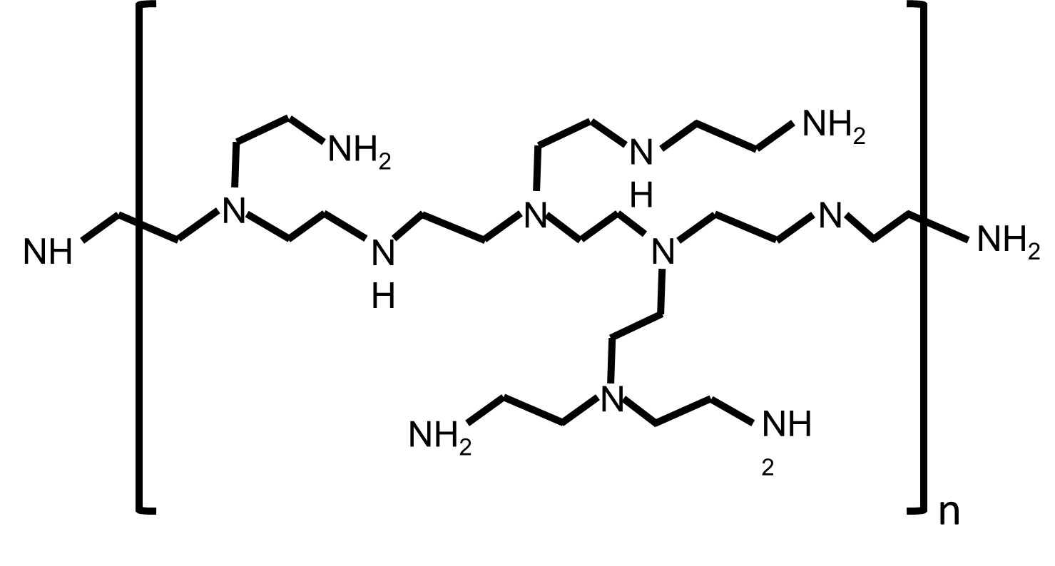
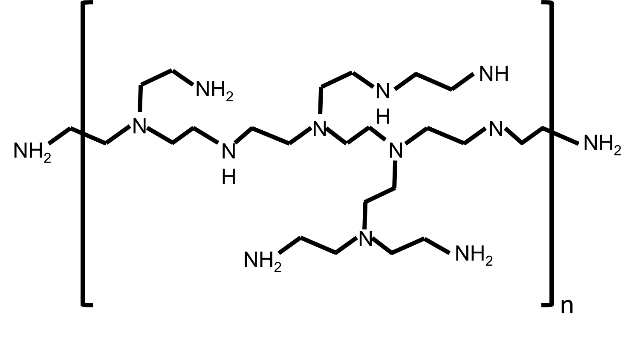
COOH
CO
CH₂
COOH
CH₂
OH
COOH
COOH
CH₂
OC
OH
2
OH
CO
CH₂
COOH
HOOC
2
OH
CH₂
COOH
CH₂
CO
COOH

