Slide 1
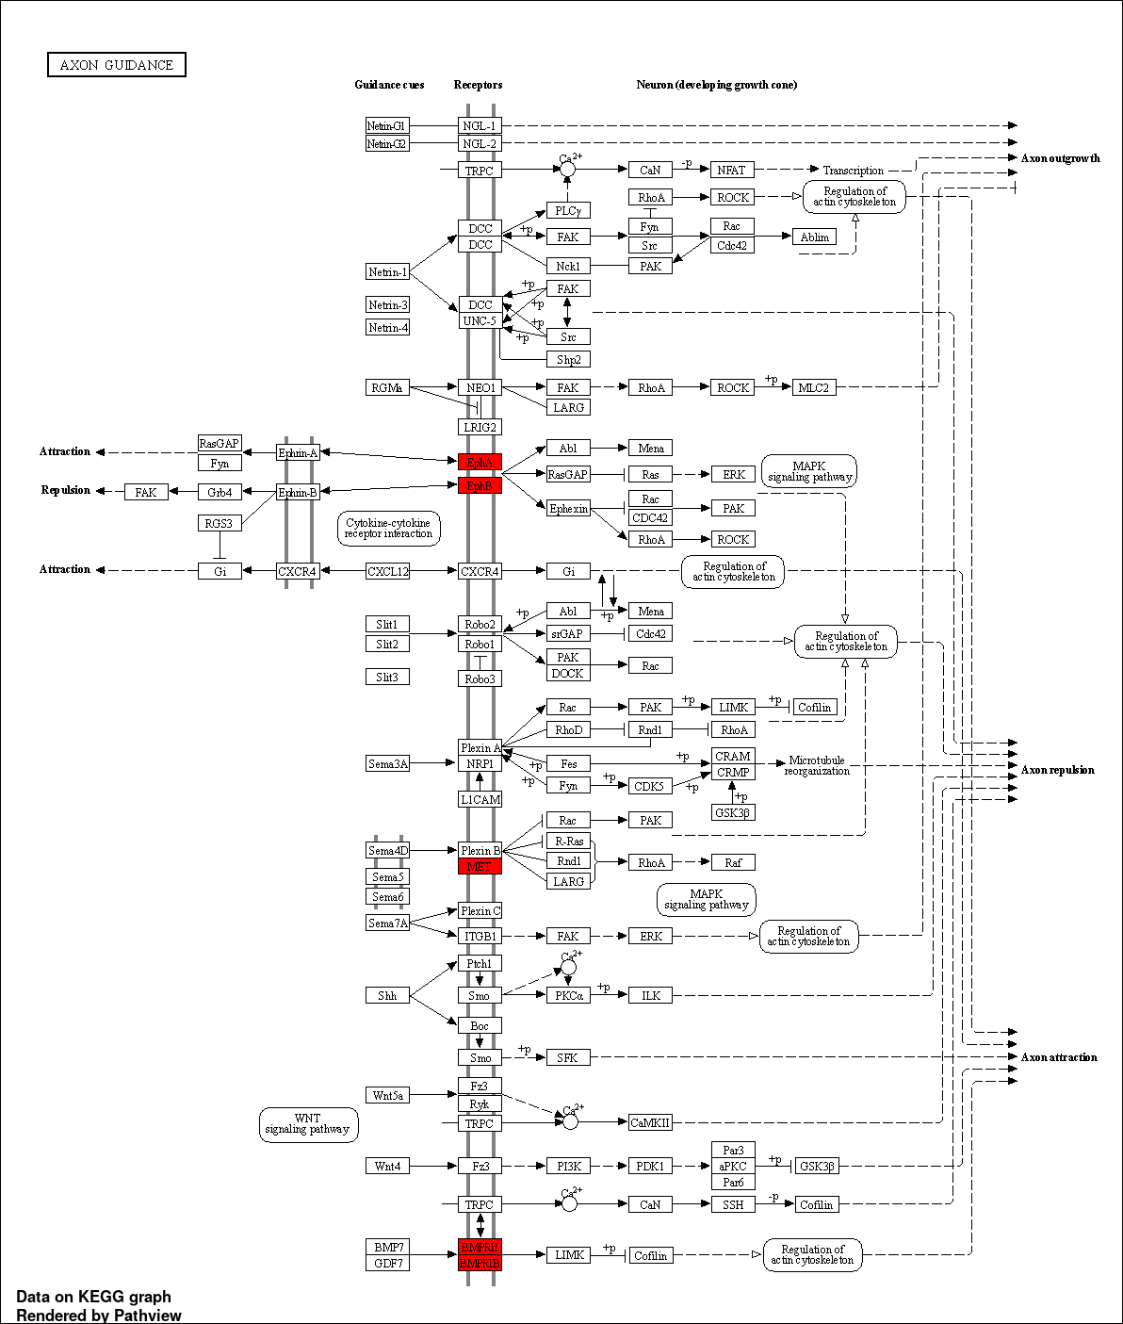
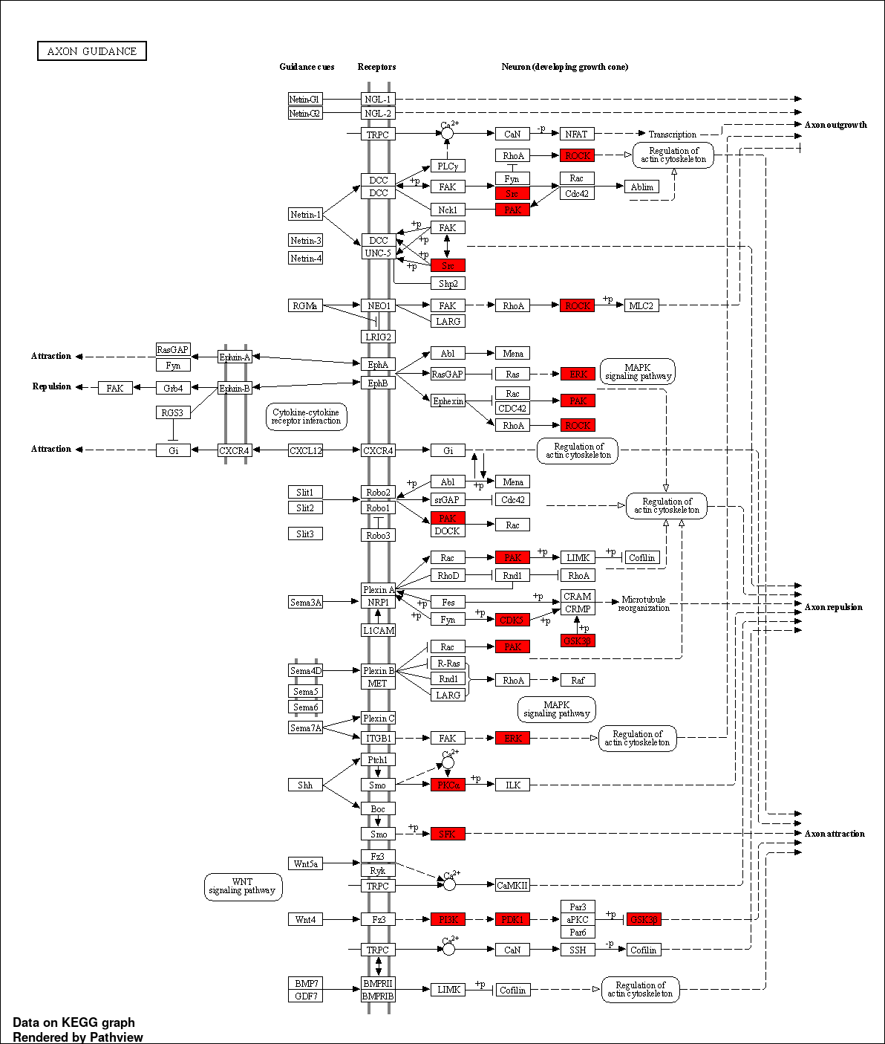
Common in both AP-MS and BioID based methods
Identified in only BioID based method
Figure S5
KEGG Axon guidance pathway
Figure S4. Comparison of Kinases identified by AP-MS and BioID based methods. KEGG pathway analysis show five kinases associated with axon guidance were identified by both AP-MS and BioID based methods (left panel), however 13 additional kinases belonging to this pathway were exclusively by BioID (right panel).

