Slide 1
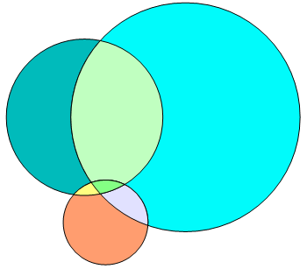
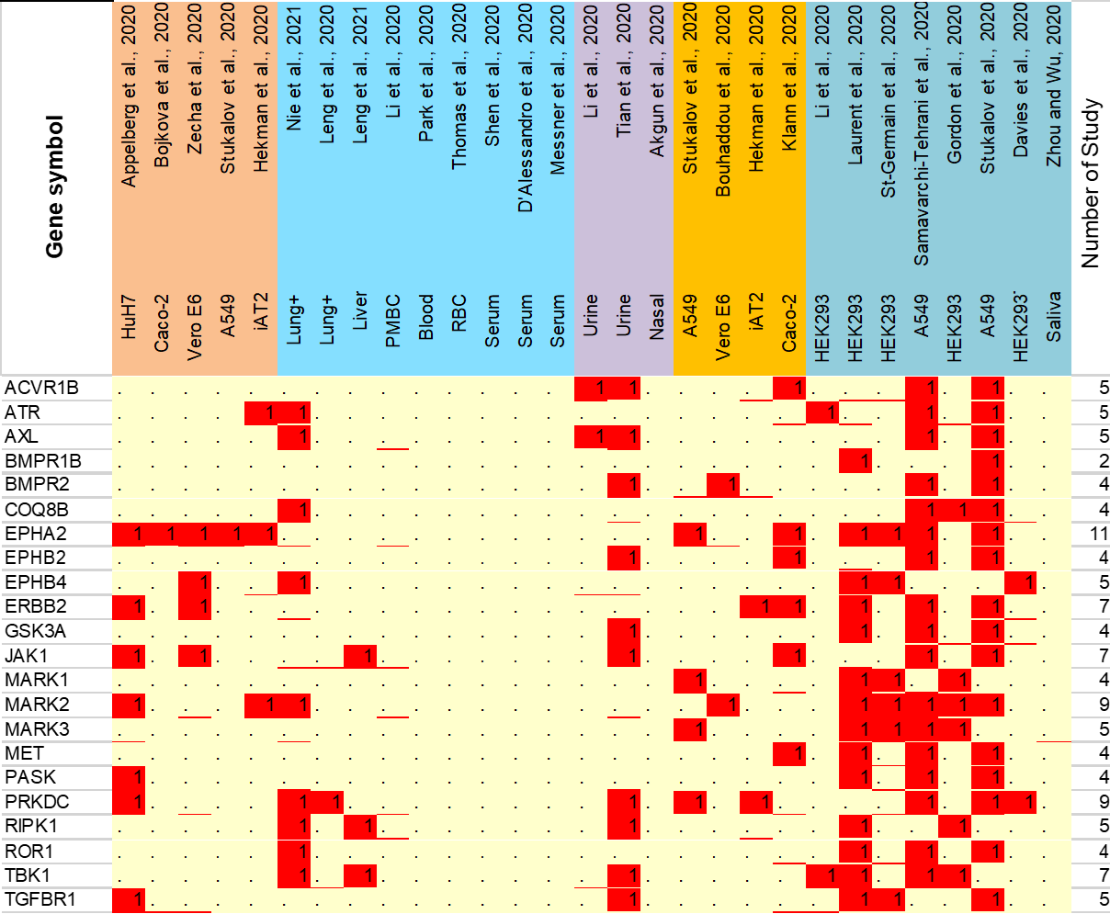
Figure S4
A
B
Intercome
Proteome
P-Proteome
AP-MS
AP-MS
AP-MS
BioID
BioID
AP-MS
AP-MS
BioID (3841)
BioID
AP-MS (1791)
810
937
2789
22
22
93
389
ACVR1, ACVR2A, ATM, BCKDK, BMPR1A, CDK12, CDK4, CIT, CSNK2A2, DDR1, EPHB3, ERBB3, FGFR1, IRAK1, JAK2, KIT, NEK9, PKN1, PRKACA, SLK, SRPK3, TGFBR2
Human Kinome (526)
ABL2, AKT1, AKT2, ALPK2, BMP2K, BUB1, BUB1B, CAMKK1, CAMKK2, CASK, CDK13, CDK16, CDK5, CDK9, CHUK, CSNK1A1, CSNK1D, CSNK1E, CSNK1G3, DAPK1, DAPK3, DCLK1, DYRK1A, EEF2K, EGFR, EIF2AK2, EIF2AK3, EIF2AK4, EPHA3, EPHA4, EPHA7, ERN1, GAK, GSK3B, IGF1R, INSR, LATS2, LYN, MAP2K3, MAP2K7, MAP3K11, MAP3K20, MAP3K21, MAP3K7, MAP4K3, MAP4K5, MAPK1, MAPK13, MAPK9, MAST4, MINK1, NEK1, NEK4, NEK7, PAK4, PDK1, PDK3, PEAK1, PIK3C2A, PIK3CB, PKMYT1, PKN2, PRKAA1, PRKCA, PRKCD, PRKCH, PRKCI, PRKCQ, PRKD1, PRKD2, PRKD3, PRPF4B, PTK7, RIOK1, ROCK1, ROCK2, ROR2, RPS6KC1, SCYL1, SCYL2, SCYL3, SMG1, SRC, SRPK2, STK11, TNIK, TP53RK, TRPM7, TTK, VRK2, WNK1, WNK3, YES1
Figure S4.Comparative analysis of human kinases identified in all three proteomic platforms. A, Venn diagram analysis shows the unique and overlapped kinases identified by AP-MS and BioID-based interactome analysis. B, heat map shows the overlapping information of the 22 kinases those abundance level or phosphorylation status were also altered in response to SARS-CoV-2 infection. Detail list of the proteins can be found in Supplementary Table 2.

