Slide 1
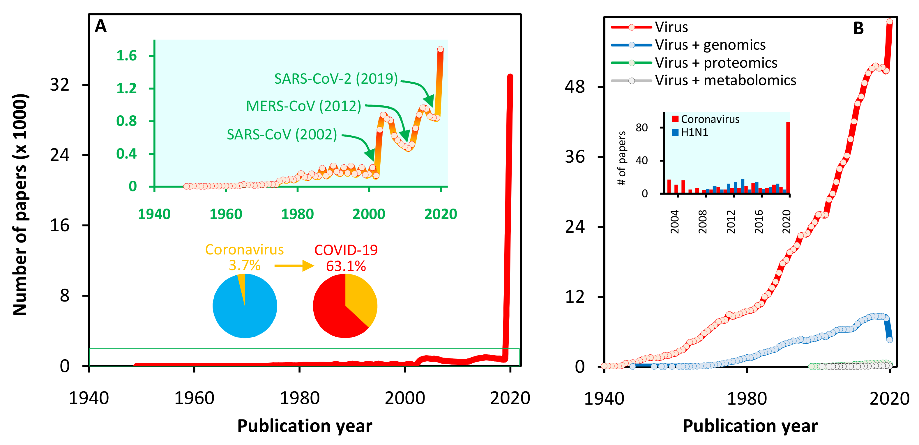
Figure S1
Figure S1. Coronavirus and COVID-19 in scientific literature. (A) There was an explosion of research papers (32000+) in 2020 on COVID-19 (Pub Med search using "coronavirus", "COVID-19", and various other similar terms). Inset graph shows the expanded view wherein outbreaks of SARS-CoV-1 (2002) and MERS-CoV (2012) led to small increases in the number of papers on coronavirus. Inset pie charts: within a year, COVID-19 forms the majority of papers on coronavirus which only forms a small (~3.7) percentage of total papers on viruses. (B) The trend in the number of papers on viruses - genomics area forms 16% of the papers; but proteomics and metabolomics areas are not yet fully explored. Inset bar chart shows the number of proteomics-related papers in coronavirus and H1N1. Only a few proteomics papers were specific to SARS-CoV-1 (since 2002), and MERS-CoV (since 2012), but most of the 86 papers (in 2020) were on COVID-19. Pub Med searches as of July 15, 2020.

