Slide 1
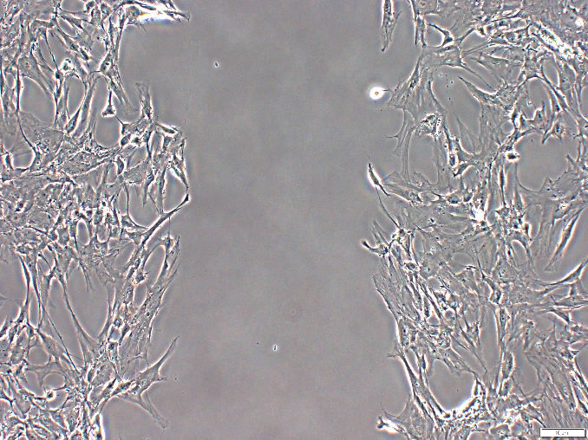
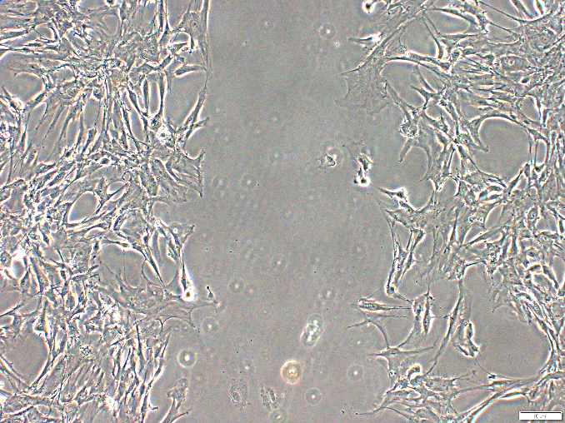
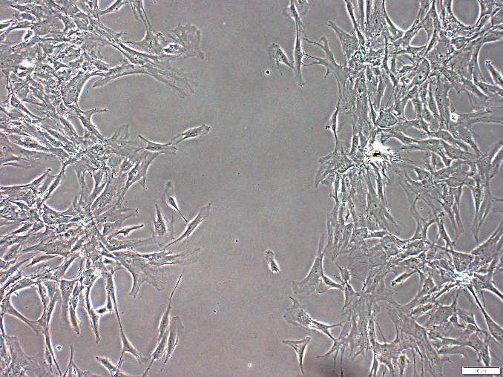
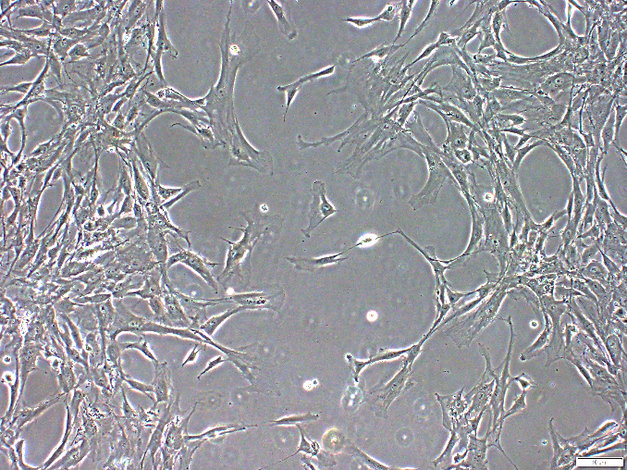
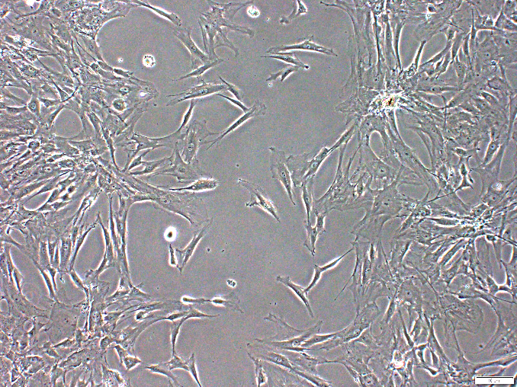
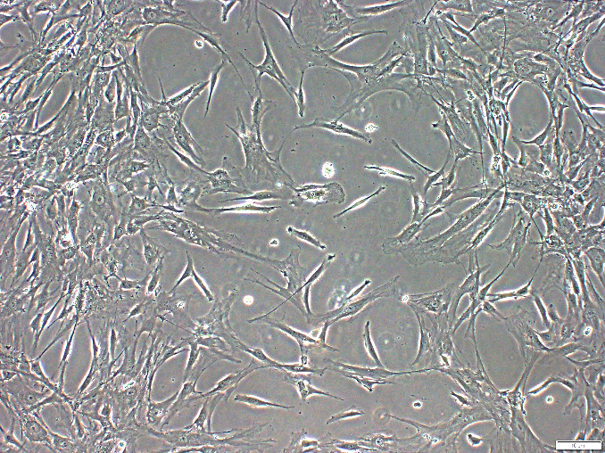
Figure S1
A.
supernant
293T
Cell lysate
CMV-aChemerin
-
+
-
+
+N-signal peptide
Chemerin
~19KDa
~19KDa
Active Chemerin
GAPDH
~16KDa
B.
hBM-MSC
Control
Secreted aChemerin
(%)
6h
Area of migration
0h
**
aChemerin
-
+
6h
(%)
12h
Area of migration
*
12h
aChemerin
-
+
Notes:
Overexpression of Chemerin in mouse liver, increases BM MSC migration.
This digrapm shows the map of cmv flag vector
Red shows cmv promotor region and blue indicate coding region of chemeirn (bio informatics 번호 :NM)
Simplamatic of shecmatic diagram used for animal experiment
This expoerienmt show overexpression of cmv chemerin in 293 t cell
2nd panel show tag of this protein
Gapdh show same amount of protein
B.

Slide 2
Figure S2
Mouse liver gDNA PCR
GFP
aChemerin
aChemerin
Vector
-
DiI-hBM-MSCs
-
+
+
293T
141-bp

