Slide 1
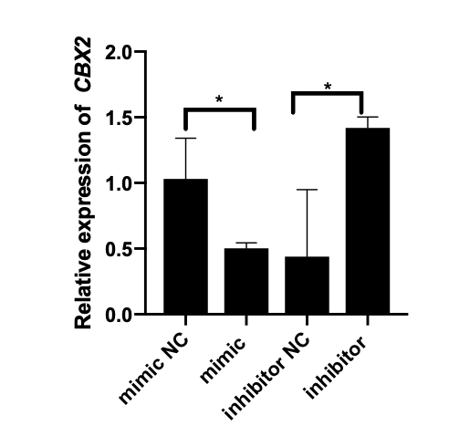
Supplementary figure 6
A
Mutated, control reporter
B
C
D
*

