Slide 1
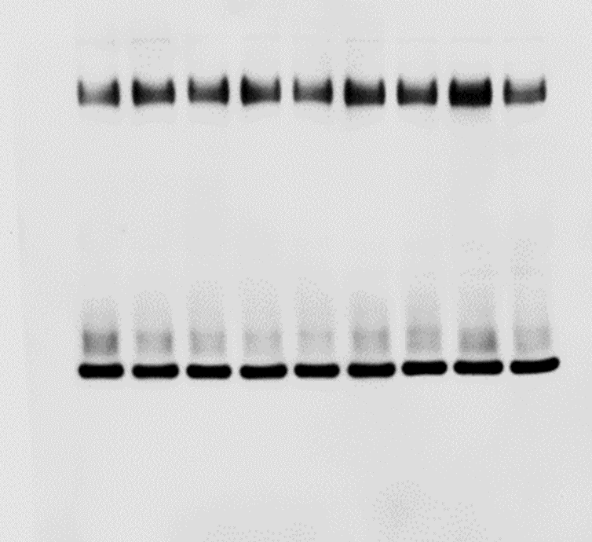
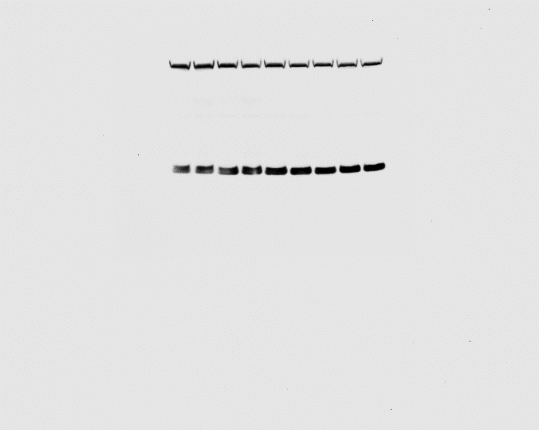
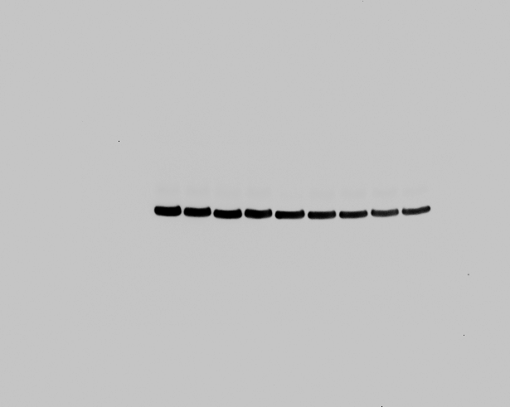
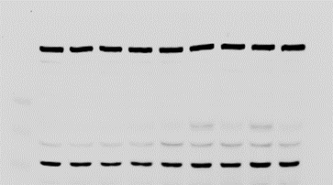
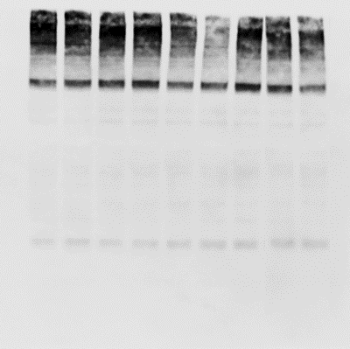
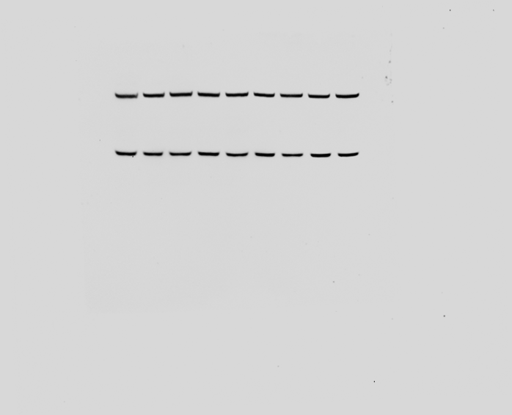
Figure 7A
APP^{NL-G-F} , 3m
APP^{NL-G-F}, 9m
APP^{NL-G-F} , 3m
APP^{NL-G-F}, 9m
APP^{NL-G-F} , 3m
APP^{NL-G-F}, 9m
APP^{NL-G-F} , 3m
APP^{NL-G-F}, 9m
WT, 3m
WT, 9m
WT, 9m
WT, 3m
WT, 9m
WT, 3m
WT, 9m
kDa
kDa
WT, 3m
kDa
kDa
-188
-98
-62
-49
-38
-28
-17
-13
-188
-98
-62
-49
-38
-28
-17
-13
-188
-98
-62
-49
-38
-28
-17
-13
-188
-98
-62
-49
-38
-28
-17
-13
*
*
*
*
SAPs
SAPs
LAMP1
PSAP
SAP-C
APP^{NL-G-F} , 3m
APP^{NL-G-F}, 9m
WT, 3m
WT, 9m
APP^{NL-G-F} , 3m
kDa
APP^{NL-G-F}, 9m
The right lane for each blot was not shown in original figure. * indicates non-specific band or band from previously used antibody due to re-probe. The lower part of membrane for SAPs was cut and used to probe with LC3 (data not shown).
WT, 3m
WT, 9m
-188
-98
-62
-49
-38
-28
-17
-13
kDa
-188
-98
-62
-49
-38
-28
-17
-13
*
ATG9A
Calnexin

Slide 2
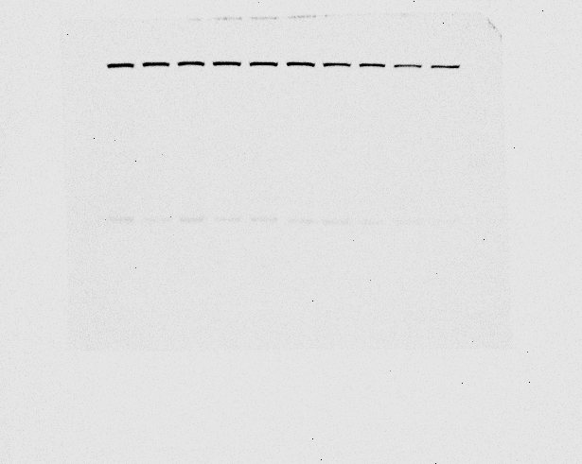
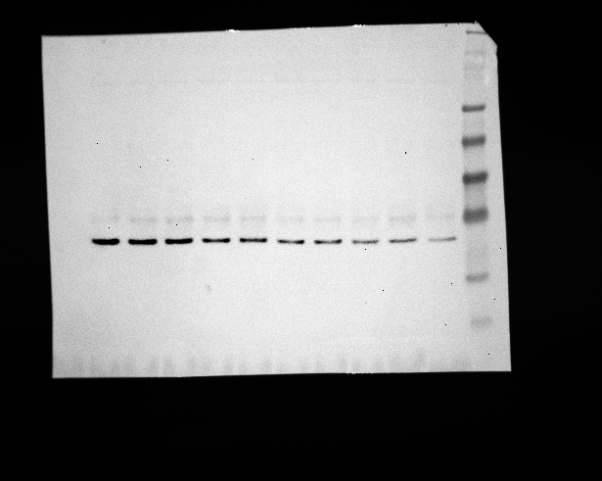
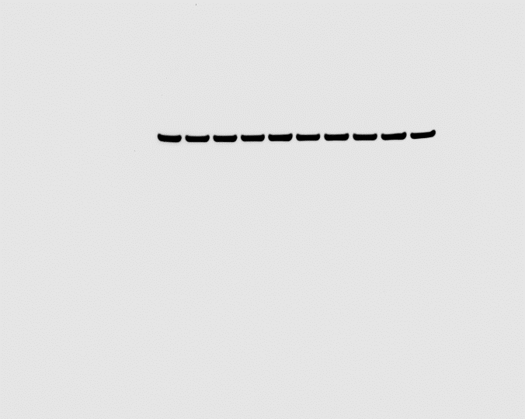
Figure 7C
2
kDa
1
2
kDa
2
kDa
Aβ42 (µM):
0
0.5
1
4
0
0.5
4
0
0.5
1
4
-188
-98
-62
-49
-38
-28
-17
-13
-188
-98
-62
-49
-38
-28
-17
-13
-188
-98
-62
-49
-38
-28
-17
-13
*
*
SAP-C
LAMP1
PSAP
0
0.5
1
2
4
kDa
Aβ42 (µM):
-188
-98
-62
-49
-38
-28
-17
-13
* indicates non-specific band or band from previously used antibody due to re-probe.
Actin

Slide 3
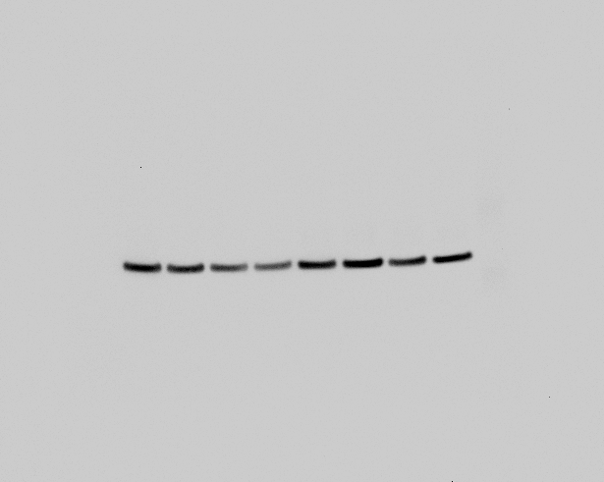
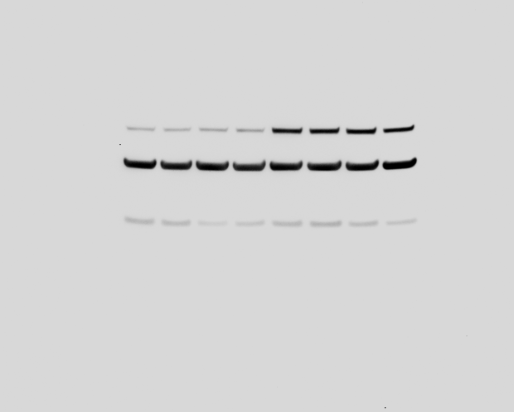
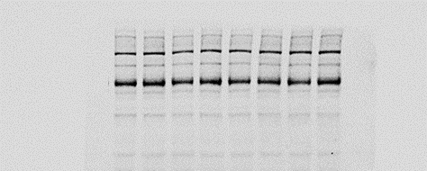
Figure 7E
kDa
1
kDa
0
1
0
1
kDa
Aβ42 (µM):
0
1
0
1
0
1
0
-188
-98
-62
-49
-38
-28
-17
-13
-188
-98
-62
-49
-38
-28
-17
-13
-188
-98
-62
-49
-38
-28
-17
-13
*
*
*
PSAP
SAP-C
Actin
* indicates non-specific band or band from previously used antibody due to re-probe. Lower part of PSAP membrane was cut.

Slide 4
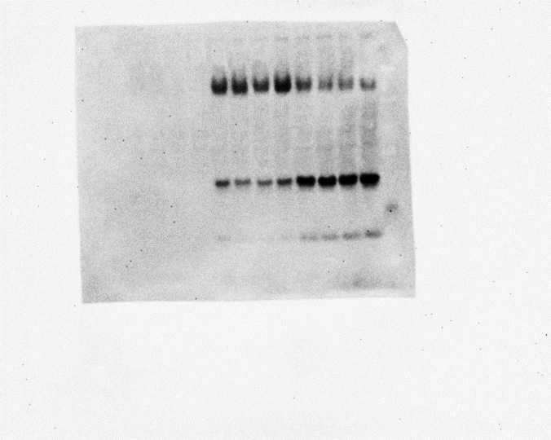
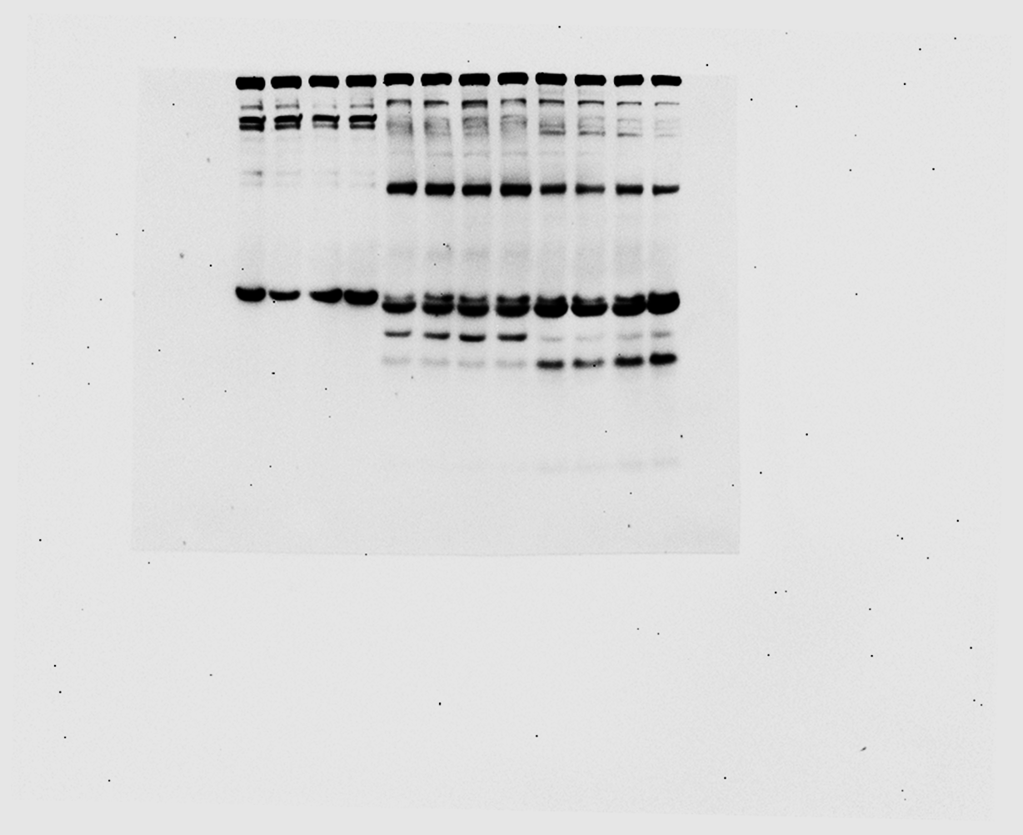
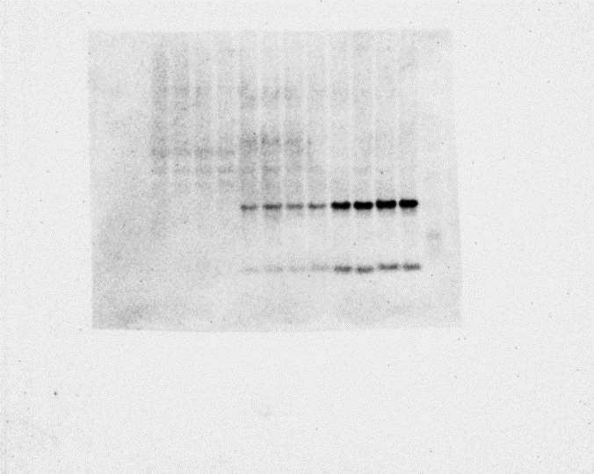
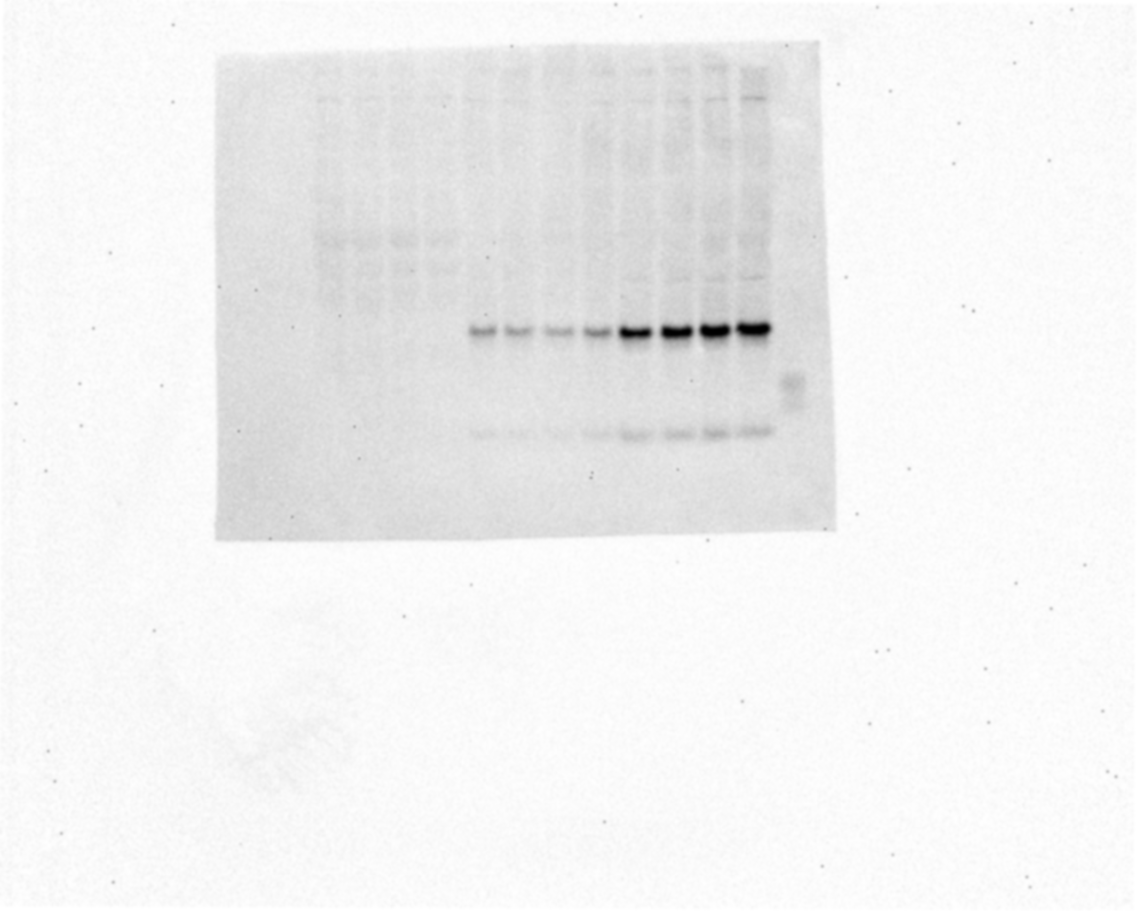
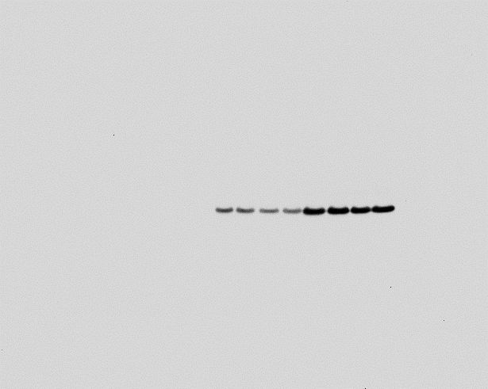
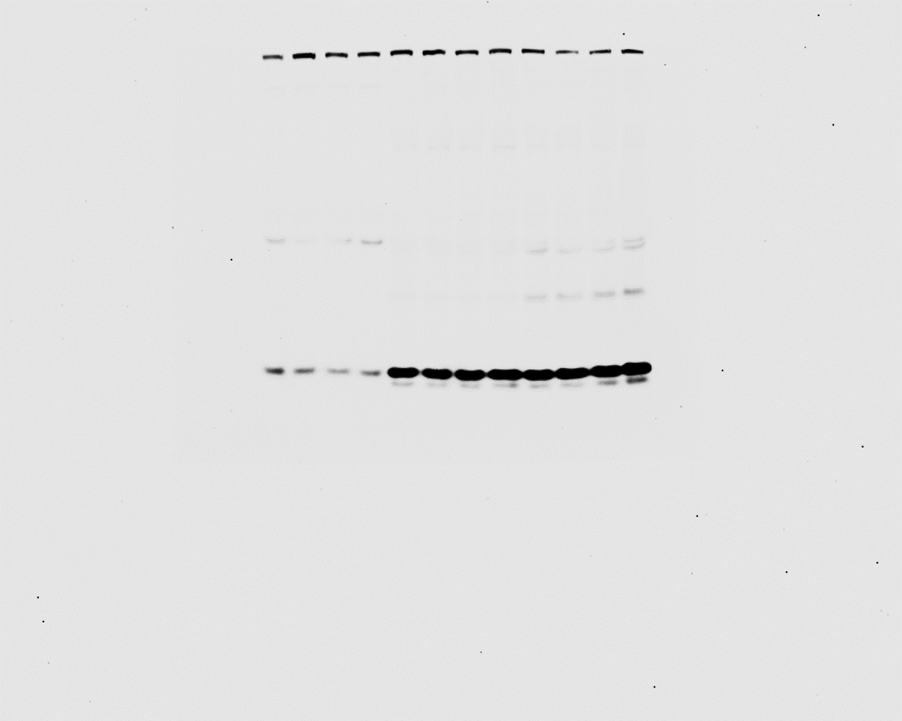
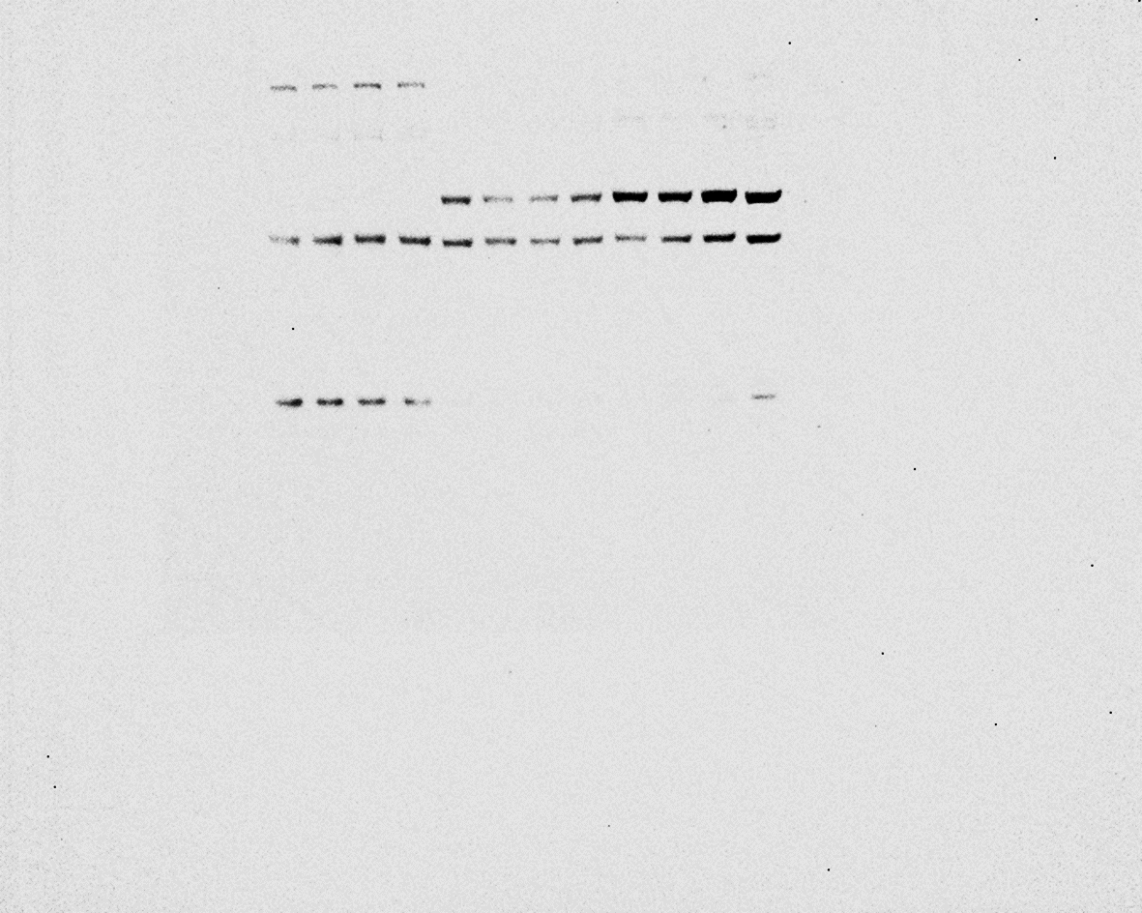
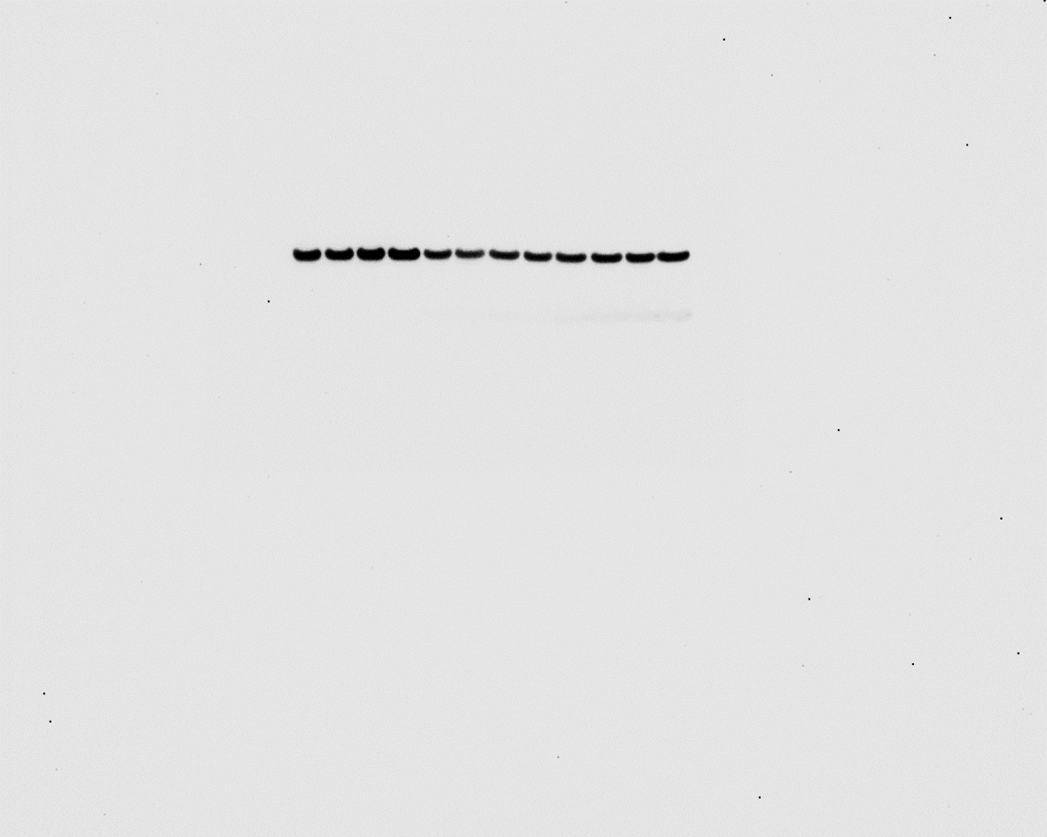
Figure 8B
5xFAD
5xFAD
5xFAD
5xFAD
5xFAD
5xFAD
5xFAD
5xFAD
5xFAD
WT
WT
WT
kDa
WT
WT
WT
5xFAD
5xFAD
5xFAD
WT
WT
WT
kDa
kDa
WT
WT
WT
kDa
-188
-98
-62
-49
-38
-28
-17
-13
-188
-98
-62
-49
-38
-28
-17
-13
-188
-98
-62
-49
-38
-28
-17
-13
-188
-98
-62
-49
-38
-28
-17
-13
*
*
*
*
LAMP1
Cath-D
Cath-B
SAPs
5xFAD
5xFAD
5xFAD
5xFAD
5xFAD
5xFAD
5xFAD
5xFAD
5xFAD
5xFAD
WT
WT
WT
WT
WT
WT
WT
5xFAD
5xFAD
WT
WT
WT
kDa
WT
WT
kDa
kDa
kDa
-188
-98
-62
-49
-38
-28
-17
-13
*
-188
-98
-62
-49
-38
-28
-17
-13
*
-188
-98
-62
-49
-38
-28
-17
-13
-188
-98
-62
-49
-38
-28
-17
-13
*
*
SAP-C
LC3
MFN-2
GAPDH
Possible non-specific bands are indicated by *.

Slide 5
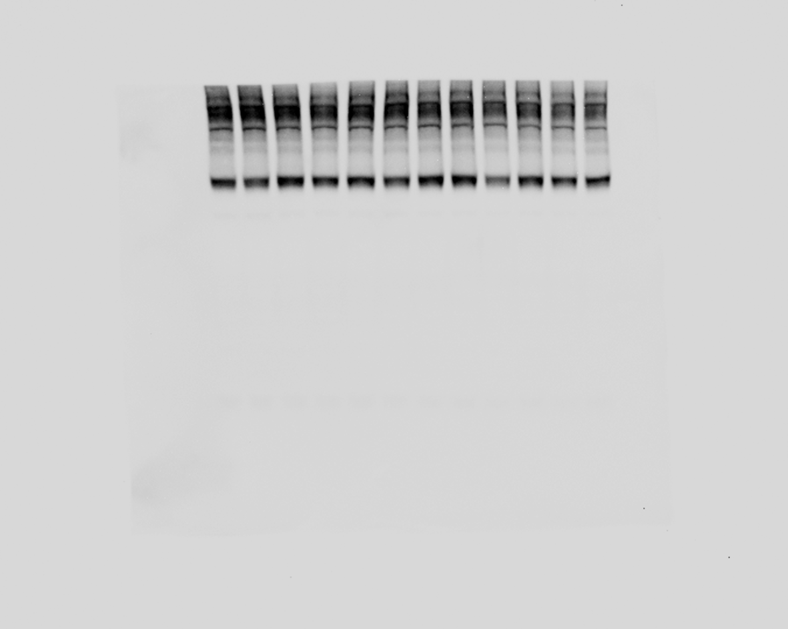
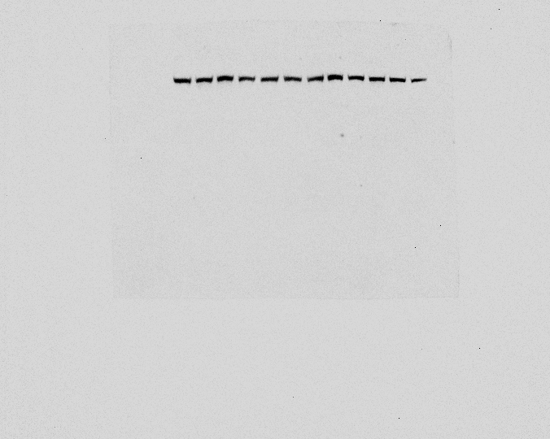
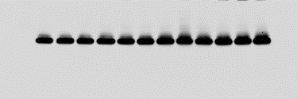
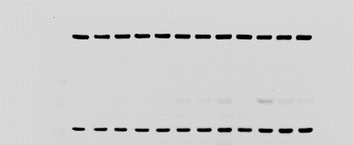
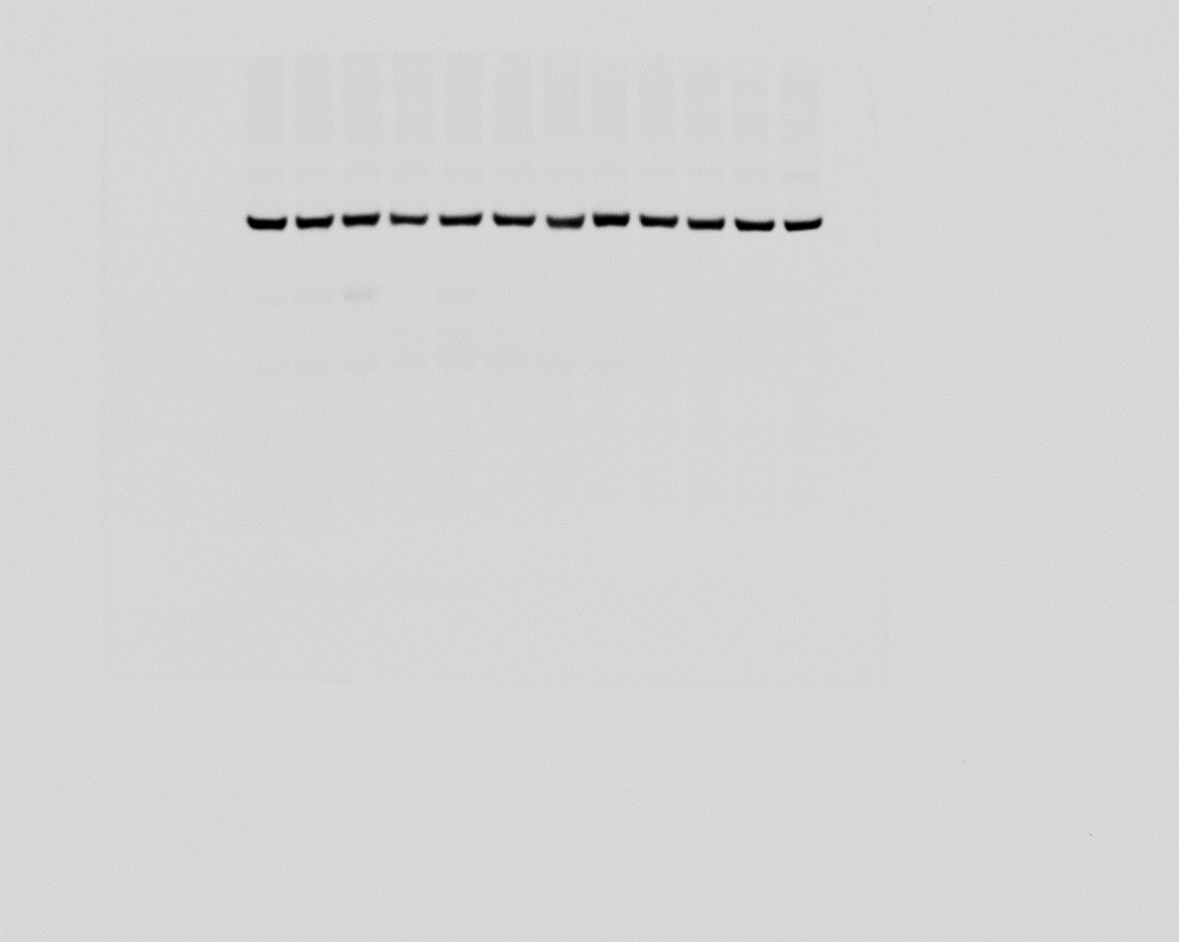
Supplemental Figure 5A
24m
3m
15m
6m
1.5m
9m
24m
24m
3m
15m
6m
3m
15m
1.5m
9m
6m
1.5m
9m
kDa
kDa
kDa
-188
-98
-62
-49
-38
-28
-17
-13
-188
-98
-62
-49
-38
-28
-17
-13
-188
-98
-62
-49
-38
-28
-17
-13
ATG9A
LAMP1
*
PSAP
SAP-C
kDa
kDa
-188
-98
-62
-49
-38
-28
-17
-13
-188
-98
-62
-49
-38
-28
-17
-13
* indicates non-specific band or band from previously used antibody due to re-probe. Membranes for ATG9A, SAP-C and SAPs were cut.
*
SAPs
Calnexin

Slide 6
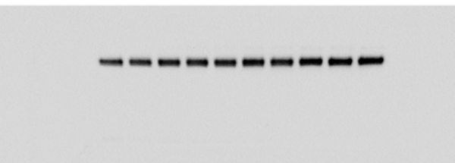
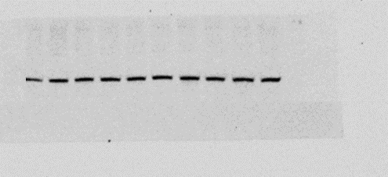
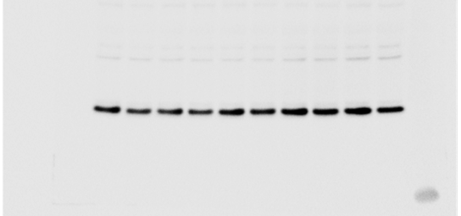
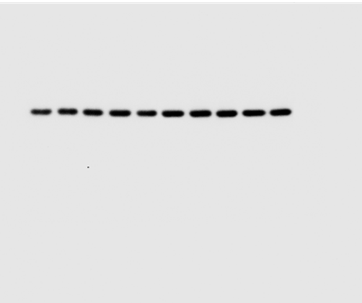
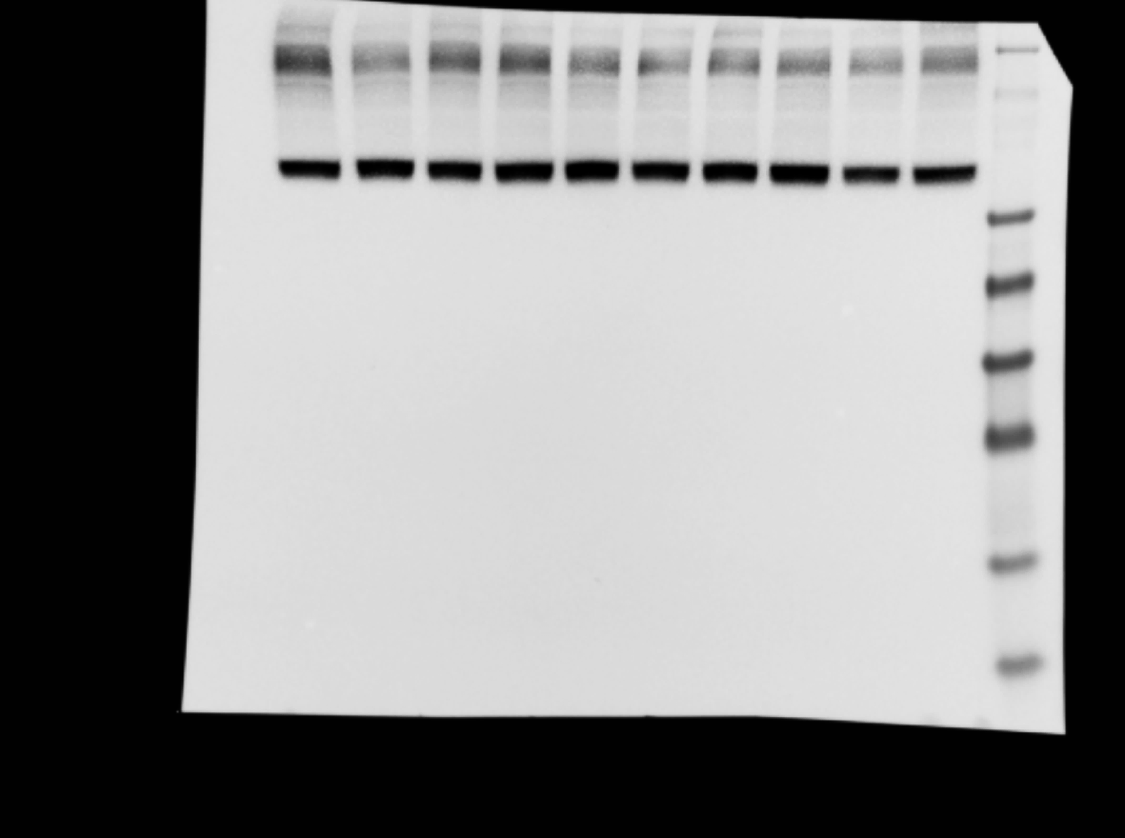
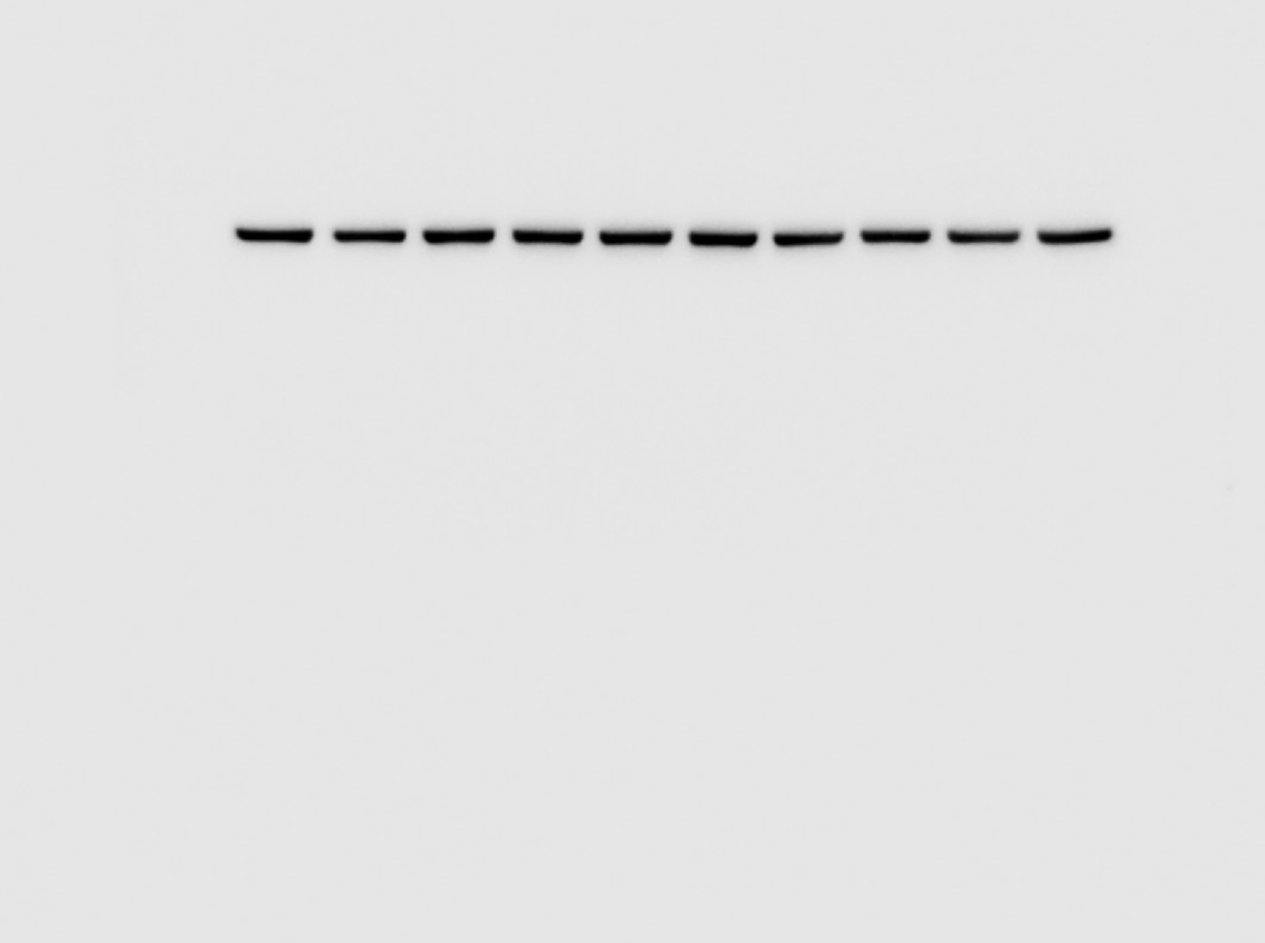
Supplemental Figure 5C
2.5m
4m
5m
7m
10m
2.5m
4m
5m
7m
10m
kDa
kDa
-188
-98
-62
-49
-38
-28
-17
-13
-188
-98
-62
-49
-38
-28
-17
-13
LAMP1
PSAP
SAPs
SAP-C
kDa
kDa
-188
-98
-62
-49
-38
-28
-17
-13
-188
-98
-62
-49
-38
-28
-17
-13
ATG9A
Calnexin
Top two panel membranes were cut

