Slide 1
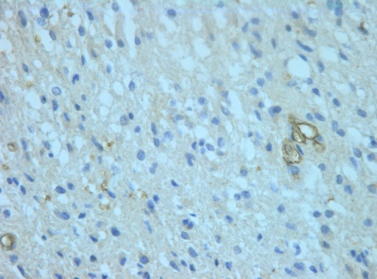
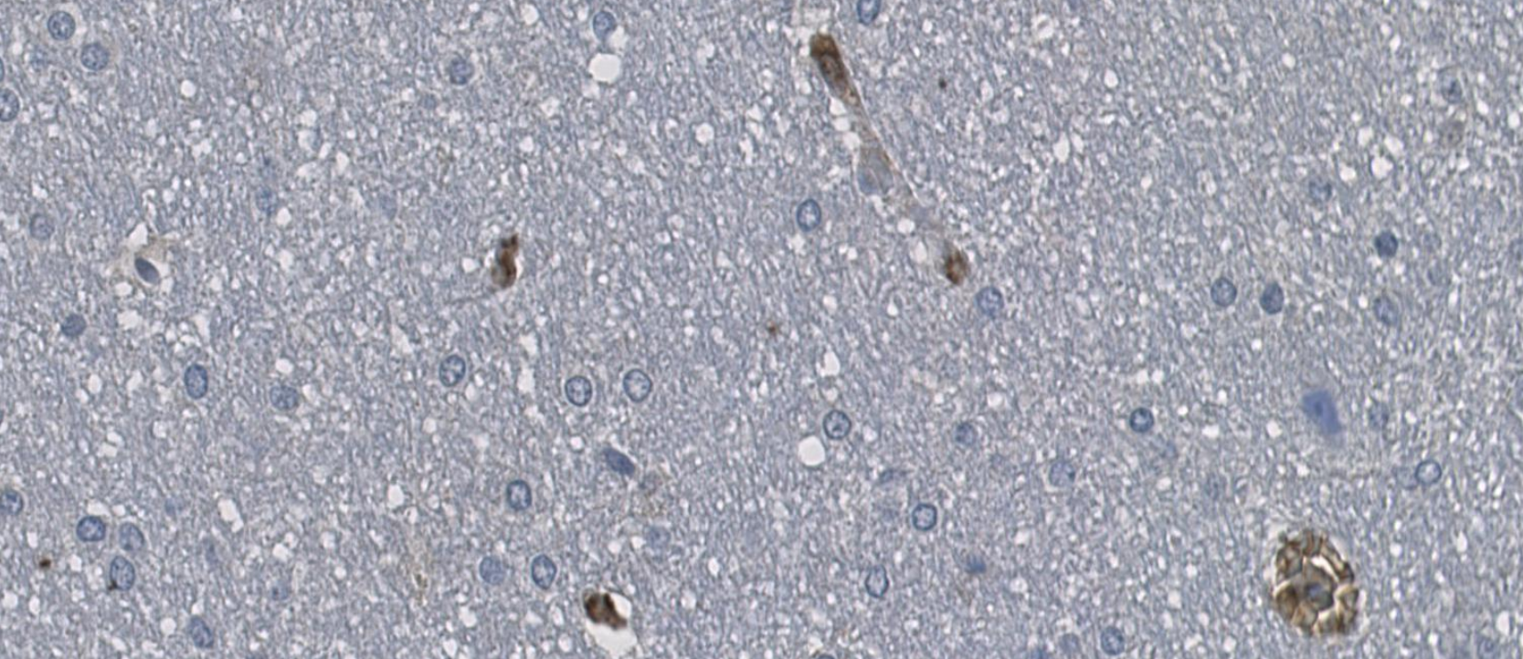
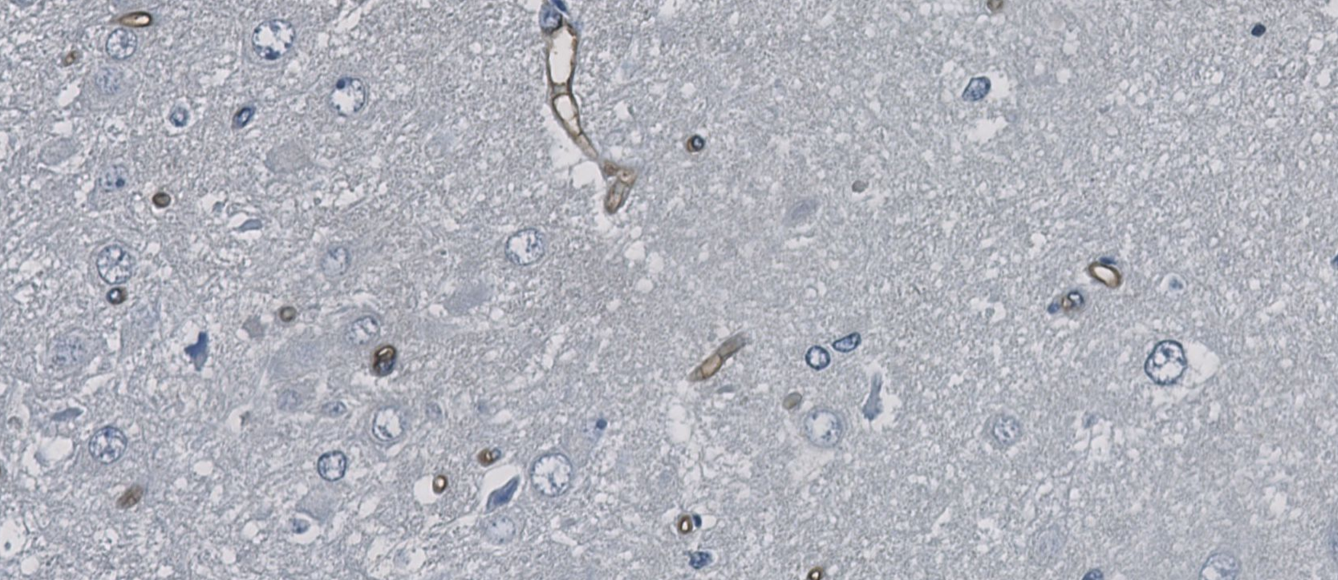
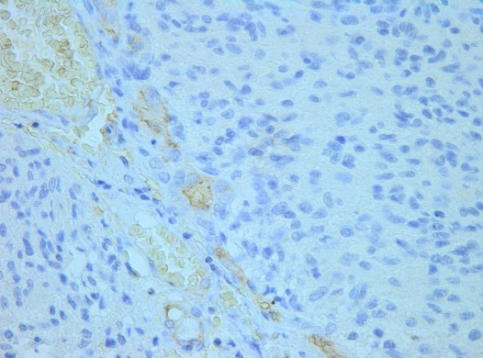
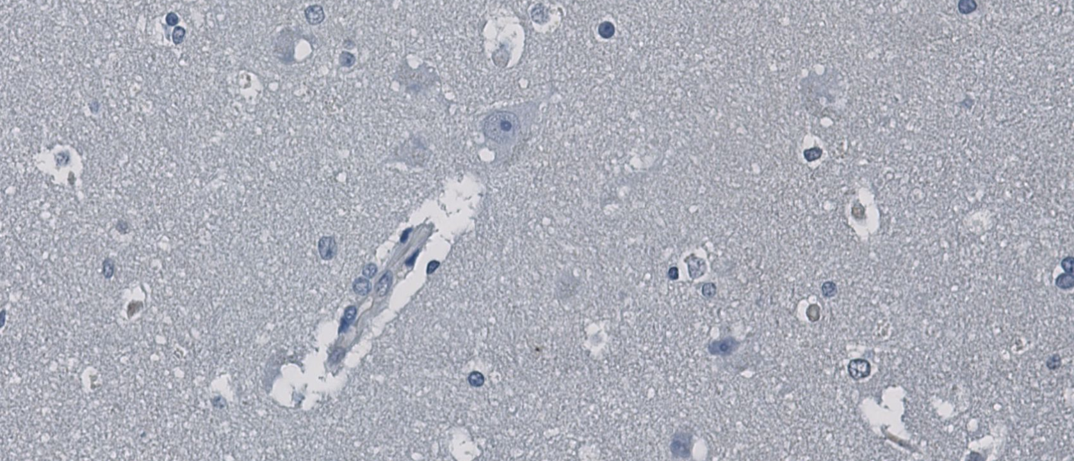
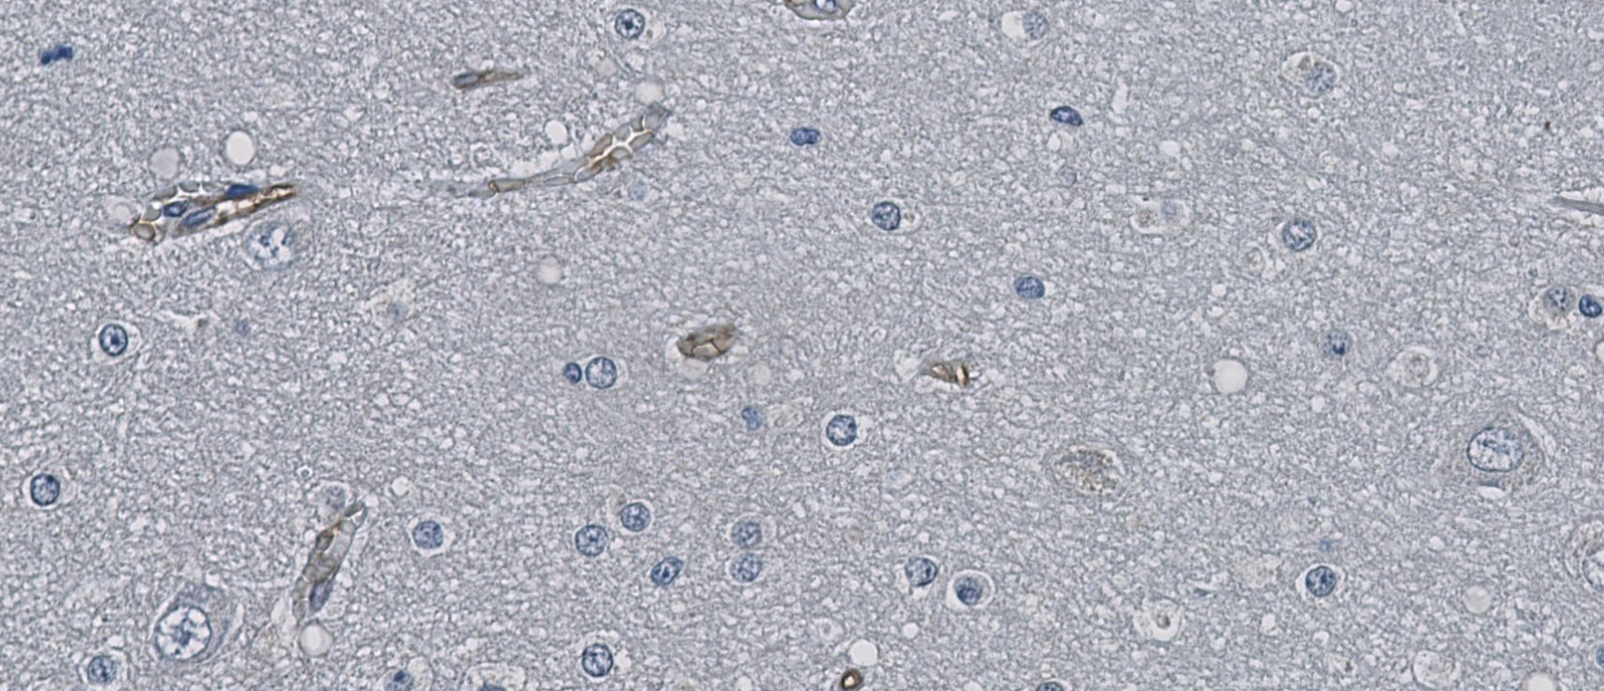
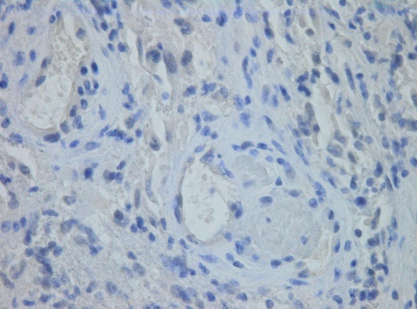
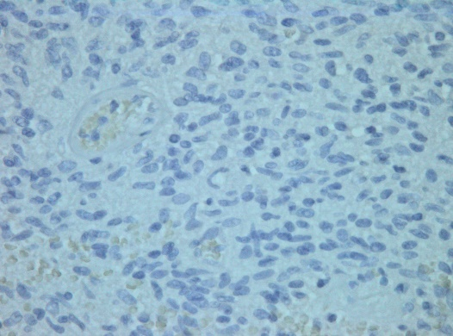
A
Glioblastoma
B
Normal brain
N04.0241
H-score normal brain: 7
endothelium: 216
ZH-157
H-score tumor: 93
endothelium: 157
N04.0927
H-score normal brain: 10
endothelium: 139
N05.1546
H-score normal brain: 9
endothelium: 41
ZH-164
H-score
tumor: 1
endothelium: 131
N05.1809
H-score normal brain: 2
endothelium: 107
ZH-304
H-score
tumor: 3
endothelium: 83
ZH-332
H-score
tumor: 4
endothelium: 42
S1

Slide 2
A
B
Endothelial cells
Tumor cells
High TβRIII expression
Low TβRIII expression
High TβRIII expression
Low TβRIII expression
P=0.880
P=0.365
S2

Slide 3
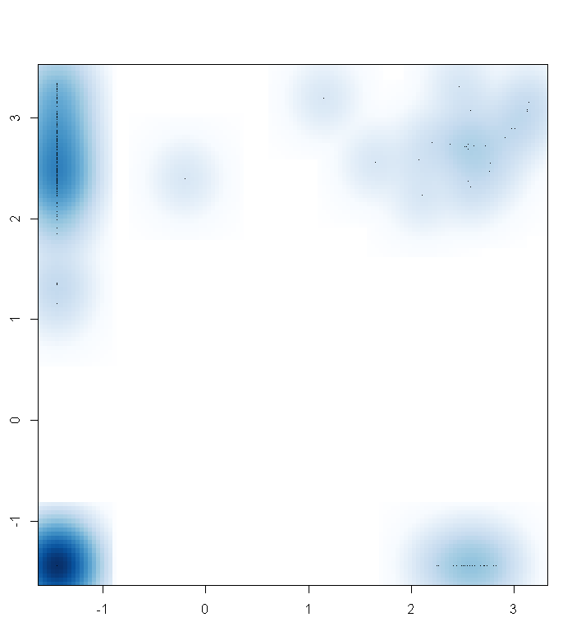
161
24
αSMA
277
19
CD31
S3

