Slide 1
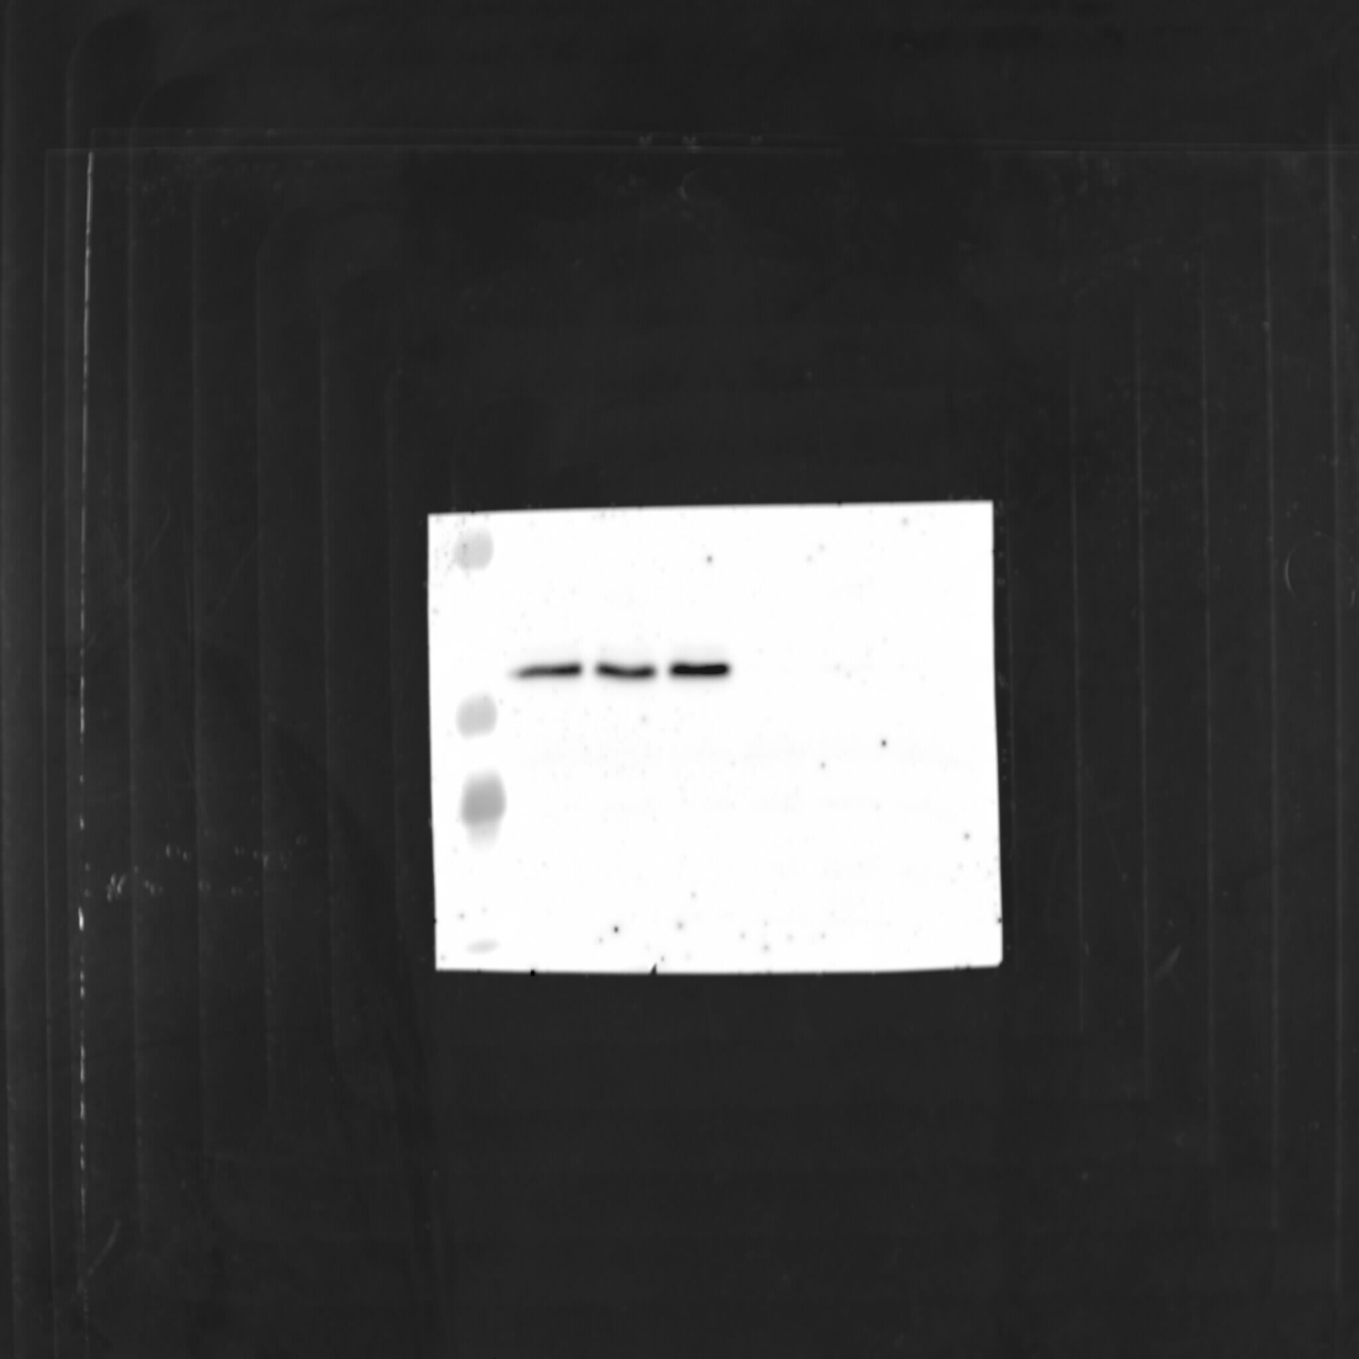

pCRKL Y207
B-Actin
55
1_K562_CTRL
2_K562_CTRL
55
3_K562_CTRL
1_K562_DRG
2_K562_DRG
3_K562_DRG
1_K562_CTRL
2_K562_CTRL
3_K562_CTRL
1_K562_DRG
2_K562_DRG
3_K562_DRG
36
36
Figure 3: The phosphoproteome analysis of K562 perturbed with Nilotinib
Notes:
K562-Nilotinib

Slide 2
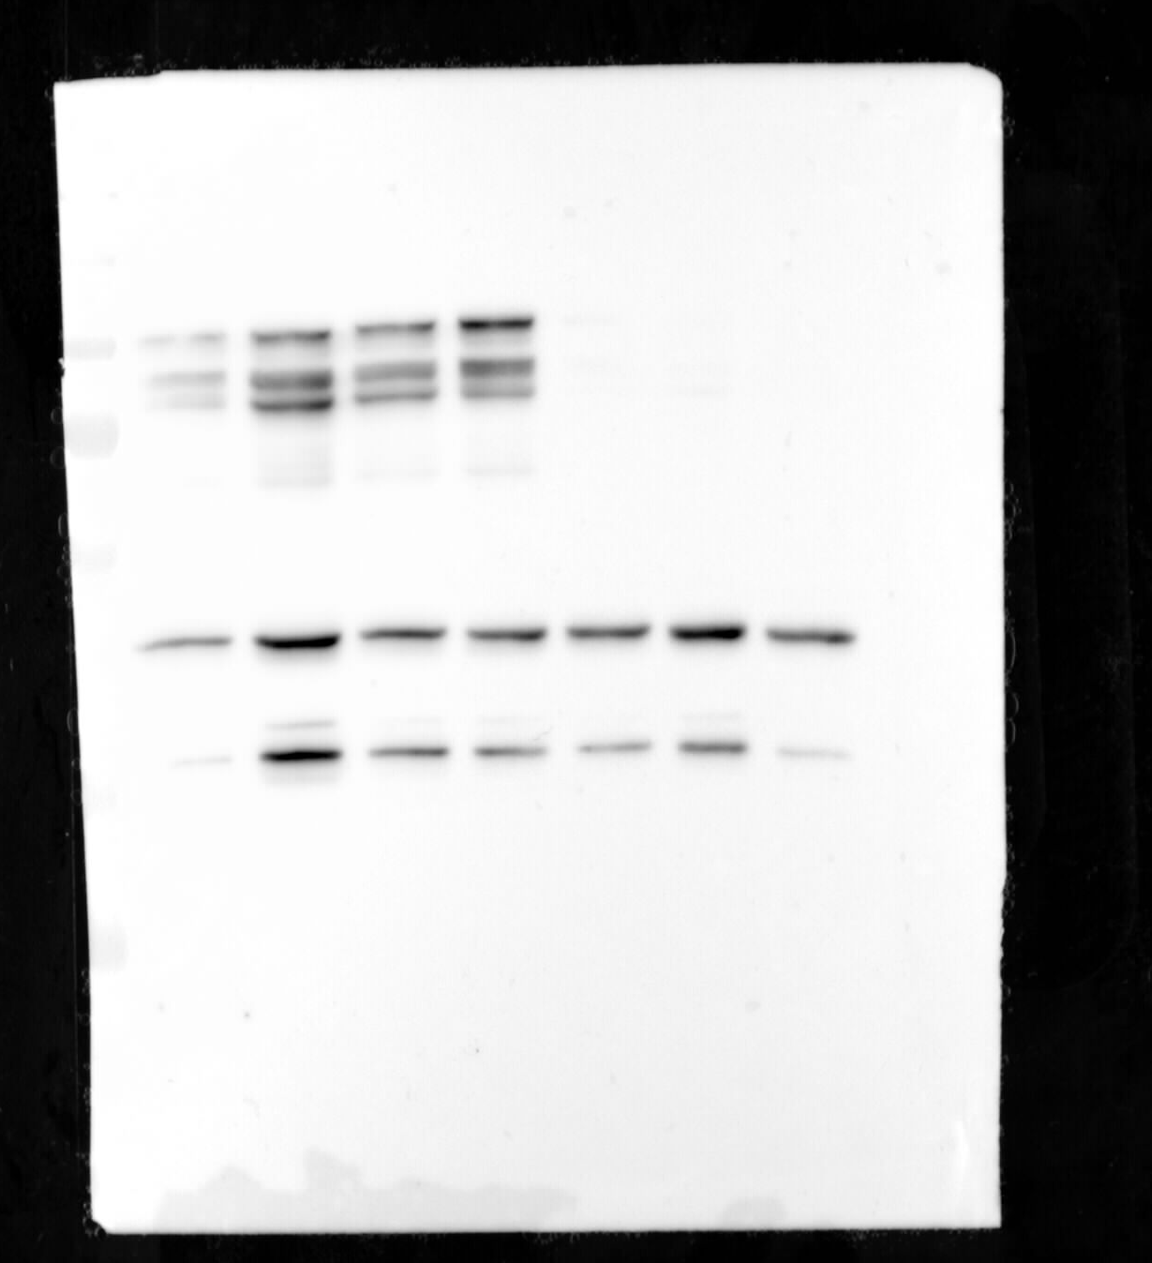
Additional control
1_MOLM13_CTRL
2_MOLM13_CTRL
3_MOLM13_CTRL
1_MOLM13_DRG
2_MOLM13_DRG
3_MOLM13_DRG
130
pSTAT5A Y694/
pSTAT5B Y699
95
72
55
B-Actin
36
28
Figure 4: The phosphoproteome analysis of MOLM13 perturbed with Midostaurin
Notes:
Molm13-Midostaurin

Slide 3
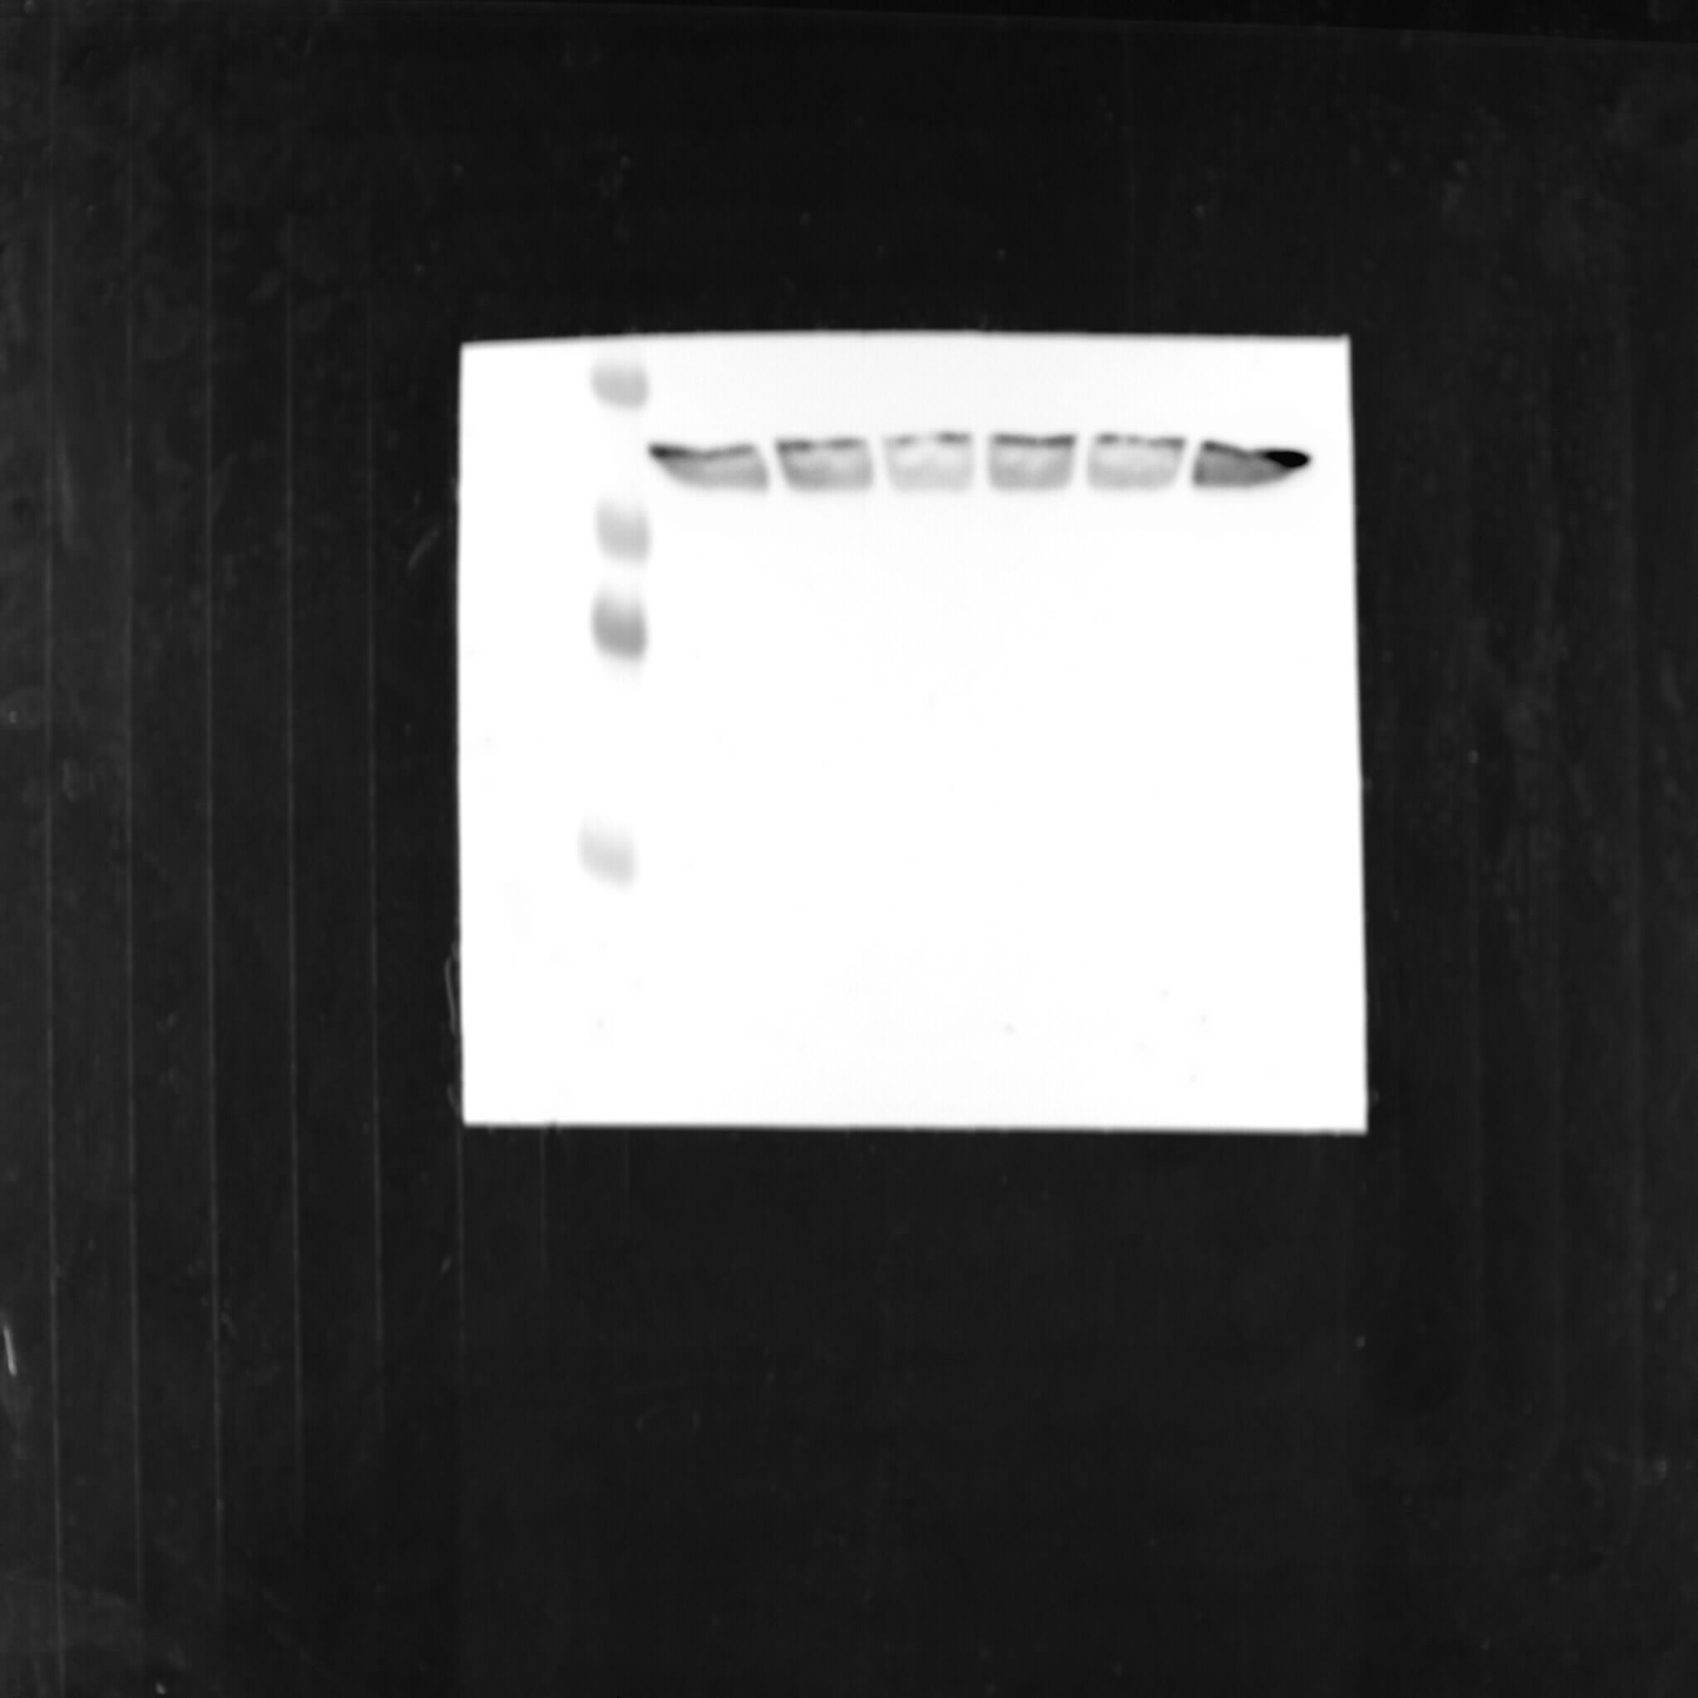
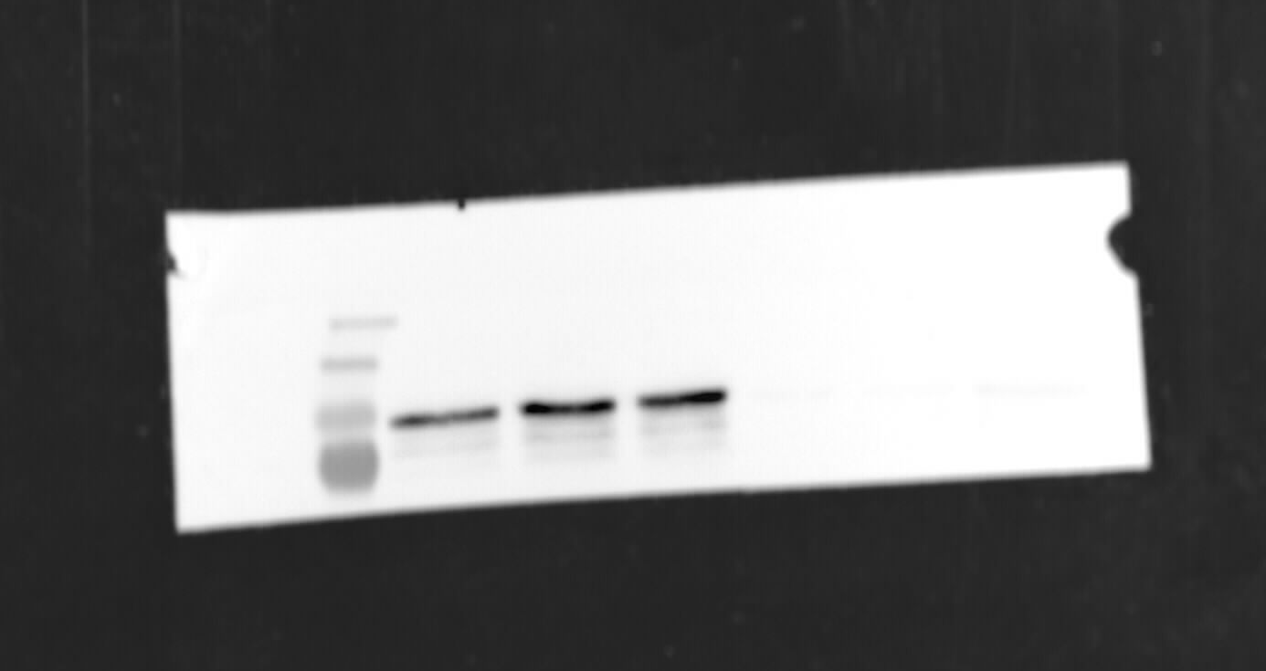
B-Actin
pSTAT5A Y694/
pSTAT5B Y699
55
1_MV4-11_CTRL
2_MV4-11_CTRL
3_MV4-11_CTRL
1_MV4-11_DRG
2_MV4-11_DRG
3_MV4-11_DRG
36
1_MV4-11_CTRL
2_MV4-11_CTRL
3_MV4-11_CTRL
1_MV4-11_DRG
2_MV4-11_DRG
3_MV4-11_DRG
28
250
130
95
72
Figure 5: The phosphoproteome analysis of MV4-11 perturbed with Midostaurin.
Notes:
MV4-11 Midostaurin

