Slide 1
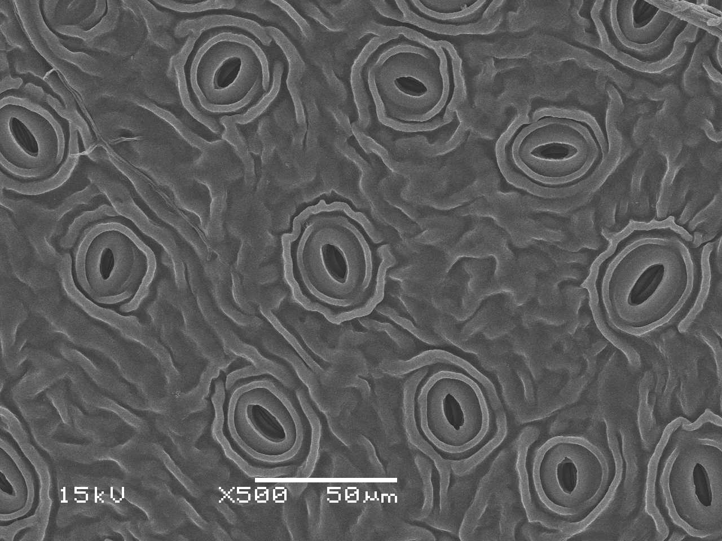
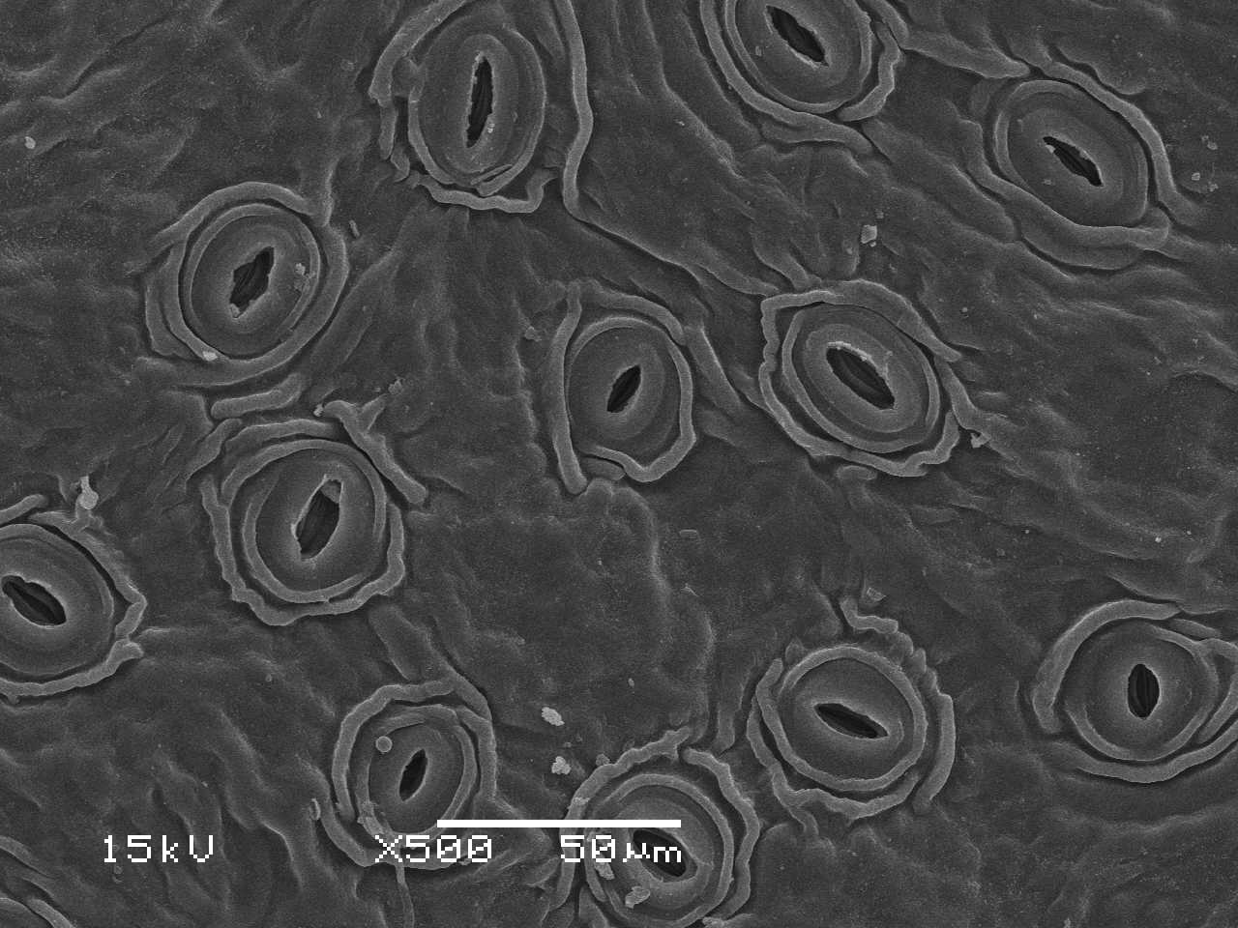
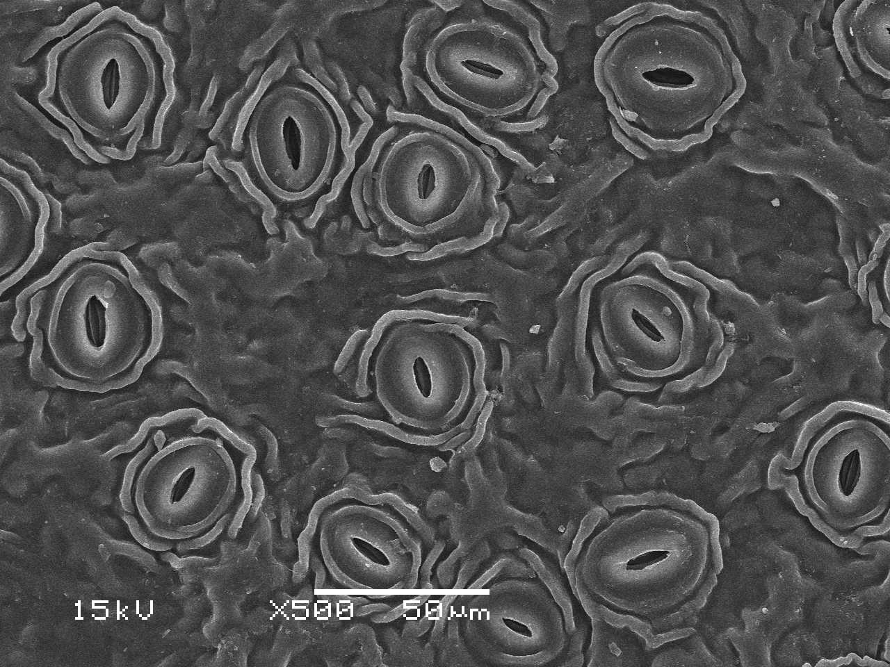
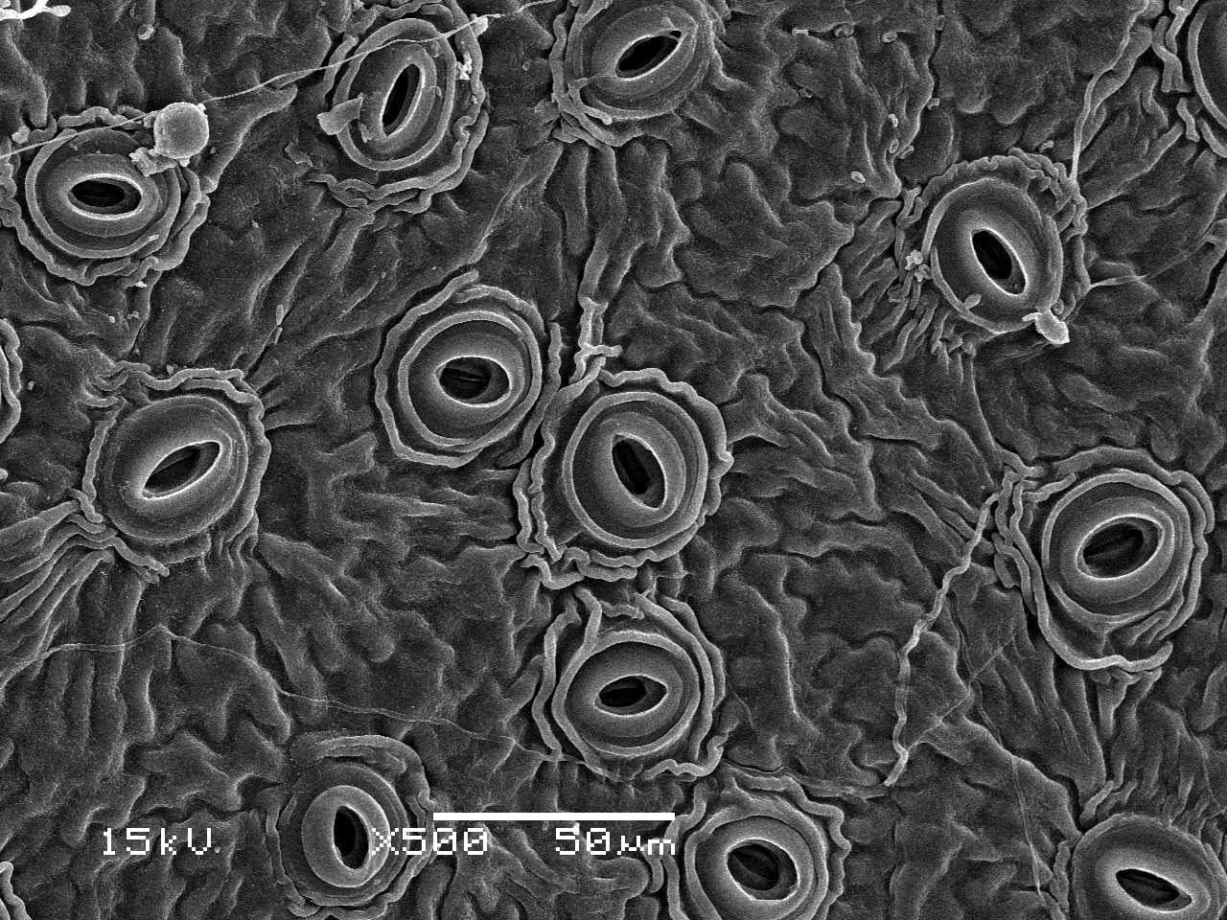
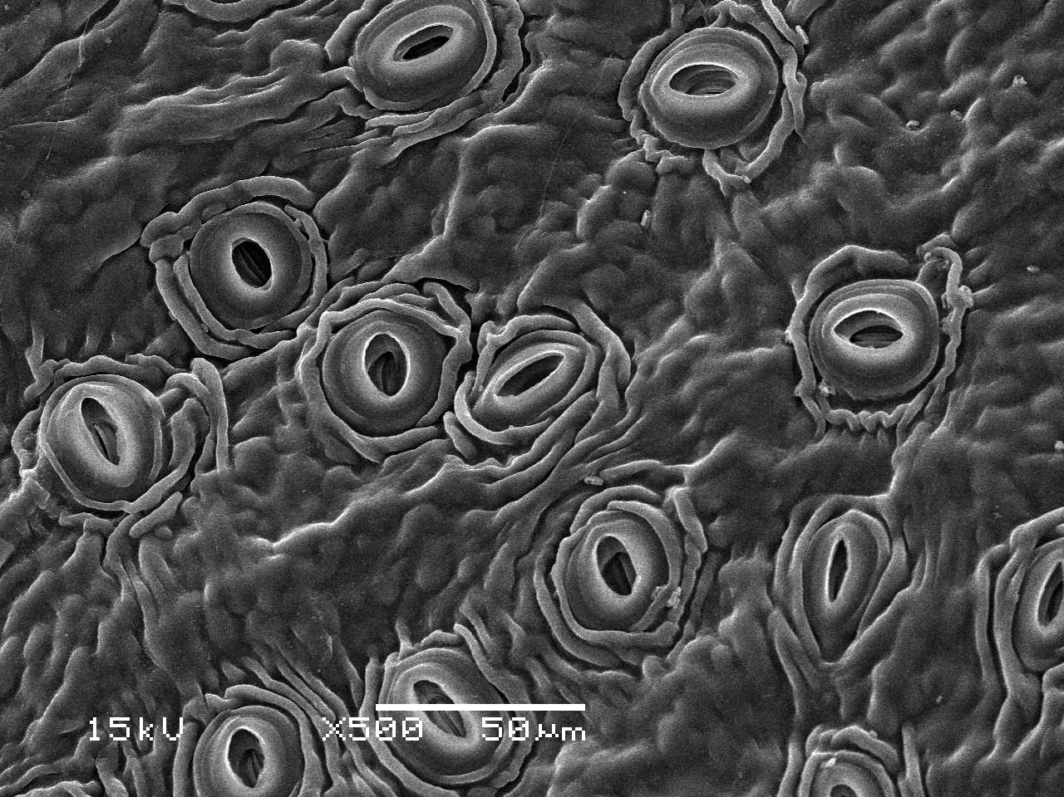
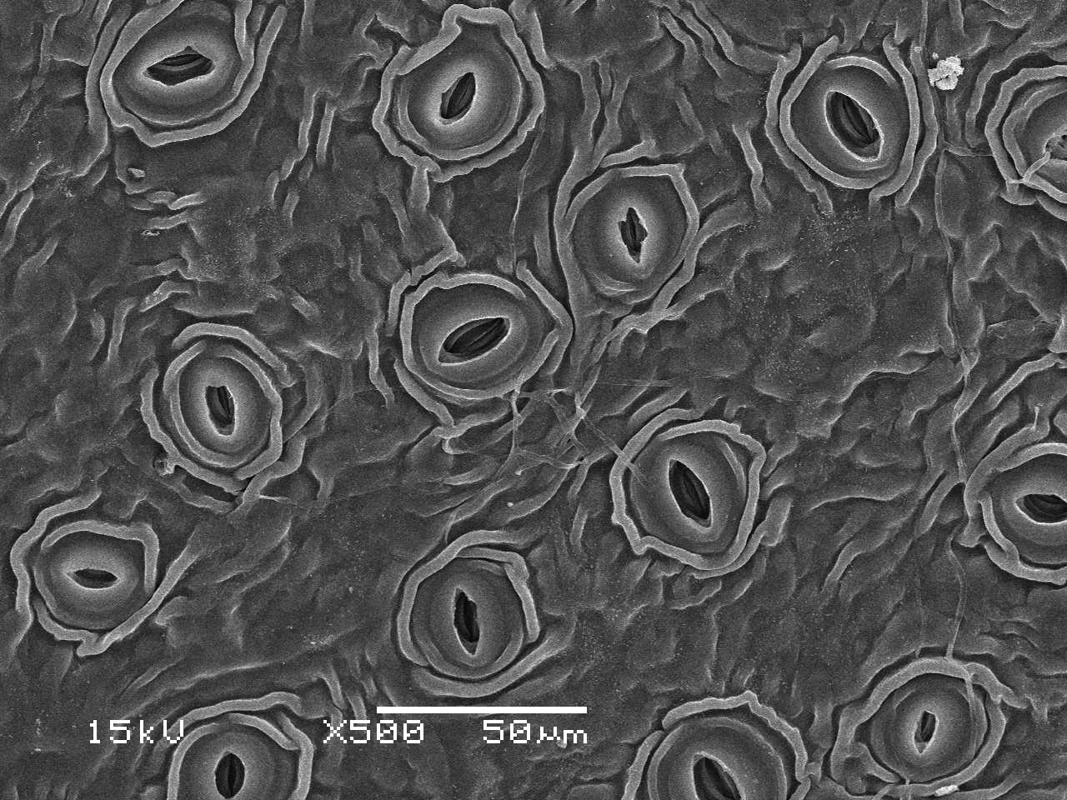
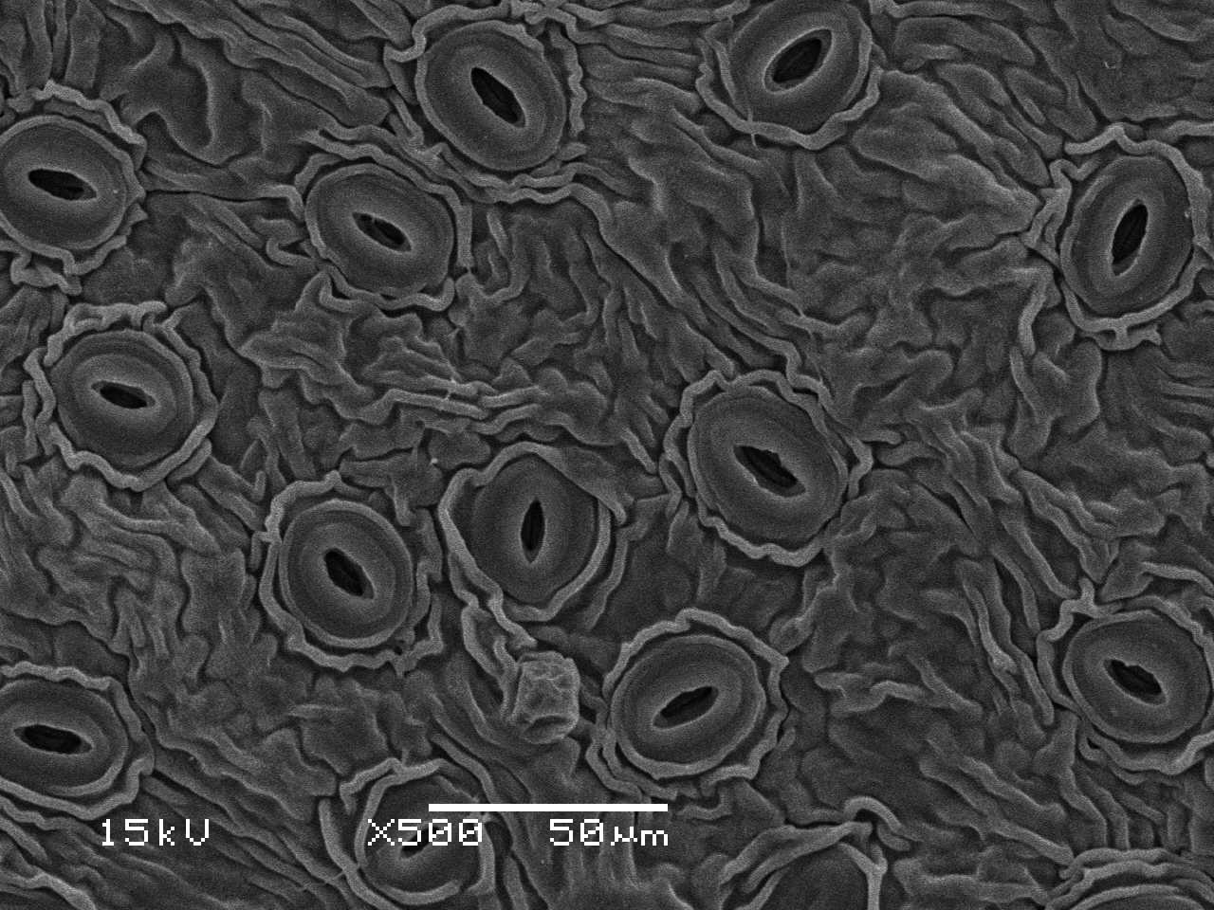
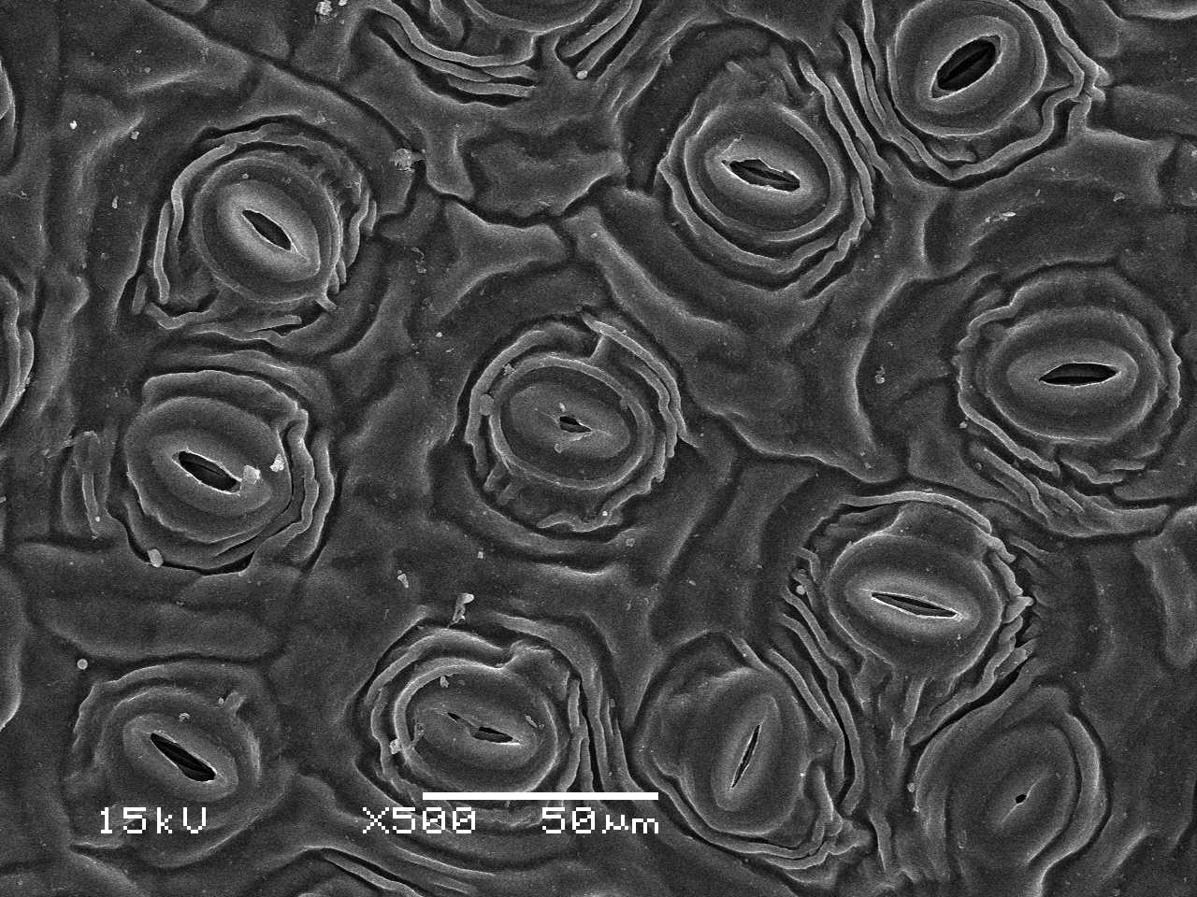
A
Jinguanyin
Wuniuzao
0316B
0306A
0306H
Fuyun 20
0202-10
Hongyafoshou
B
Stomatal density /mm²
C
a
ab
ab
a
b
b
ab
ab
Guard cell length (μm)
D
bc
a
ab
a
ab
ab
ab
c
Guard cell pair width (μm)
Figure S3. Stoma parameters of the eight tea germplasm. (A) SEM images of the abaxial leaf surface from the eight tea germplasms. Bar = 50 µm. (B) Stomata density (n=10); (C) Guard cell length (n=20); (D) Guard cell pair width (n=20). Statistically significant difference (p<0.05) was indicted by different letters.

