Slide 1
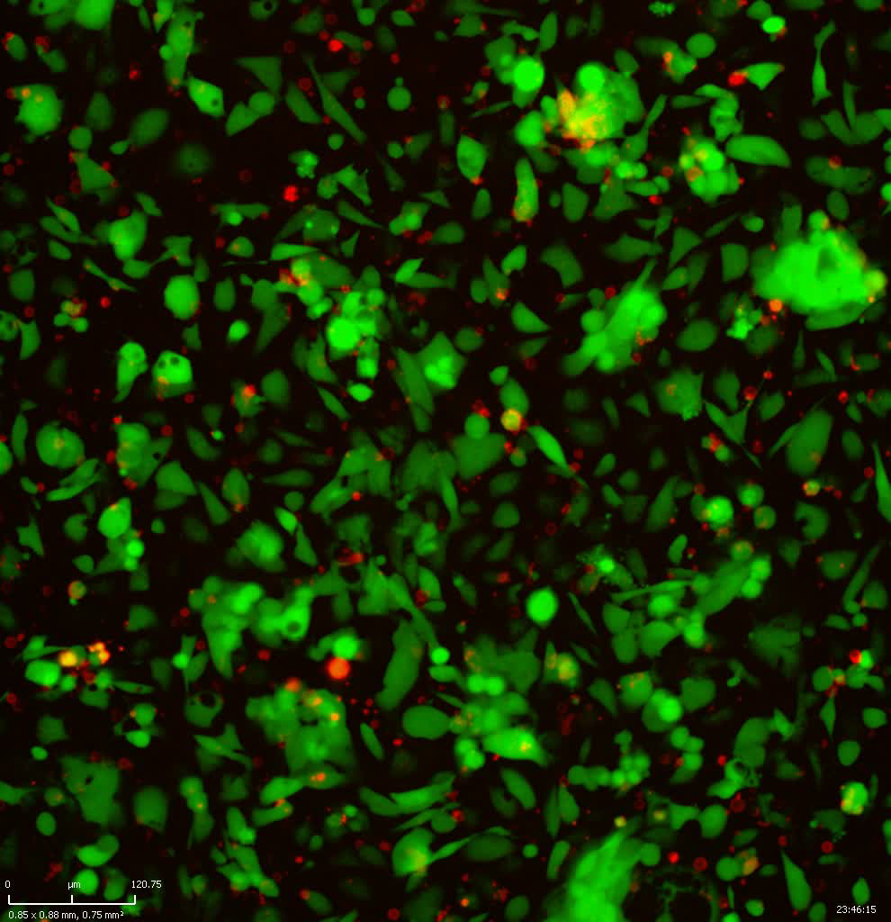
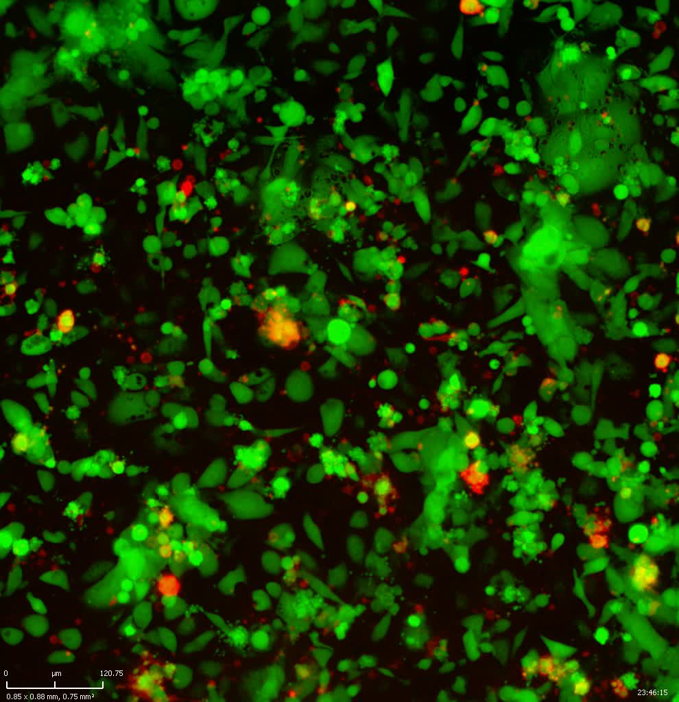
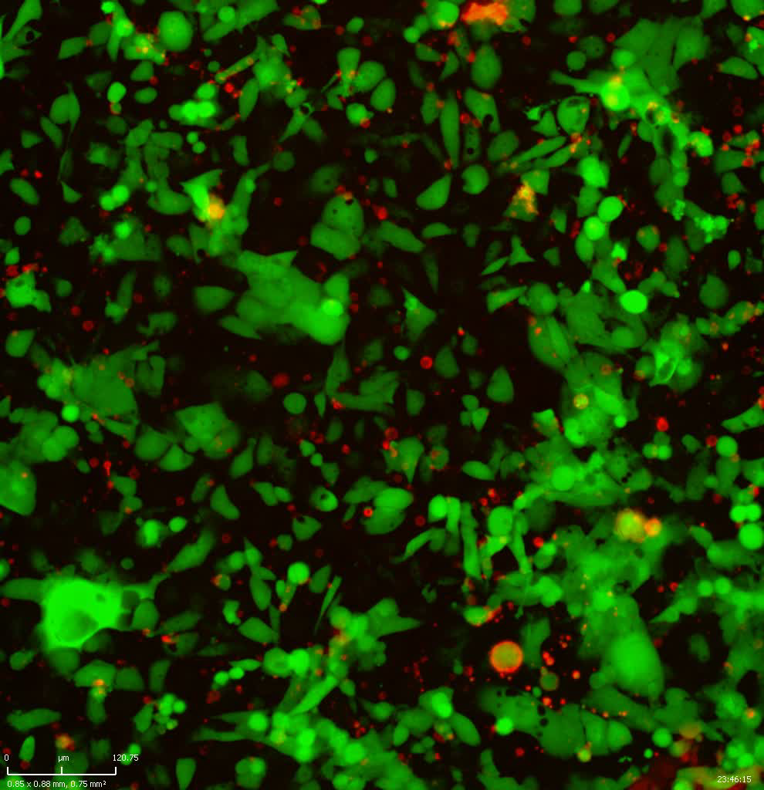
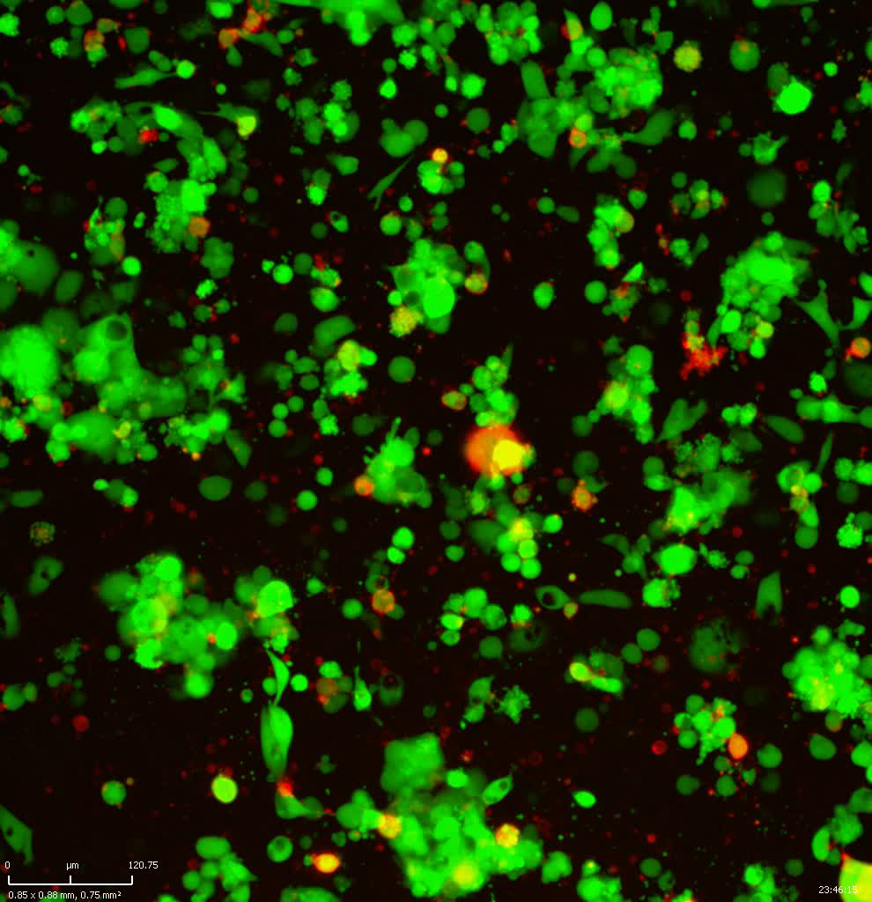
A
COR-L23-A*03:01
Control
TCRA3V
B
COR-L23-A*11:01
Control
TCRA11V
Supplementary Movie

