Slide 1
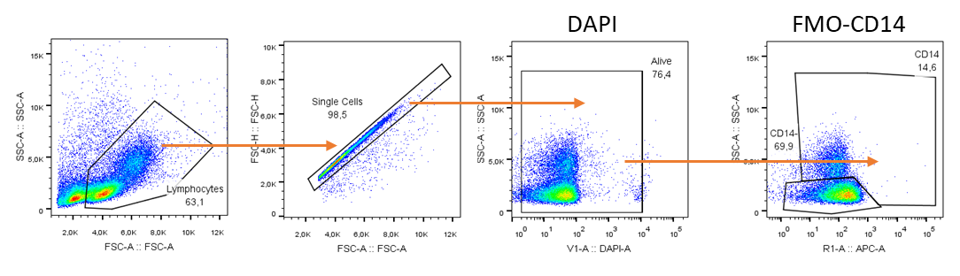
Supplementary figure 1. Gating strategy: FMOs and Stained samples
A
Initial selection of lymphocytes, single cells and alive cells

Slide 2
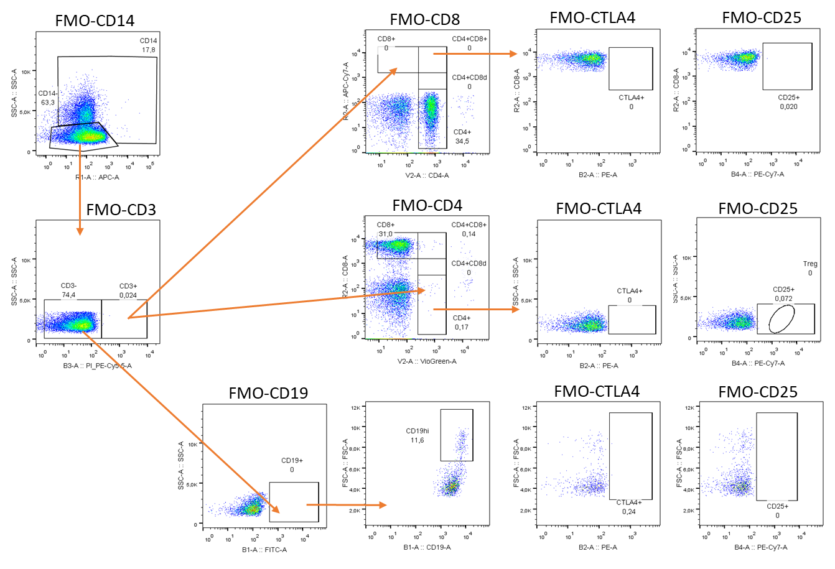
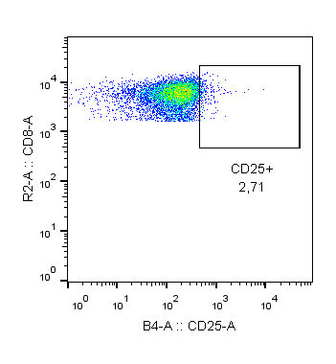
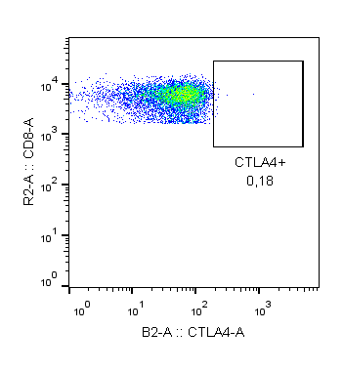
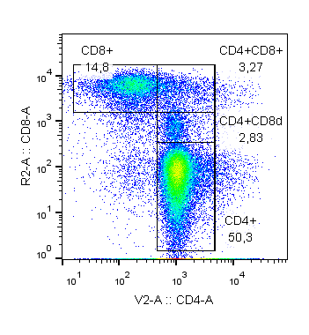
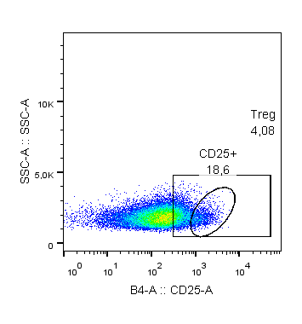
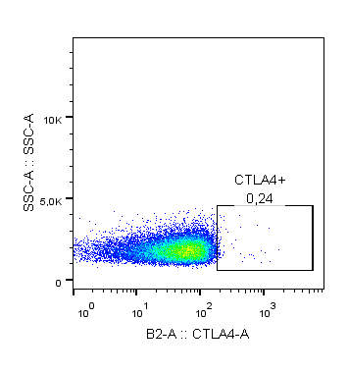
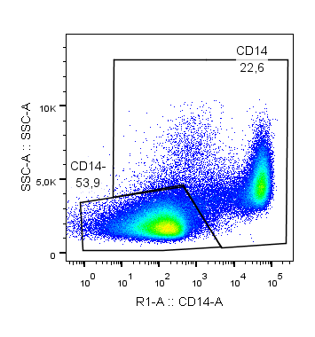
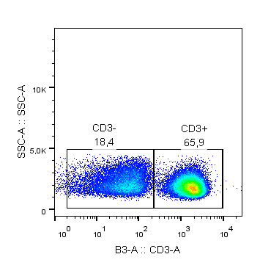
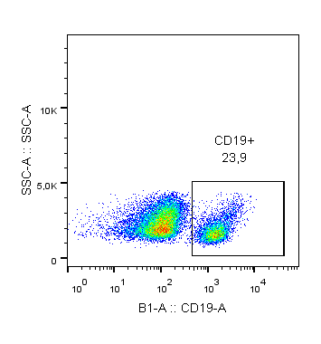
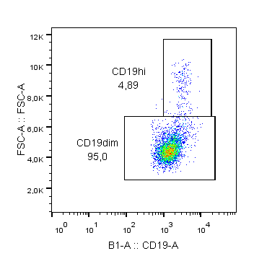
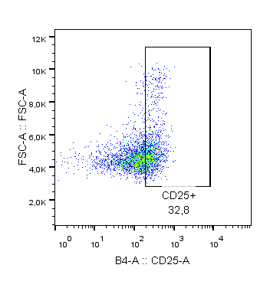
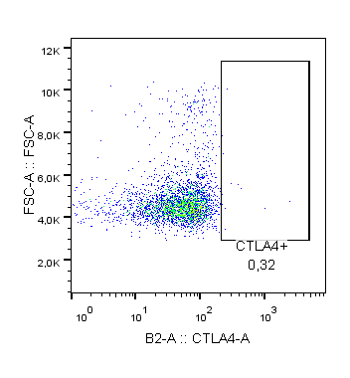
Supplementary figure 1. Gating strategy: FMOs and Stained samples
B
T and B cells gating strategy from panel 3
FMOs
Stained Samples

Slide 3
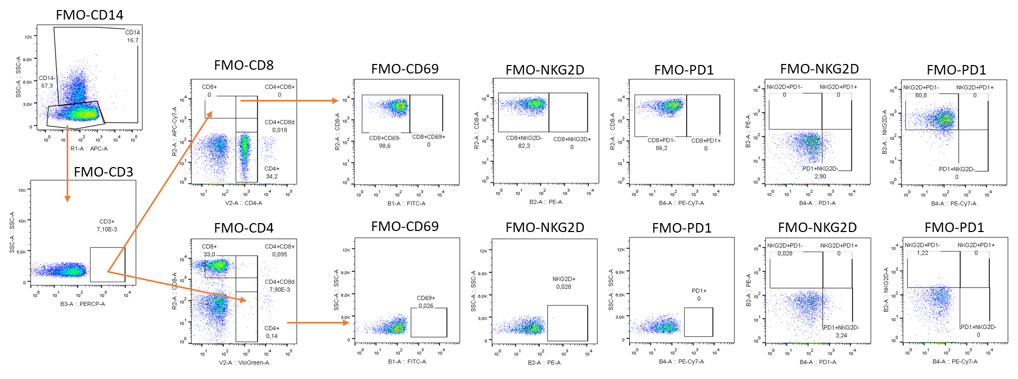
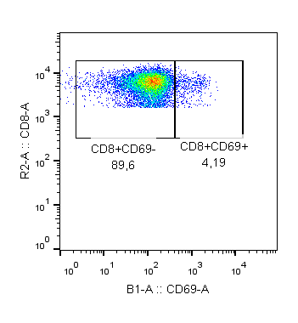
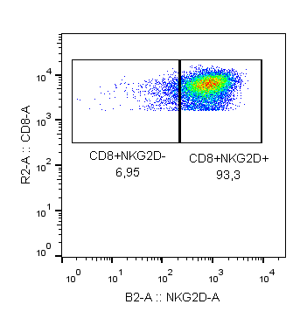
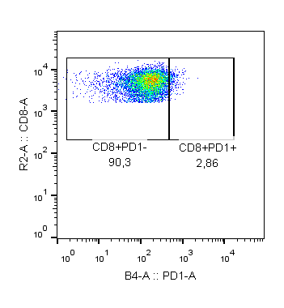
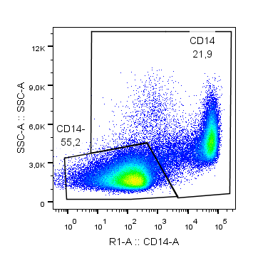
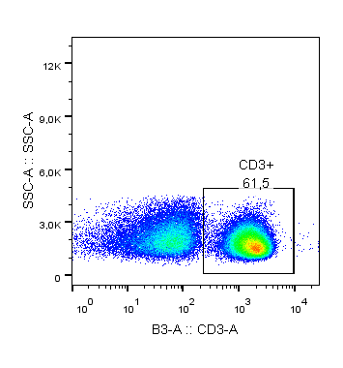
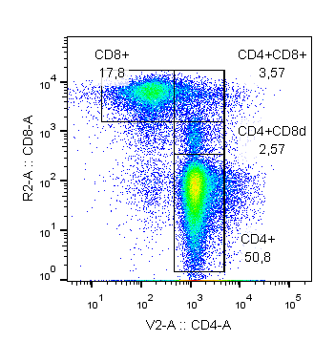
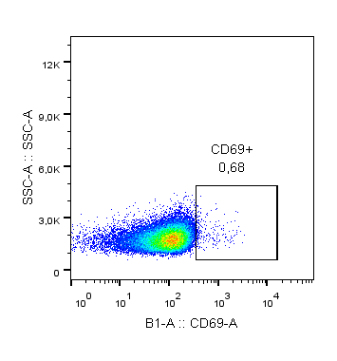
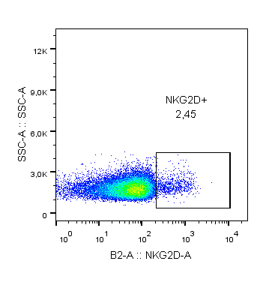

Supplementary figure 1. Gating strategy: FMOs and Stained samples
C
T cells gating strategy from panel 4
FMOs
Stained Samples

Slide 4
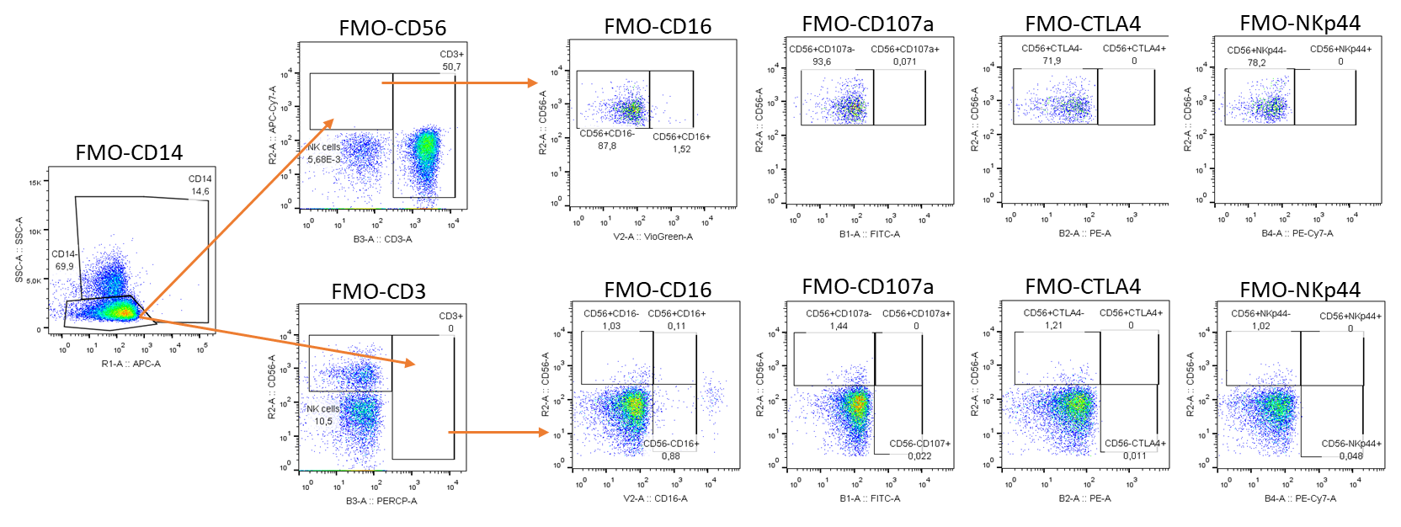
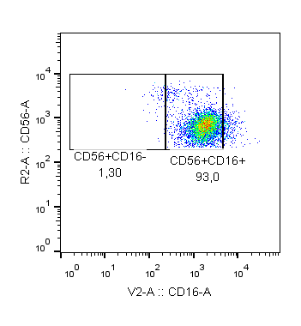
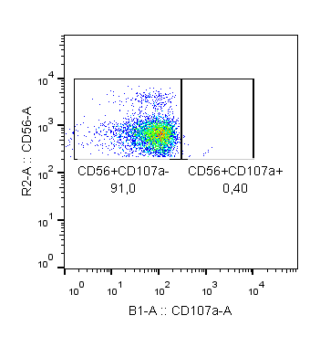
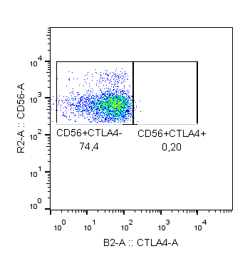
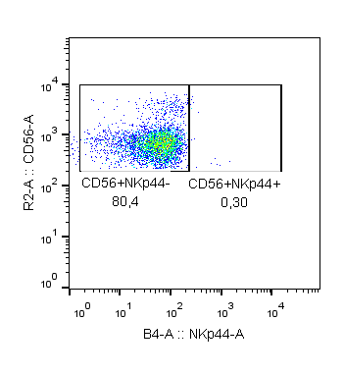
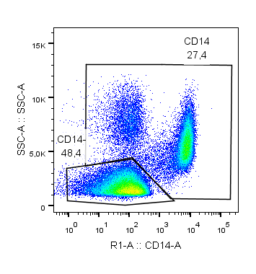
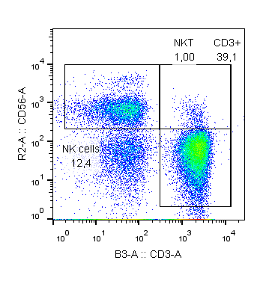
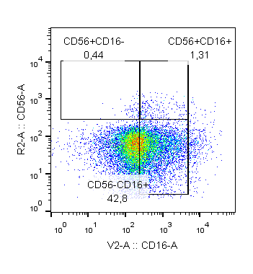
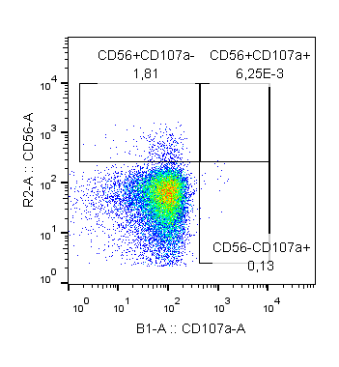
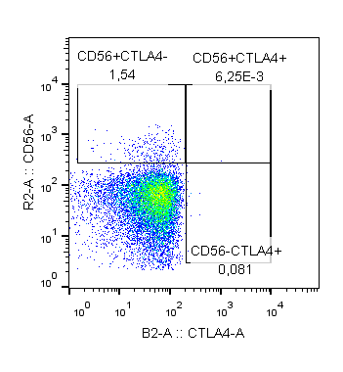
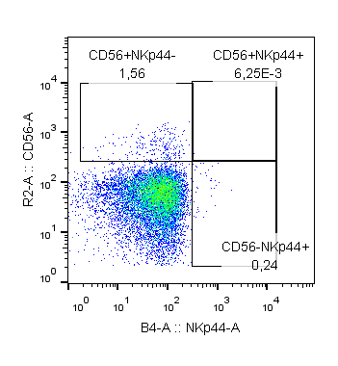
Supplementary figure 1. Gating strategy: FMOs and Stained samples
D
NK and T-NK like cells gating strategy from panel 1
FMOs
Stained Samples

Slide 5
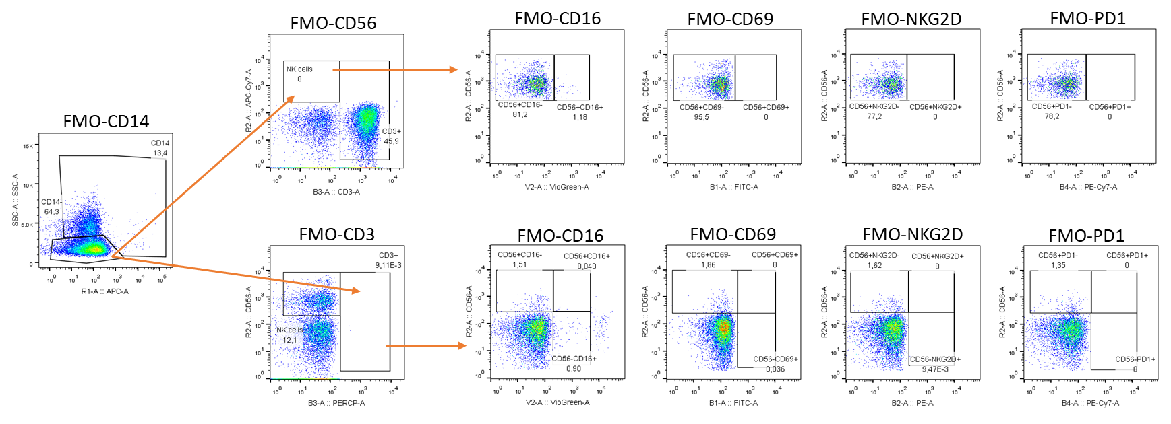
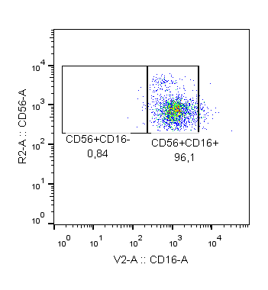
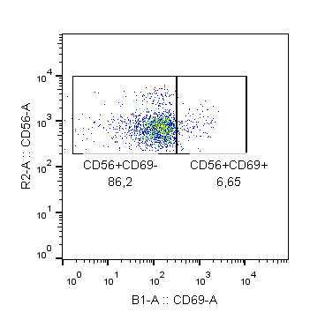
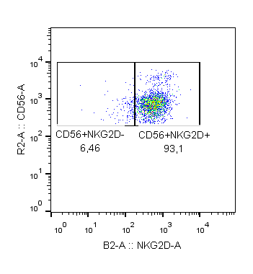

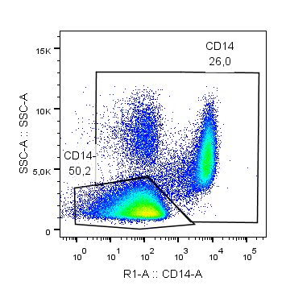
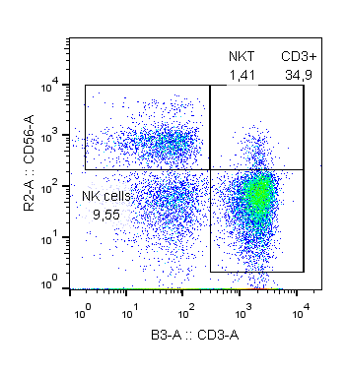
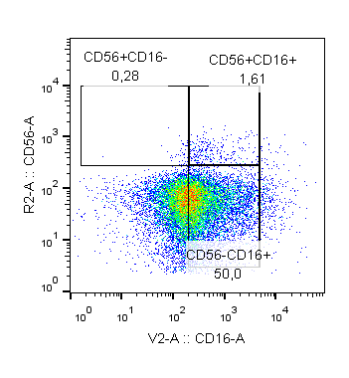
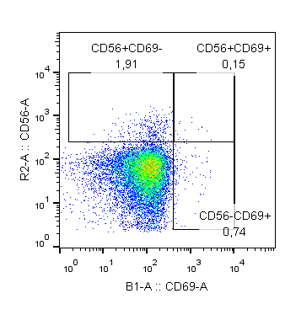
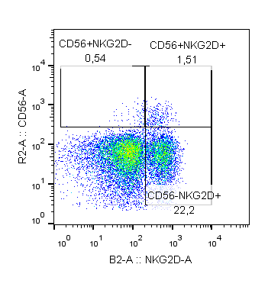

Supplementary figure 1. Gating strategy: FMOs and Stained samples
E
NK and T-NK like cells gating strategy from panel 2
FMOs
Stained Samples

Slide 6
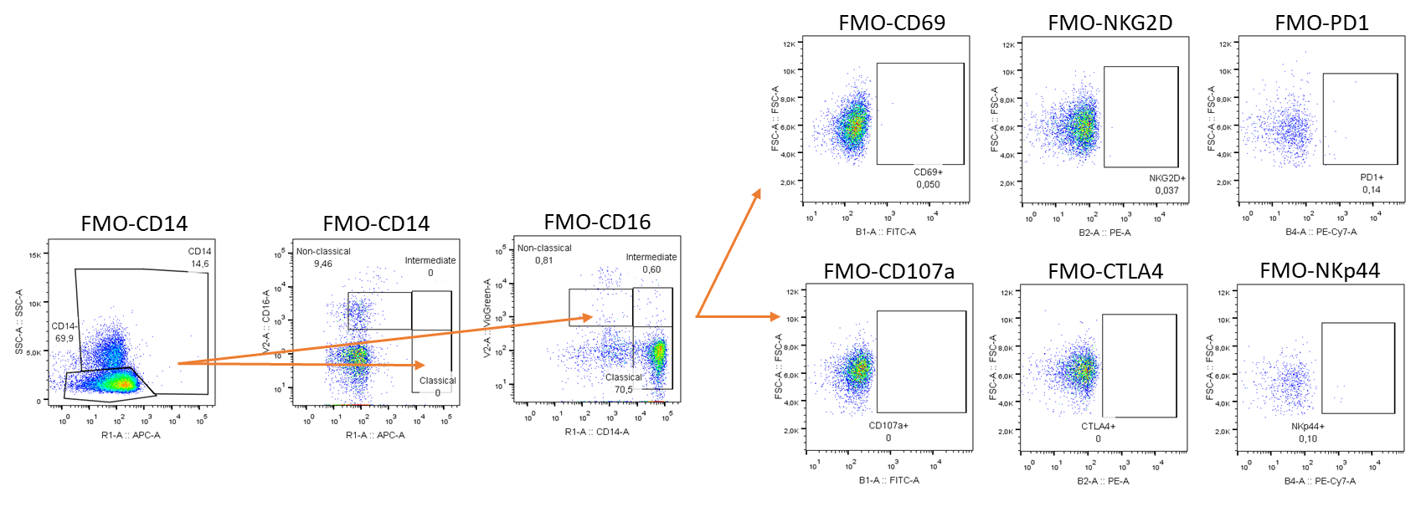
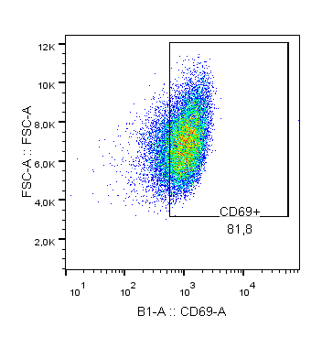
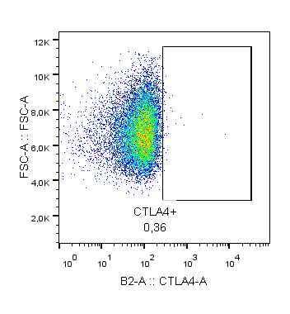
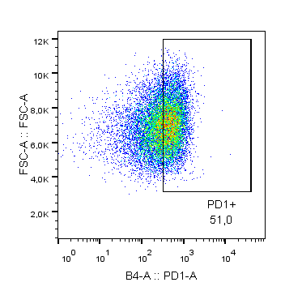
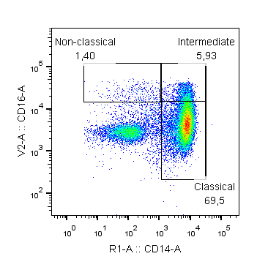
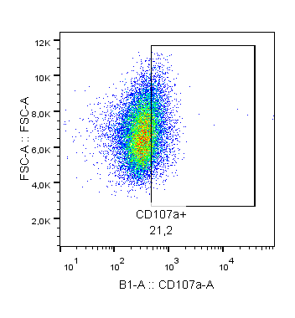
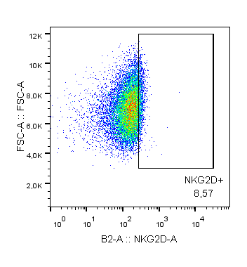
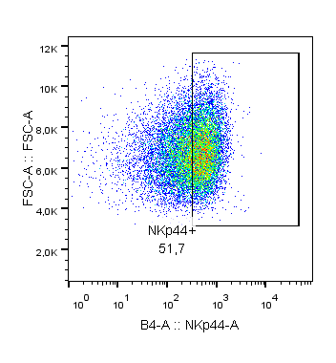
Supplementary figure 1. Gating strategy: FMOs and Stained samples
F
Monocytes gating strategy from panel 1 and 2
FMOs
Stained Samples

Slide 7
Supplementary figure 1. Flow cytometry gating strategy analysis, FMOs and stained samples. (A) Initial selection of lymphocytes, single cells and alive cells. (B) T and B cells gating strategy from panel 3 using FMOs controls for CD14, CD3, CD4, CD8, CD19, CD25 and CTLA-4 surface markers. (Left panel shows FMOs and right panel shows stained samples). (C) T cells gating strategy from panel 4 using FMOs controls for CD14, CD3, CD4, CD8, CD69, NKG2D and PD-1 surface markers. (Upper panel shows FMOs and lower panel shows stained samples). (D) NK and T-NK like cells gating strategy from panel 1 using FMOs controls for CD14, CD3, CD56, CD16, CD107a, CTLA-4 and NKp44 surface markers. (Upper panel shows FMOs and lower panel shows stained samples). (E) NK and T-NK like cells gating strategy from panel 2 using FMOs controls for CD14, CD3, CD56, CD16, CD69, NKG2D and PD-1 surface markers. (Upper panel shows FMOs and lower panel shows stained samples). (F) Monocytes gating strategy from panel 1 and 2 using FMOs controls for CD14, CD16, CD69, NKG2D, PD-1, CD107a, CTLA-4 and NKp44 surface markers. (Upper panel shows FMOs and lower panel shows stained samples).

Slide 8
Supplementary figure 2.
A
B
D
C
E
F

Slide 9
Supplementary figure 2. Peripheral blood immune cells biomarkers with trends. (A) Percentage of monocytes, CD4 T cells, CD8 T cells, B cells, NK cells and T-NK like cells. (B) MFI of PD-1 on T cells (CD3⁺CD56⁻PD-1⁺), CD4 T cells (CD3⁺CD4⁺PD-1⁺), CD8 T cells (CD3⁺CD8⁺PD-1⁺), T-NK like (CD3+CD56⁺PD-1⁺) cells and NK cells (CD3⁻CD56⁺PD-1⁺). (C) Percentage of NKG2D⁺ cells on T cells (CD3⁺CD56⁻NKG2D⁺), CD4 T cells (CD3⁺CD4⁺NKG2D⁺), CD8 T cells (CD3⁺CD8⁺NKG2D⁺), T-NK like (CD3+CD56⁺NKG2D⁺) cells and NK cells (CD3⁻CD56⁺NKG2D⁺). (D) Percentage of CD56⁺ cells on T-NK like (CD3⁺CD56⁺) cells and NK cells (CD3⁻CD56⁺). (E) Percentage of CD3⁺CD4⁺CD25^{hi}. (F) Percentage of CD3⁻CD19⁺ and CD3⁻CD19^{hi}. Legend: Diagnosis (PRE, grey dots), prior to surgery (POST, black dots), independently of pathological response (blue bar), CPR-patients (yellow bars) and non-CPR patients (purple bar). Non-parametric Mann-Whitney test was used for comparisons (ns, not-significant; *p-value <0.05; **p-value <0.01; ***p-value <0.001).

Slide 10
Supplementary figure 3. Correlations between cells and cytokines described as predictive biomarkers at diagnosis
PANEL 1. CORRELATIONS PRE TREATMENT BETWEEN CELLS AND CITOKINES
PANEL 2. ROC CURVES CITOKINES INDEPENDENTLY
A
B
F
C
D
E
G
H

Slide 11
Supplementary figure 3. Correlations between cells and cytokines described as predictive biomarkers at diagnosis at diagnosis. Panel 1 shows correlations at diagnosis. (A) Correlation between NT-3 and MFI NKG2D on T-NK like cells. (B) Correlation between NT-3 and MFI NKG2D on CD8 T cells. (C) Correlation between VEGF-D and MFI NKG2D on T-NK like cells. (D) Correlation between VEGF-D and MFI NKG2D on CD8 T cells. (E) Correlation between b-NGF and MFI CD56 on T-NK like cells. Panel 2 shows AUC ROC curves for predictive cytokines (F) AUC ROC curve of b-NGF. (G) AUC ROC curve of NT-3. (H) AUC ROC curve of VEGF-D. Spearman´s correlation showing R and p-value and Receiver Operating Characteristic (ROC) curve analysis showing AUC ROC curve, p-value and optimum cut-off.

Slide 12
Supplementary figure 4. Correlations between described cell biomarkers
PANEL 1. CORRELATIONS PRE TREATMENT BETWEEN CELLS
PANEL 2. CORRELATIONS POST TREATMENT BETWEEN CELLS
A
D
G
B
E
H
C
F
I

Slide 13
Supplementary figure 4. Correlations between described cell biomarkers. Panel 1 shows correlations at diagnosis. (A) MFI CD19 on B cells versus CD4⁺PD-1⁺ cells. (B) MFI CD19 on B cells versus MFI CD25 on CD4⁺CD25^{hi}. (C) MFI CD19 on B cells versus MFI CD56 on T-NK like cells. (D) MFI CD56 on T-NK like cells versus MFI CD25 on CD4⁺CD25^{hi}. (E) MFI NKG2D on T cells versus MFI CD56 on T-NK like cells. (F) MFI NKG2D on T cells versus MFI NKG2D on T-NK like cells. Panel 2 shows correlations after neoadjuvant treatment. (G) MFI CD19 on B cells versus MFI NKG2D on T cells. (H) MFI CD19 on B cells versus MFI NKG2D on T-NK like cells. (I) MFI NKG2D on T cells versus MFI NKG2D on T-NK like cells. Spearman´s correlation showing R and p-value.

Slide 14
Supplementary figure 5. Correlations between described cytokines biomarkers at diagnosis
CORRELATIONS PRE TREATMENT BETWEEN CITOQUINES
A
D
G
J
B
E
I
C
F
H

Slide 15
Supplementary figure 5. Correlations between described cytokines biomarkers at diagnosis. (A) NT-3 versus VEGF-D. (B) NT-3 versus Flt-3L. (C) NT-3 versus PARC. (D) NT-3 versus MPIF-1. (E) VEGF-D versus b-NGF. (F) VEGF-D versus Flt-3L. (G) VEGF-D versus PARC. (I) PARC versus Flt-3L. (H) PARC versus MPIF-1. (J) 4-1BB versus BCMA. Spearman´s correlation showing R and p-value.

Slide 16
Supplementary table 1
Supplementary table 2
Supplementary table 2. Hospitals and principal investigator
Hospital | Principal Investigator | Patient included (N=31)
H. Puerta de Hierro | M. Provencio | 5
H. ICO Bellvitge | E. Nadal | 5
C.H.U. A Coruña | R. García Campelo | 3
H. Fundación Jiménez Díaz | M. Dominé | 3
H. Gral de Alicante | B. Massuti | 3
H. Vall d'Hebrón | A. Martinez | 2
H. U. La Paz | J. de Castro | 2
H. Cínico U. de Valencia | A. Insa | 2
H. Clínic Barcelona | N. Viñolas | 1
C.H.U. de Vigo | G. Huidobro | 1
C.H.U. Insular G.C. | D. Rodriguez | 1
H. Reina Sofía | I. Barneto | 1
H. Sant Pau | M. Majem | 1
H. U. Salamanca | E. Del Barco | 1

Slide 17
Supplementary table 4. Effect of chemo-immunotherapy on immune cells
A
PERCENTAGE OF CELLS | P-VALUE TOTAL | P-VALUE CPR | P-VALUE non-CPR
Classical | 0,005 | 0,100 | 0,019
CD14++CD16-CTLA4+ | 0,033 | 0,712 | 0,023
CD14++CD16+CD107a+ | 0,004 | 0,004 | 0,388
CD14++CD16+CD69+ | 0,073 | 0,015 | 0,695
Non-classical | 0,000 | 0,012 | 0,011
CD14+CD16+CD69+ | 0,004 | 0,012 | 0,099
CD14+CD16+NKp44+ | 0,005 | 0,036 | 0,084
CD14+CD16+PD1+ | 0,007 | 0,048 | 0,084
CD3+CD56-CD16+ | 0,015 | 0,047 | 0,388
CD3+CD56-CD107a+ | 0,006 | 0,011 | 0,100
CD3+CD56-CTLA4+ | 0,013 | 0,307 | 0,028
CD3+CD56-NKp44+ | 0,011 | 0,023 | 0,136
CD3+CD56-PD1+ | 0,000 | 0,001 | 0,006
CD3+NKG2D+PD1+ | 0,000 | 0,002 | 0,008
CD3+NKG2D-PD1+ | 0,000 | 0,001 | 0,003
CD3+CD4+CD69+ | 0,008 | 0,029 | 0,308
CD3+CD4+NKG2D+PD1+ | 0,000 | 0,002 | 0,013
CD3+CD4+PD1+ | 0,000 | 0,001 | 0,003
CD3+CD4+PD1+NKG2D- | 0,000 | 0,001 | 0,004
CD3+CD4+CD8d | 0,032 | 0,139 | 0,327
CD3+CD8+NKG2D- | 0,017 | 0,017 | 0,347
CD3+CD8+NKG2D+ | 0,020 | 0,015 | 0,480
CD3+CD8+PD1- | 0,043 | 0,036 | 0,695
CD3+CD8+PD1+ | 0,000 | 0,001 | 0,008
CD3+CD8+NKG2D+PD1+ | 0,000 | 0,001 | 0,010
CD3+CD8+PD1+NKG2D- | 0,000 | 0,003 | 0,008
CD3+CD56+CD16- | 0,023 | 0,041 | 0,666
CD3+CD56+NKG2D- | 0,031 | 0,035 | 0,530
CD3+CD56+PD1+ | 0,000 | 0,001 | 0,050
CD3-CD56+CD107a+ | 0,001 | 0,017 | 0,034
CD3-CD56+CTLA4+ | 0,041 | 0,191 | 0,071
CD3-CD56+NKp44+ | 0,043 | 0,048 | 0,530
CD3-CD56+PD1+ | 0,012 | 0,006 | 0,530
CD3-CD56+NKG2D+PD1+ | 0,080 | 0,026 | 0,875
CD3-CD56+NKG2D-PD1+ | 0,020 | 0,029 | 0,388
B
EXPRESION OF IMMUNE MARKER (MFI) | P-VALUE TOTAL | P-VALUE CPR | P-VALUE non-CPR
CD14++CD16-CTLA4+_MFICTLA4+ | 0,041 | 0,379 | 0,021
CD14++CD16-NKp44+_MFINKp44+ | 0,092 | 0,394 | 0,045
CD14++CD16+CD69+_MFICD69+ | 0,041 | 0,088 | 0,308
CD14++CD16+NKp44+_MFINKp44+ | 0,006 | 0,140 | 0,019
CD14++CD16+PD1+_MFIPD1+ | 0,009 | 0,020 | 0,136
CD3+CD56-CD16+_MFICD16+ | 0,011 | 0,125 | 0,060
CD3+CD56-CD69+_MFICD69+ | 0,141 | 0,820 | 0,045
CD3+CD56-PD1+_MFIPD1+ | 0,001 | 0,005 | 0,091
CD3+NKG2D+PD1+_MFIPD1+ | 0,010 | 0,020 | 0,347
CD3+NKG2D-PD1+_MFIPD1+ | 0,008 | 0,021 | 0,272
CD3+CD4+PD1+_MFIPD1+ | 0,003 | 0,015 | 0,099
CD3+CD4+PD1+NKG2D-_MFIPD1+ | 0,011 | 0,015 | 0,530
CD3+CD4+Treg_MFICD25+ | 0,031 | 0,427 | 0,031
CD3+CD8+_MFICD8+ | 0,000 | 0,041 | 0,006
CD3+CD8+CD69+_MFICD69+ | 0,002 | 0,069 | 0,023
CD3+CD8+CD69-_MFICD8+ | 0,001 | 0,056 | 0,006
CD3+CD8+NKG2D-_MFICD8+ | 0,002 | 0,061 | 0,071
CD3+CD8+NKG2D+_MFICD8+ | 0,000 | 0,036 | 0,006
CD3+CD8+PD1-_MFICD8+ | 0,000 | 0,041 | 0,005
CD3+CD8+PD1+_MFICD8+ | 0,000 | 0,001 | 0,005
CD3+CD8+PD1+_MFIPD1+ | 0,112 | 0,022 | 0,878
CD3+CD8+NKG2D+PD1+_MFIPD1+ | 0,122 | 0,030 | 0,953
CD3+CD56+_MFICD56 | 0,056 | 0,637 | 0,019
CD3+CD56+CD16+_MFICD16+ | 0,044 | 0,112 | 0,388
CD3+CD56+CD16+_MFICD56+ | 0,068 | 0,570 | 0,023
CD3+CD56+CD69-_MFICD56+ | 0,039 | 0,551 | 0,011
CD3+CD56+CD69+_MFICD69+ | 0,021 | 0,140 | 0,209
CD3+CD56+NKG2D+_MFICD56+ | 0,028 | 0,443 | 0,010
CD3+CD56+NKp44+_MFICD56+ | 0,030 | 0,209 | 0,241
CD3+CD56+PD1-_MFICD56+ | 0,044 | 0,496 | 0,023
CD3+CD56+PD1+_MFICD56+ | 0,048 | 0,397 | 0,147
CD3-CD56+_MFICD56+ | 0,002 | 0,031 | 0,071
CD3-CD56+PD1+_MFIPD1+ | 0,001 | 0,012 | 0,092
CD3-CD56+NKG2D+PD1+_MFIPD1+ | 0,016 | 0,047 | 0,423
CD3-CD56+NKG2D-PD1+_MFIPD1+ | 0,016 | 0,133 | 0,173

Slide 18
Supplementary table 5. Effect of chemo-immunotherapy on plasma factors
A
CYTOKINE | P-VALUE TOTAL | P-VALUE CPR | P-VALUER non-CPR
ANG | 0,052 | 0,027 | 0,695
ANG-1 | 0,000 | 0,053 | 0,002
Angiostatin | 0,020 | 0,041 | 0,480
BDNF | 0,000 | 0,017 | 0,002
BMP-4 | 0,039 | 0,191 | 0,182
BMP-5 | 0,171 | 0,955 | 0,050
b-NGF | 0,011 | 0,112 | 0,084
BTC | 0,008 | 0,233 | 0,028
CD40L | 0,018 | 0,363 | 0,041
CTACK | 0,023 | 0,031 | 0,272
DR6 | 0,000 | 0,027 | 0,015
EGF | 0,001 | 0,053 | 0,010
EGF R | 0,030 | 0,140 | 0,028
ENA-78 | 0,022 | 0,069 | 0,308
Eotaxin | 0,043 | 0,173 | 0,084
Fas | 0,007 | 0,069 | 0,158
Fcr RIIB/C | 0,593 | 0,045 | 0,213
Flt-3L | 0,000 | 0,005 | 0,012
Follistatin | 0,049 | 0,281 | 0,117
GDF-15 | 0,000 | 0,009 | 0,008
GM-CSF | 0,000 | 0,036 | 0,002
GRO | 0,028 | 0,036 | 0,638
HCC-1 | 0,004 | 0,001 | 0,239
HGF | 0,022 | 0,156 | 0,182
IFNg | 0,000 | 0,053 | 0,002
IGFBP-4 | 0,329 | 0,156 | 0,023
IL-10 | 0,000 | 0,031 | 0,003
IL-11 | 0,000 | 0,031 | 0,002
IL-12p40 | 0,017 | 0,069 | 0,239
IL-12p70 | 0,000 | 0,021 | 0,006
IL-13 | 0,000 | 0,140 | 0,002
IL-15 | 0,125 | 0,570 | 0,034
IL-16 | 0,116 | 0,532 | 0,008
IL-17 | 0,001 | 0,112 | 0,005
IL-17B | 0,001 | 0,069 | 0,023
IL-17R | 0,041 | 0,078 | 0,209
IL-1a | 0,006 | 0,363 | 0,023
IL-1ra | 0,005 | 0,394 | 0,004
IL-2 | 0,000 | 0,061 | 0,002
IL-29 | 0,058 | 0,776 | 0,041
IL-5 | 0,000 | 0,069 | 0,002
IL-6 | 0,000 | 0,078 | 0,002
IL-6sR | 0,028 | 0,233 | 0,084
B
CYTOKINE | P-VALUE TOTAL | P-VALUE CPR | P-VALUE non-CPR
IL-7 | 0,000 | 0,078 | 0,002
IL-8 | 0,005 | 0,363 | 0,012
IL-9 | 0,000 | 0,031 | 0,008
Insulin | 0,001 | 0,027 | 0,041
IP-10 | 0,023 | 0,211 | 0,182
LAP | 0,007 | 0,140 | 0,028
L-Selectin | 0,043 | 0,100 | 0,530
MCP-1 | 0,015 | 0,532 | 0,008
MCP-3 | 0,018 | 0,394 | 0,050
MCSF R | 0,002 | 0,061 | 0,028
MICA | 0,405 | 0,041 | 0,347
MIF | 0,000 | 0,023 | 0,006
MIG | 0,000 | 0,078 | 0,002
MIP-1d | 0,003 | 0,140 | 0,002
MIP-3a | 0,038 | 0,244 | 0,136
MIP-3b | 0,049 | 0,307 | 0,158
MSPa | 0,002 | 0,078 | 0,015
NGF R | 0,030 | 0,532 | 0,041
NT-3 | 0,028 | 0,496 | 0,041
PAI-I | 0,009 | 0,363 | 0,006
PDGF-AA | 0,000 | 0,011 | 0,002
PDGF-AB | 0,000 | 0,005 | 0,002
PDGF-BB | 0,000 | 0,027 | 0,003
PECAM-1 | 0,017 | 0,211 | 0,099
PF4 | 0,000 | 0,078 | 0,004
PIGF | 0,019 | 0,191 | 0,182
RAGE | 0,003 | 0,041 | 0,117
SCF R | 0,000 | 0,001 | 0,002
TARC | 0,116 | 0,020 | 0,875
TGFb | 0,066 | 0,865 | 0,041
TIM-1 | 0,045 | 0,020 | 0,530
TIMP-1 | 0,006 | 0,256 | 0,023
TIMP-2 | 0,001 | 0,003 | 0,136
TNF RI | 0,001 | 0,078 | 0,005
TNF RII | 0,002 | 0,173 | 0,004
TNFa | 0,000 | 0,088 | 0,002
TNFb | 0,000 | 0,061 | 0,002
TRAIL R3 | 0,004 | 0,125 | 0,034
TRAIL-R4 | 0,339 | 0,041 | 0,814
VCAM-1 | 0,045 | 0,112 | 0,433
VEGF R3 | 0,033 | 0,233 | 0,239
VEGF | 0,003 | 0,069 | 0,071
C
SOLUBLE FACTOR | P-VALUE TOTAL | P-VALUE CPR | P-VALUE non-CPR
BTLA | 0,004 | 0,281 | 0,006
CD28 | 0,004 | 0,363 | 0,002
CD80/B7-1 | 0,012 | 0,691 | 0,006
CD86/B7-2 | 0,023 | 0,691 | 0,019
CTLA-4 | 0,010 | 0,478 | 0,008
GITR | 0,008 | 0,570 | 0,004
GITRL | 0,014 | 0,394 | 0,028
HVEM | 0,141 | 0,233 | 0,050
ICOS | 0,022 | 0,532 | 0,034
LAG-3 | 0,001 | 0,125 | 0,003
PD-L1 | 0,010 | 0,460 | 0,017
TIM-3 | 0,001 | 0,100 | 0,002
TLR-2 | 0,003 | 0,281 | 0,006

Slide 19
Supplementary Table 1. Characteristics of patients with blood sample at diagnosis and surgery.
Supplementary Table 2: Hospitals and principal investigator with the number of patients recruited into the study.
Supplementary Table 3. Raw data generated from this study. xsl file containing all raw data associated to flow cytometry and cytokine analysis.
Supplementary Table 4. Effect of chemo-immunotherapy on immune cells. P-values for percentage of immune cells (A) and median fluorescence intensity (B) in peripheral blood, affected by neoadjuvant treatment. Significant p-values are identified by bold and red font.
Supplementary Table 5. Effect of chemo-immunotherapy on plasma factors. P-values for cytokines (A-B) and soluble factors (B) in plasma, affected by neoadjuvant treatment. Significant p-values are identified by bold and red font.

