Slide 1
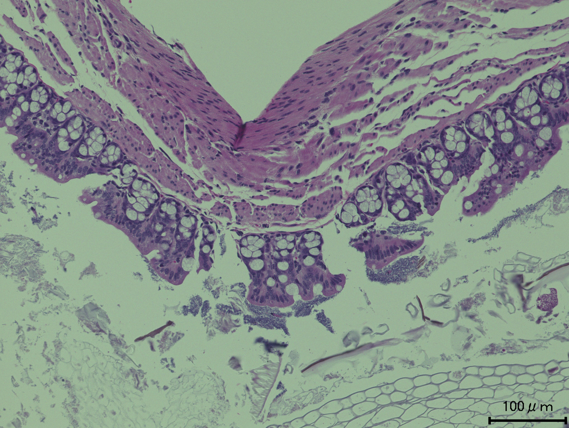
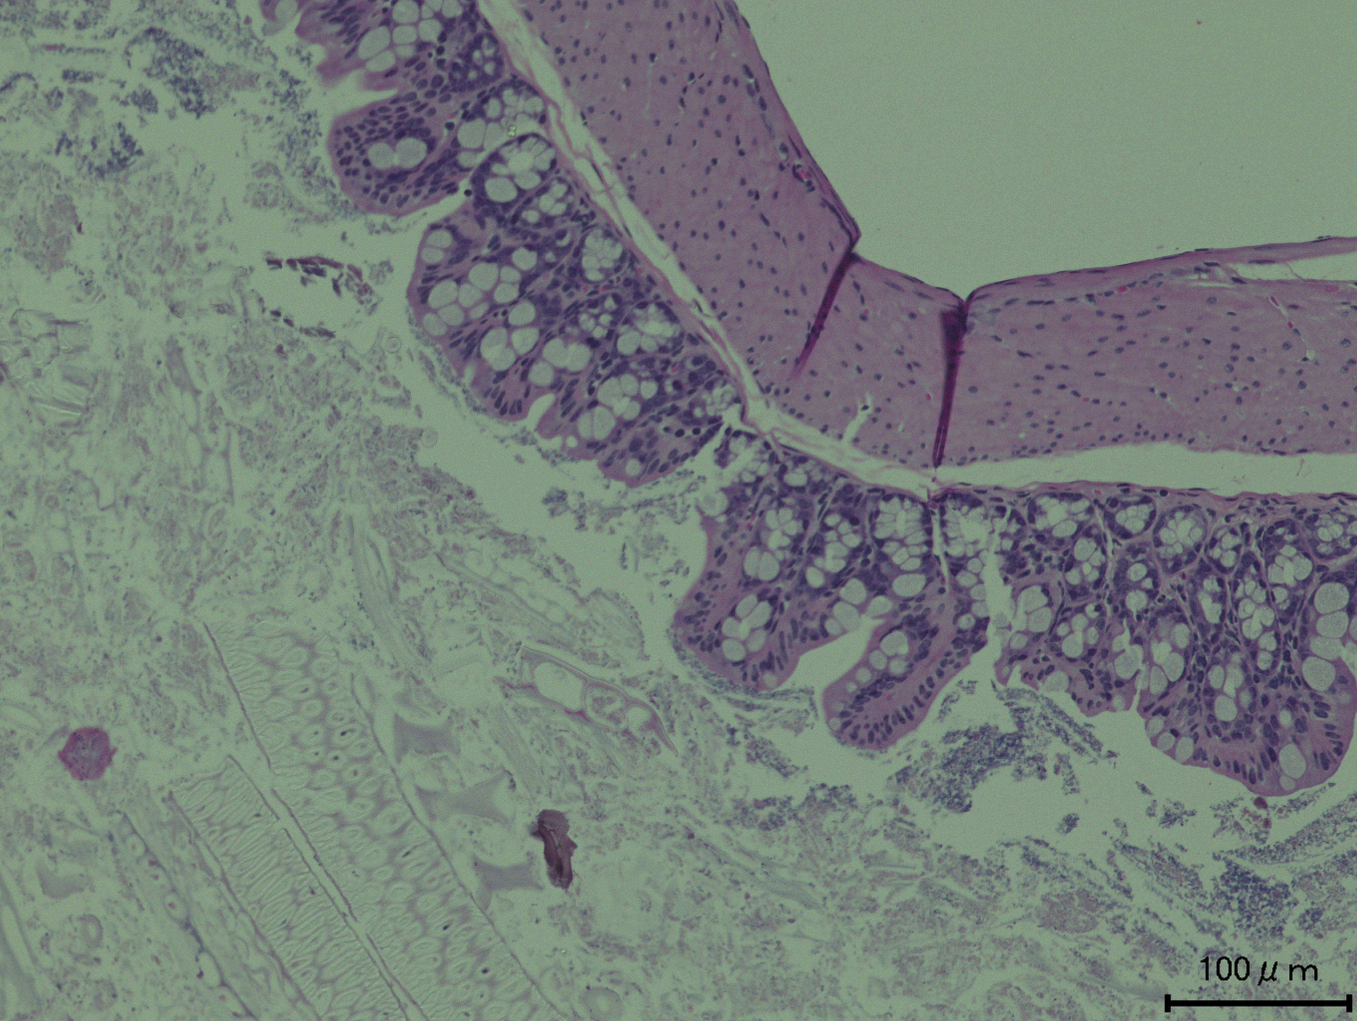
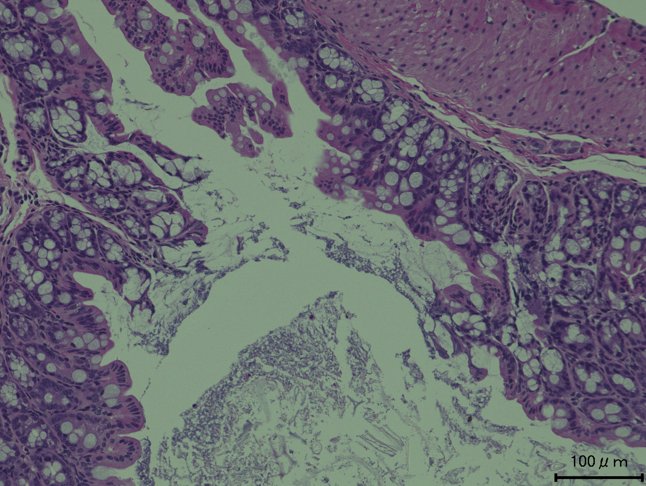
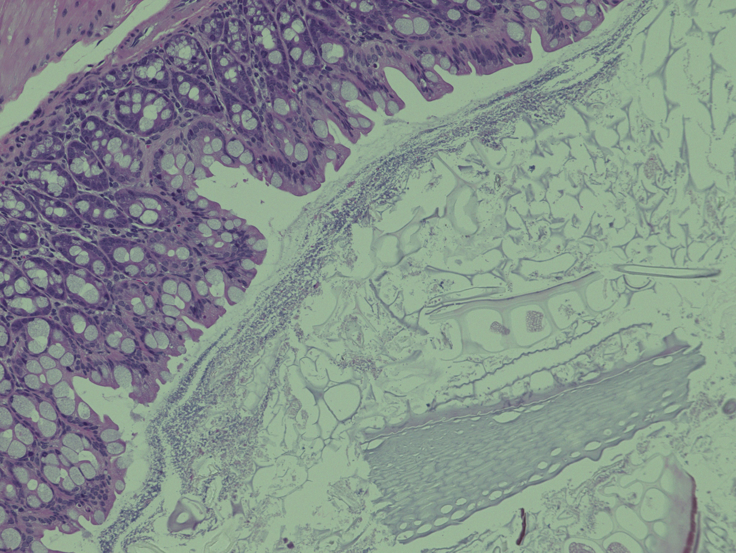
Figure S-1
A
Control
CBM 588
*
Fidaxo
Combination
*
*
*
*
*
*
*
*
*
*
*
*
*
*
*
*
*
*
*
*
pg/ml
Supporting Information 1. (A) Hematoxylin and eosin (H&E) staining of colons at day 8 (magnification, 20×and the scale bar represents 100mm). Histopathology scoring of H&E-stained colon sections in each group mice. Black arrow represents the parts we admitted epithelial damages. All values are mean±SD (n = 5).
(B) IL-4, IL-6, TGF-β1 and IL-10 protein concentration in mice colon tissue detected at day 8 by ELISA. All values are mean ± SD (n = 5 - 10). Statistical analysis of the quantitative multiple group comparisons was performed using a one-way analysis of variance followed by Tukey’s test, *p < 0.05.

Slide 2
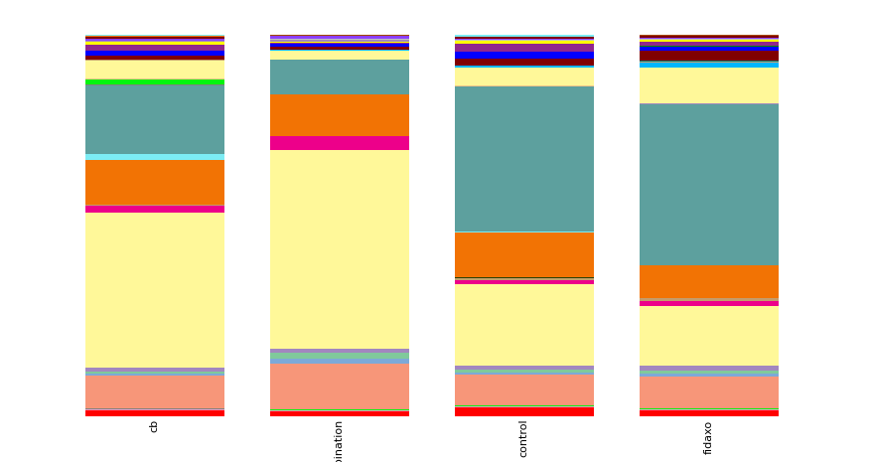
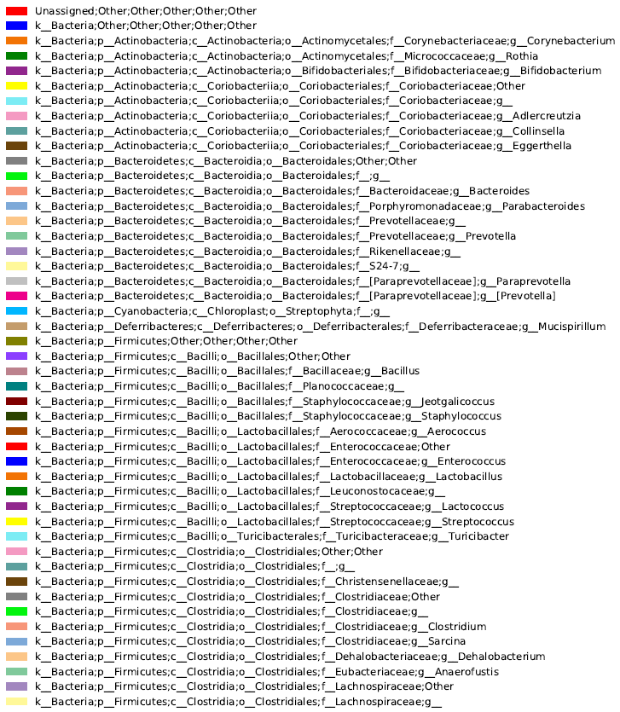
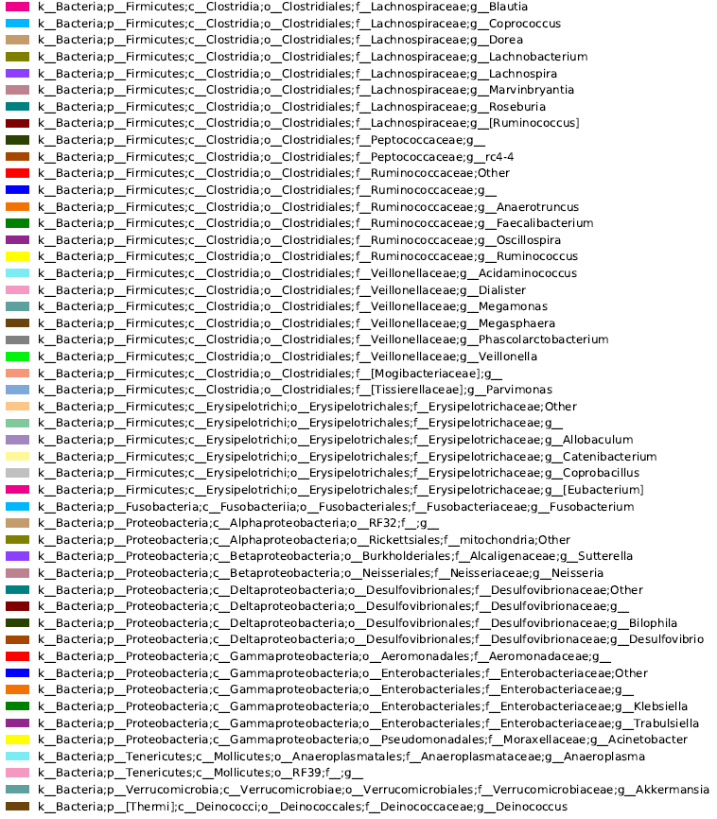
Figure S-2
A
CBM 588
Combination
Control
Fidaxo
Supporting Information 2. Bacterial compositions in different experimental groups at the species level.

Slide 3
Figure S-3
A
B
*
*
*
*
Supporting Information 3. (A) Weight changes of control (○) and succinate administration (●) groups for mice over the duration of the study (5 days), data shown as mean (n = 5 per group). (B) IL-6, IL-10, IL-4, and TGF-β₁ protein concentration in mice colon tissue detected at day 5. All values are mean ± SD (n = 5 - 10). *p < 0.05.
Figure S-4
Supporting Information 4. IL-4 and IL-10 protein concentration in mice colon tissue detected at day 8. All values are mean ± SD (n = 5 - 10). *p < 0.05.
*
*
pg/ml

Slide 4

Figure S-5
A
B
*
*
*
pg/ml
Supporting Information 5. (A) Weight changes of comobination (○) and comobination + Anti-IL-17A antibody administration (●) groups for mice over the duration of the study (10 days), data shown as mean (n = 5 per group). (B) IL-6, IL-10, IL-4, and TGF-β₁ protein concentration in mice colon tissue detected at day 5. All values are mean ± SD (n = 5 - 10). *p < 0.05.

