Slide 1
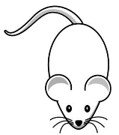

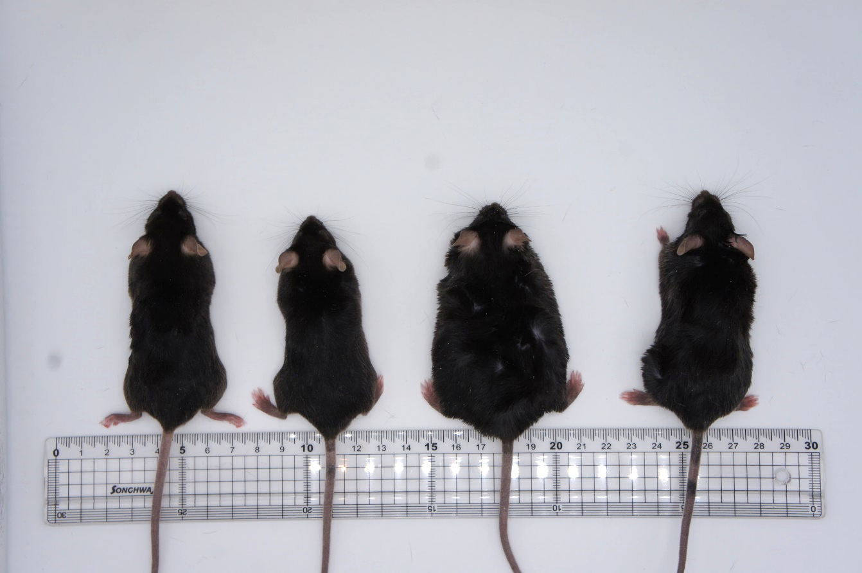
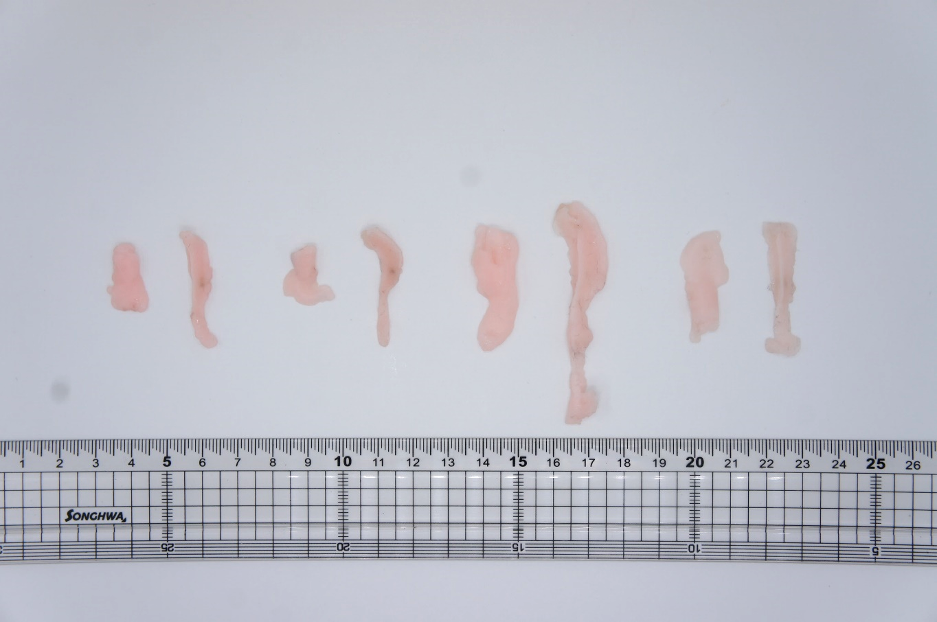
(A)
Group : Normal diet (ND), ND + PLA2, High fat diet (HFD), HFD + PLA2
PBS or bvPLA2 (0.5mg/kg) every 3 days i.p
10% kcal ND
Sacrifice
0-4 weeks
5
ND
15 (weeks)
PBS or bvPLA2 (0.5mg/kg) every 3 days i.p
60% kcal HFD
Sacrifice
5
HFD
15 (weeks)
(B)
(C)
(D)
ND
ND+PLA2
HFD
HFD+PLA2
(E)
(F)
ND
ND+PLA2
HFD
HFD+PLA2
eWAT
iWAT
eWAT
iWAT

Slide 3
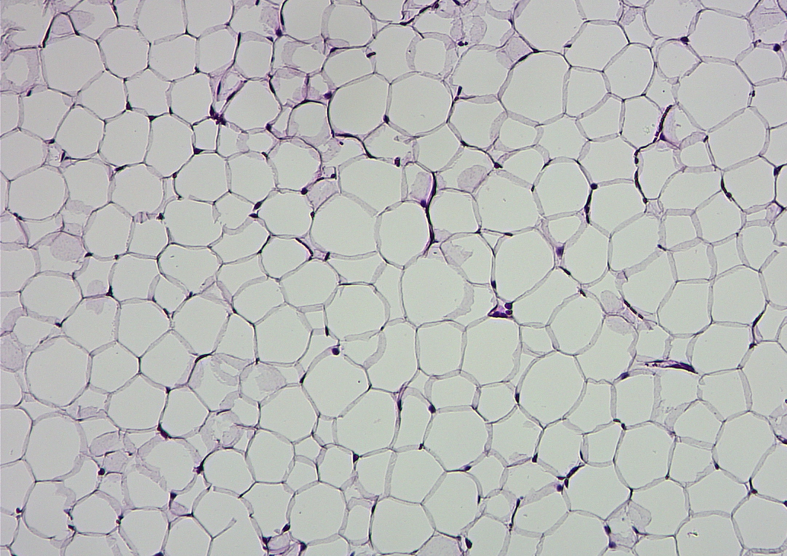
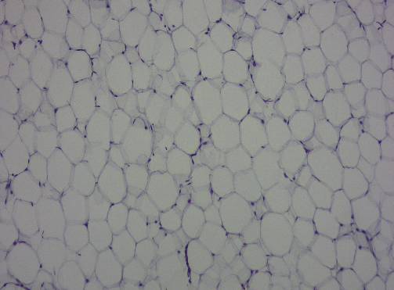
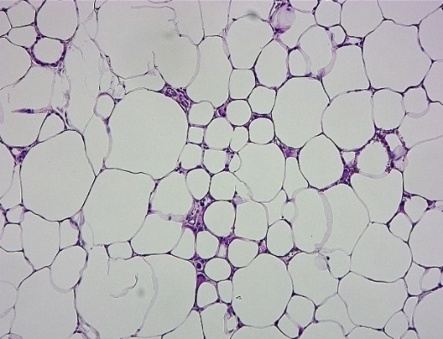
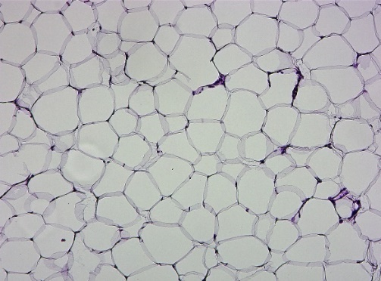
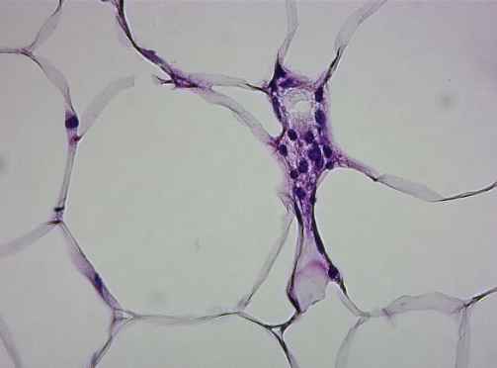
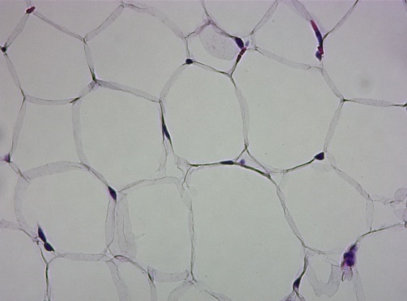
(A)
(B)
(C)
TNF-α
IL-1β
IL-12a
10x
ND
ND+PLA2
(D)
IL-4
CD206
Ym1
10x
40x
HFD
HFD+PLA2
(E)
PPAR r
C/EBP α
UCP-1

Slide 4
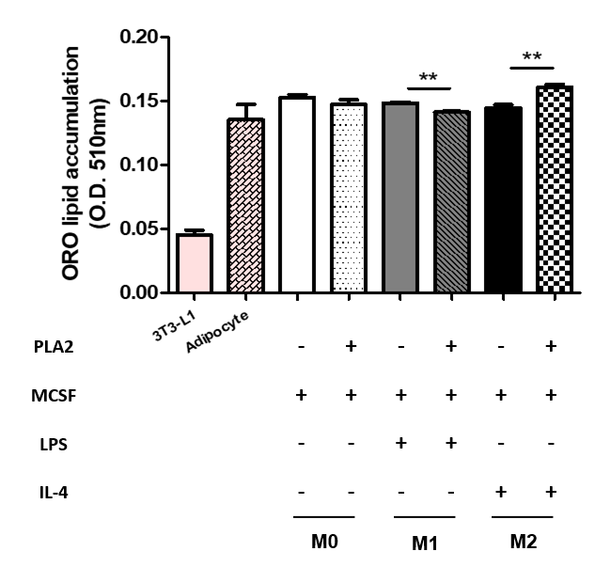
(A)
TNF-α
IL-12a
Ym1
CD206
PLA₂
PLA₂
PLA₂
0
0.1
1
10
0
0.1
1
10
0
0.1
1
0
10
0.1
1
10
0
0.1
1
10
0
0.1
1
10
0
0.1
1
10
0
0.1
1
10
0
0.1
1
10
PLA₂
0
0.1
1
10
0
0.1
1
10
0
0.1
1
MCSF
10
MCSF
+
+
+
+
+
+
+
+
+
+
+
+
MCSF
+
+
+
+
+
+
+
+
+
+
+
+
+
+
+
+
+
+
+
+
+
+
+
+
MCSF
LPS
-
-
-
-
+
+
+
+
-
-
-
-
LPS
-
-
-
-
+
+
+
+
-
-
-
-
LPS
-
-
-
-
+
+
+
+
-
-
-
-
LPS
+
+
+
+
+
+
+
+
+
+
+
+
IL-4
-
-
-
-
-
-
-
-
+
+
+
+
IL-4
-
-
-
-
-
-
-
-
+
+
+
+
IL-4
-
-
-
-
-
-
-
-
+
+
+
+
IL-4
-
-
-
-
+
+
+
+
-
-
-
-
M0
M1
M2
M0
M1
M2
M0
M1
M2
-
-
-
-
-
-
-
-
+
+
+
+
M0
M1
M2
(B)
3T3-L1 Preadipocyte
MDI media
(IBMX, DEX, Insulin)
+ PBS / bvPLA2
Differentiated
Adipocyte
Confluent
0
1
2
3
4 (days)
Media change
Media change
Oil red O staining
(C)
(D)

Slide 5
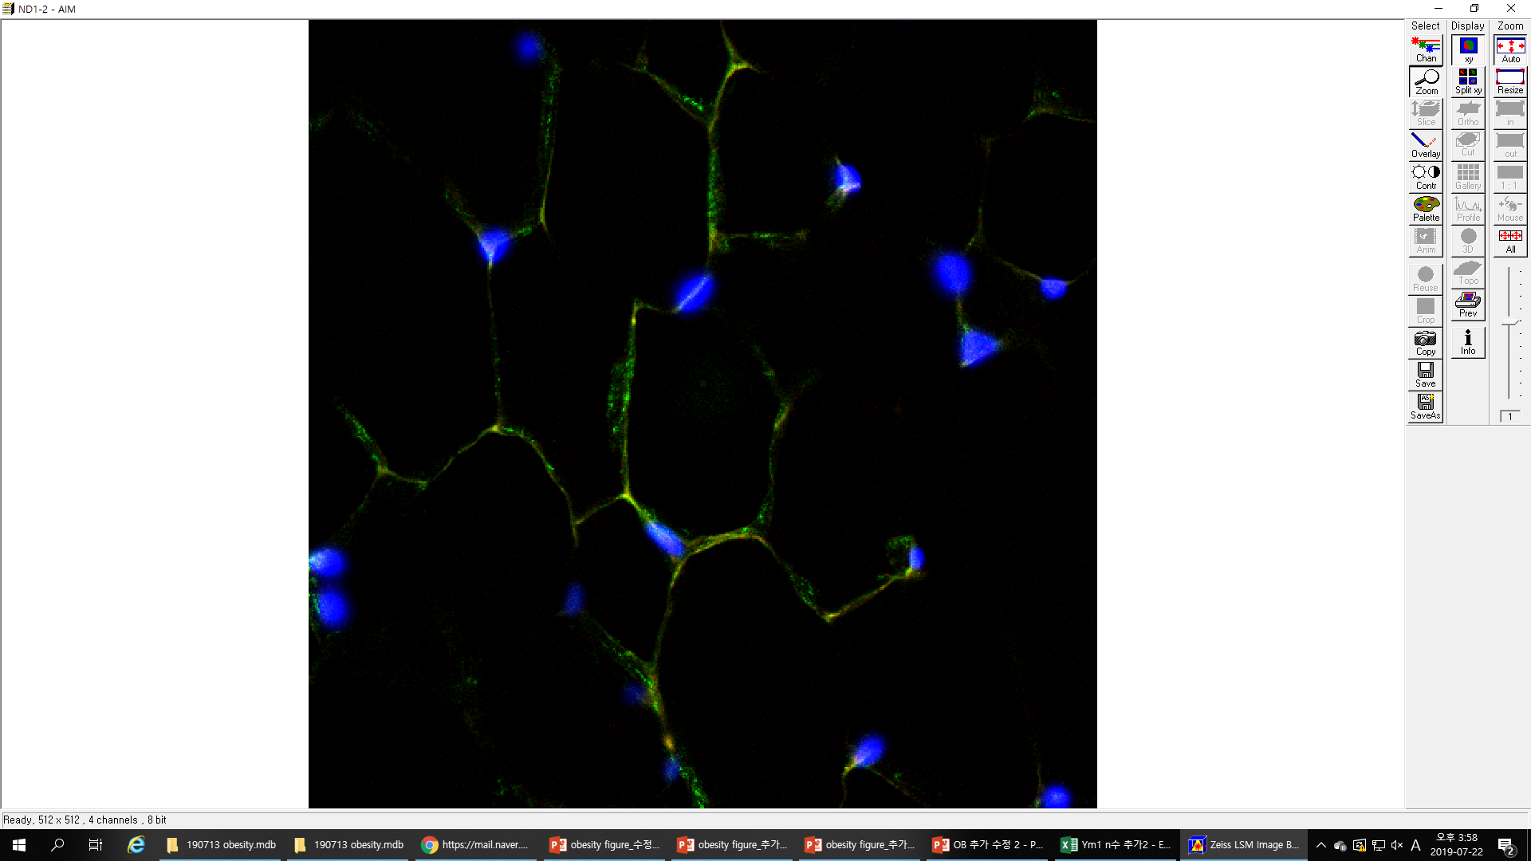
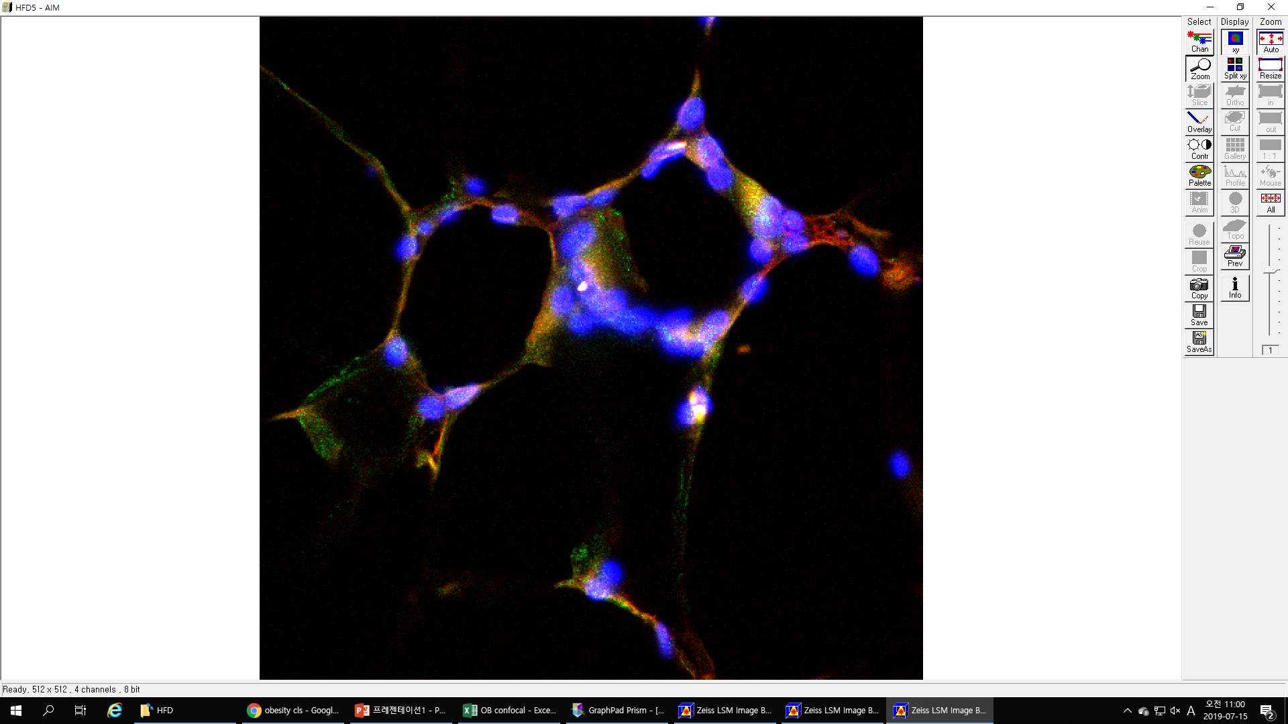
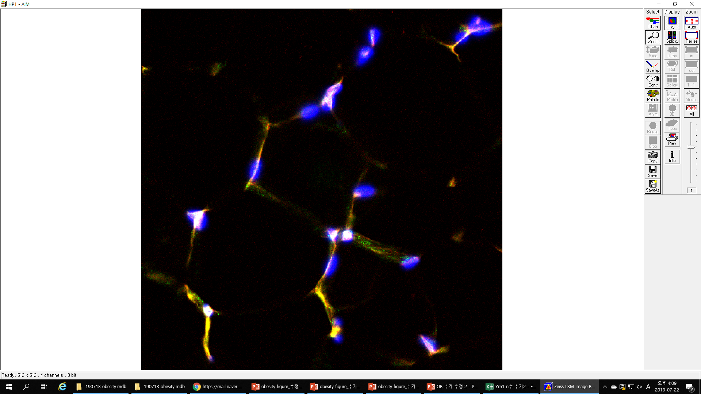
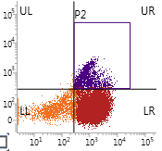
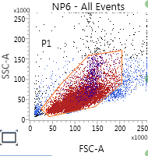
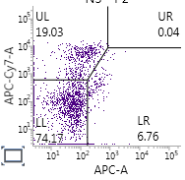
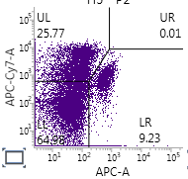
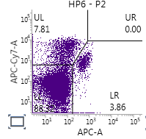
(A)
(B)
ND
HFD
HFD+PLA2
CD11c/CD163/DAPI
50μm
(C)
(D)
CD11b+ CD45+
macrophage
SSC-A
CD11b
FSC-A
CD45
ND
HFD
HFD+PLA2
M1
M1
M1
CD11C
M2
M2
M2
CD206

Slide 6
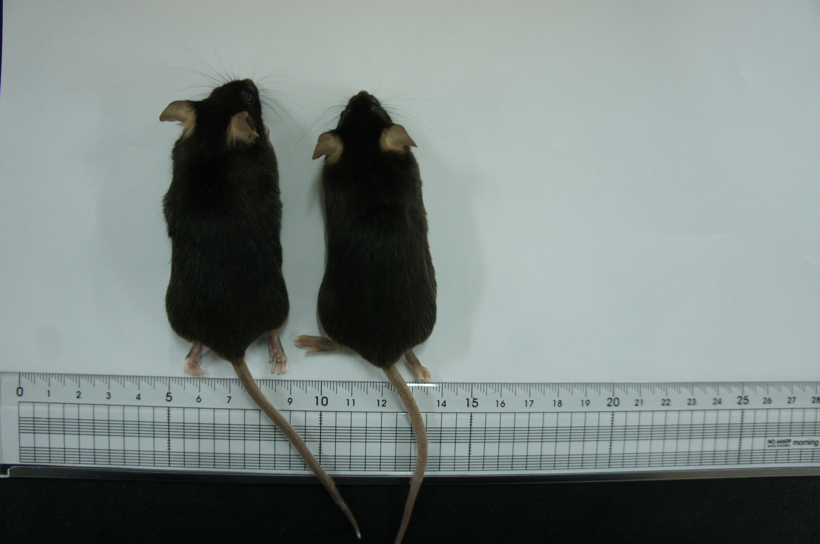
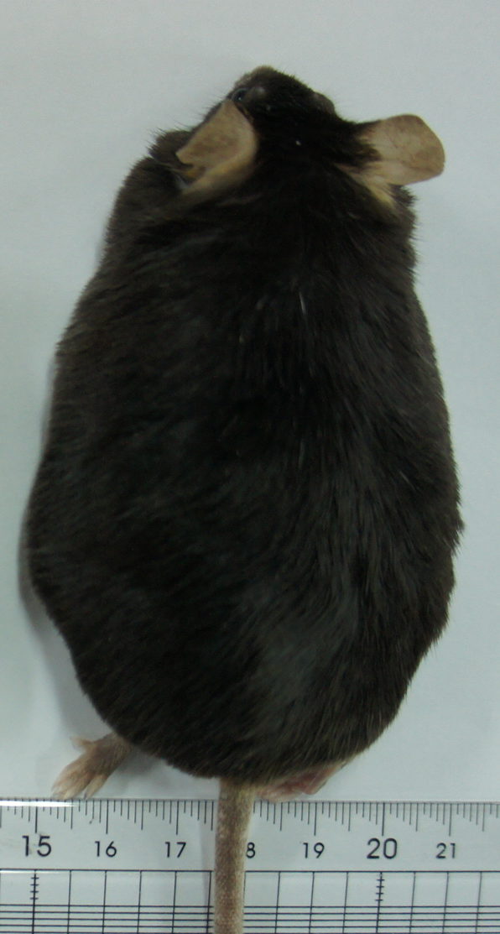
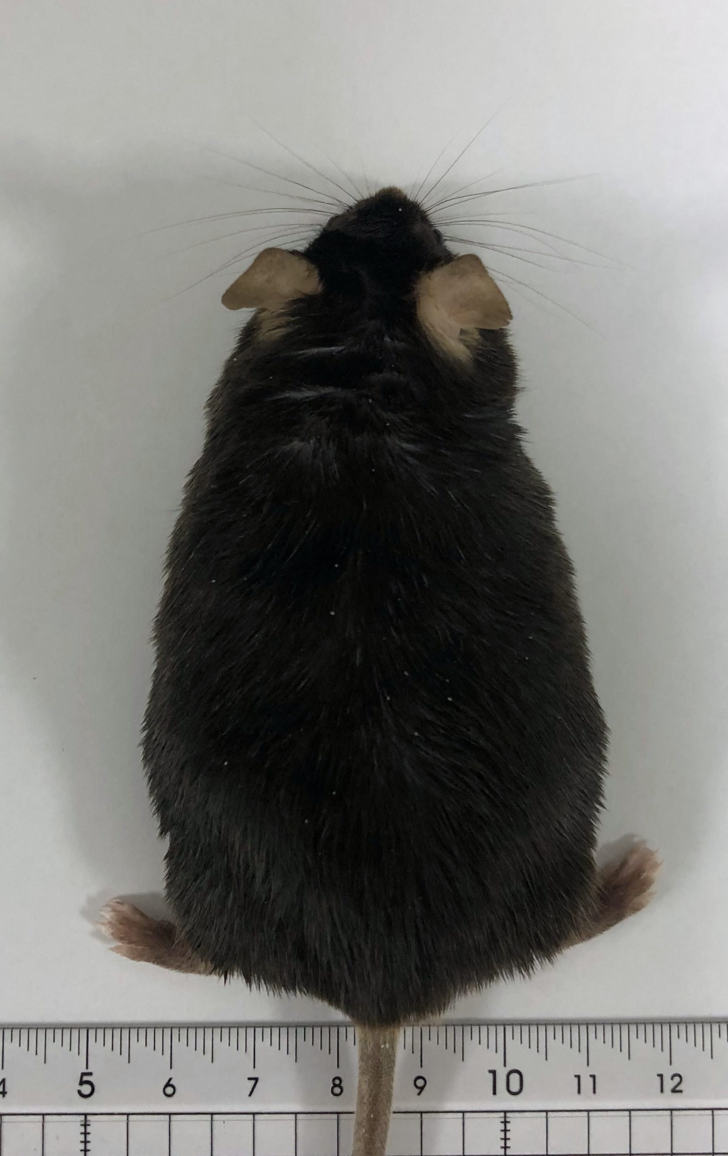
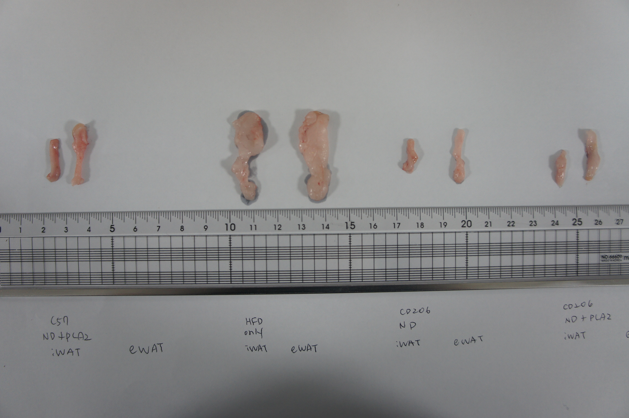
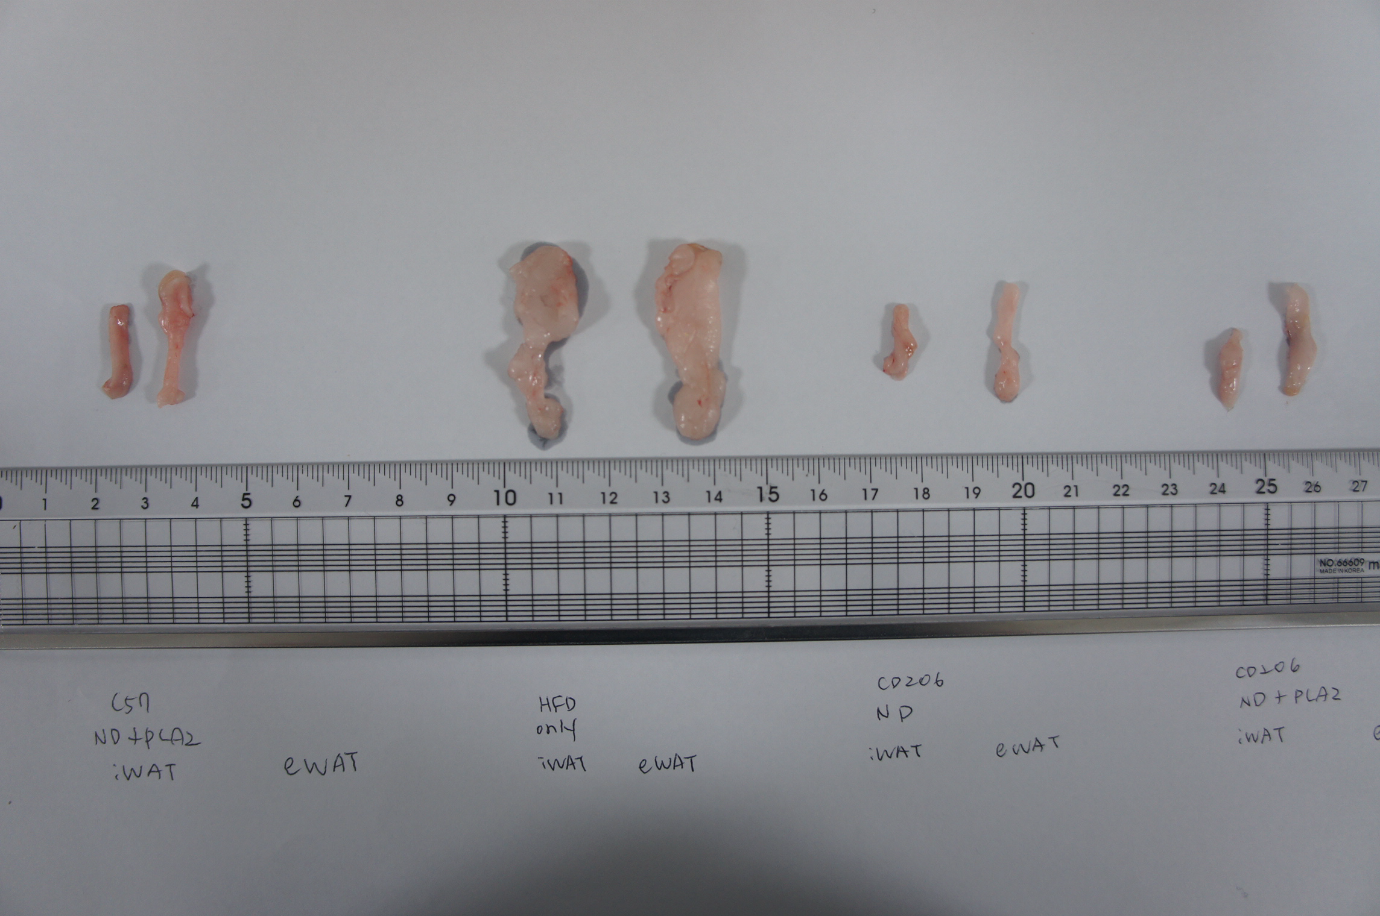
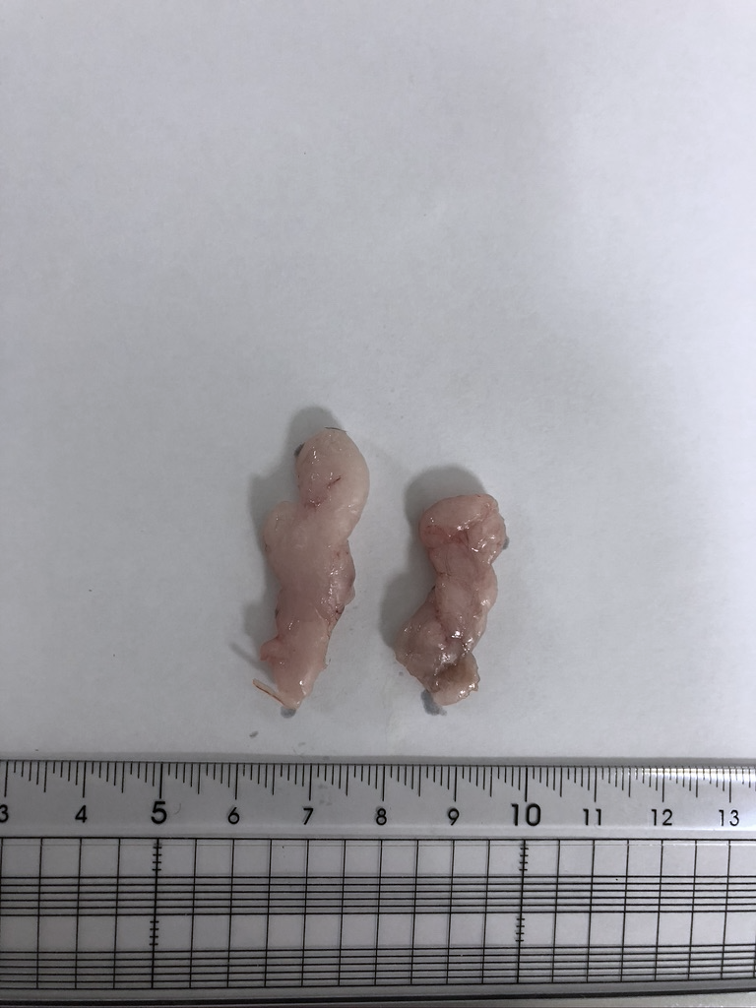
(A)
(B)
ND
ND+PLA2
HFD
HFD+PLA2
(C)
(D)
eWAT
iWAT
ND
ND+PLA2
HFD
HFD+PLA2
eWAT
iWAT
(E)
TNF-α
IL-12a
Ym1
CD206
PLA₂
0
0.1
1
10
0
PLA₂
PLA₂
0.1
1
10
0
0.1
1
10
0
0.1
1
10
0
0.1
1
10
0
0.1
1
0
0.1
1
10
0
0.1
1
10
0
0.1
1
10
10
PLA₂
0
0.1
1
10
0
0.1
1
10
0
0.1
1
MCSF
+
+
+
+
+
+
+
+
+
+
+
+
MCSF
10
MCSF
+
+
+
+
+
+
+
+
+
+
+
+
+
+
+
+
+
+
+
+
+
+
+
+
MCSF
LPS
-
-
-
-
+
+
+
+
-
-
-
-
LPS
-
-
-
-
+
+
+
+
-
-
-
-
LPS
+
+
+
+
+
+
+
+
+
+
+
+
IL-4
-
-
-
-
-
-
-
-
+
+
+
+
LPS
-
-
-
-
+
+
+
+
-
-
-
-
IL-4
-
-
-
-
-
-
-
-
+
+
+
+
IL-4
-
-
-
-
+
+
+
+
-
-
-
-
M0
M1
M2
IL-4
-
-
-
-
-
-
-
-
+
+
+
+
-
-
-
-
-
-
-
-
+
+
+
+
M0
M1
M2
M0
M1
M2
M0
M1
M2

Slide 7
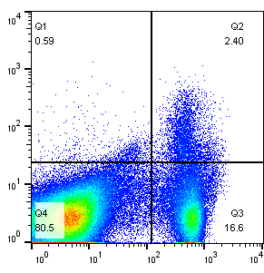
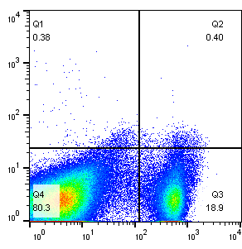
(A)
(B)
Untreated
PC61
CD25
CD4
Supplementary Figure 1

