Slide 1

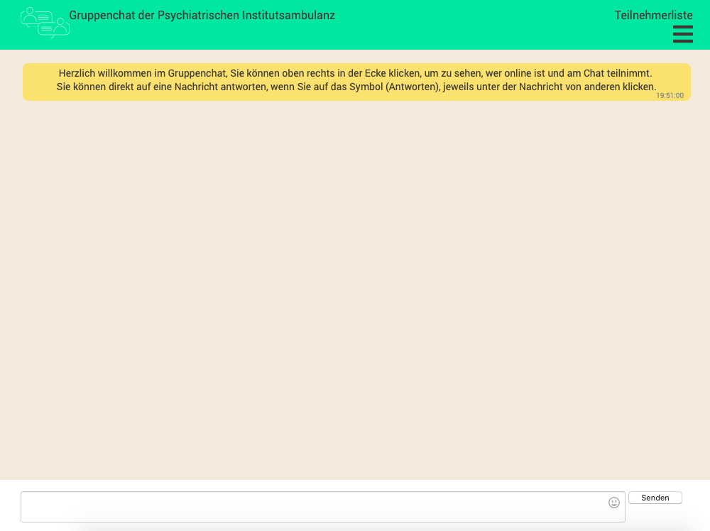
Figure 1 Homepage of group chat website
Figure 2 Chat interface

