Slide 1
Progressive valvular calcifications with critical aortic stenosis in a 25 year old woman with end stage renal disease on hemodialysis – A case report.
(EHJ-CR-D-20-00573R1)

Slide 2
Introduction
Valvular calcification (VC) is more prevalent in patients undergoing hemodialysis (HD)¹
VC occurs 10-20 years earlier in chronic kidney disease (CKD)^{1,2}
In patients on HD, the reported prevalence for aortic valve calcification (AVC) is 55% and 59% for mitral valve calcification¹⁻³
VC is associated with increased mortality¹

Slide 3
Case Presentation
History
A 25 year old woman presented to the emergency room with complaints of
Shortness of breath during hemodialysis and
Sudden onset of angina

Slide 4
Case Presentation
History
The patient had a history of congenital hypoplastic kidneys.
Hemodialysis 3x weekly from the age of 19.
Patient adherence was continously low, especially during periods of cannabis abuse.
Kidney transplantation ”on hold” (age 22).
Sustained secondary parathyroidism
Teritiary parathyroidism
Parathyroidectomy 6 month prior to admission

Slide 5
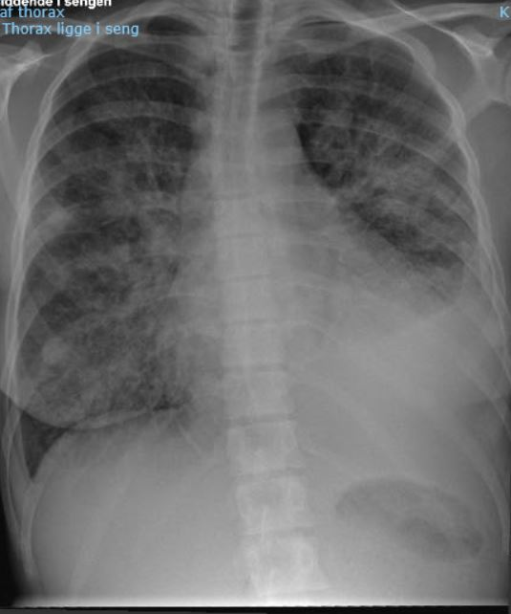
Case Presentation
Findings and Investigations
Vital signs:
BP 120/92,
Bpm 97,
Sp02 98%,
BMI 13.
ECG: Normal ST segments
Lab. No rise and fall in Troponins
Chest X-ray: Pulmonary edema and effusion

Slide 6
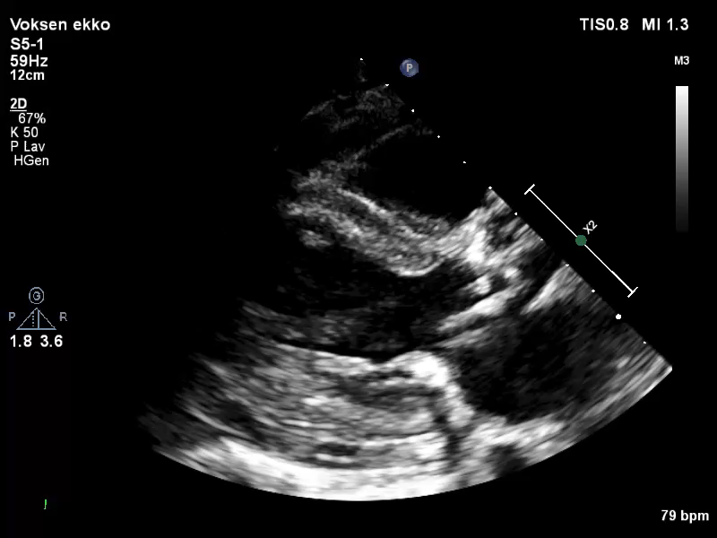
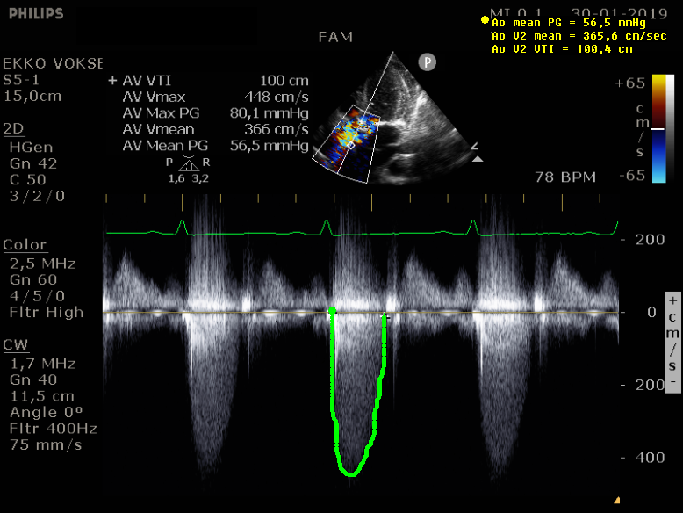
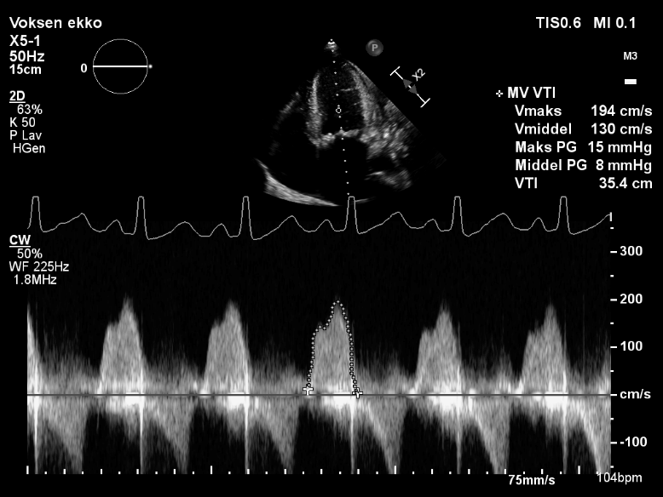
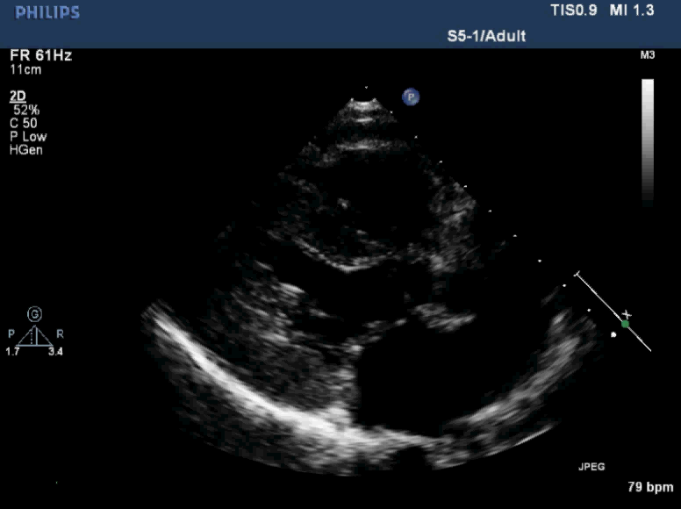
Echocadiogram at admission (1,2,3)
1
3
Echocardiogram 2 years earlier…
2
2

Slide 7
Critical Aortic Valve stenosis
Peak gradient: 80 mmHg
Mean gradient: 56 mmHg
AVA(index): 0.4 cm2/m2
Mitral stenosis
Severe annular calcifications
Moderate mitral valve stenosis
Mean gradient 6-8 mmHg

Slide 8
Case presentation
Investigation
Endocarditis was excluded: Absence of fever, vegetations on TEE and bacteremia.
Multidisiplinary heart team Conference: (Concerns: Patient Age, anatomical conditions, small LVOT, anticoagulation, low adherence, future renal transplanation)
The patient was given Mechanic Aortic and mitral valve replacement

Slide 9
Discussion
VC in CKD/ESRD – etiology is multifactorial
Bone and mineral disorder with CKD (BMD-CKD)^{2,6}
“hyperphosphatemia and hyperparathyroidism are independently associated with progressive VC^{1,3}
Secondary hyperparathyroidism
Tertiary hyperparathyroidism
Parathyroidectomy
After parathyreoidectomy, PTH was controlled, however phosphate remained elevated.

Slide 10
Discussion
VC in CKD/ESRD – etiology is multifactorial
Low patient adherence to medical treatment and dietary restrictions⁵
Volume overload and Endothelial dysfunction
Fistula
Hemodialysis
In conclusion this case illustrates rapid progression of VC resulting in critical AS in a young patient with ESRD on HD and low treatment adherence to medical treatment and dietary restrictions.

Slide 11
Learning Points
The VC process is possibly accelerated by CKD/ESRD
Bone and mineral disorder (BMD-CKD) is associated with VC
Low adherence to dietary and fluid restrictions in ESRD/HD lead to:
volume overload and endothelial cell dysfunction
hyperparathyroidism with disturbed bone - and mineral metabolism

Slide 12
References
1. Urena-Torres. P.,D´Marco. L, Raggi. P, Garcia-Moll. X, Brandenburg. V, Mazzaferro. S et al., Valvular heart disease and calcification in CKD: more common than appreciated. Nephrol Dial Transplant, 2019.
2. Bellasi. A., Mangano. M, Galassi. A, Cozzolino. M. [CKD-MBD, cardiovascular involvement and prognosis]. G Ital Nefrol, 2017.34(Suppl 69): p. 150-161.
3. Ternacle, J, Cõté. N, Krapf. L, Nguyen. A, Clavel. MA, Pibarot. P. Chronic Kidney Disease and the Pathophysiology of Valvular Heart Disease. Can J Cardiol, 2019. 35(9): p. 1195-1207.
4. Lentine. K.L, Kasiske. B.L, Levey. A.S, Adams.P.L, Alberú. S, Bakr. M.A, et al., Summary of Kidney Disease: Improving Global Outcomes (KDIGO) Clinical Practice Guideline on the Evaluation and Care of Living Kidney Donors. Transplantation, 2017.101(8): p. 1783-1792.
5. Gallant. K.M.H andSpiegel. D.M.:, Calcium Balance in Chronic Kidney Disease. Curr Osteoporos Rep,2017. 15(3): p.214-221.
6. Chertow GM, Burke SK, Raggi P. Treat to Goal Working Group Sevelamer attenuates the progression of coronary and aortic calcification in hemodialysis. Kidney Int 2002; 62:245-252

