Slide 1
tSNE_2
tSNE_1
Figure S1. The TSNE plot displays the 23 clusters of individual samples.

Slide 2
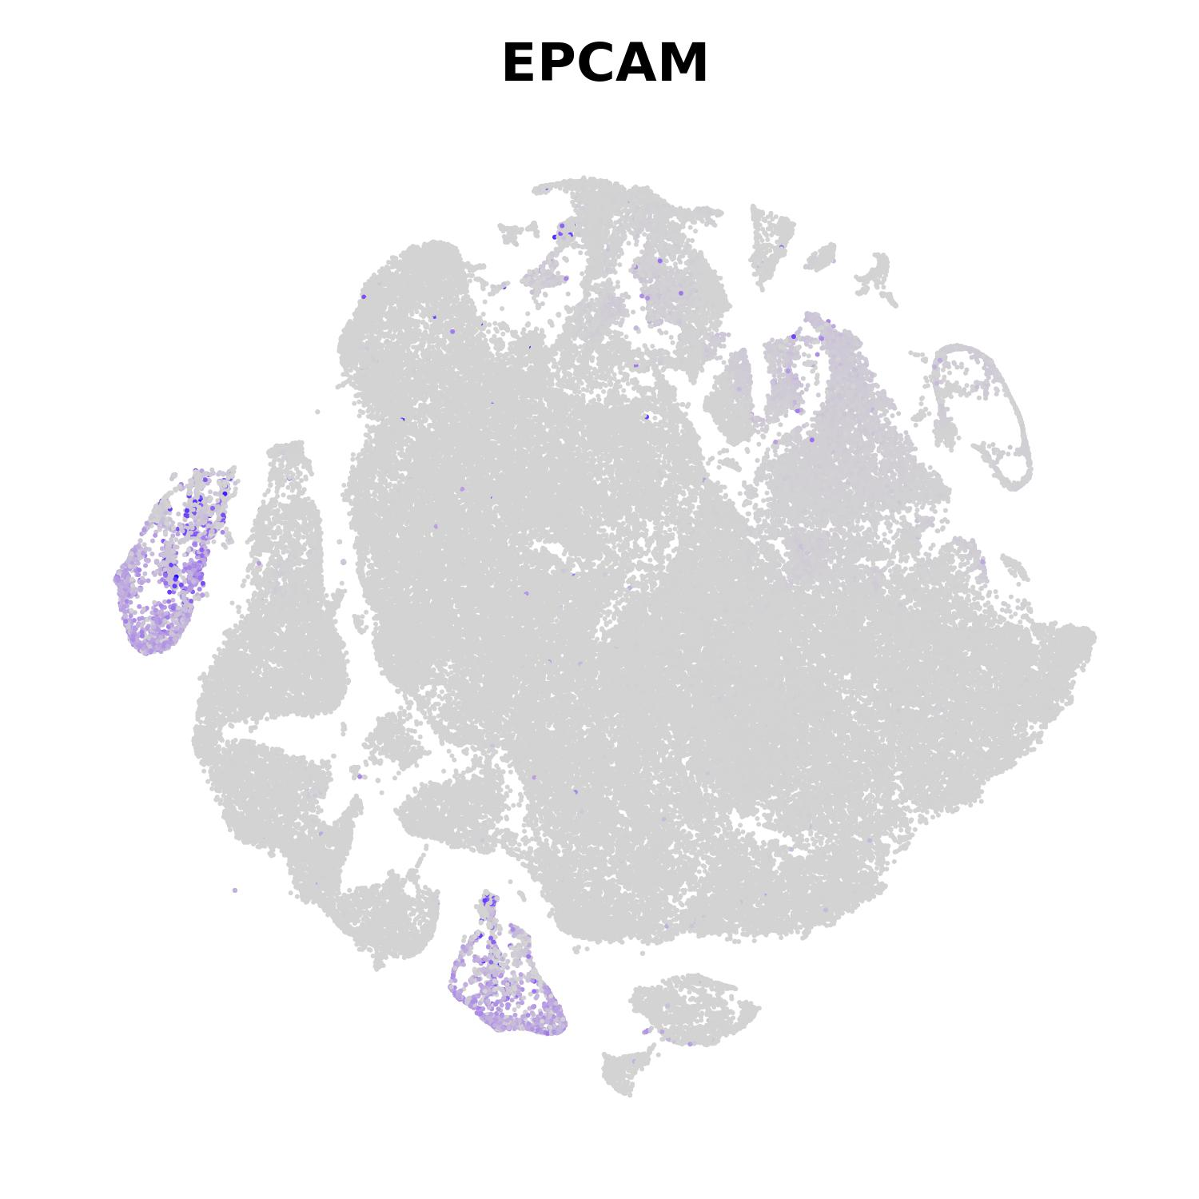
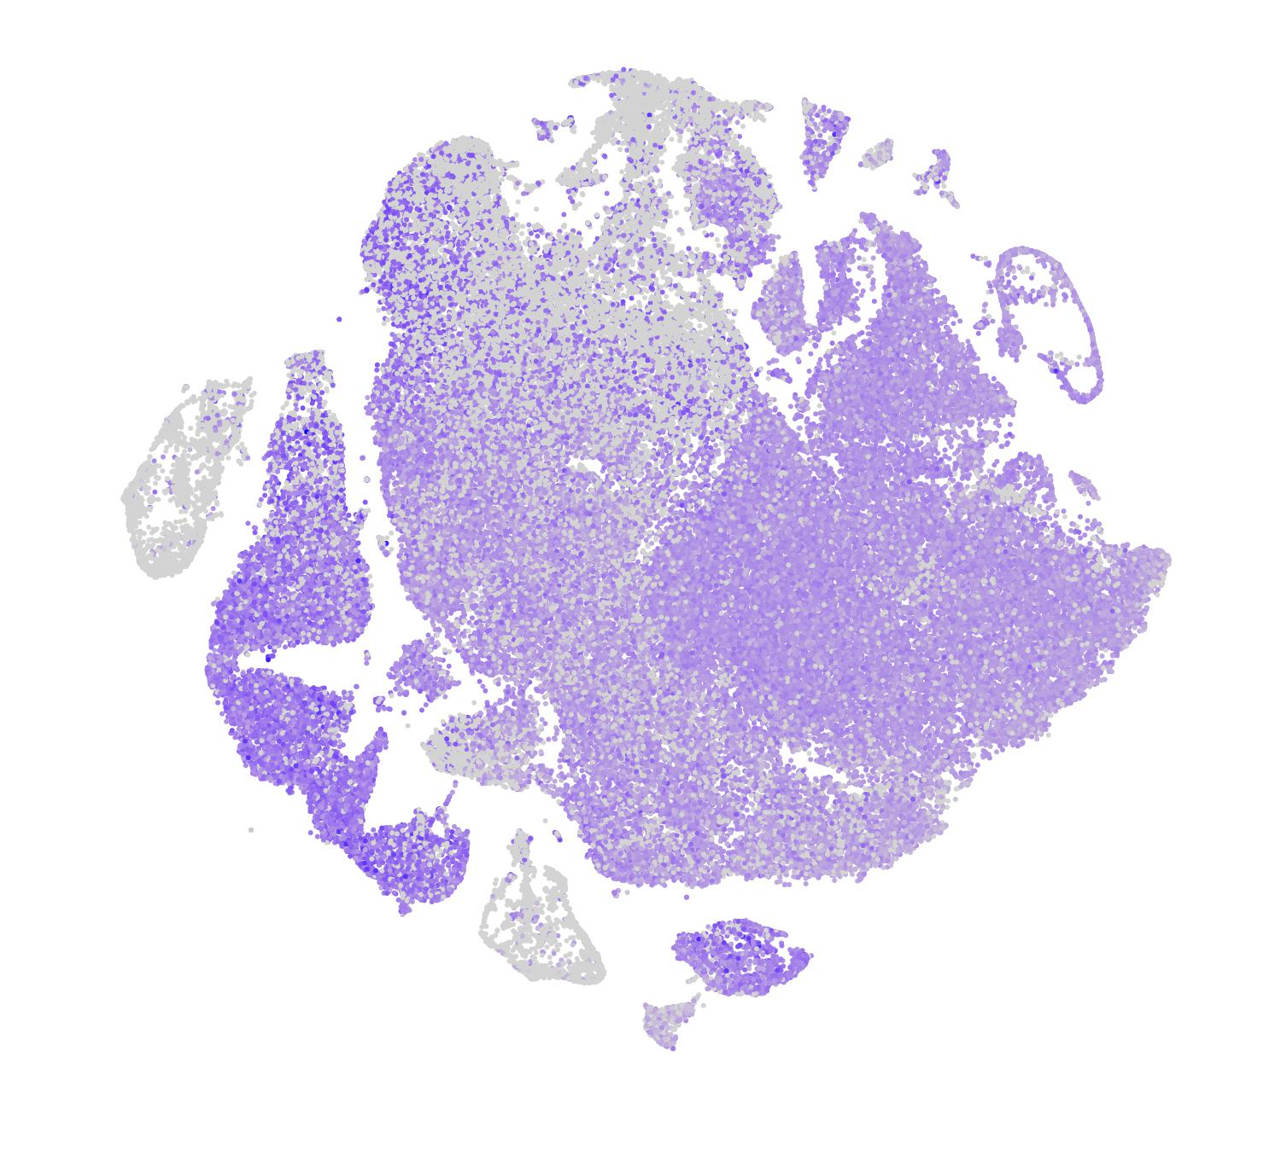
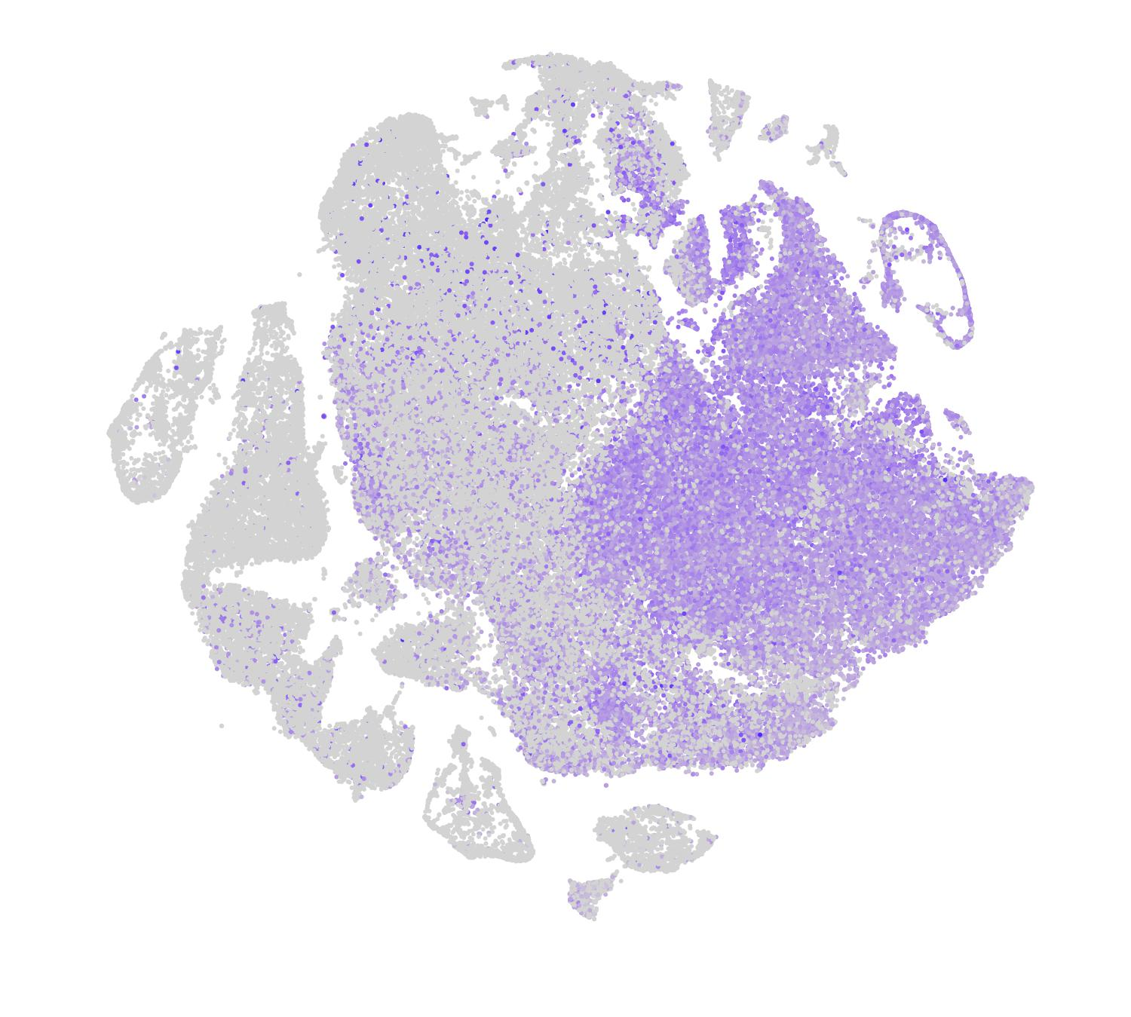
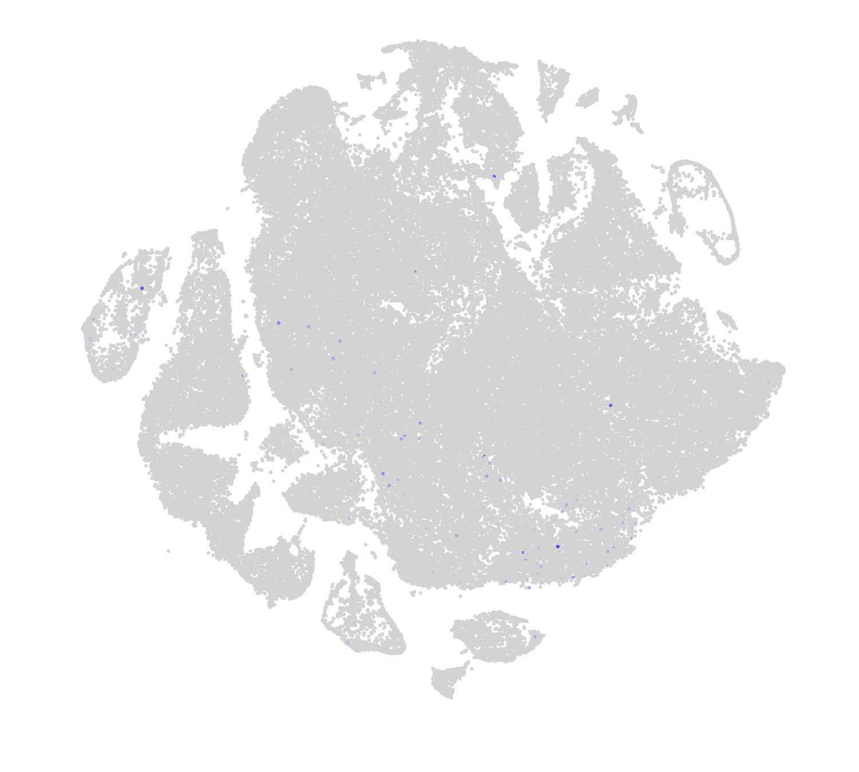
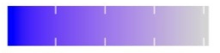
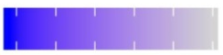
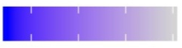
EPCAM
(Epithelial)
PTPRC
(immune)
PECAM1
(Endothelial)
PDGFRA
(Fibroblasts)
tSNE_2
tSNE_1
3 2 1 0
5 4 3 2 1 0
3 2 1 0
3 2 1 0
Figure S2. T-SNE plot displays RNA expression of EPCAM (Epithelial marker), PTPRC (immune marker), PECAM1 (Endothelial marker) and PDGFRA (Fibroblasts marker).

Slide 3
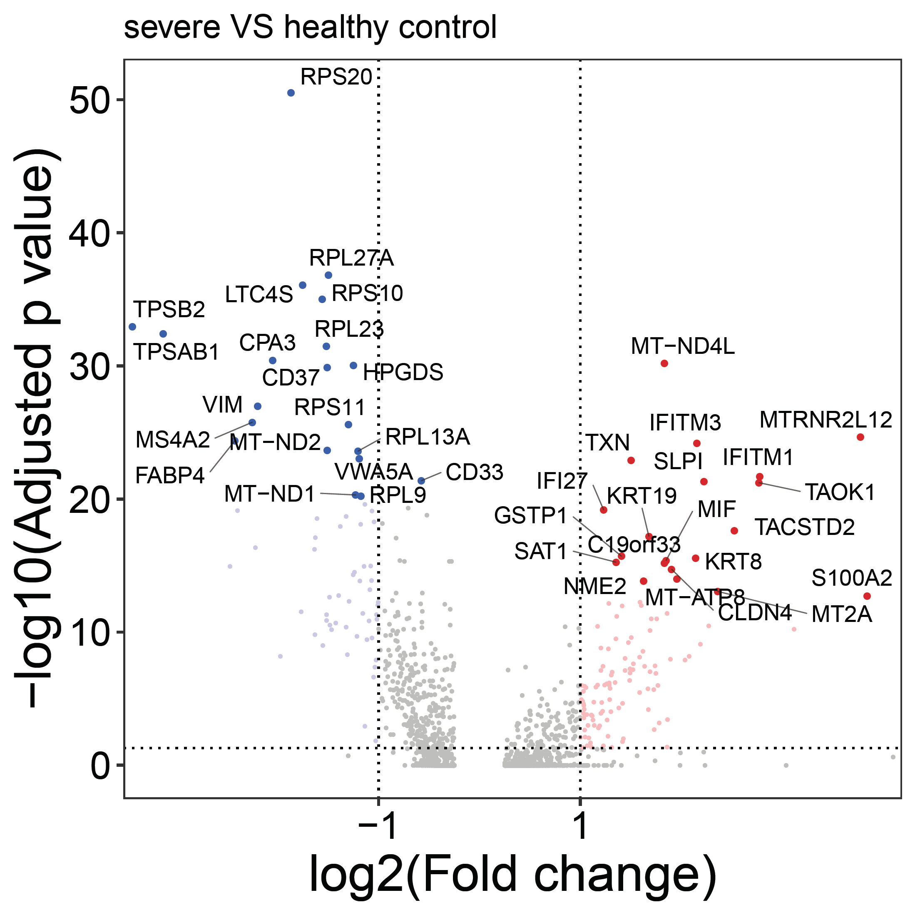
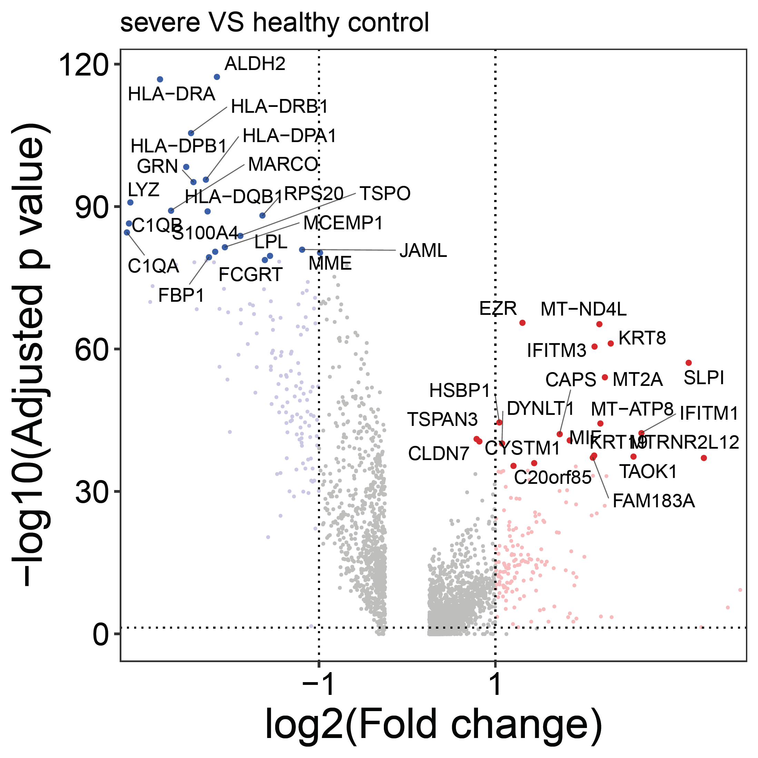
n= 65
n= 107
MHC class II genes
HLA-DPA1
HLA-DPB1
HLA-DQA1
HLA-DQB1
HLA-DRA
n= 162
MHC class II genes
HLA-DMA
HLA-DMB
HLA-DPA1
HLA-DPB1
HLA-DQA1
HLA-DQB1
HLA-DRA
HLA-DRB1
HLA-DRB5
n= 138
Figure S3. Volcano plot of differentially expressed genes in club (top) and ciliated (bottom) cells comparing samples from severe COVID-19 patients and health control.

Slide 4
Club
Translocation of ZAP-70 to Immunological synapse
Phosphorylation of CD3 and TCR zeta chains
PD-1 signaling
Generation of second messenger molecules
Metallothioneins bind metals
Cytokine Signaling in Immune system
Interleukin-4 and Interleukin-13 signaling
Cell junction organization
Dissolution of Fibrin Clot
Cell-Cell communication
-log10(FDR)
Ciliated
Translocation of ZAP-70 to Immunological synapse
MHC class II antigen presentation
Phosphorylation of CD3 and TCR zeta chains
PD-1 signaling
Generation of second messenger molecules
Cytokine Signaling in Immune system
Immune System
Interferon alpha/beta signaling
Interleukin-10 signaling
Interleukin-4 and Interleukin-13 signaling
-log10(FDR)
Figure S4. The top 5 enriched signaling pathways of up-regulated (red) or down-regulated (green) genes in lung epithelial cells of mild vs. severe patients.

Slide 5
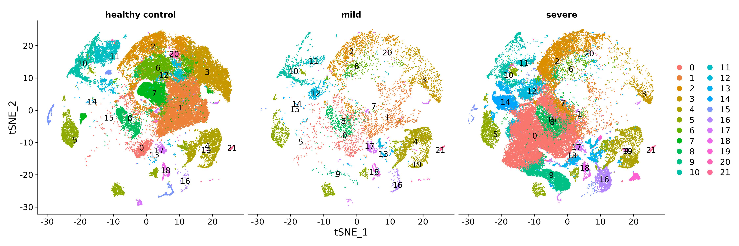
Figure S5. The clustering of non-epithelial cells of BALF in healthy control, mild and severe patients with COVID-19.

Slide 6
Sample | name | 0 | 1 | 2 | 3 | 4 | 5 | 6 | 7 | 8 | 9 | 10 | 11 | 12 | 13 | 14 | 15 | 16 | 17 | 18 | 19 | 20 | 21
healthy | Subject_1 | 157 | 1433 | 555 | 822 | 187 | 271 | 515 | 638 | 223 | 0 | 5 | 87 | 112 | 6 | 1 | 131 | 9 | 164 | 39 | 13 | 20 | 53
healthy | Subject_2 | 168 | 1640 | 471 | 850 | 192 | 186 | 832 | 434 | 246 | 0 | 9 | 103 | 92 | 6 | 2 | 199 | 9 | 74 | 41 | 0 | 9 | 3
healthy | Subject_3 | 206 | 1390 | 331 | 498 | 175 | 176 | 338 | 524 | 140 | 0 | 6 | 91 | 60 | 0 | 3 | 181 | 9 | 56 | 51 | 0 | 11 | 22
healthy | Subject_4 | 95 | 1230 | 262 | 579 | 283 | 327 | 638 | 514 | 148 | 0 | 5 | 118 | 47 | 2 | 1 | 92 | 2 | 47 | 32 | 1 | 40 | 7
healthy | Subject_5 | 105 | 1608 | 390 | 869 | 122 | 153 | 683 | 701 | 179 | 0 | 6 | 103 | 58 | 2 | 6 | 197 | 3 | 98 | 31 | 0 | 57 | 6
healthy | Subject_6 | 147 | 891 | 280 | 586 | 518 | 468 | 285 | 428 | 134 | 0 | 13 | 61 | 61 | 5 | 0 | 154 | 4 | 70 | 64 | 0 | 27 | 27
healthy | Subject_7 | 132 | 1049 | 188 | 386 | 197 | 174 | 237 | 376 | 71 | 0 | 3 | 42 | 18 | 9 | 0 | 99 | 3 | 31 | 29 | 0 | 8 | 6
healthy | Subject_8 | 136 | 1461 | 478 | 958 | 377 | 416 | 603 | 642 | 313 | 0 | 11 | 118 | 114 | 3 | 1 | 263 | 12 | 94 | 66 | 0 | 124 | 12
healthy | Subject_9 | 61 | 792 | 180 | 336 | 58 | 41 | 261 | 321 | 92 | 0 | 4 | 64 | 60 | 0 | 1 | 77 | 1 | 82 | 46 | 0 | 10 | 1
healthy | Subject_10 | 154 | 928 | 310 | 424 | 143 | 137 | 266 | 339 | 112 | 0 | 3 | 60 | 39 | 4 | 1 | 168 | 0 | 43 | 71 | 0 | 5 | 3
mild | C141 | 295 | 370 | 504 | 285 | 738 | 372 | 195 | 0 | 305 | 16 | 11 | 13 | 177 | 27 | 3 | 2 | 58 | 176 | 69 | 11 | 1 | 70
mild | C142 | 265 | 444 | 443 | 385 | 720 | 420 | 82 | 2 | 193 | 23 | 3 | 24 | 419 | 47 | 7 | 2 | 51 | 101 | 44 | 7 | 2 | 45
mild | C144 | 30 | 7 | 44 | 20 | 135 | 53 | 22 | 0 | 13 | 2 | 3 | 4 | 75 | 33 | 4 | 4 | 19 | 1 | 22 | 2 | 0 | 16
severe | C143 | 8082 | 228 | 1802 | 328 | 716 | 798 | 44 | 22 | 804 | 1810 | 135 | 48 | 267 | 1045 | 1743 | 81 | 855 | 225 | 107 | 150 | 0 | 53
severe | C145 | 7689 | 420 | 2369 | 177 | 524 | 445 | 227 | 20 | 839 | 809 | 106 | 106 | 1264 | 347 | 284 | 56 | 223 | 125 | 175 | 32 | 15 | 60
severe | C146 | 529 | 13 | 167 | 10 | 45 | 34 | 15 | 2 | 60 | 1145 | 104 | 34 | 106 | 11 | 146 | 4 | 6 | 22 | 8 | 3 | 1 | 3
severe | C148 | 739 | 23 | 258 | 37 | 80 | 80 | 5 | 1 | 47 | 159 | 20 | 2 | 71 | 21 | 17 | 10 | 31 | 4 | 14 | 14 | 1 | 6
severe | C149 | 555 | 61 | 240 | 8 | 270 | 424 | 13 | 0 | 106 | 140 | 7 | 9 | 105 | 58 | 40 | 0 | 25 | 51 | 9 | 1 | 1 | 24
severe | C152 | 993 | 21 | 162 | 101 | 280 | 105 | 104 | 0 | 162 | 48 | 159 | 5 | 63 | 1104 | 103 | 8 | 302 | 77 | 14 | 541 | 0 | 2
Cluster 0, Neutrophil;
Cluster 1, Unknown;
Cluster 2, Macrophage;
Cluster 3, Macrophage;
Cluster 4, T & NK cells;
Cluster 5, T & NK cells;
Cluster 6, Macrophage;
Cluster 7, Unknown;
Cluster 8, Unknown;
Cluster 9, Neutrophil;
Cluster 10, Unknown;
Cluster 11, Unknown;
Cluster 12, Unknown;
Cluster 13, T & NK cells;
Cluster 14 Unknown;
Cluster 15 Macrophage;
Cluster 16 T & NK cells;
Cluster 17 Unknown;
Cluster 18 Dendritic cells;
Cluster 19 B cells;
Cluster 20 Macrophage;
Cluster 21 B cells.
Figure S6. The cell number of assigned clusters (non-epithelial cells) in different samples are summarized.

Slide 7
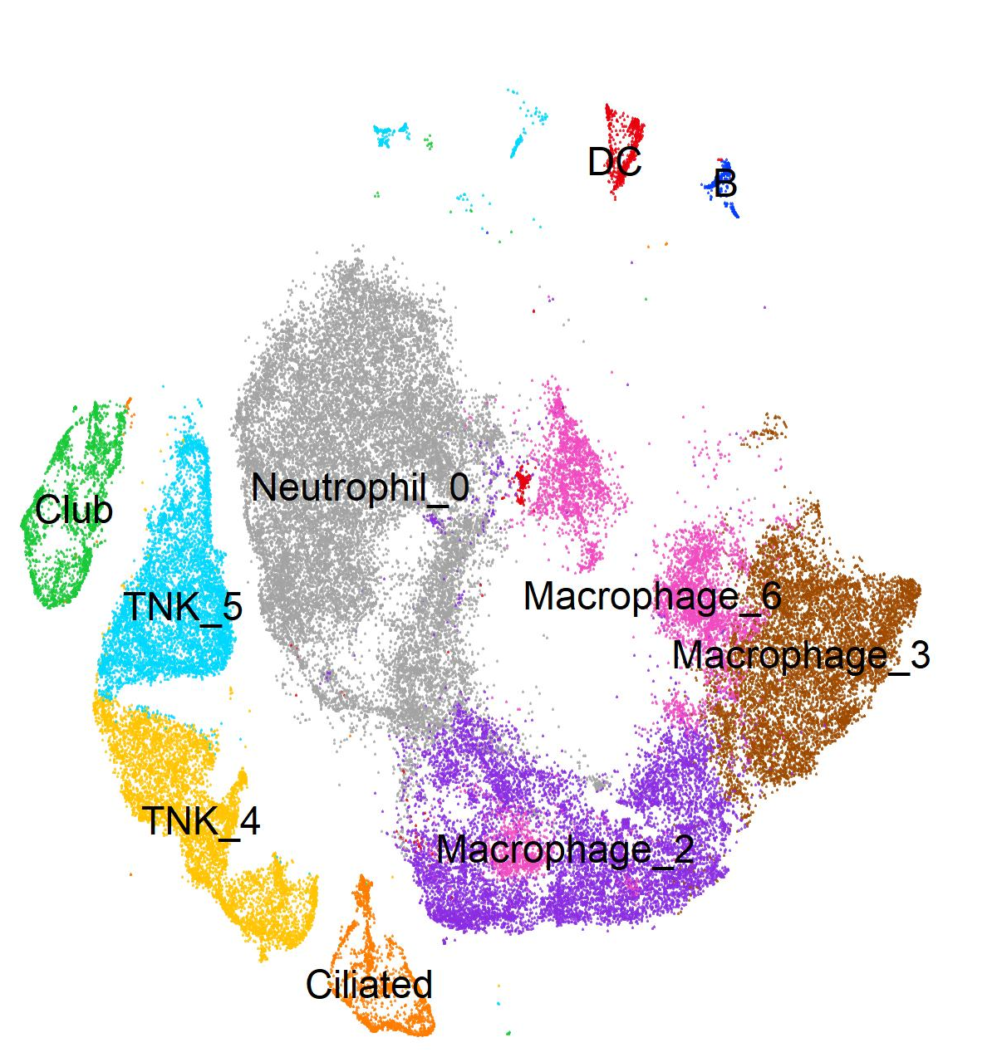
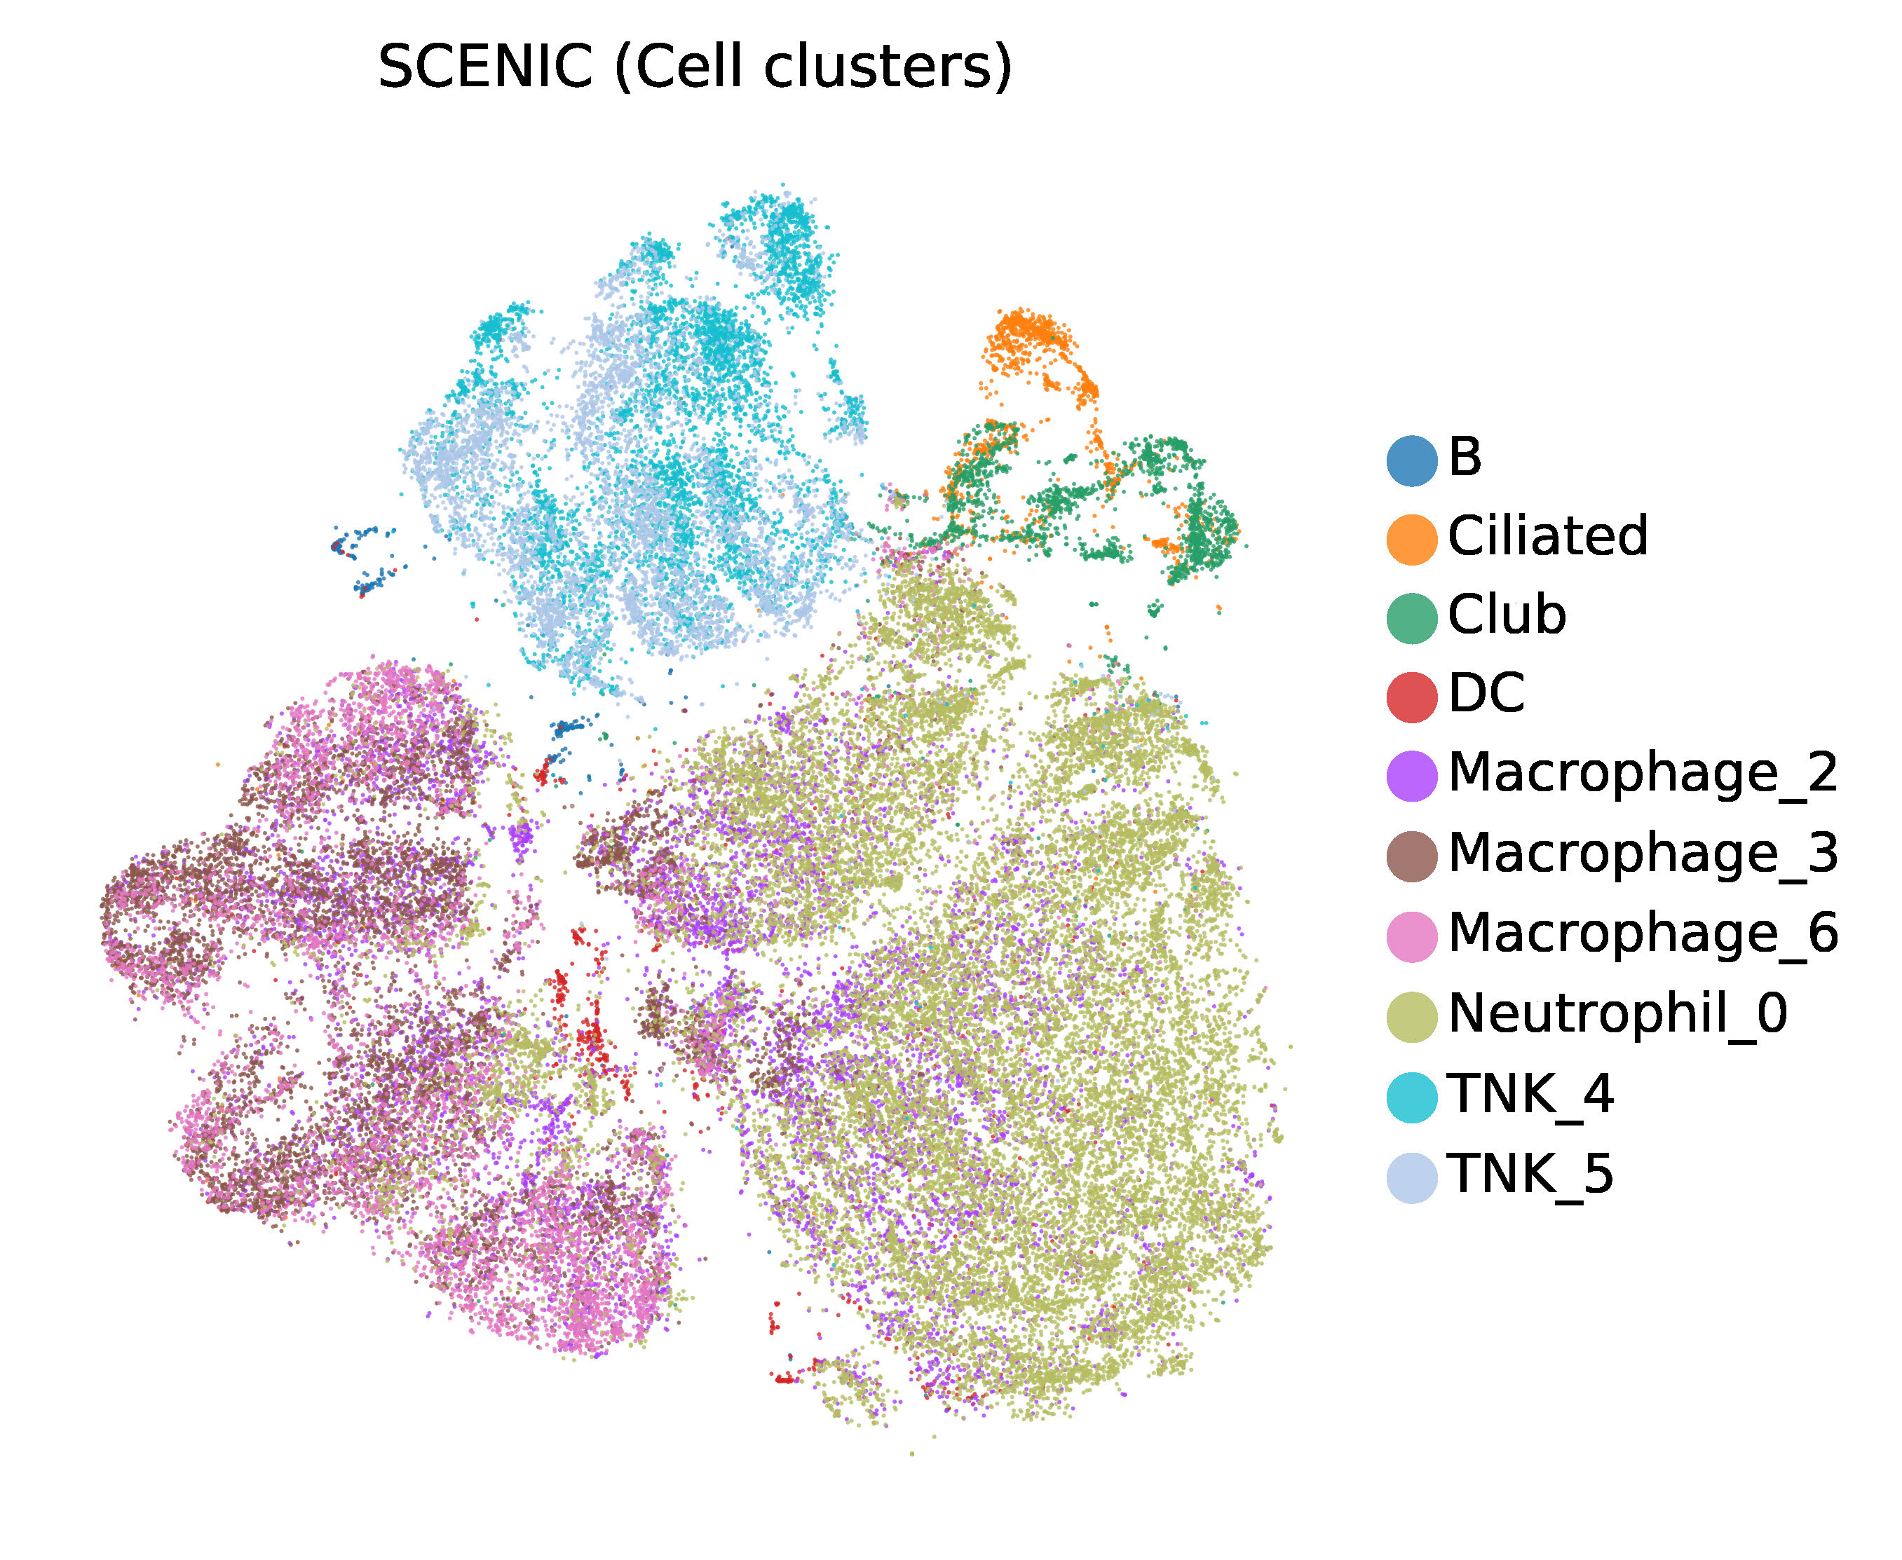
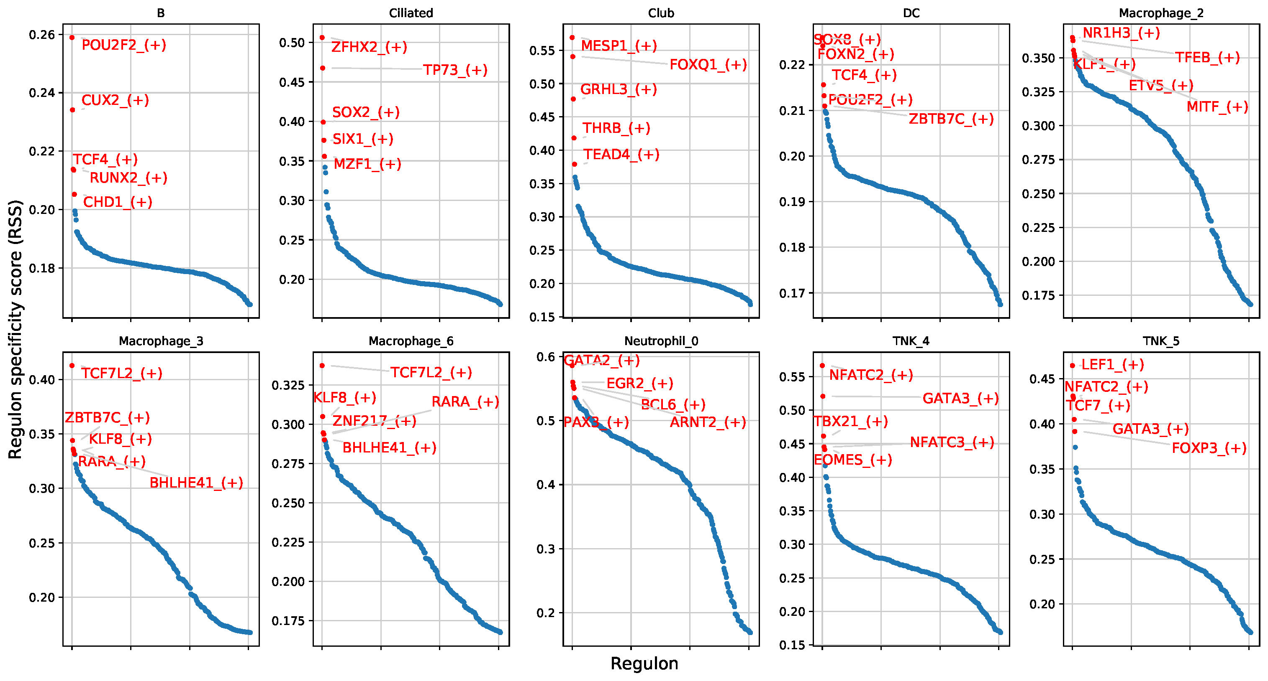
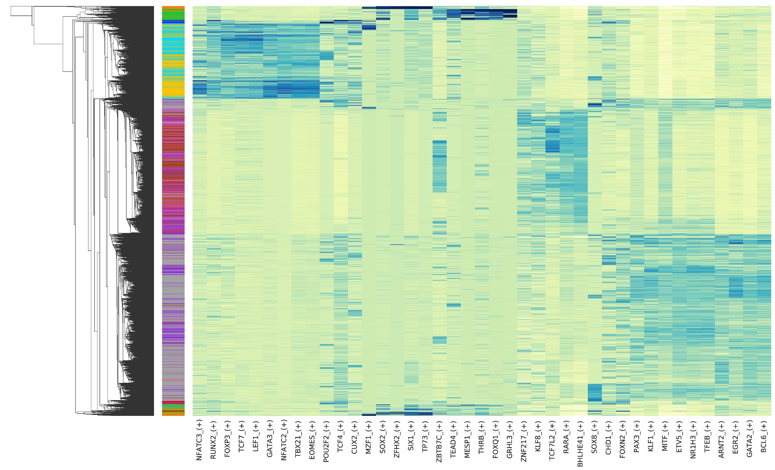
A
High variable genes
SCENIC AUC
T-SNE 2
T-SNE 1
B
C
Cell type
Cell type
Figure S7. (A) Dimensionality reductions side-by-side. (B) Top 5 regulons for each cell type analyzed. (C) Regulon specificity scores (RSS) across different cell types.

Slide 8
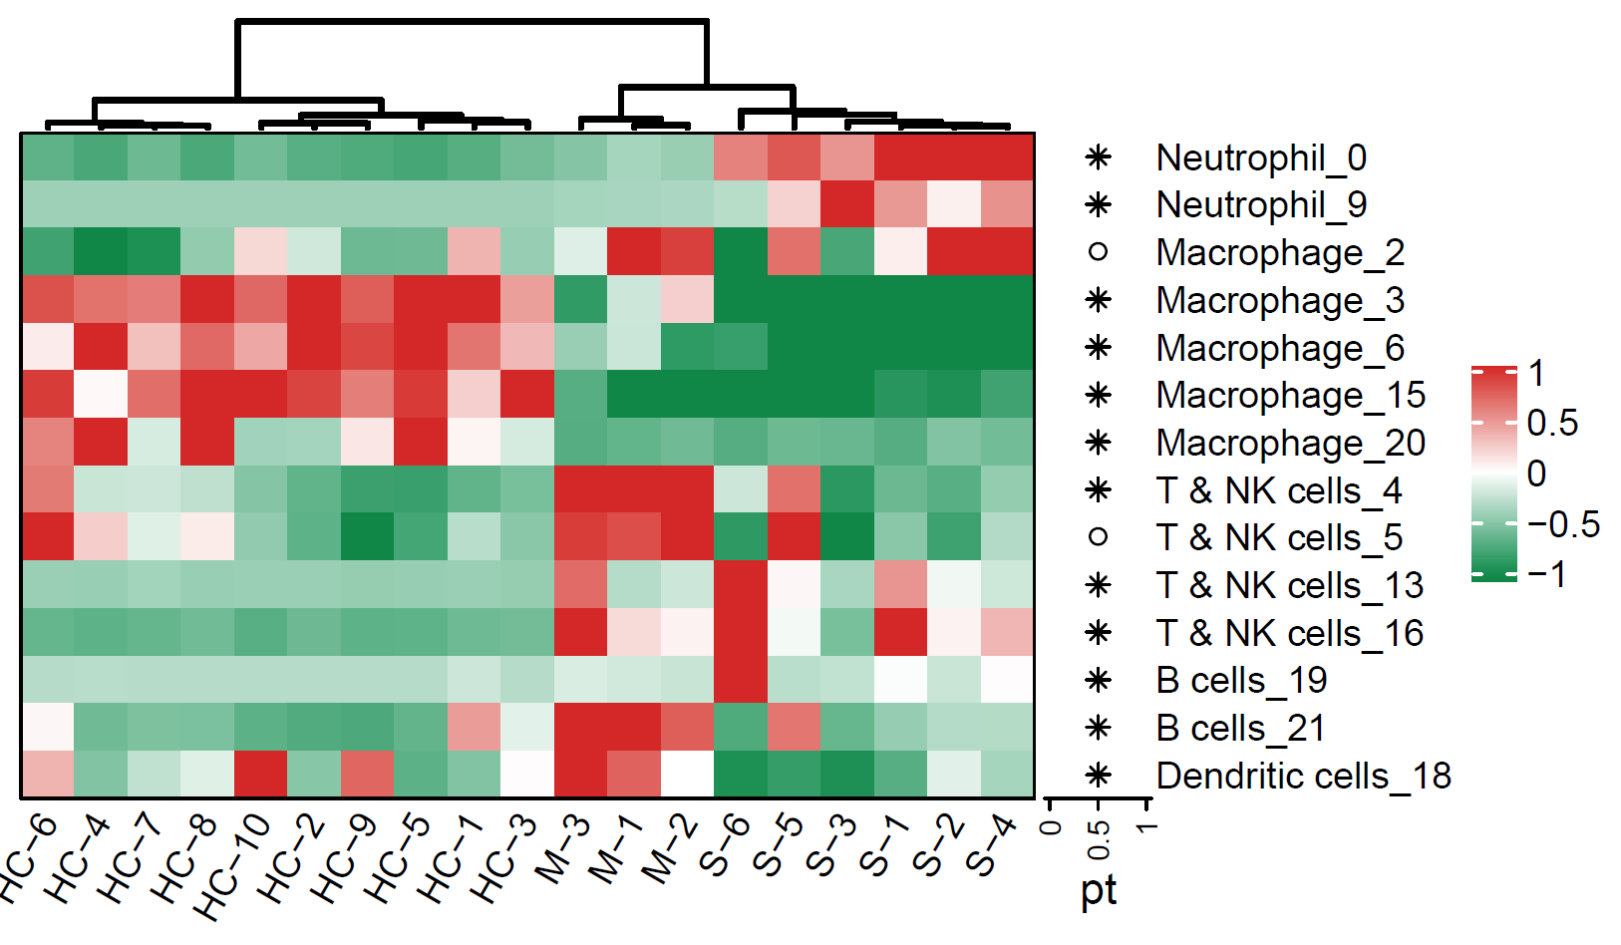
Figure S8. Heatmap displays the percentages of different immune cell types of all CD45+ cells in all samples.

Slide 9
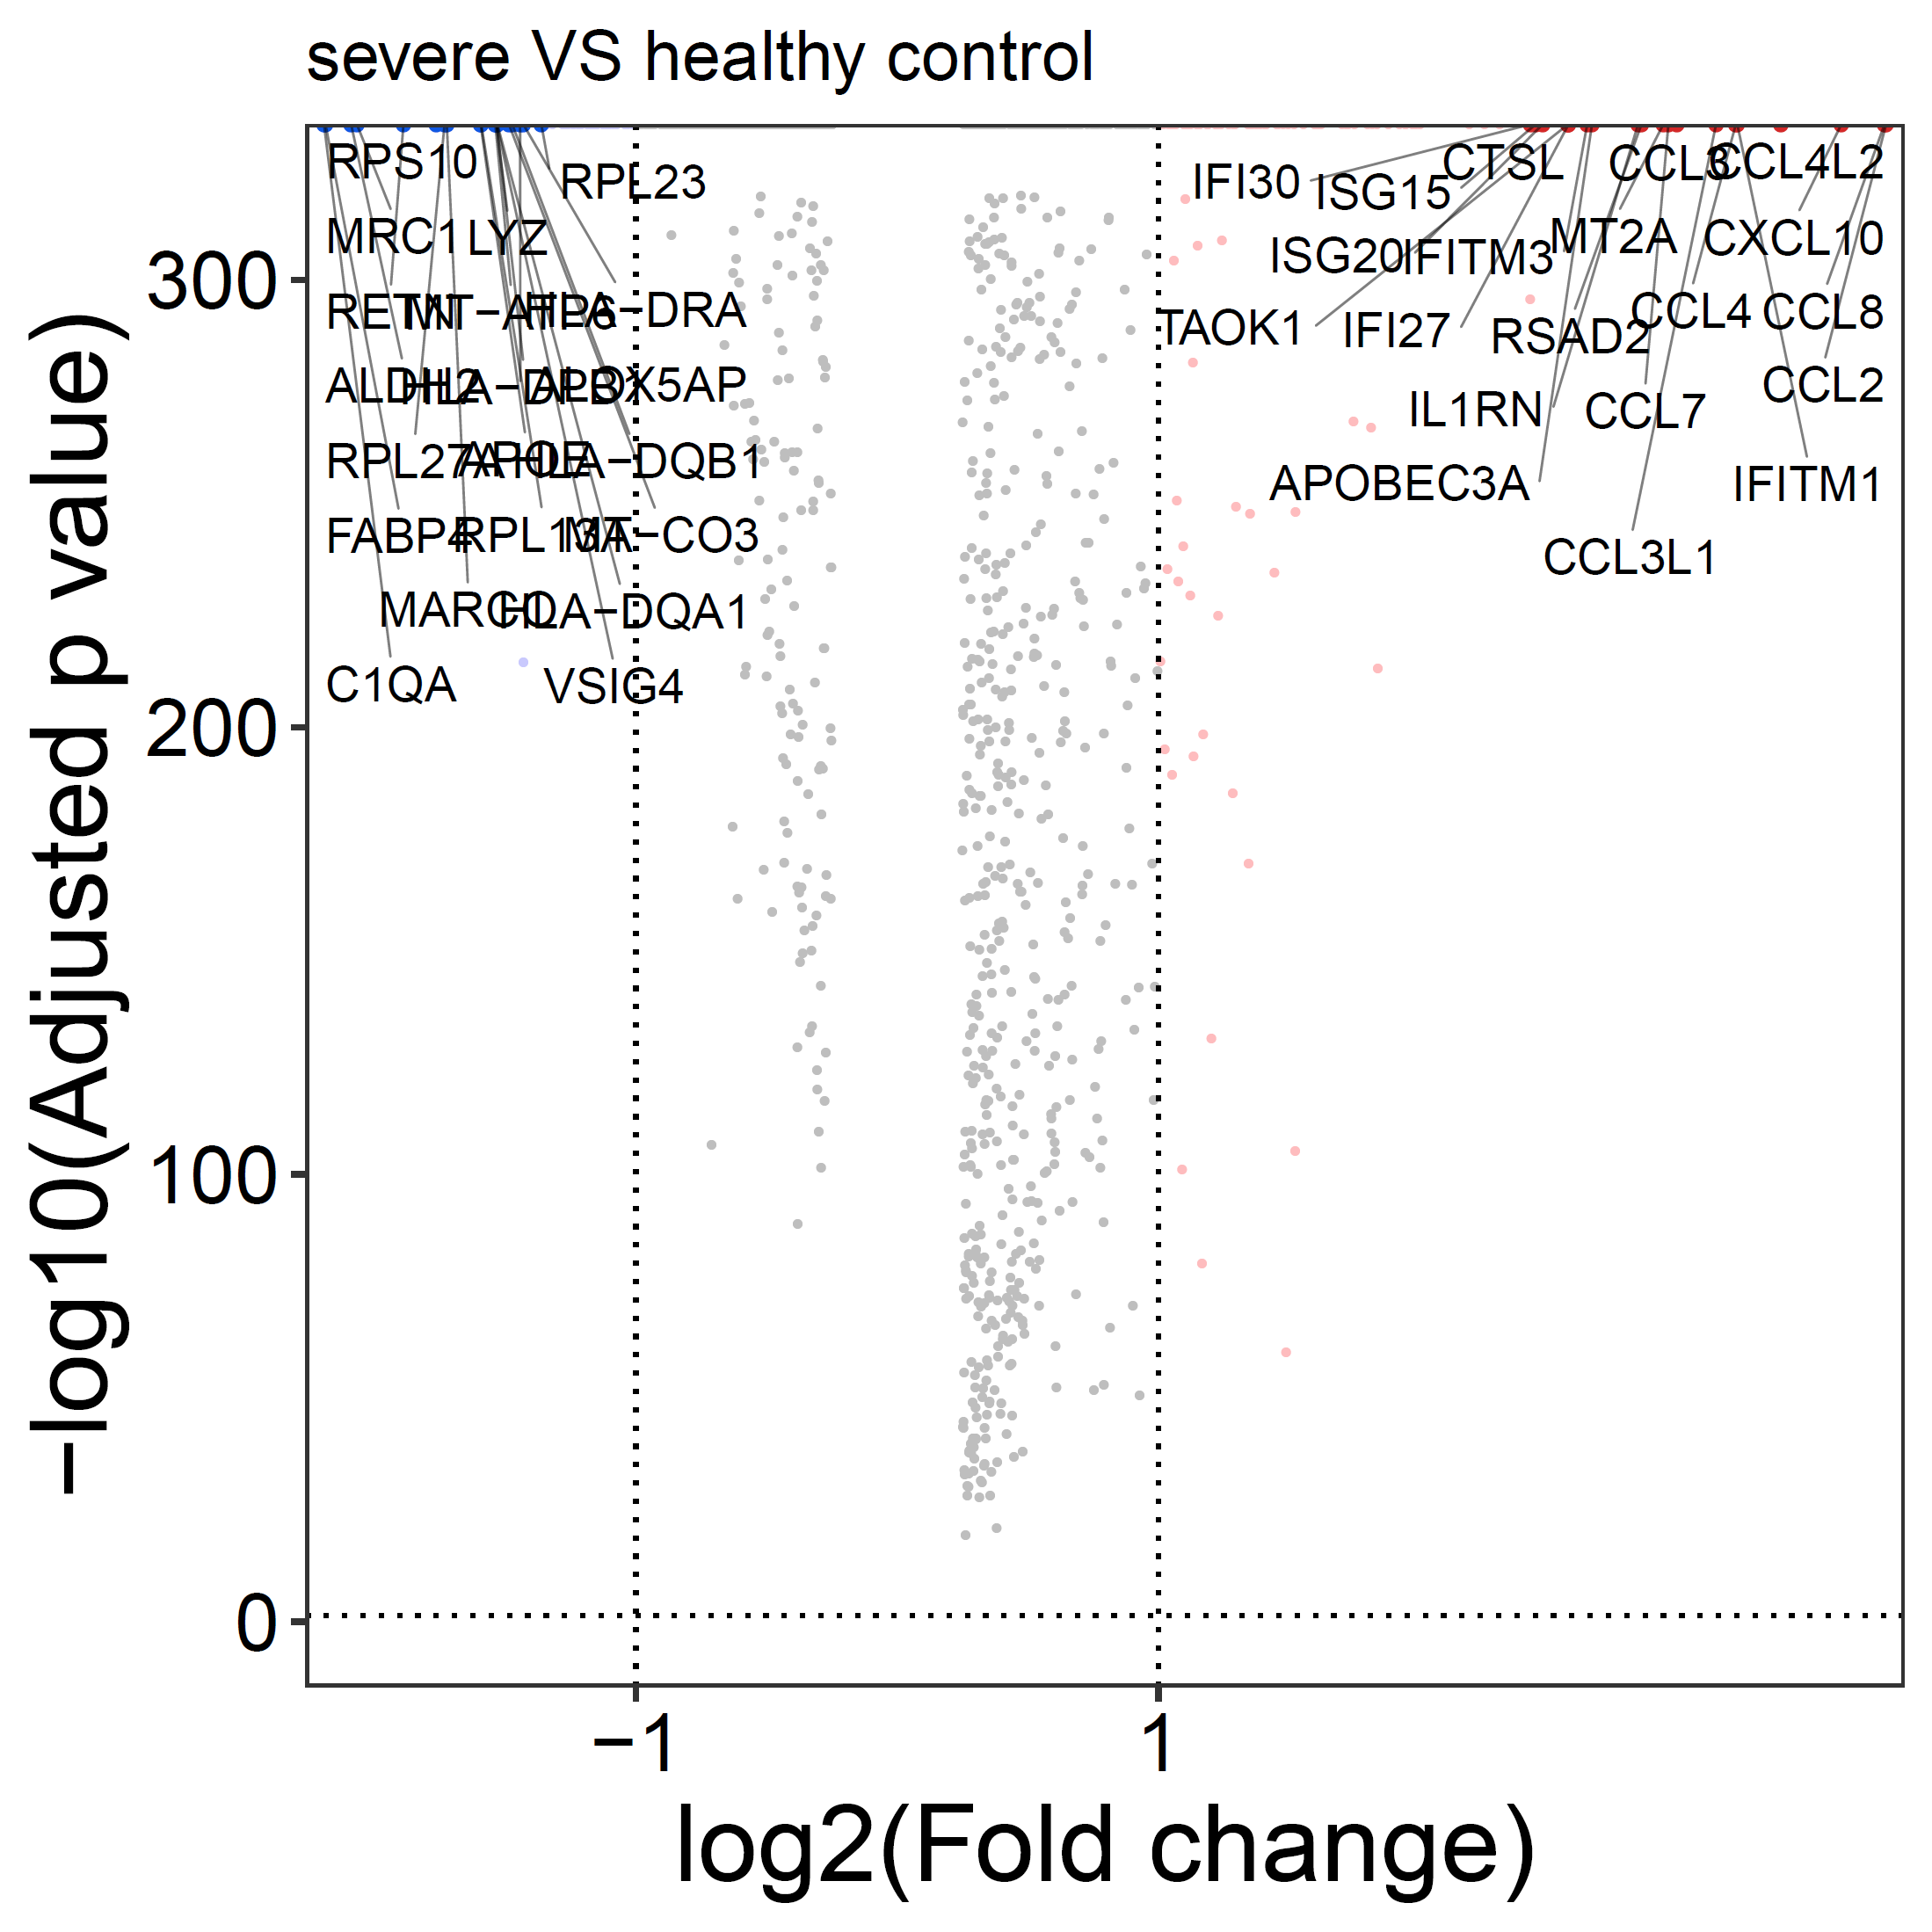
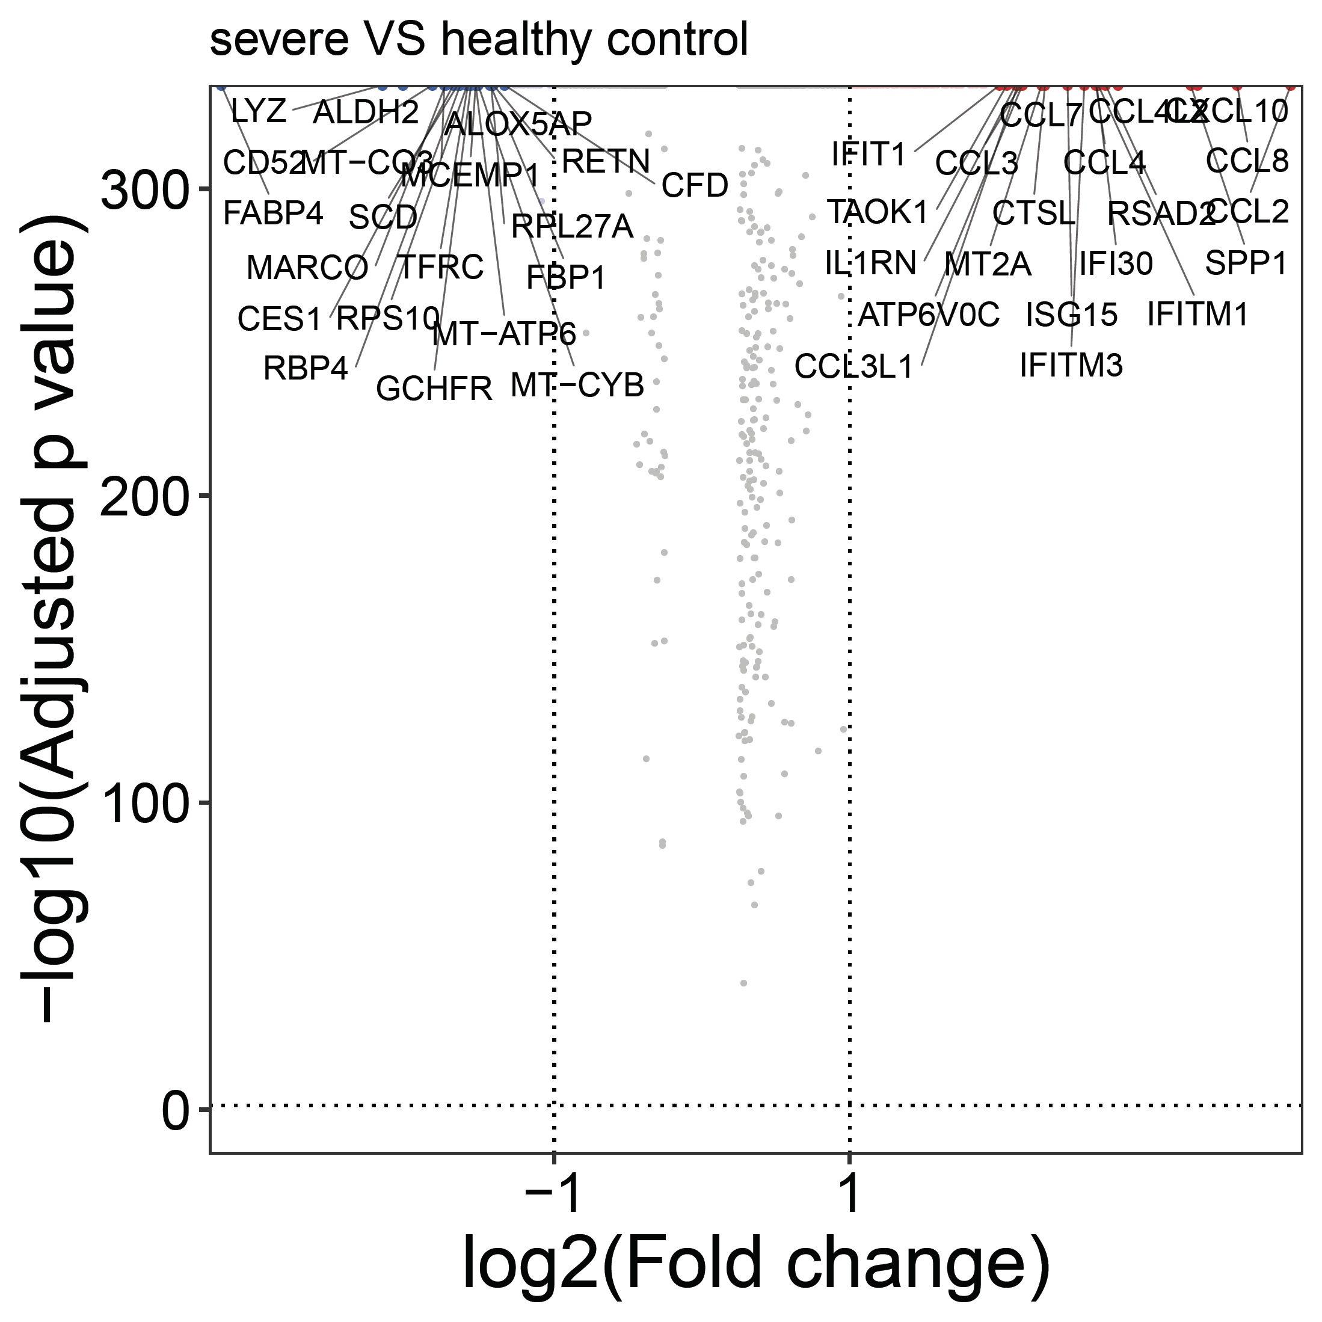
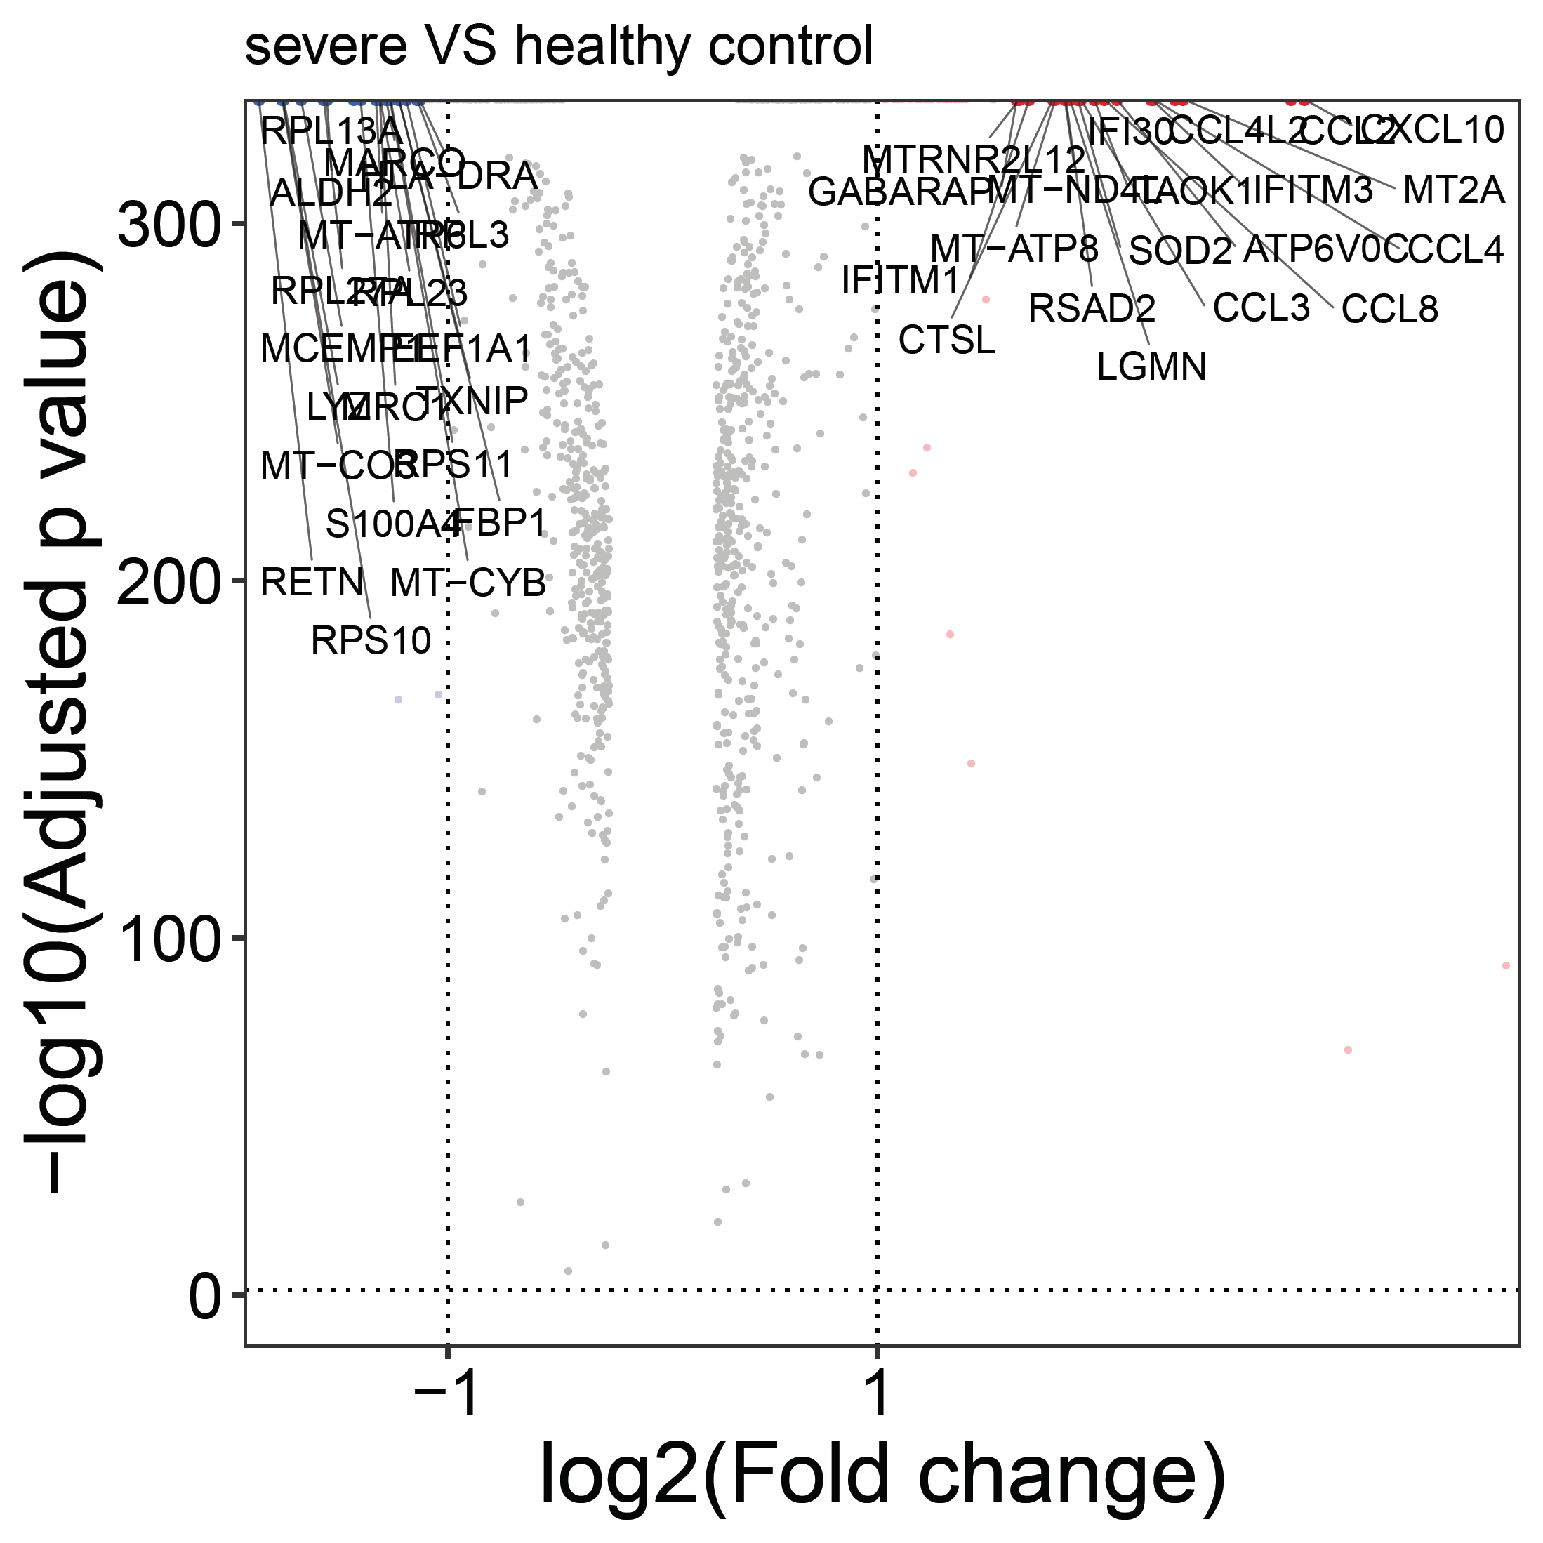
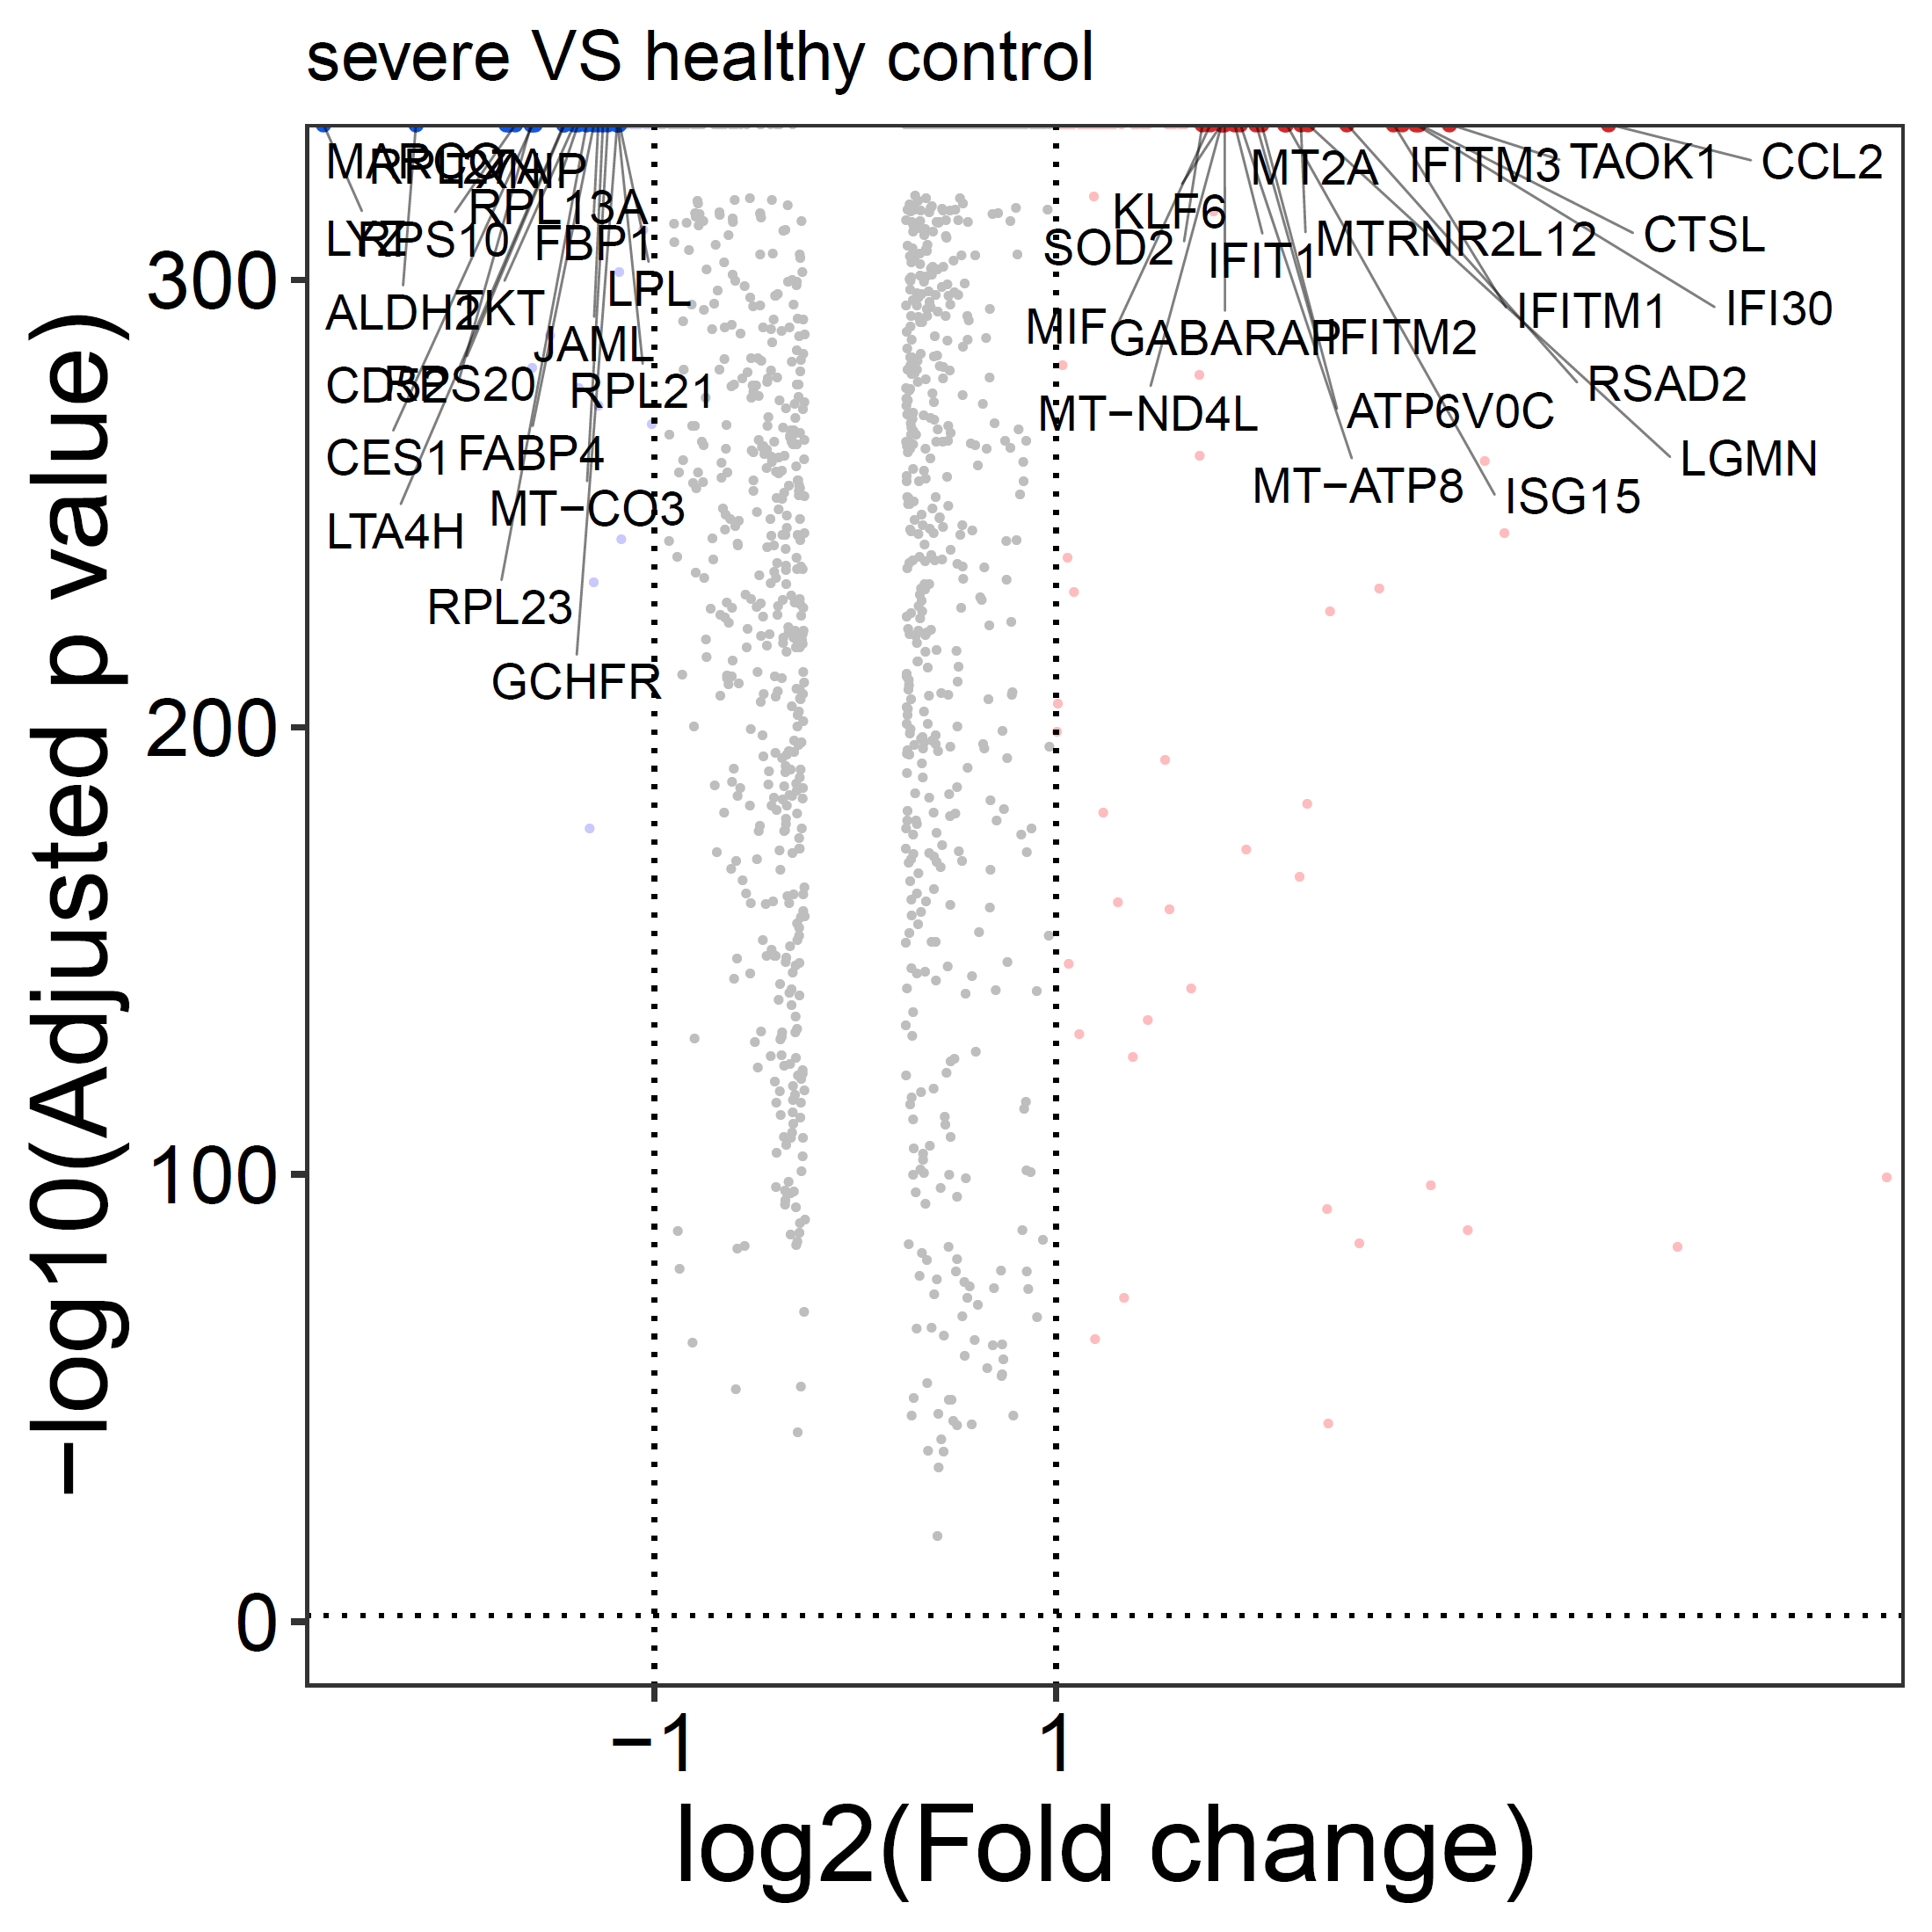
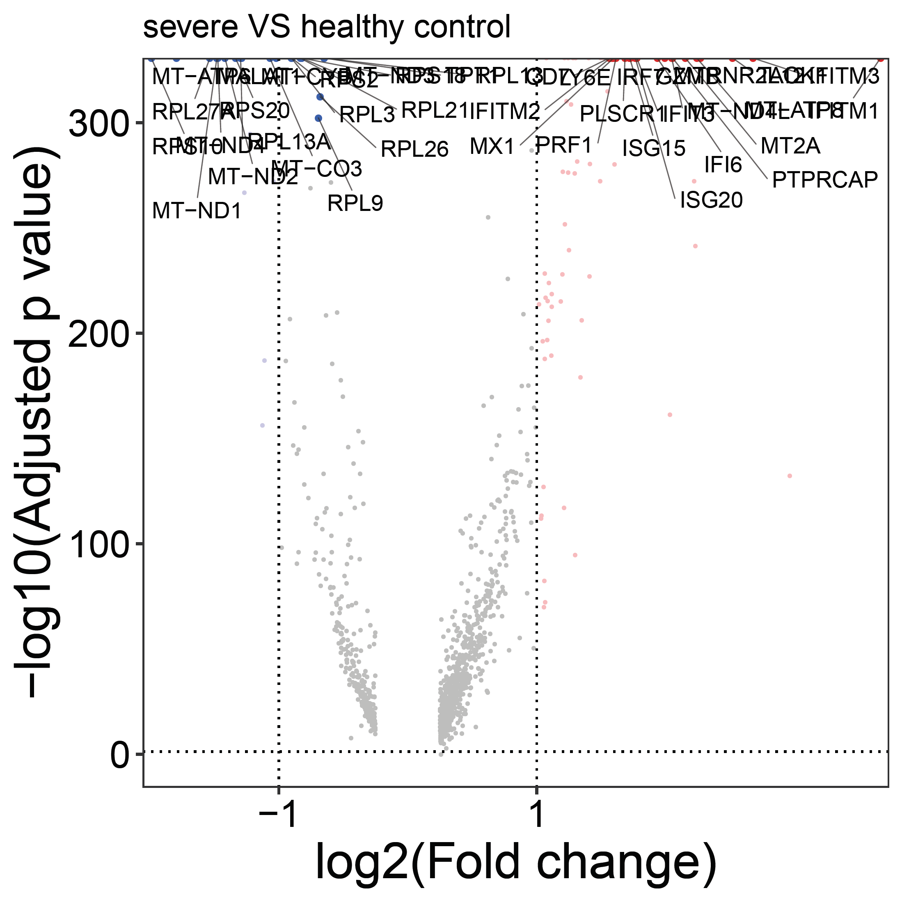
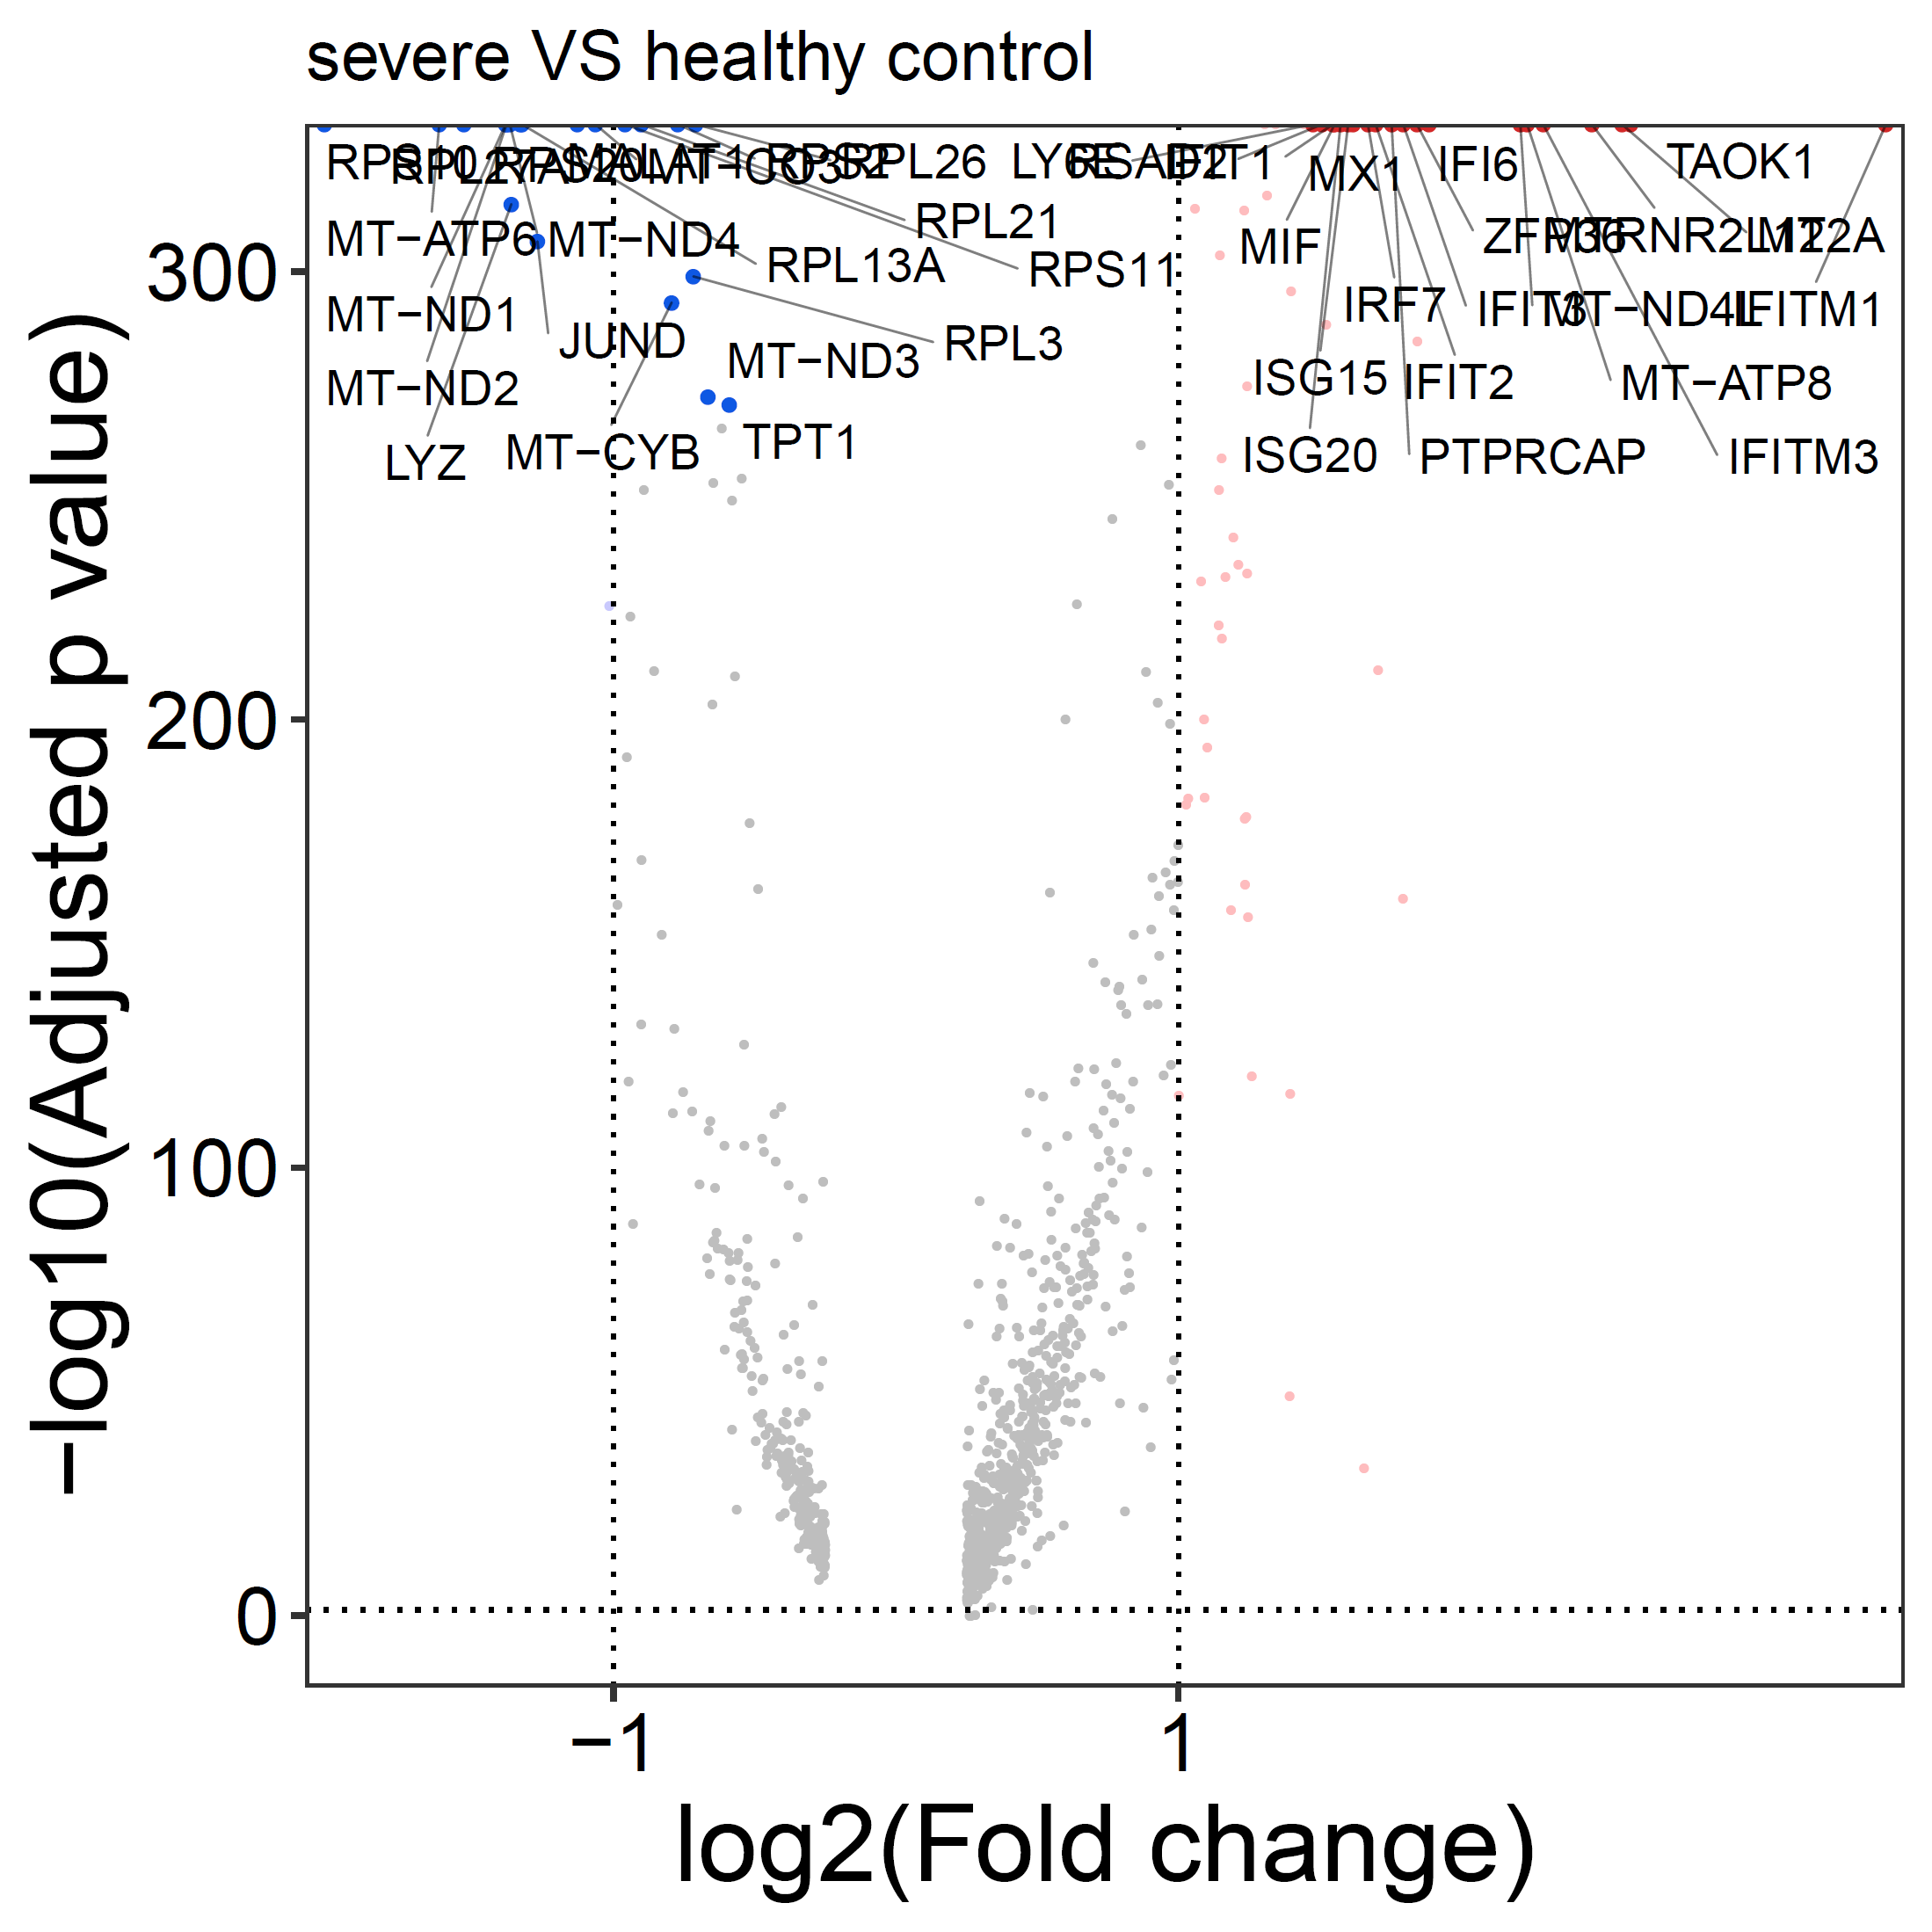
Neutrophil_0
Macrophage_2
Macrophage_3
Macrophage_6
T & NK_4 cells
T & NK_5 cells
Figure S9. Volcano plot of differentially expressed genes in Neutrophil_0, Macrophage_2, Macrophage_3, Macrophage_6, T & NK_4 and T & NK_5 cells comparing samples from severe COVID-19 patients and health control.

Slide 10
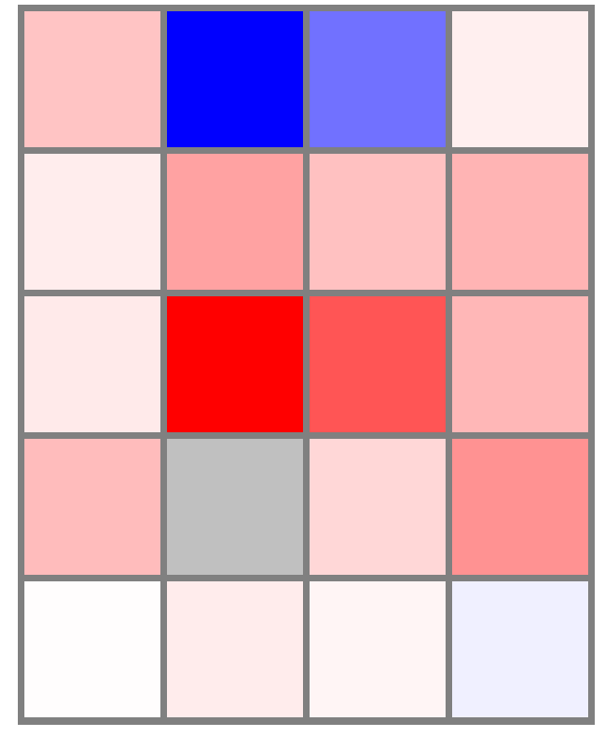
SARS-CoV-2 infected vs.Mock
lung epithelial cells (S vs. HC)
A549-ACE2
Calu-3
NHBE
ANXA1
C3
CXCL2
SAA1
TNFSF13
***
***
***
***
Log2 (Fold change)
***
***
***
***
-1 0 5
***
***
***
***
NULL
***
***
Figure S10. Comparison of ANXA1, C3, CXCL2, SAA1 and TNFSF13 expressions in lung epithelia cells (severe COVID-19 patients vs. health control ) and different in vitro cell lines models (A549-ACE2, Calu-3 and NHBE with or without SARS-CoV2 infection). *** P < 0.001. Null: no expression.

