Slide 1
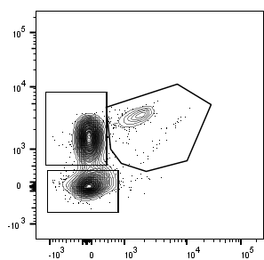
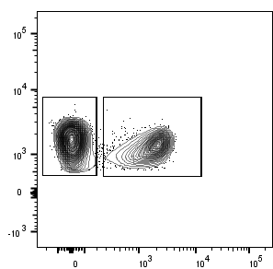
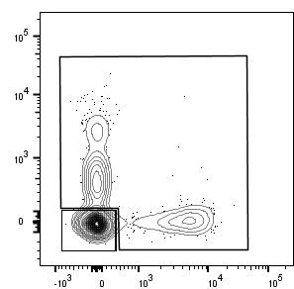
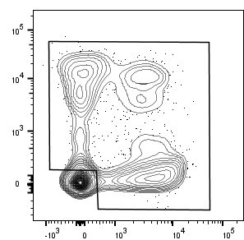
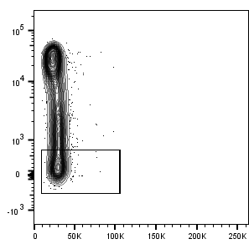
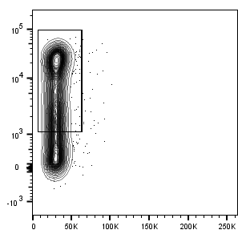
A
Lymphocytes
Single cells
Live cells
CD8 T-cells
SSC-A
FSC-H
Zombie NIRTM
TCRαβ BV421
B
FSC-A
FSC-A
FSC-A
CD8 PECy7
NK-like
CD56 BV510
panKIR PE
FSC-A
TCRαβ BV421
NKG2A PE
Eomes PerCPeF710
C
LTγδ
CD8(-)
panKIR PE
CD3 AF700
CD3 AF700
TCRγδ PerCP-Cy5.5
CD8 PE-Cy7
NKG2A PE-Vio615
NK-like
CD8 panKIR/NKG2A
panKIR PE
CD45RA BV650
CD45RA BV650
Memory CD8
D
NKG2A PE-Vio615
SSC-A
SSC-A
E
panKIR/NKGA2A(+)
Eomes(-)
Eomes(+)
Innate E(-)
Innate E(+)
EMRA
N
panKIR/NKG2A PE
panKIR/NKG2A PE
NKG2A/panKIR PE
CD45RA PE
panKIR/NKGA2A(-)
Conv E(-)
Conv E(+)
EM
CM
EomesPerCPeF710
EomesPerCPeF710
Eomes PerCPeF710
CCR7 FITC
Supplemental Figure 1: Gating strategy for the analysis of CD8(+) T-cell subpopulations in PBMC from HD and AlloTx recipients. A. Gates applicable to all the main Figures. B. Gating strategy of the Eomes(+) versus Eomes(-) NK-like cell populations analysed for IFN-γ expression in Figure 1D. C. Gating strategy of the different cell populations depicted in Figure 1E for MTDR analysis. D. Gating strategy of the Eomes and panKIR/NKG2A (+) and (-) cell populations depicted in Figure 4A for senescence (CD27(-)CD28(-)) analysis. E. Gating strategy based on NKG2A/panKIR and Eomes expression defining Innate E(+) and E(-) and Conv E(+) and E(-) CD8 T-cells, applicable to all the Figures (except for Figure 1E and Figure 4A). CD8 T-cell subpopulation denominations in the CCR7/CD45RA gating: naive (N): CD45RA(+)CCR7(+); EMRA: CD45RA(+)CCR7(-); central memory (CM): CD45RA(-)CCR7(+); effector memory (EM): CD45RA(-)CCR7(-).
Notes:
1,2,3, 5 : MT16 T1
4 : MT15 T1
A : toutes les fig : ligne 1 + EK + EMRA
B : K+/- E+/-
C : fig 1E

Slide 2
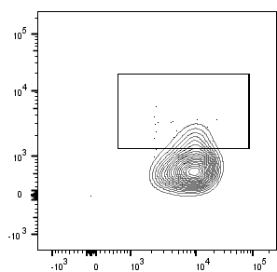
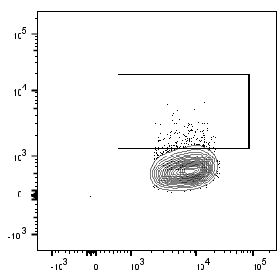
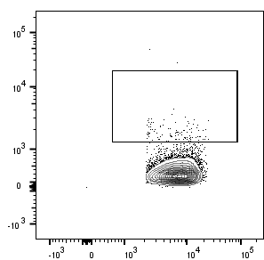
Innate E(+): panKIR/NKG2A (+) Eomes(+) Conv E(+): panKIR/NKG2A (-) Eomes(+)
Innate E(-): panKIR/NKG2A (+) Eomes(-) Conv E(-): panKIR/NKG2A (-) Eomes(-)
Innate E(+)
Innate E(-)
Conv E(+)
Conv E(-)
A
39.2%
31.0%
14.2%
5.2%
HD
73.5%
66.4%
30.5%
25.6%
AlloTx
CD27 PerCPCy5.5
CD28 BV510
B
47.7%
34.3%
22.3%
5.6%
HD
Perforin high
72.6%
85.5%
39.9%
10.2%
AlloTx
Perforin high
Perforin FITC
CD8 PECy7
C
17.9%
13%
3.2%
0.9%
HD
CD122 BV421
D
CD8 PECy7
8.2%
4.2%
0.9%
0.7%
HD
modal
IFN-γ AF488
Supplemental Figure 2: Representative plots of senescence (A), perforin (B), CD122 (C) and IFN-g (D) analysis.
Notes:
The advantage of viewing a univariate display as a histogram is the ability to visualize modal events (those occurring most frequently), estimating the coefficient of variation (CV), and standard deviation of the curve(s). Gating on the modal population(s) is easiest in a histogram vs. CDF.

Slide 3
Innate E(+): panKIR/NKG2A (+) Eomes(+) Conv E(+): panKIR/NKG2A (-) Eomes(+)
Innate E(-): panKIR/NKG2A (+) Eomes(-) Conv E(-): panKIR/NKG2A (-) Eomes(-)
r=0.0984
p=0.6474
r=0.0911
p=0.6719
K(+) E(+) (%)
K(+) E(-) (%)
Age (years)
Age (years)
r=0.5762
p=0.0032
r=-0.5936
p=0.0022
K(-) E(+) (%)
K(-) E(-) (%)
Age (years)
Age (years)
Supplemental Figure 3: The higher frequency of innate-like CD8 T-cell populations is not correlated with age of HD, contrarily to naive and memory conventional CD8 T-cell populations. Pearson correlation analysis between frequency of the four CD8 T-cell subpopulations according to panKIR/NKG2A and Eomes markers and age of HD (n=22).

Slide 4
Innate E(+)
(panKIR/NKG2A(+) Eomes(+))
Innate E(-)
(panKIR/NKG2A(+) Eomes(-))
CD45RA and CCR7 expression (%)
CD45RA and CCR7 expression (%)
N
EMRA
CM
EM
N
EMRA
CM
EM
Conv E(+)
(panKIR/NKG2A(-) Eomes(+))
Conv E(-)
(panKIR/NKG2A(-) Eomes(-))
CD45RA and CCR7 expression (%)
CD45RA and CCR7 expression (%)
N
EMRA
CM
EM
N
EMRA
CM
EM
Supplemental Figure 4: Distribution of naïve, EMRA, central memory and effector memory cell phenotypes among innate and conventional naïve/memory CD8 T-cell subpopulations. Flow cytometry analysis of the frequencies of CD45RA- and/or CCR7- expressing cells in the four CD8 T-cell subpopulations according to NKG2A/Pan-KIR and Eomes (E) markers among TCRαb(+)CD8(+) live lymphocytes in HD (n=11) and AlloTx (n=8). CD8 T-cell subpopulation denominations: naive (N): CD45RA(+)CCR7(+); EMRA: CD45RA(+)CCR7(-); central memory (CM): CD45RA(-)CCR7(+); effector memory (EM): CD45RA(-)CCR7(-).
Notes:
Mettre les graphes avec les données des patients + faire stat
-> rajouter cet élément dans le texte (resultats ou discu)

Slide 5
Innate E(+): panKIR/NKG2A (+) Eomes(+) Conv E(+): panKIR/NKG2A (-) Eomes(+)
Innate E(-): panKIR/NKG2A (+) Eomes(-) Conv E(-): panKIR/NKG2A (-) Eomes(-)
r=0.0359
p=0.8151
r=-0.1458
p=0.3393
E(+)K(+) (%)
E(-)K(+) (%)
Age (years)
Age (years)
r=0.3651
p=0.0116
r=-0.305
p=0.0371
E(+)K(-) (%)
E(-)K(-) (%)
Age (years)
Age (years)
Supplemental Figure 5: The higher frequency of innate CD8 T-cell populations is not correlated with age of AlloTx patients, contrarily to naive and memory conventional CD8 T-cell populations. Pearson correlation analysis between frequency of the four CD8 T-cell subpopulations according to panKIR/NKG2A and Eomes markers and age of AlloTx patients (n=45).

Slide 6
Innate E(+): panKIR/NKG2A (+) Eomes(+) Conv E(+): panKIR/NKG2A (-) Eomes(+)
Innate E(-): panKIR/NKG2A (+) Eomes(-) Conv E(-): panKIR/NKG2A (-) Eomes(-)
A
Innate E(+)
Innate E(-)
Conv E(+)
Conv E(-)
*
ns
ns
ns
Innate E(+) CD8 T-cells (%)
Innate E(-) CD8 T-cells (%)
Cov E(+) CD8 T-cells (%)
Cov E(-) CD8 T-cells (%)
B
CD8(+)
HD
AlloTx
HD
AlloTx
HD
AlloTx
HD
AlloTx
Innate E(+)
Innate E(-)
Conv E(+)
Conv E(-)
**
*
*
***
ns
CD27(-)CD28(-) cells (%)
CD27(-)CD28(-) cells (%)
CD27(-)CD28(-) cells (%)
CD27(-)CD28(-) cells (%)
CD27(-)CD28(-) cells (%)
HD
AlloTx
HD
AlloTx
HD
AlloTx
HD
AlloTx
HD
AlloTx
C
CD8(+)
Innate E(+)
Innate E(-)
Conv E(+)
Conv E(-)
**
*
ns
**
ns
Perforin(high) cells (%)
Perforin(high) cells (%)
Perforin(high) cells (%)
Perforin(high) cells (%)
Perforin(high) cells (%)
HD
AlloTx
HD
AlloTx
HD
AlloTx
HD
AlloTx
HD
AlloTx
Supplemental Figure 6: Higher cell frequency and exacerbated senescence/terminal differentiation profile of innate CD8 T-cells in AlloTx recipients do not result from age-bias. The frequencies of the four CD8 T-cell subpopulations according to panKIR/NKG2A and Eomes markers (A) and the frequencies of senescent CD27(-)CD28(-) (B) and perforin(high)-expressing cells (C) are analyzed in HD and AlloTx patient age-matched pairs (A: n=15, B: n=11, C: n=13). Each dot represents one HD or AlloTx patient. Mean ± SEM, two-tailed Mann–Whitney non-parametric test. *p<0.05; **p<0.01; ns: not significant.

Slide 7
Innate : panKIR/NKG2A (+) Eomes(+/-) Conv : panKIR/NKG2A (-) Eomes(+/-)
r=0.0760
p=0.6647
r=0.3578
p=0.0348
CD27(-)CD28(-) in
Innate T-cells (%)
CD27(-)CD28(-) in
Conv CD8 T-cells (%)
Age (years)
Age (years)
r=0.1389
p=0.3928
r=0.2802
p=0.0841
Perforin(high) in
Innate CD8 T-cells (%)
Perforin(high) in
Conv CD8 T-cells (%)
Age (years)
Age (years)
Supplemental Figure 7: Senescent and inflammaging phenotypes are not related to age in innate CD8 T-cells from AlloTx patients. Pearson correlation analysis between frequency of the senescent (CD27(-) CD28(-)) and inflammaging (perforin(high)) phenotypes among Innate (panKIR/NKG2A(+)) and Conv (panKIR/NKG2A(-)) CD8 T-cells and age in AlloTx patients (CD27(-)CD28(-): n=35; perforin: n=40).
Notes:
A et B : retiré 1 outlier dans DS et 1 outlier dans patients
C : retiré 1 outlier dans patients
C : retiré 1 outlier dans DS

Slide 8
Supplementary table: Anti-human antibodies used in this study
Antibody | Fluorochrome | Clone | Supplier | Reference | RRID
IFN-γ | AF488 | 4S.B3 | BioLegend | 502515 | AB_493029
TCRαβ | AF488 | IP26 | BioLegend | 306712 | AB_528967
Perforin | FITC | sigmaG9 | BD Biosciences | 556577 | AB_396470
CCR7 | FITC | 150503 | RD systems | FAB197F | AB_2259847
IFN-γ | APC | B27 | BioLegend | 506510 | AB_315443
Eomes | eF660 | WD1928 | eBioscience | 50-4877-42 | AB_2574229
TCRαβ | BV421 | IP26 | BioLegend | 306722 | AB_2562805
Ki67 | BV421 | Ki-67 | BioLegend | 350506 | AB_2563860
CD122 | BV421 | Mik-β3 | BD Biosciences | 562887 | AB_2737866
CD45RA | BV510 | HI100 | BioLegend | 304142 | AB_2561947
CD28 | BV510 | CD28.2 | BioLegend | 302936 | AB_2562030
TCRαβ | BV510 | IP26 | BioLegend | 306734 | AB_2650821
NKG2A | PE | REA110 | Miltenyi Biotec | 130-113-566 | AB_2726171
KIR2D | PE | NKVFS1 | Miltenyi Biotec | 130-092-688 | AB_871570
KIR3DL1/2 | PE | 5.133 | Miltenyi Biotec | 130-095-205 | AB_10839570
CD8 | PECy7 | RPA-T8 | BD Pharmingen | 557746 | AB_396852
CD69 | PerCpCy5.5 | FN50 | BioLegend | 310926 | AB_2074956
CD27 | PerCPCy5.5 | O323 | BioLegend | 302820 | AB_2073318
Eomes | PerCPeF710 | WD1928 | eBioscience | 46-4877-42 | AB_2573759

