Slide 2
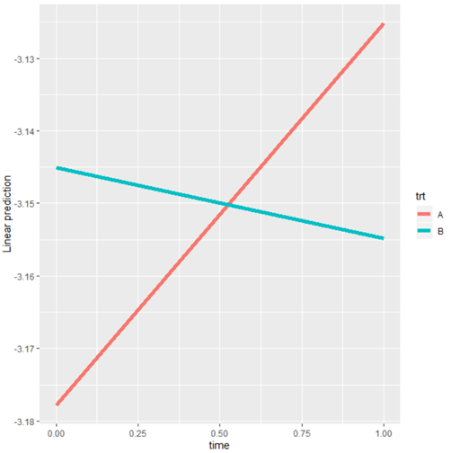
Supplemental Figure 1
Change in Log C18 Levels Between Baseline and 3-Months By Treatment Group
Log C18
Usual Care
Exercise
Baseline 3-Months

