Slide 1
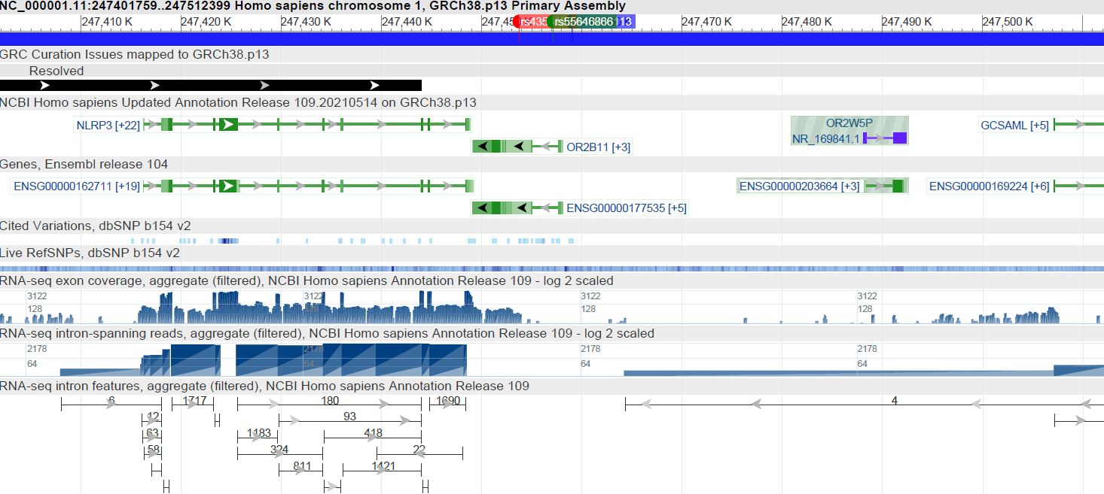
Supplementary Figure S1: Location of rs4353135, rs55646866 and rs10733113713
Location of rs4353135 (red), rs55646866 (green) and rs10733113713 (blue) on chromosome 1, downstream of NLRP3 and upstream/within OR2B11

