Slide 1
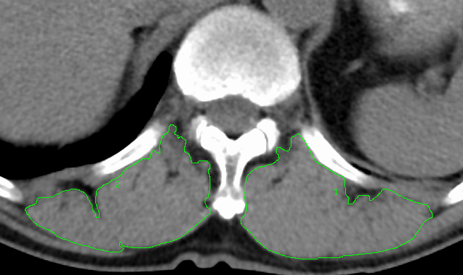
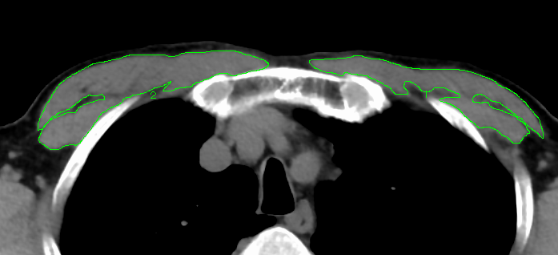
Supplemental figure 1
Tashiro H et al,
(a)
(b)

Slide 2
Supplemental figure 2
Tashiro H et al,
(a)
(b)
ρ = 0.74
p < 0.0001
ρ = -0.35
p = 0.02
V’O₂ (ml/min/kg) at peak exercise
V’O₂ (ml/min/kg) at peak exercise
6-minute walk distance (m)
COPD assessment test

