Slide 1
COVID-19 induced VT storm unmasking a clinically silent cardiomyopathy: a case report
July 2020
EHJ-CR-D-20-01244

Slide 2
Introduction
The manifestations of coronavirus disease (COVID-19) range from asymptomatic infection to multi-organ failure and death.
Among these, COVID-19 related myocarditis and arrhythmias are hypothesized to result from:
Direct viral myocardial injury and/or
Inflammatory cytokines induced damage ¹⁻⁴
We report a patient presenting with ventricular tachycardia (VT) storm induced by COVID-19 infection that unmasked an underlying clinically silent genetic cardiomyopathy.

Slide 3
Case Presentation
History and Examination Findings
A 57-year-old gentleman had 3 VT episodes within 3 hours (2 in a peripheral centre and one in our emergency).
Managed by DC (direct current) cardioversion and injectable amiodarone.
Medical history: Type-2 diabetes-mellitus and Grave’s disease for last 10 years (on regular treatment). No past history suggestive of cardiac illness.
Family history: Sudden cardiac death (SCD) in two siblings at ages of 55 and 59 years.
At presentation, pulse rate : 60/minute and BP : 120/84 mmHg. No other significant clinical findings.

Slide 4
Case Presentation
Investigations
ECG during: a) VT: suggestive of RV (right ventricle) origin (Figure A-next slide) b) Sinus rhythm: Epsilon waves suggestive of ARVC (Arrhythmogenic right ventricular cardiomyopathy) ⁵ (Figure B-next slide)
2D Echo: dilated RV, with poor RV function and normal LV function suggestive of ARVC.⁵
Incidentally patient found to be COVID-19: RTPCR positive (persistently positive till week 4)

Slide 5
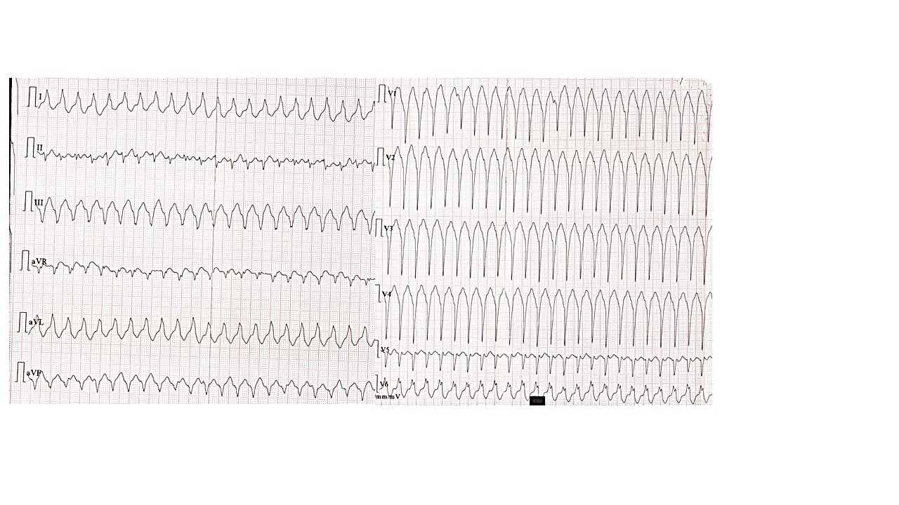
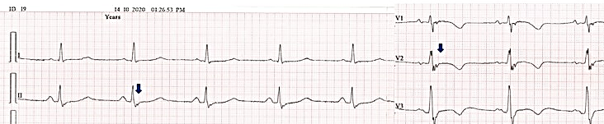
Case Presentation
Investigations
A: 12 lead ECG (at 25mm/s speed) recording of monomorphic VT episode recorded at time of presentation to emergency
B: ECG in sinus rhythm (50 mm/sec). Epsilon waves in leads V1 to V3 (arrow) with T-wave inversion.

Slide 6
Case Presentation
Investigations
Raised inflammatory markers like IL-6, cardiac troponin T (c-TnT), and ventricular premature contraction (VPC) burden on Holter monitoring.
An increasing trend was noted till 4th week→ then gradual decline → return to normal by 6th week (when RTPCR also became negative). (Figure C-next slide)
Cardiac MRI (at 6th week): features suggestive of ARVC and concomitant myocarditis- [myocardial edema and selective subepicardial LGE (Late Gadolinium Enhancement)] (Figure D-next slide)

Slide 7
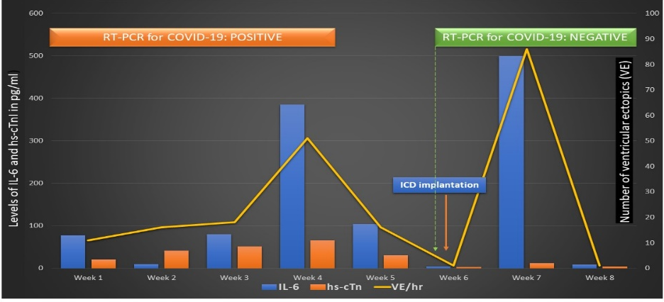
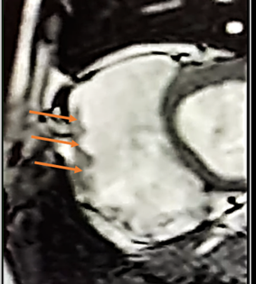
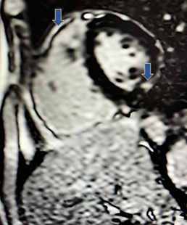
Case Presentation
Investigations
D: Cardiac MRI: suggestive of RV dilatation and outpouchings (orange arrows), mid myocardial wall LGE (blue arrows).
C: Trend of various inflammatory markers and cardiac troponin T along with VPC burden during the course of hospital stay. y axis: levels of IL-6 and hs-cTnT, x axis: time since hospitalisation, secondary vertical axis: VPC burden.
RV outpouchings
LGE in myocarditis

Slide 8
Case Presentation
Management
Patient managed medically for 6 weeks with oral amiodarone, carvedilol along with antithyroid and oral hypoglycemic drugs.
At 6th week: Automated implantable cardioverter defibrillator (AICD) implantation done as per guidelines. ⁶
Transient surge in inflammatory markers, cTnT noted post AICD procedure → settled spontaneously within a week.(Figure C- previous slide)
Patient discharged on all the above medications and oral ramipril.
6 weeks follow-up: Asymptomatic and euthyroid without any recurrence of symptoms or AICD interventions.

Slide 9
Discussion
VT storm due to COVID-19 induced myocarditis that unmasked an underlying clinically silent cardiomyopathy (ARVC) has not yet been reported.
Highlights the etiologic role of systemic inflammation in COVID-19 induced arrhythmogenicity.
Serially monitored cytokines(IL-6), cTnT and VPC burden showed a parallel trend of rise and fall during the active and convalescent phases of COVID-19 infection.

Slide 10
Discussion
Increased IL-6 in hyperinflammatory states correlates with QT prolongation and SCD risk.⁷
The report also highlights the etiologic relationship between IL-6 and electrical instability in ARVC by its effect of reducing plakoglobin protein expression on cardiomyocytes. ⁸

Slide 11
Discussion
IL-6 surge induced by COVID-19 and later by AICD implantation stress induced VPC surge in our patient with underlying ARVC.
Patient is under regular clinical follow-up and monitoring of thyroid status to assess amiodarone induced thyroid dysfunction.

Slide 12
Learning Points
VT storm unmasking an underlying clinically silent cardiomyopathy may be the sole manifestation of active Covid19-infection.
2. Ventricular arrhythmia burden paralleled the systemic cytokine surge which hints towards a role of IL-6 in arrhythmogenesis in our patient with underlying dormant ARVC.

Slide 13
References
1. Siripanthong B, Nazarian S, Muser D, Deo R, Santangeli P, Khanji MY et al. Recognizing COVID-19-related myocarditis: The possible pathophysiology and proposed guideline for diagnosis and management. Heart Rhythm. 2020 Sep;17(9):1463-1471. doi: 10.1016/j.hrthm.2020.05.001.
2. Turagam MK, Musikantow D, Goldman ME, Bassily-Marcus A, Chu E, Shivamurthy P et al. Malignant Arrhythmias in Patients With COVID-19: Incidence, Mechanisms, and Outcomes. Circ Arrhythm Electrophysiol. 2020 Nov;13(11): e008920.
3. Bhatla A., Michael M., Adusumalli S., Matthew C., Eric Oh, Ann Tierney, et al COVID-19 and cardiac arrhythmias, Heart Rhythm, Volume 17, Issue 9, 2020, Pages 1439-1444
4. Lazzerini PE, Boutjdir M, Capecchi PL. COVID-19, Arrhythmic Risk, and Inflammation: Mind the Gap! Circulation. 2020 Jul 7;142(1):7-9. doi: 10.1161/CIRCULATIONAHA.120.047293.
5. Arrhythmogenic Right Ventricular Cardiomyopathy: Current Diagnostic Criteria - American College of Cardiology [Internet]. [cited 2020 Oct 24]. Available from: https://www.acc.org/latest-in-cardiology/ten-points-to-remember/2019/10/29/11/37/arrhythmogenic-right-ventricular-cardiomyopathy
6. Priori SG, Blomström-Lundqvist C, Mazzanti A, Bloma N, Borggrefe M, Camm J, et al. 2015 ESC Guidelines for the management of patients with ventricular arrhythmias and the prevention of sudden cardiac death: The Task Force for the Management of Patients with Ventricular Arrhythmias and the Prevention of Sudden Cardiac Death of the European Society of Cardiology (ESC). Europace. 2015 Sep 28;17(11):1601–87
7. Alí A, Boutjdir M, Aromolaran AS. Cardiolipotoxicity, inflammation, and arrhythmias: role for interleukin-6 molecular mechanisms. Front Physiol 2018;9:1866. 10.3389/fphys.2018.01866
8. Gemayel C, Pelliccia A, Thompson PD. Arrhythmogenic right ventricular cardiomyopathy. J Am Coll Cardiol. 2001 Dec;38(7):1773-81.

