Slide 1
Novel Atrioventricular Sequential Pacing Approach Using a Transvenous Atrial Pacemaker and a Leadless Pacemaker: A Case Report
May 2020
EHJ-CR-D-20-01239R1

Slide 2
Introduction
Lead related Tricuspid Regurgitation (TR) is an increasingly recognised complication for trans-venous pacemakers.
Severe lead related TR is associated with an increased risk of heart failure hospitalization and death.¹
Transvenous lead extraction (TLE) can reduce lead related TR in up to a third of patients.²
For patients with an ongoing indication for pacing after TLE options include implanting a CS lead, His bundle pacing and leadless pacemakers.

Slide 3
Introduction (continued)
Leadless pacemaker implantation is associated with high procedural success rates and low complication rates.
A 2nd generation leadless pacemaker called the Micra™ AV has recently been released.
The Micra AV uses an accelerometer based algorithm to allow atrio-ventricular (AV) synchronous pacing (termed VDD)³.

Slide 4
Case Presentation
History and Examination Findings
66 year old woman.
Background: hypertension, type II diabetes, hypothyroidism, left atrial myxoma excision, previous atrial flutter ablation and a dual chamber pacemaker implant in 2006 for sinus node dysfunction.
Presenting complaint: 1 year history of breathlessness on exertion, lower limb oedema and postural neck pulsations.
On examination: pitting oedema, elevated jugular venous pressure with prominent V waves.

Slide 5
Case Presentation
Investigations
Blood Tests: listed in Table 1
Echo: Severe TR due to TV tethering by the right ventricular (RV) lead (fig.1). Normal left ventricular (LV) function. Aortic sclerosis.
Pacemaker interrogation: 100% atrial pacing
  10% RV pacing
Table 1 | Result
Sodium | 145 mmol/L
Potassium | 4.0 mmol/L
Creatinine | 93 μmol/L
Hb | 122 g/L
Platelets | 248 x10⁹/L

Slide 6
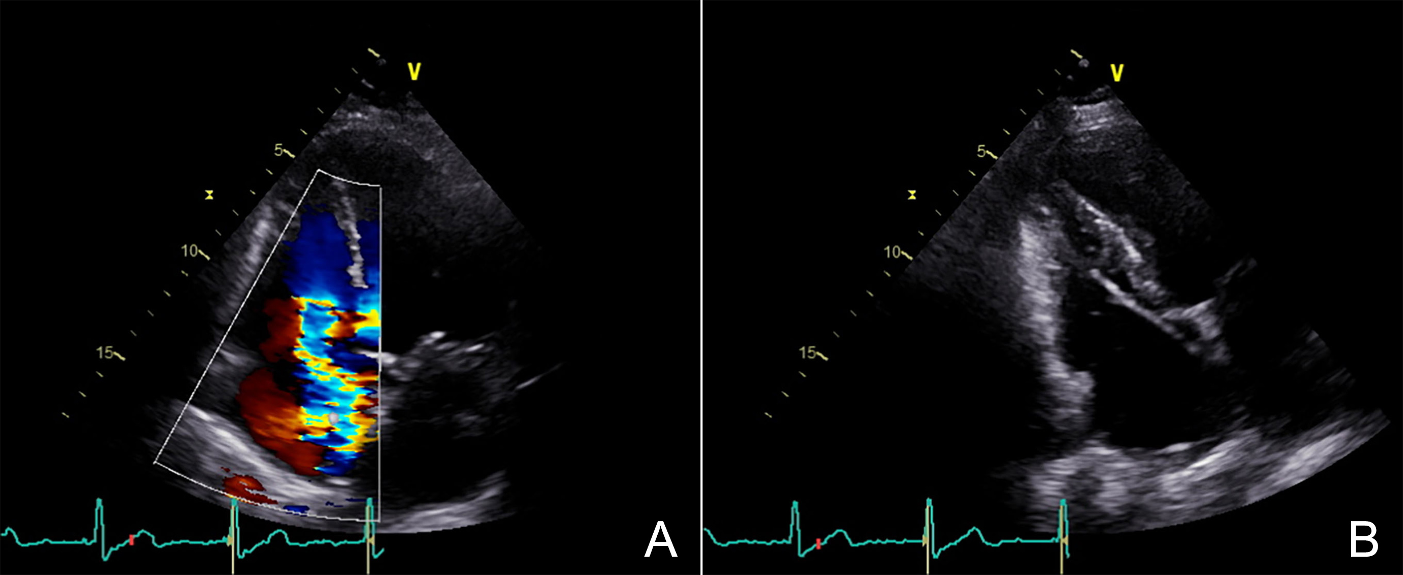
Case Presentation
Investigations
Figure 1
A: Apical four chamber view showing severe tricuspid regurgitation (white arrow).
B: Modified apical four chamber view suggesting RV lead impingement of the TV septal leaflet (red arrow).

Slide 7
Case Presentation
Management
Diagnosed as severe symptomatic lead related TR.
Discussed in multi-disciplinary team meeting. EUROSCORE II risk of inpatient mortality 4.1% with surgical TV replacement/repair.
Decision for transvenous RV lead extraction with implantation of Micra™ AV in the first instance in a bid to avert open heart surgery.
Procedure performed under GA as a day case with no immediate complications and AV sequential pacing was achieved (fig.2, fig.3).
Unfortunately severe symptomatic TR persisted so was referred to surgical team for TV repair/replacement (awaited)

Slide 8
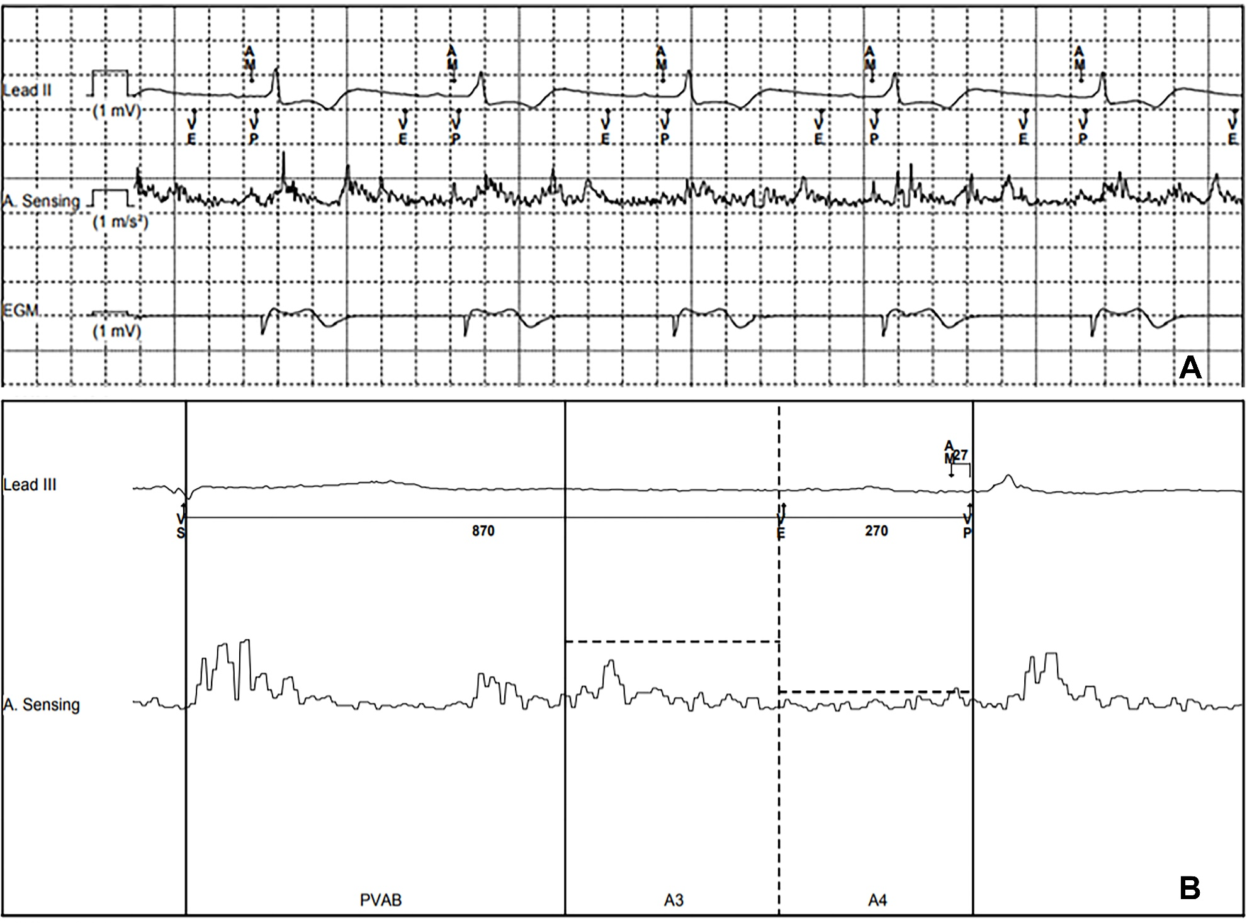
Case Presentation
Management
Figure 2:
A: Pacing System Analysis demonstrating atrial mechanical sensing (AM) and AV sequential pacing.
B: Micra™ AV accelerometer waveform showing a small but well-sensed A4 signal.
Fig. 2

Slide 9
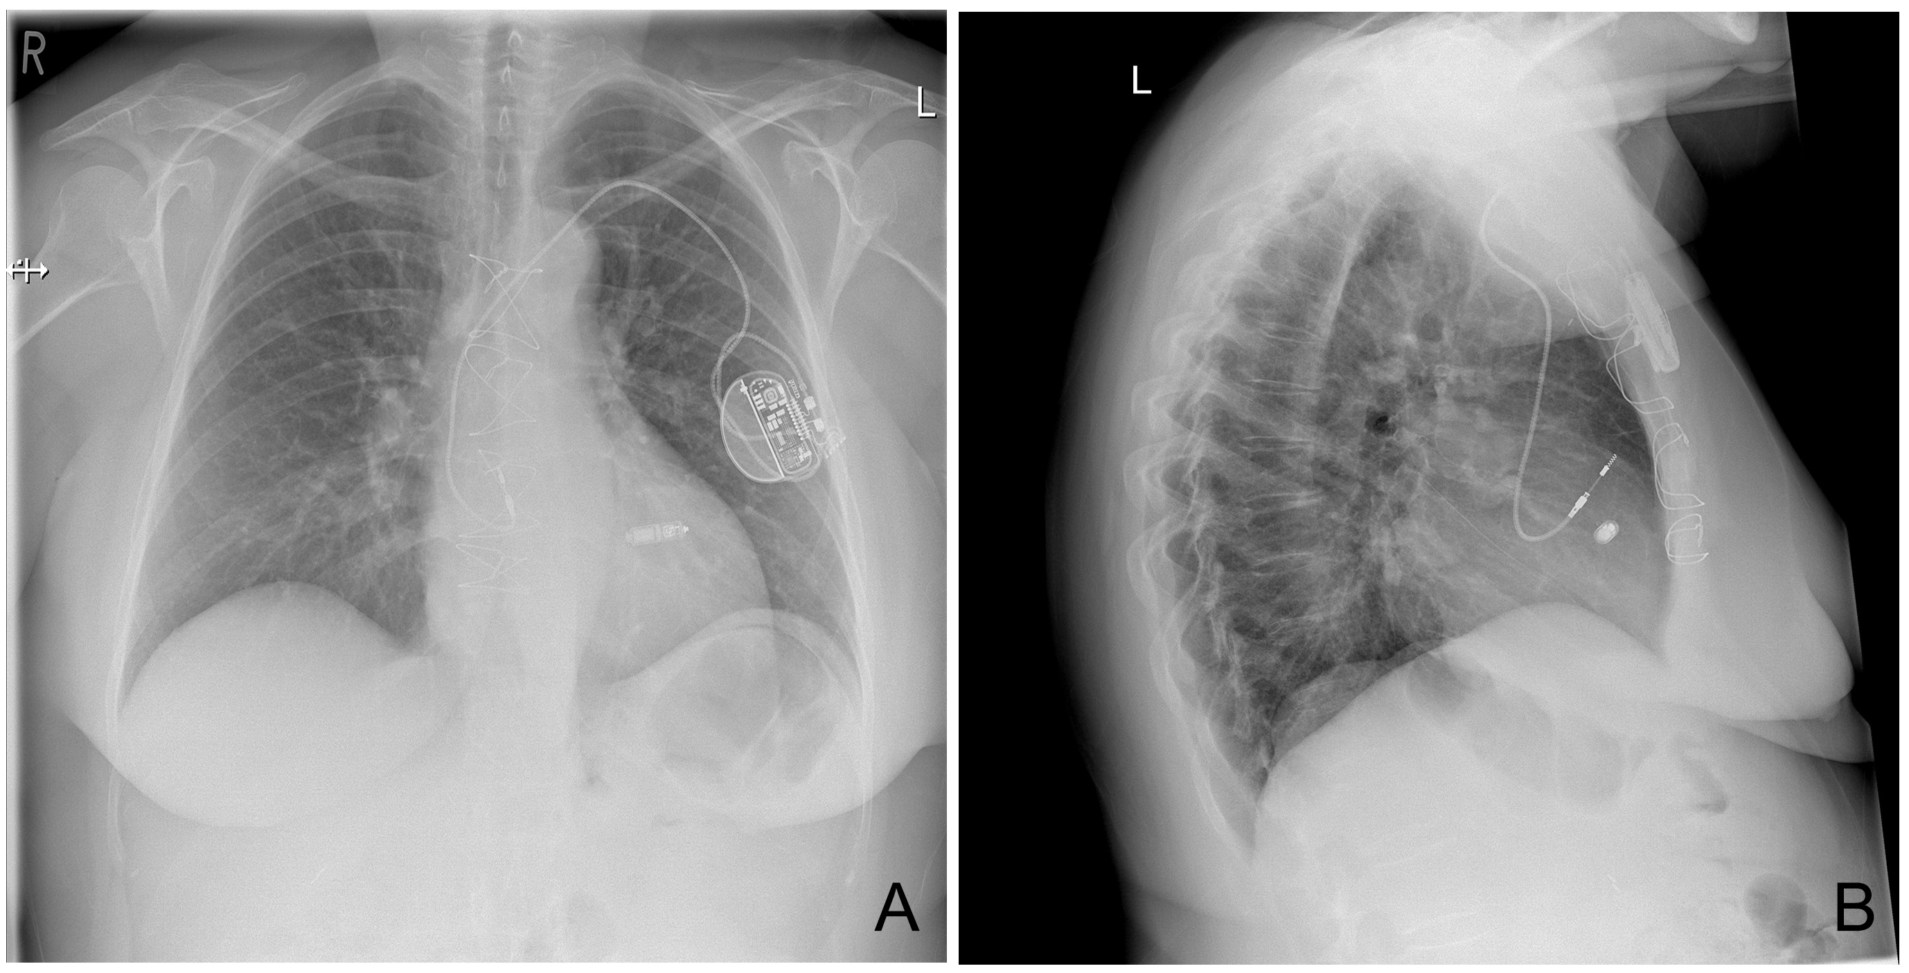
Case Presentation
Management
Figure 3
A: Post-procedural postero-anterior chest x-ray excluding pneumothorax and haemothorax.
B: Lateral chest x-ray showing correct lead and device positions.

Slide 10
Discussion
TLE can reduce lead related TR but results can be variable.
Whether TR will be reduced after TLE is closely related to the mechanism of TR.
TLE is less effective in the presence of tricuspid annular dilatation.
In our case TLE failed to reduce TR.
Possible pacing strategies after TLE in this context include LV leads, His-bundle pacing and leadless pacemakers.
We were concerned about the risk of lead displacement if TV surgery was required after TL, therefore decided on AAI pacemaker + Micra AV.

Slide 11
Discussion
The Micra AV uses its 3-axis accelerometer to produce wave-forms termed A1, A2, A3, and A4. These correspond to the heart sounds S1 to S4 (fig.2B).
The Micra AV ignores signals A1 to A3 as they fall within the post-ventricular atrial blanking (PVAB) and A3 window (fig.2B).
The Micra AV senses the A4 signal which represents the mechanical atrial contraction (designated AM) (fig.2B).
Ventricular pacing is delivered after sensing A4 (fig.2A, 2B).

Slide 12
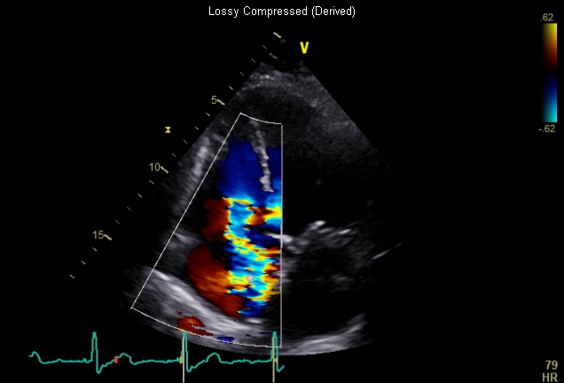

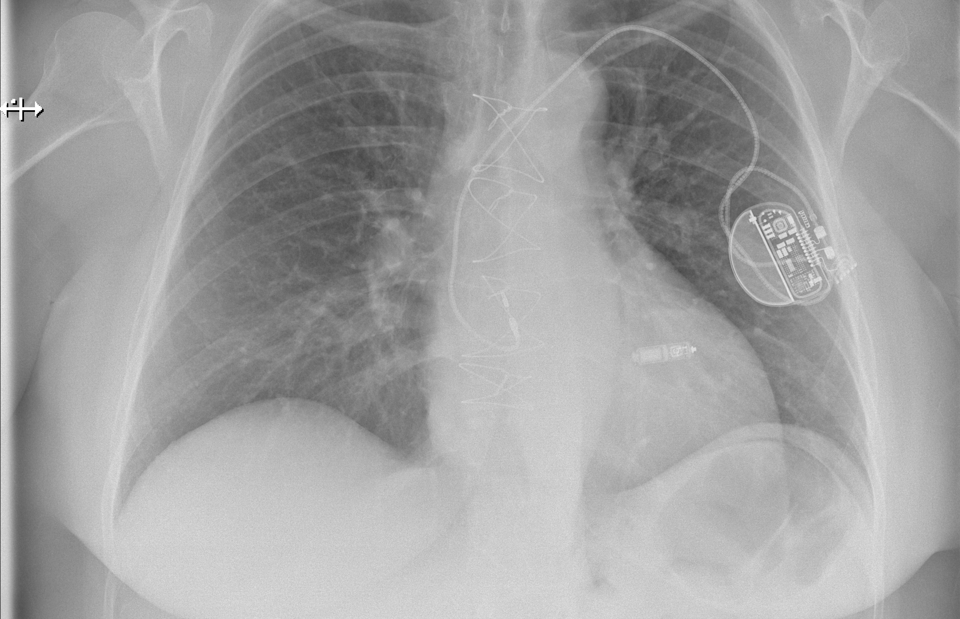
Learning Points
Lead-related tricuspid valve dysfunction is an important and increasingly recognised complication.
The Micra™ AV is a 2nd generation leadless pacemaker which uses a 3-axis accelerometer to sense the atrial mechanical contraction, thus enabling atrio-ventricular synchronous pacing (VDD).
AV sequential pacing can be achieved using a dual pacemaker approach involving the use of a Micra™ AV and a transvenous AAI.

Slide 13
References
Höke U, Auger D, Thijssen J, Wolterbeek R, van der Velde E, Holman E et al. Significant lead-induced tricuspid regurgitation is associated with poor prognosis at long-term follow-up. Heart 2014;100:960-968. doi:10.1136/heartjnl-2013-304673
Park S, Gentry 3rd J, Varma N, Wazni O, Tarakji K, Mehta A et al. Transvenous Extraction of Pacemaker and Defibrillator Leads and the Risk of Tricuspid Valve Regurgitation. JACC Clin Electrophysiol. 2018;4(11):1421-1428.
12. Steinwender C, Khelae S, Garweg C, Chan J, Ritter P, Johansen J et al. Atrioventricular Synchronous Pacing Using a Leadless Ventricular Pacemaker. JACC: Clinical Electrophysiology. 2020;6(1):94-106.

