Slide 1
JAMA Ophthalmology Journal Club Slides:
Intravitreal Aflibercept for the Treatment of Severe Nonproliferative Diabetic Retinopathy
Brown DM, Wykoff CC, Boyer D, et al. Evaluation of intravitreal aflibercept for the treatment of severe nonproliferative diabetic retinopathy: results from the PANORAMA randomized clinical trial. JAMA Ophthalmol. Published online August 5, 2021. doi:10.1001/jamaophthalmol.2021.2809

Slide 2
Introduction
Importance:
  Proactive treatment of nonproliferative diabetic retinopathy (NPDR) reduces the risk of progression to vision-threatening complications.
Objective:
  To evaluate vascular endothelial growth factor blockade therapy with intravitreal aflibercept injections in eyes with severe NPDR without diabetic macular edema (DME).
Study Design, Setting, and Participants:
  Double-masked 100-week randomized clinical trial.
  402 Adults with Diabetic Retinopathy Severity Scale (DRSS) level 47 or 53 with no DME and best-corrected visual acuity of 20/40 or better.
  Interventions:
    Aflibercept, 2 mg, every 16 weeks after 3 initial monthly doses and one 8-week interval (aflibercept 2q16 group).
    Aflibercept, 2 mg, every 8 weeks after 5 initial monthly doses, with pro re nata (PRN) dosing beginning at week 56 (aflibercept 2q8/PRN group).
    Sham injections (control group).

Slide 3
Methods
Main Outcomes and Measures:
  Proportions of eyes with a 2-step or greater improvement in DRSS level, vision-threatening complications, and center-involved DME (CI-DME) from baseline to weeks 24, 52, and 100.
Limitations:
  The study population was limited to eyes with moderately severe to severe NPDR.
  Participants were evaluated on a fixed schedule, with more frequent visits than are typically used in a clinical setting outside of a clinical trial.
  The 100-week clinical trial design provided a relatively short duration of follow-up for a chronic disease.

Slide 4
Results
Among 402 participants (1 eye per participant), the mean (SD) age was 55.7 (10.5) years; 225 (56.0%) were male, and 310 (77.1%) were White.
A total of 135 were randomized to the aflibercept 2q16 group, 134 to the aflibercept 2q8/PRN group, and 133 to the control group.
The proportion of eyes with ≥2-step improvement in DRSS level 47 or 53 with no DME and best-corrected score from baseline was significantly greater in the combined aflibercept groups vs observation at week 24 and in each aflibercept group vs observation at weeks 52 and 100.
Significantly fewer eyes in the aflibercept groups developed vision-threatening complications (VCTs) (including PDR and/or anterior segment neovascularization) and CI-DME at weeks 52 and 100 vs observation.
The cumulative event rates at week 100 were lower in the aflibercept groups vs observation.

Slide 5
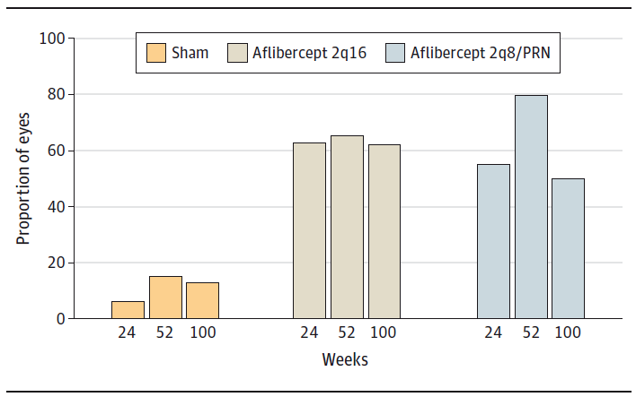
Results
Proportion of Eyes With a 2-Step or Greater Improvement
on DRSS From Baseline Through Week 100
Eyes in the aflibercept 2q16 group (n = 135) received intravitreal injections of aflibercept, 2 mg, every 16 weeks after 3 initial monthly doses and one 8-week interval; eyes in the aflibercept 2q8/PRN group (n = 134) received intravitreal injections of aflibercept, 2 mg, every 8 weeks after 5 initial monthly doses, with pro re nata (PRN) dosing beginning at week 56; and eyes in the control group (n = 133) received sham injections. The full analysis set was analyzed using the last observation carried forward method. At week 52, P < .001 for aflibercept 2q16 vs sham (65.2% vs 15.0%) and aflibercept 2q8/PRN vs sham. At week 100, P values for aflibercept 2q16 vs sham and aflibercept 2q8/PRN vs sham were nominal.

Slide 6
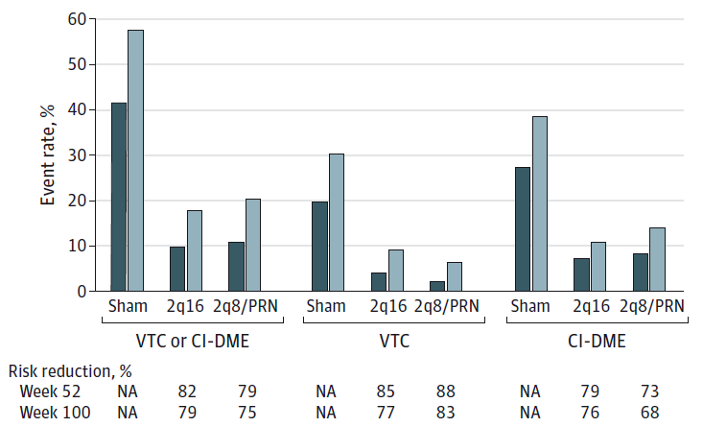
Results
Analysis of Events Indicative of Diabetic Retinopathy Progression:
Event Rates Among Eyes That Developed VTCs or CI-DME

Slide 7
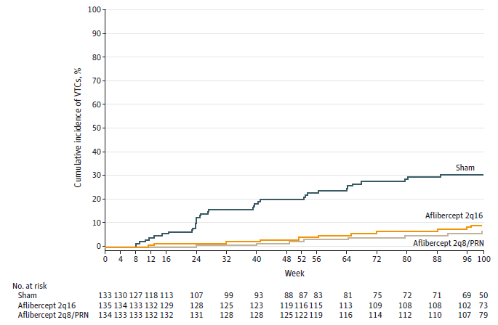
Results
Cumulative Incidence of Events Indicative of Diabetic Retinopathy Progression:
VTCs Through Week 100
The cumulative event rate at week 100 was 9.1% in the aflibercept 2q16 group (hazard ratio, 0.23; P < .001) and 6.9% in the aflibercept 2q8/PRN group (hazard ratio, 0.17; P < .001) compared with 30.6% in the control group.

Slide 8
Results
In a post hoc analysis of participants who had VTCs and/or CI-DME, 3 times as many participants (28.6%) who received sham injections lost 5 or more ETDRS letters at some point over the course of the study compared with those who received intravitreal aflibercept injections (9.0% in each treatment group).
Of 133 eyes in the control group, 19 eyes (14.3%) received rescue treatment for VTCs, and 39 eyes (29.3%) received rescue treatment for CI-DME.
Of 135 eyes in the aflibercept 2q16 group, 4 eyes (3.0%) received rescue treatment for VTCs, and 10 eyes (7.4%) received rescue treatment for CI-DME.
Of 134 eyes in the aflibercept 2q8/PRN group, 5 eyes (3.7%) received rescue treatment for CTCs, and 11 eyes (8.2%) received rescue treatment for CI-DME.
The proportion of participants who underwent panretinal photocoagulation or vitrectomy was lower in the aflibercept groups compared with the control group.

Slide 9
Comment
Significantly more eyes receiving aflibercept injections achieved ≥2 step improvement in DRSS levels at weeks 24 and 52.
At week 100, significant DRSS level improvements were maintained with both aflibercept dosing strategies, and both aflibercept groups had a significantly lower incidence of VTCs and CI-DME vs observation.
No differences in visual acuity were seen at 2 years; however, 3 times as many patients treated with sham who experienced VTCs and/or CI-DME had vision loss of ≥5 letters over the study course.
In year 2, dosing in the 2q8/PRN group was not fixed, with a mean of 1.8 injections. The proportion of eyes with ≥2 step improvement in DRSS level declined from 79.9% at week 52 to 50% at week 100.
  Among 34% of patients receiving no injections during year 2, the incidence of VTCs rose to 9.8%; while still lower than the sham group at 27.1%, this suggests that discontinuation of therapy may lead to VTCs and that proactive treatment at fixed intervals (eg, 3-4 times a year) may lead to a greater avoidance of VTCs and CI-DME.

Slide 10
Comment
Results from this study, combined with clinical experience and evidence from prior studies suggest that there is value in targeting the disease process at the nonproliferative stage to reduce the development of PDR and CI-DME.
  Treatment of PDR with panretinal photocoagulation is inherently destructive and is associated with reduced peripheral visual fields and other potential adverse consequences.
  Even with treatment, once PDR has developed, damage to the retina may no longer be reversible.
The overall safety of intravitreal aflibercept injections through 100 weeks in the study was consistent with the known safety profile.

Slide 11
Contact Information
If you have questions, please contact the corresponding author:
  Charles C. Wykoff, MD, PhD, Retina Consultants of Texas (Retina Consultants of America), 6560 Fannin St, Ste 750, Houston, TX 77030 (ccwmd@retinaconsultantstexas.com).
  Funding/Support
This study was funded by Regeneron Pharmaceuticals.

Slide 12
Conflict of Interest Disclosures
Dr Brown reported receiving grants from Regeneron Pharmaceuticals during the conduct of the study and grants from Adverum Biotechnologies, Genentech, Heidelberg Pharma, Kodiak Sciences, Novartis, Regeneron Pharmaceuticals, and REGENXBIO; personal fees from Adverum Biotechnologies, Allergan, Chengdu Kanghong Biotech, Clearside Biomedical, Genentech, Kodiak Sciences, Novartis, Ohr Pharmaceutical, Regeneron Pharmaceuticals, REGENXBIO, Samsung Bioepis, and Santen Pharmaceutical; and consultancy work for Bayer, BioTime, Kodiak Sciences, Optos, and Senju Pharmaceutical outside the submitted work. Dr Wykoff reported receiving grants from Adverum Biotechnologies, Aerie Pharmaceuticals, Aldeyra Therapeutics, Alimera Sciences, Allergan, Apellis Pharmaceuticals, Bayer, Boehringer Ingelheim, Chengdu Kanghong Biotech, Clearside Biomedical, Gemini Therapeutics, Genentech, Graybug Vision, Gyroscope Therapeutics, Ionis Pharmaceuticals, Iveric Bio, Kodiak Sciences, Lowy Medical Research Institute, Mylan Pharmaceuticals, Neurotech Pharmaceuticals, NGM Biopharmaceuticals, Novartis, Opthea, Outlook Therapeutics, Oxurion, RecensMedical, Regeneron Pharmaceuticals, REGENXBIO, Roche, Samchundang Pharm, Samsung Bioepis, Santen Pharmaceutical, Senju Pharmaceutical, Taiwan Liposome Company, and Xbrane Biopharma; personal fees from Acucela, Adverum Biotechnologies, Aerie Pharmaceuticals, Aerpio Pharmaceuticals, Alcon, Alimera Sciences, Allegro Pharmaceuticals, Allergan, Alnylam Pharmaceuticals, Apellis Pharmaceuticals, Arctic Vision, Arrowhead Pharmaceuticals, Bausch + Lomb, Bayer, Bionic Vision Technologies, Chengdu Kanghong Biotech, Clearside Biomedical, Corcept Therapeutics, Dutch Ophthalmic Research Center, EyePoint Pharmaceuticals, Genentech, Gyroscope Therapeutics, Iveric Bio, Kato Pharmaceuticals, Kodiak Sciences, Merck & Co, NGM Biopharmaceuticals, Notal Vision, Novartis, OccuRx, Ocular Therapeutix, ONL Therapeutics, Opthea, Oxurion, Palatin Technologies, PentaVision, PolyPhotonix, RecensMedical, Regeneron Pharmaceuticals, REGENXBIO, Roche, SAI MedPartners, Santen Pharmaceutical, Takeda Pharmaceutical, Thea Open Innovation, and Verana Health; and other support from ONL Therapeutics, PolyPhotonix, RecensMedical, Regeneron Pharmaceuticals (speaking fees), and Visgenx outside the submitted work. Dr Boyer reported receiving grants from Adverum Biotechnologies, Allergan, Boehringer Ingelheim, Genentech, Graybug Vision, Kodiak Sciences, Novartis, Ophthea, Regeneron Pharmaceuticals, REGENXBIO, and Roche; personal fees from Adverum Biotechnologies, Allegro Pharmaceuticals, Boeringer Ingelheim, Genentech, Regeneron Pharmaceuticals, REGENXBIO, Roche, Santen Pharmaceutical, and Unity Biotechnology; and consulting work for Adverum Biotechnologies, Allergan, Bayer, Boehringer Ingelheim, Genentech, Graybug Vision, Kodiak Sciences, Novartis, Ophthea, Regeneron Pharmaceuticals, and REGENXBIO outside the submitted work.

Slide 13
Conflict of Interest Disclosures (continued)
Dr Heier reported receiving grants from Optovue and Regeneron Pharmaceuticals during the conduct of the study and grants from Aerpio Pharmaceuticals, Aldeyra Therapeutics, Apellis Pharmaceuticals, AsclepiX Therapeutics, Bayer, Genentech, Graybug Vision, Gyroscope Therapeutics, Hemera Biosciences, Iveric Bio, Janssen Pharmaceuticals, Chengdu Kanghong Biotech, Kodiak Sciences, NGM Biopharmaceuticals, Notal Vision, Novartis, Regeneron Pharmaceuticals, REGENXBIO, and Stealth BioTherapeutics; personal fees from 4D Molecular Therapeutics, Adverum Biotechnologies, Aerie Pharmaceuticals, Aerpio Pharmaceuticals, Aldeyra Therapeutics, Allegro Pharmaceuticals, Alzheon, Annexon Biosciences, Apellis Pharmaceuticals, Aprea Therapeutics, AsclepiX Therapeutics, Aviceda Therapeutics, Bionic Vision Technologies, Dark Horse Pharmaceuticals, DTx Pharma, Eloxx Pharmaceuticals, Galimedix Therapeutics, Genentech, Graybug Vision, Gyroscope Therapeutics, Iveric Bio, jCyte, Chengdu Kanghong Biotech, LensGen, NGM Biopharmaceuticals, Novartis, Ocular Therapeutix, OcuTerra Therapeutics, Oxurion, Palatin Technologies, Regeneron Pharmaceuticals, REGENXBIO, Stealth BioTherapeutics, Thea Open Innovation, Verseon, Vinci Pharmaceuticals, and Voyant Beauty; and consultancy work for 4D Molecular Therapeutics, Adverum Biotechnologies, Aerie Pharmaceuticals, Aerpio Pharmaceuticals, Aldeyra Therapeutics, Allegro Pharmaceuticals, Alzheon, Annexon Biosciences, Apellis Pharmaceuticals, Aprea Therapeutics, AsclepiX Therapeutics, Aviceda Therapeutics, Beaver-Visitec International, Bionic Vision Technologies, DTx Pharma, Eloxx Pharmaceuticals, Galimedix Therapeutics, Genentech, Graybug Vision, Gyroscope Therapeutics, Horizon Therapeutics, iRenix Medical, Iveric Bio, jCyte, Chengdu Kanghong Biotech, LensGen, NGM Biopharmaceuticals, Notal Vision, Novartis, Ocular Therapeutix, OcuTerra Therapeutics, Oxurion, Palatin Technologies, Regeneron Pharmaceuticals, REGENXBIO, Stealth BioTherapeutics, Thea Open Innovation, Verseon, Vinci Pharmaceuticals, and Voyant Beauty outside the submitted work. Dr Clark reported receiving grants and personal fees from Bayer, Genentech, Kodiak Sciences, and Regeneron Pharmaceuticals during the conduct of the study and grants from Genentech and personal fees from Bayer, Genentech, Cardinal Health, and Regeneron Pharmaceuticals outside the submitted work. Dr Emanuelli reported receiving grants from Aerie Pharmaceuticals, Allegro Pharmaceuticals, Allergan, Diabetic Retinopathy Clinical Research Network, Genentech, ICON, Ionis Pharmaceuticals, KalVista Pharmaceuticals, Kodiak Sciences, Novartis, Opthea, Optos, Regeneron Pharmaceuticals, Santen Pharmaceutical, Senju Pharmaceutical, Sydnexis, and Ribomic during the conduct of the study and personal fees from Aerie Pharmaceuticals, Allegro Pharmaceuticals, Aviceda Therapeutics, Genentech, Kodiak Sciences, Novartis, Regeneron Pharmaceuticals, Santen Pharmaceutical, and EyePoint Pharmaceuticals and participation in a clinical trial funded by Novartis outside the submitted work. Dr Higgins reported serving on the advisory board of Regeneron Pharmaceuticals and participating in clinical trials for Aerpio Pharmaceuticals, Allergan, Apellis Pharmaceuticals, Chengdu Kanghong Biotech, Chiltern, Gemini Therapeutics, Genentech, Graybug Vision, GreenLight Clinical, F. Hoffman-La Roche, Iconic Therapeutics, Ionis Pharmaceuticals, Iveric Bio, Kodiak Sciences, National Institutes of Health, Neurotech Pharmaceuticals, Novartis, Ohr Pharmaceutical, Opthea, OraPharma, Outlook Therapeutics, PanOptica, Regeneron Pharmaceuticals, Samsung Bioepis, Stealth BioTherapeutics, ThromboGenics, Tyrogenex, Xcovery, and XOMA outside the submitted work.

Slide 14
Conflict of Interest Disclosures (continued)
Dr Singer reported receiving grants from Aerpio Pharmaceuticals, Allegro Pharmaceuticals, Allergan, Apellis Pharmaceuticals, Genentech, Graybug Vision, Inflammosome Therapeutics, Ionis Pharmaceuticals, Kodiak Sciences, Nanoscope Therapeutics, Novartis, Optos, Regeneron Pharmaceuticals, and Santen Pharmaceutical; serving as a consultant for Aerie Pharmaceuticals, Allergan, Genentech, Guidepoint Global, Novartis, Regeneron Pharmaceuticals, Santen Pharmaceutical, and Spark Therapeutics; and owning equity in Avecida Therapeutics, Inflammosome Therapeutics, and Nanoscope Therapeutics outside the submitted work. Dr Weinreich reported having a patent pending that is licensed to Regeneron Pharmaceuticals and having equity in Regeneron Pharmaceuticals outside the submitted work. Dr Yancopoulos reported having equity in Regeneron Pharmaceuticals outside the submitted work. Dr Berliner reported having a patent pending that is licensed to Regeneron Pharmaceuticals and having equity in Regeneron Pharmaceuticals outside the submitted work. Ms Chu reported having a patent pending that is licensed to Regeneron Pharmaceuticals and having equity in Regeneron Pharmaceuticals outside the submitted work. Dr Reed reported having equity in Regeneron Pharmaceuticals outside the submitted work. Dr Cheng reported having equity in Regeneron Pharmaceuticals outside the submitted work. Dr Vitti reported having equity in Regeneron Pharmaceuticals outside the submitted work. No other disclosures were reported.

