Slide 1
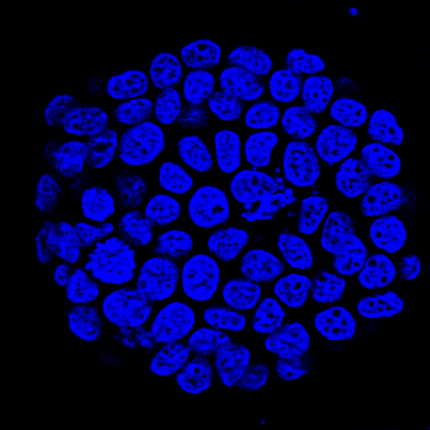
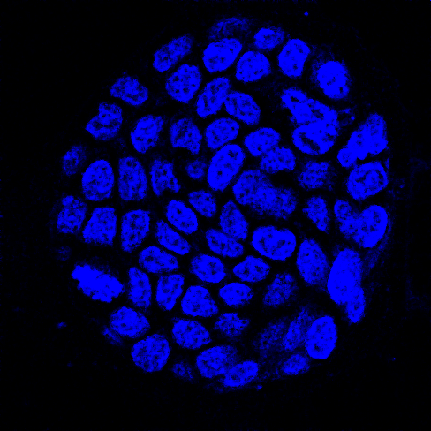
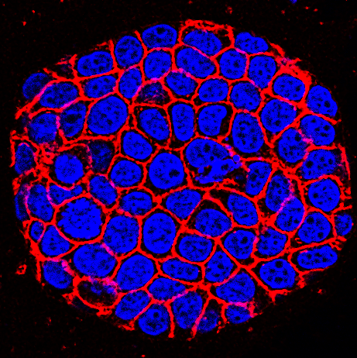
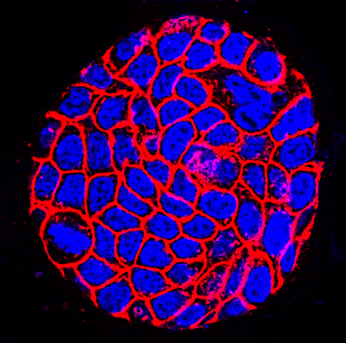
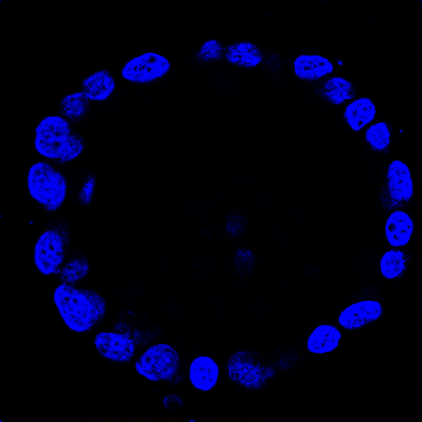
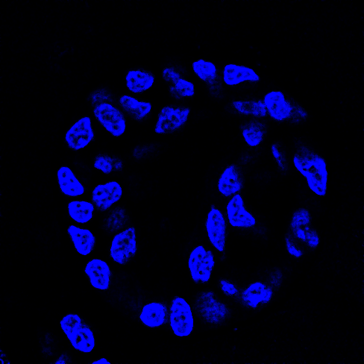
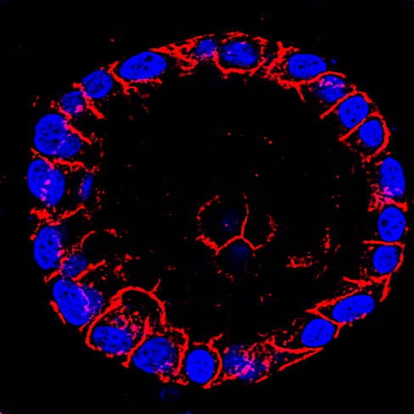
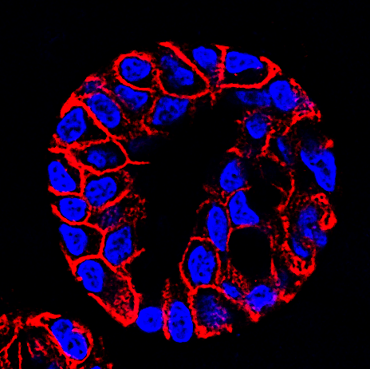
Supplementary Figure 2
TP53 KO
TP53/ARID1A DKO
DAPI
DAPI
(Cross Section – Top Surface)
CDH1
CDH1
(Cross Section – Middle)
Supplementary Figure 2. Loss of ARID1A induces nuclear pleomorphism. Cytologic features of high-grade dysplasia were observed in TP53/ARID1A DKO organoids by confocal imaging. The arrows (orange) indicate examples of abnormal nuclei in ARID1A-deficient cells. Cell membranes were stained with CDH1 (red). Nuclei were stained with DAPI (blue).

