Slide 1
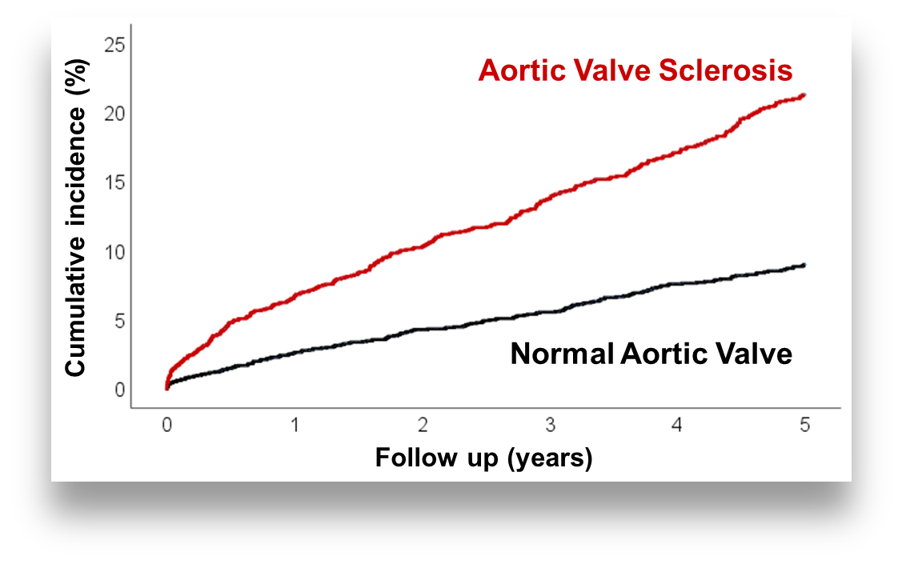
High-Risk Patients with Coronary Artery Disease
Normal aortic valve
Aortic valve sclerosis
57 %
43 %
Age
Cardiac Function
Previous Myocardial Infarction
Male Sex
Diabetes Mellitus
Renal Function
Age
Cardiac Function
Previous Myocardial Infarction
Female Sex
Diabetes Mellitus
Renal Function
=
=
Lower risk of 5-yrs Mortality
7 %
Higher risk of 5-yrs Mortality
17 %
Adjusted Hazard Ratio
1
Adjusted Hazard Ratio
1.29
Clinical Implications
Regular clinical follow-up
Standard therapy
Closer clinical follow-up
More intensive therapy

