Slide 1
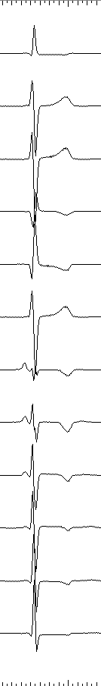
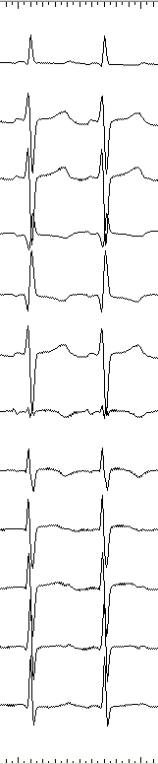
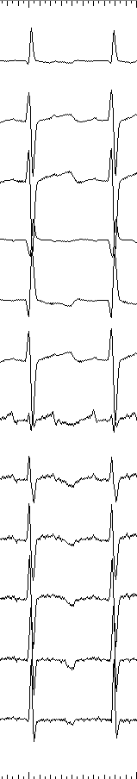
Supplemental Figure 1A
I
II
III
aVR
aVL
aVF
V1
V2
V3
V4
V5
V6
Sinus rhythm
AFL
AT

Slide 2
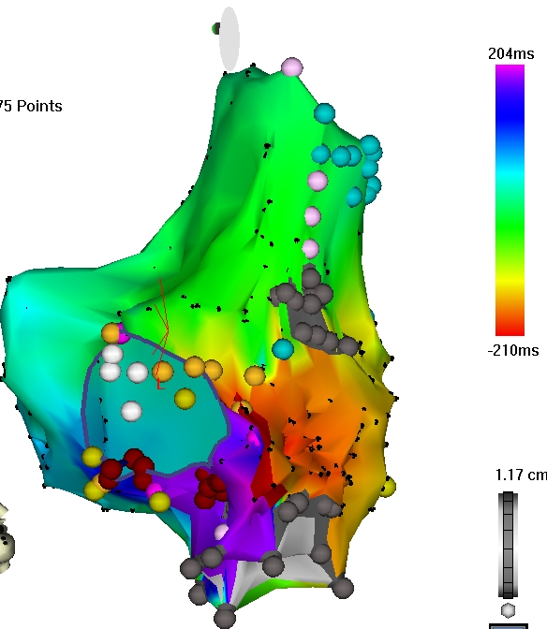
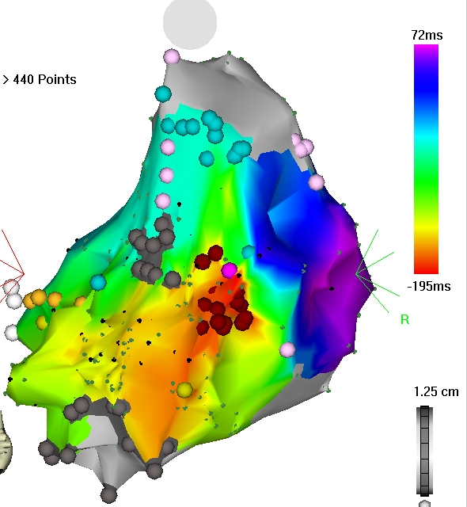
Supplemental Figure 1B
● | Success ablation point
● | Ablation point
● | Double potential
● | Fragmented potential
● | scar
A
D
B
C
AFL
(Left Lateral view)
Focal AT
(PA view)

Slide 3
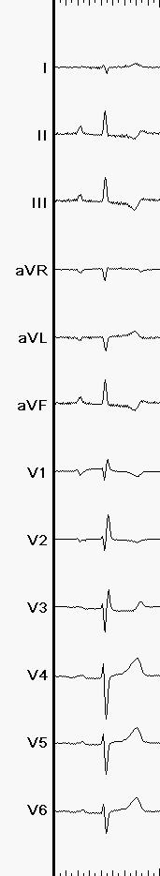
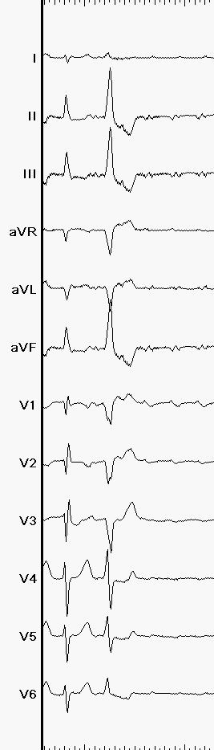
Supplemental Figure 2A
I
II
III
aVR
aVL
aVF
V1
V2
V3
V4
V5
V6
Sinus rhythm
AT

Slide 4

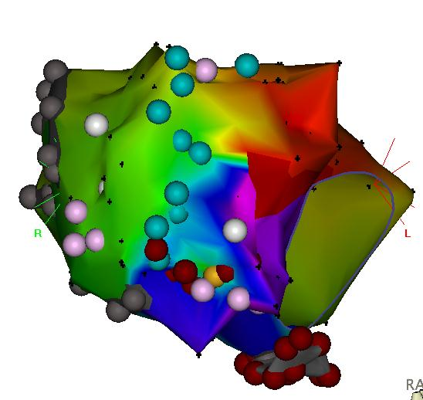
Supplemental Figure 2B
Incision line
● | Success ablation point
● | Ablation point
● | Double potential
● | Fragmented potential
● | scar
A
C
Tricuspid
Annulus
B
CTI line
RAO view

Slide 5
Supplemental Figure 3A
100
80
Survival rate (%)
60
40
20
n=23
0
0 | 1 | 2 | 3 | 4 | 5 | 6 | 7 | 8 | 9 | 10 | 11 | 12
Time from 1st RFCA (years)
Number at risk
23 | 20 | 18 | 15 | 13 | 12 | 10 | 8 | 6 | 6 | 3 | 3 | 2

Slide 6
Supplemental Figure 3B
100
80
Survival rate (%)
60
40
No long-term SVT
Long-term SVT
n=19
p=0.10
20
0
0 | 1 | 2 | 3 | 4 | 5 | 6 | 7 | 8 | 9 | 10 | 11 | 12
Number at risk
Time from the last RFCA (years)
No long-term SVT
7 | 7 | 7 | 6 | 5 | 5 | 5 | 4 | 3 | 2 | 2 | 2 | 1
12 | 8 | 6 | 2 | 2 | 2 | 2 | 1 | 1 | 0 | 0 | 0 | 0
Long-term SVT

