Slide 1
Supplementary Figures 1-20
HNRNPA2B1 regulates tamoxifen- and fulvestrant- sensitivity and hallmarks of endocrine resistance in breast cancer cells
Belinda J. Petri¹, Kellianne M. Piell¹, Gordon C. South Whitt¹, Ali E. Wilt¹, Claire C. Poulton¹, Norman L. Lehman², Brian F. Clem¹, Matthew Nystoriak³, Marcin Wysoczynski³, and Carolyn M. Klinge^{1*}
¹Department of Biochemistry & Molecular Genetics; ²Department of Pathology and Laboratory Medicine; ³Department of Medicine, University of Louisville School of Medicine; Louisville, KY 40292 USA
*Corresponding author: Carolyn M. Klinge, Department of Biochemistry & Molecular Genetics
University of Louisville School of Medicine, Louisville, KY 40292 USA. Telephone: 502-852-3668, Email: carolyn.klinge@louisville.edu

Slide 2
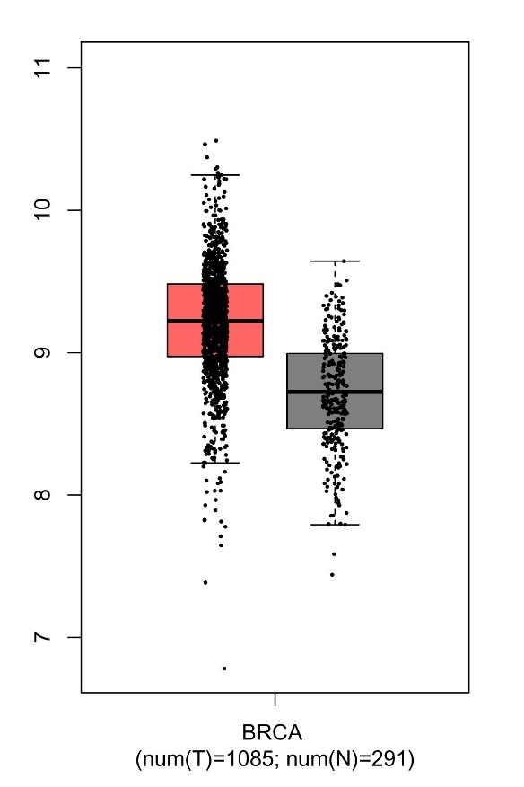
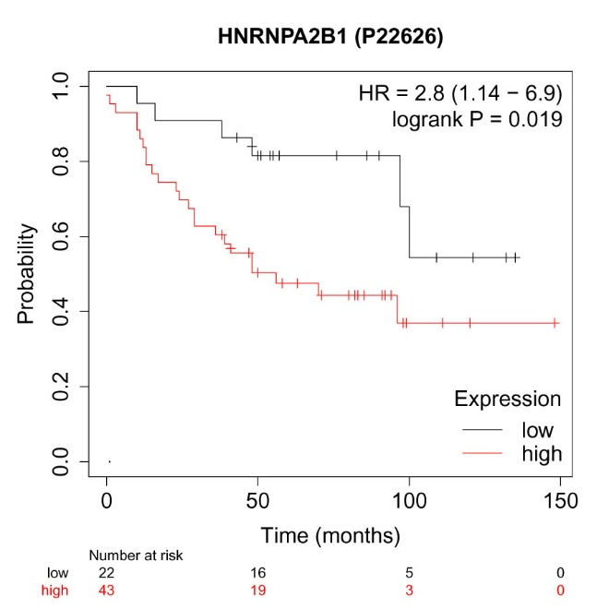
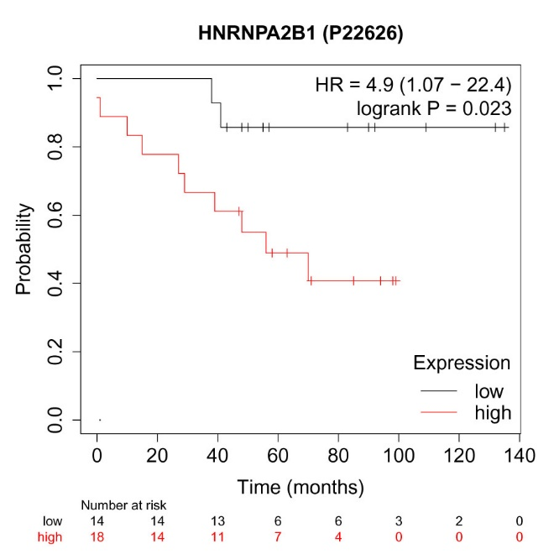
A
B
C
T
N
Supplementary Figure 1: HNRNPA2B1 transcript (A) and protein (B and C) expression in human breast tumors. A) Data are HNRNPA2B1 gene expression in normal breast (n = 291) and breast tumors (N = 1085) in GEPIA database. B and C) Data are protein expression of HNRNPA2B1 in breast tumors. B is Overall Survival (OS) in all subtypes; C is OS in ER+ breast tumor patients from KM Plotter for breast protein.

Slide 3
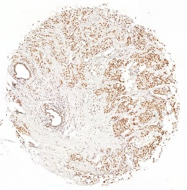
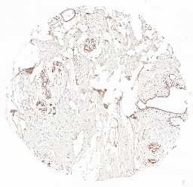
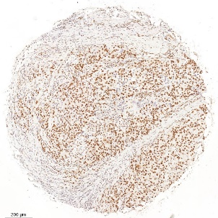
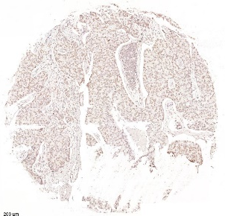
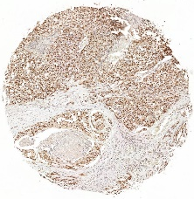
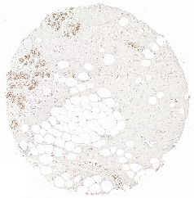
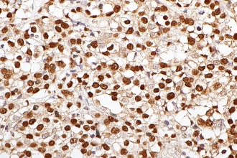
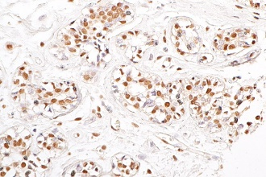
IDC ER+ HER2+
Nl. Breast ER+ HER2-
IDC HER2+
LNM HER2+
A
B
E
F
200 µm
200 µm
200 µm
200 µm
8.3%
9%
8.3%
18%
50%
Allred Score
37%
Allred Score
50%
0
1
2
3
62%
0
1
2
3
36%
36%
83%
IDC TNBC
Nl. Breast ER+ HER2-
C
D
Supplementary Figure 2: HNRNPA2B1 IHC in a breast TMA. (A & B) and (C & D) are paired invasive breast cancer (IBC) and normal breast from the patient. (E & F) are paired IDC and lymph node metastasis (LMN). A and C show strong HNRNPA2B1 staining in the primary IDC tumor compared to weak or intermediate staining in paired Nl. Breast tissue from same patient. The IDC HER2+ tumor in E shows strong staining compared to weak or intermediate staining in its paired LNM (F). Bar is 200 µm. Circle plots show Allred scores for HNRNPA21 as the percent of total samples of that sample type. (IDC ER+ HER2+= 8, Nl. Breast ER+ HER- = 8, IDC HER2+ = 12, LNM HER2+ = 10, IDC TNBC = 11).
200 µm
200 µm
9%
Allred Score
37%
27%
0
1
2
3
62%
64%

Slide 4
Supplementary Figure 3: HNRNPA2B1 Protein Expression in breast cancer cell lines. MCF-7-A2B1 cells express ~ 6.6-fold higher HNRNPA2B1 compared to MCF-7 cells. WCE were isolated from MCF-7-A2B1 (three different WCE preparations), LCC9, LY2 or MCF-7. WCE (45 µg protein) were separated by 10% SDS-PAGE and immunoblotted for A2B1. The blot was stripped and re-probed for α–tubulin for normalization that is expressed relative to MCF-7 cells. This is a representative blot. A summary of the quantitation of the relative expression of A2B1 in MCF-7-A2B1 cells compared to MCF-7 cells is in Figure 2C in the text.

Slide 5
MCF-7
MCF-7-A2B1
Supplementary Figure 4: Phase-contrast microscopy for morphological analysis of differences in MCF-7 and MCF-7-A2B2 growth. MCF-7 cells and MCF-7-A2B1 cells seeded at equal densities in 6-well plates and grown to ~80% confluence. 4X phase-contrast random images were captured using a Keyence BZ-X800 All-in-One fluorescence imaging system (scale bar = 200 µm). Colonies of MCF-7-A2B1 cells appear to ‘pile up’ compared to the clumped monolayer appearance of MCF-7 cells.

Slide 6
A
1.5
*
*
*
*
*
*
*
*
B
LCC9
*
*
*
1.0
Relative Cell Viability
0.5
*
*
0.0
control
1 µM 4OHT
control
1 µM 4OHT
control
1 µM 4OHT
100 nM 4-OHT
100 nM 4-OHT
100 nM 4-OHT
C
LY2
100 nM Fulvestrant
100 nM Fulvestrant
100 nM Fulvestrant
MCF-7-A2B1
stable
LCC9
(TAM-R)
MCF-7
Supplementary Figure 5: Stable overexpression of HNRNPA2B1 in MCF-7 cells reduces cell viability and reduces growth inhibition by 4-OHT and fulvestrant. A) MCF-7, MCF-7-A2B1, and LCC9 (TAM-resistant (R)) cells were grown in SS medium 48 h prior to treatment with vehicle control (DMSO), 100 nM or 1 µM 4-OHT, or 100 nM fulvestrant for 4 days. Values were normalized to control within each cell line and are from 8 separate, independent MTT assays. *p < 0.001 one-way ANOVA, Tukey’s test. For B, C, and D), after transfection with siControl (indicated as – in plot D), the cells were incubated for an additional ~ 48 h in SS medium prior to 72 h treatment (B and C) or 5 d with 100 nM or 1 µM 4-OHT or 100 nM fulvestrant with medium/treatment changed after 48h. Values are from 8 (B), 10 (C), and 6 (D) independent MTT assays. *p < 0.05 one way ANOVA, Tukey’s post hoc test. D) *p < 0.0001 versus siControl transfected cells (all treatments), **p < 0.0001 versus C-treated MCF-7-A2B1+siA2B1 cells, one way ANOVA, Tukey’s post hoc multiple comparisons test.
*
*
D
MCF-7-A2B1

Slide 7
A
C
*
*
*
*
*
*
1.5
1.0
Relative Cell Viability
0.5
B
MCF-7
**
1.5
0.0
siControl + + + +
1.0
siHNRNPA2B1 + + + +
Relative HNRNPA2B1 protein
Control
100 nM
1 µM
100 nM
Fulvestrant
0.5
4-OHT
0.0
siControl
siA2B1
Supplementary Figure 6: Transient knockdown of HNRNPA2B1 does not affect tamoxifen- or fulvestrant- sensitivity of MCF-7 cells. A) MCF-7 cells were transfected with siControl (first lane) or siHNRNPA2B1 for 48 h in OPTIMEM and 24 h in SS medium prior to WCE extract. 30 µg WCE was loaded per lane. Note this was a long exposure to visualize HNRNPA2B1 in MCF-7 cells (note appearance of band in lane 1). The blot was probed for HNRNPA2B1 and stripped and reprobed for GAPDH. B) summarizes western blots for HNRNPA2B1 relative to GAPDH or α-tubulin in 11 separate transfections. *p < 0.001 in Student’s two-tailed t-test. C) 48 h after transfection, cells were treated for 72 h with DMSO (vehicle control), 100 nM or 1 µM 4-OHT or 100 nM fulvestrant for 3 additional days with a change of medium/treatment after 48 h. Values (8) are from 5 separate, independent MTT assays . *p < 0.004 one way ANOVA, Tukey’s post hoc multiple comparisons test.

Slide 8
A
B
NS
LCC9
NS
LY2
1.2
1.2
1.0
1.0
0.8
0.8
Absorbance 490 nm
Absorbance 490 nm
0.6
0.6
0.4
0.4
0.2
0.2
0.0
0.0
siControl
siHNRNPA2B1
siControl
siHNRNPA2B1
Supplementary Figure 7: Knockdown of HNRNPA2B1 does not affect basal LCC9 or LY2 viability. LCC9 (A) or LY2 (B) cells were tranfected with siControl or siHNRNPA2B1. 48 h after transfection, cells were treated for 72 h with DMSO (vehicle control) for 3 additional days with a change of medium/treatment after 48 h. Values are from two transfections assayed in quadruplicate in one MTT assay. Statistical evaluation was by two-tailed Student’s t-test.

Slide 9
A
B
C
pAb HNRNPA2B1
mAb B1 A2
1.5
3
***
1.0
****
2
Relative HNRNPA2B1 protein
Relative HNRNPA2B1 protein
0.5
1
*
0.0
0
MCF-7
T47D
B1 A2
sum
B1 A2
sum
MCF-7
T47D
Supplementary Fig. 8: HNRNPA2B1 expression in MCF-7 and T47D cells. A) Shows a representative western blot: 20 µg WCE was loaded per lane. The top blot is with the HNRNPA2B1 Rabbit IgG (IBL # 18941) that is specific for the B1 variant of HNRNPA2B1. The same blot was stripped and re-proved with the Proteintech HNRNPA2B1 monoclonal antibody (Cat. #. 67445-1-Ig) that recognizes both the B1 and A2 variants of HNRNPA2B1. Then the same blot was stripped and reprobed for α-tubulin as a loading control. B and C) Values for separate WCE preparations from cells harvested at different passages and dates and probed with these HNRNPA2B1 antibodies, normalized to α-tubulin and then normalized to MCF-7 HNRNPA2B1 within each experiment are plotted to allow comparison across separate western blots. For B, data were analyzed by an unpaired t-test, ****p <0.0001. For C, B1 and A2 variants were quantified separately and sum = addition of B1 +A2. Data were analyzed by one-way ANOVA followed by Tukey’s post hoc test, p * 0.05 and *** p < 0.001.

Slide 10
A
B
C
HNRNPA2B1 mAb
B1 open symbols
A2 closed symbols
HNRNPA2B1 pAb
2.0
2.0
1.5
1.5
pAb
****
1.0
****
1.0
Relative HNRNPA2B1 protein
Relative HNRNPA2B1 protein
****
****
****
OE
0.5
****
0.5
****
****
****
0.0
0.0
MCF-7
B1 A2 B1 A2 B1 A2 B1 A2
HCC1806
MCF-7
MDA-
MB-231
MDA-
MB-468
HCC1806
MDA-MB-231
MDA-MB-468
Supplementary Fig. 9: HNRNPA2B1 expression in MCF-7 and three TNBC cell lines. A) Shows a representative western blot: 30 µg WCE was loaded per lane. The top blot is with the HNRNPA2B1 Rabbit IgG (IBL # 18941, polyclonal (pAb)) that is specific for the B1 variant of HNRNPA2B1. The same blot was stripped and re-proved with the Proteintech HNRNPA2B1 monoclonal antibody (Cat. #. 67445-1-Ig) that recognizes both the B1 and A2 variants of HNRNPA2B1. Shown are two exposures (OE = overexposed). Then the same blot was stripped and reprobed for α-tubulin as a loading control. B and C) Values for separate WCE preparations from cells harvested at different passages and dates and probed with these HNRNPA2B1 antibodies, normalized to α-tubulin and then normalized to MCF-7 HNRNPA2B1 within each experiment are plotted to allow comparison across separate western blots. ****p < 0.0001, one-way ANOVA followed by Tukey’s post hoc test, compared to MCF-7.

Slide 11
Supplementary Fig. 10: 4-OHT does not affect breast cancer cell migration or invasion. Boyden chamber assays comparing the migration and invasion (through Matrigel) of MCF-7, MCF-7-A2B1, LCC9, and LY2 cells were performed using FBS-containing medium as the attractant. Cells were grown in SS medium for 72 h prior to treatment with DMSO or EtOH (vehicle controls) or 100 nM 4-OHT for 24 h prior to plating. Migrated (A) and invaded (C) cells were stained with crystal violet and quantified using ImageJ software. A) Representative images of migrated cells. B) Quantification of cell migration by Image J. Values are from individual wells. *P < 0.01 in one-way ANOVA followed by Tukey’s multiple comparison post hoc test. C) Representative images of invaded cells. D) Quantification of cell invasion with 3 wells/cell line and treatment. *P < 0.001, in one-way ANOVA followed byTukey’s post hoc multiple comparisons test.

Slide 12
















A
EtOH
4-OHT
C
EtOH
4-OHT
LCC9
LCC9
LCC9
+ siA2B1
LCC9
+ siA2B1
MCF-7-A2B1
MCF-7-A2B1
MCF-7-A2B1 + siA2B1
MCF-7-A2B1 + siA2B1
***
***
*
*
B
1.2
D
1.2
1.0
1.0
0.8
0.8
Relative Migration
Relative Invasion
0.6
0.6
0.4
*
0.4
0.2
0.2
0.0
0.0
4-OHT + + + +
4-OHT + + + +
siA2B1 + + + +
siA2B1 + + + +
LCC9
MCF-7-A2B1
LCC9
MCF-7-A2B1
Supplementary Figure 11: Knockdown of HNRNPA2B1 reduces LCC9 and MCF-7-A2B1 cell migration and invasion. LCC9 and MCF-7 cells were transfected with siControl or siHNRNPA2B1 (siA2B1) for 48 h prior to plating for cell migration and invasion assays and treatment with vehicle control (EtOH) or 100 nM 4-OHT as in Figure 5. Migrated (A) and invaded (C) cells were stained with crystal violet and quantified using ImageJ software. A) Representative images of migrated cells. B and D) Quantification of cell migration and invasion by Image J. Values are relative migration or invasion/well (n = 3 wells/transfection and treatment) compared to EtOH + siControl. *P < 0.05 and ***p < 0.001 in one-way ANOVA followed by Tukey’s multiple comparison post hoc test.

Slide 13
A
B
Supplementary Figure 12: Breast cancer soft agar colony formation. MCF-7-A2B1 and LCC9 cells were transfected with siControl or siA2B1 for 48 h prior to plating in three separate 60mm plates for soft agar assay/treatment. Plates were treated with EtOH (vehicle control) or 100 nM 4-OHT. The medium was replenished every 4 d. Cell images were captured after 1, 7, and 14 d at 10X. The number of colonies and colony size (area of selection in pixels²) was analyzed by Image J. The mean ± SEM from 3 plates are plotted for colony counts and colony size. Data were analyzed by two way ANOVA followed by Bonferroni’s post test. *p < 0.05, **p < 0.01, ***p < 0.001

Slide 14
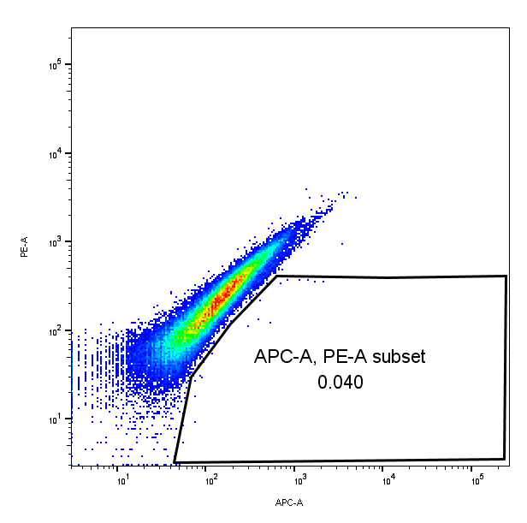
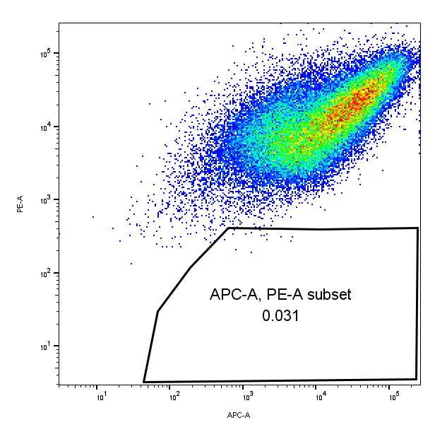
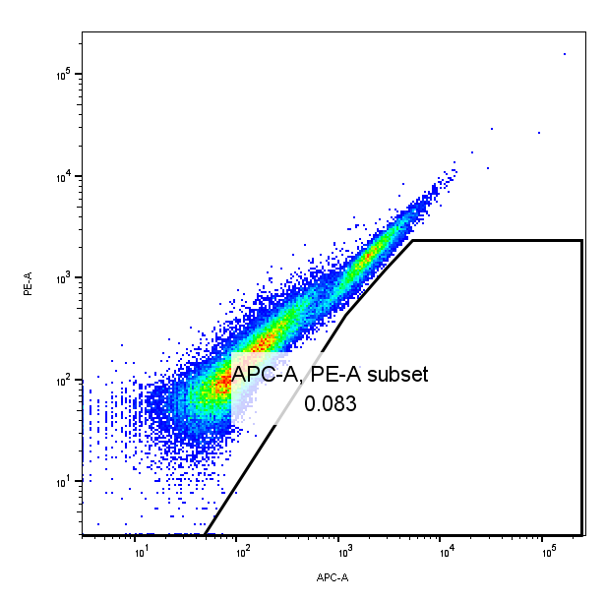
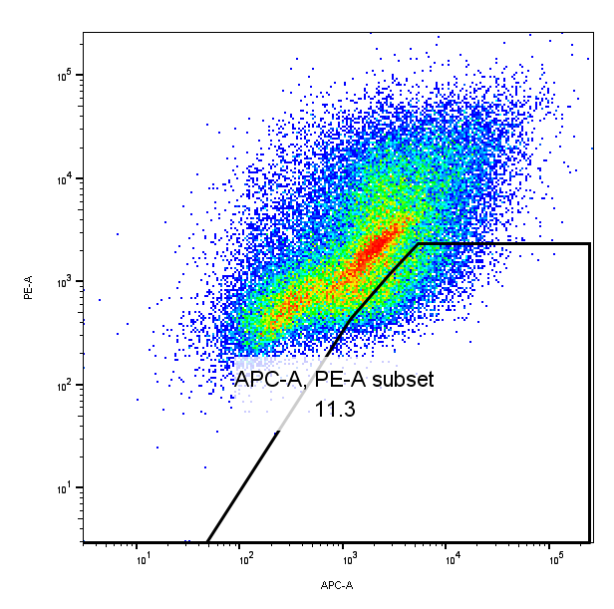
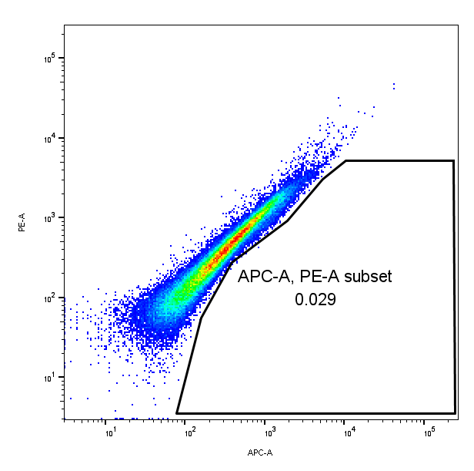
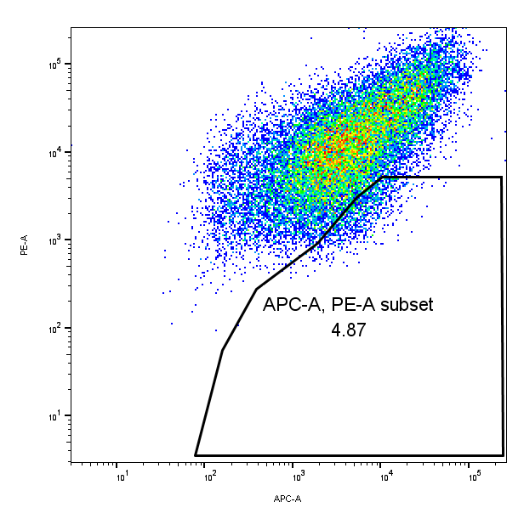
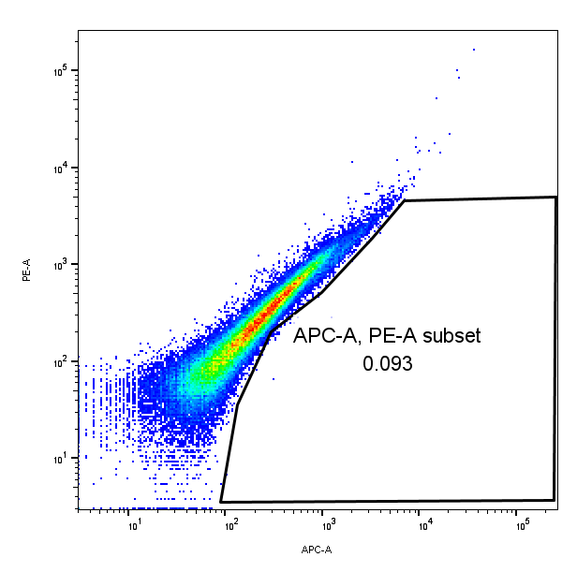
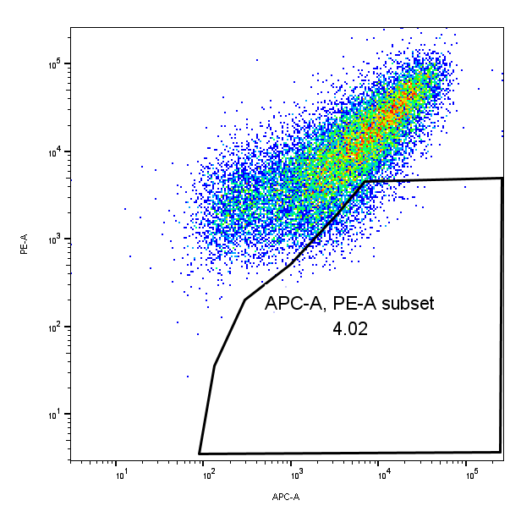
A
B
MCF-7 unstained
MCF-7 CD44+/CD24-low
MCF-7-A2B1 unstained
MCF-7-A2B1 CD44+/CD24-low
CD24
CD24
CD24
CD24
CD44
CD44
CD44
CD44
C
D
LCC9 unstained
LCC9 CD44+/CD24-low
LY2 unstained
LY2 CD44+/CD24-low
CD24
CD24
CD24
CD24
CD44
CD44
CD44
CD44
Supplementary Figure 13: Evaluation of CD44 and CD24 surface markers by flow cytometry in breast cancer cells. To determine the percent of CD44⁺/CD24^{-low} cells, MCF-7, MCF-7-A2B1, LCC9 and LY2 cells were stained with anti-CD44 APC and anti-CD24 PE (A-D) and analyzed using a flow cytometer. Shown are representative dot-plots using unstained cells to determine background autofluoresence and set the negative population and stained cells as indicated. These data demonstrate the specificity of the identification of the CD44+/CD24-/low population.

Slide 15
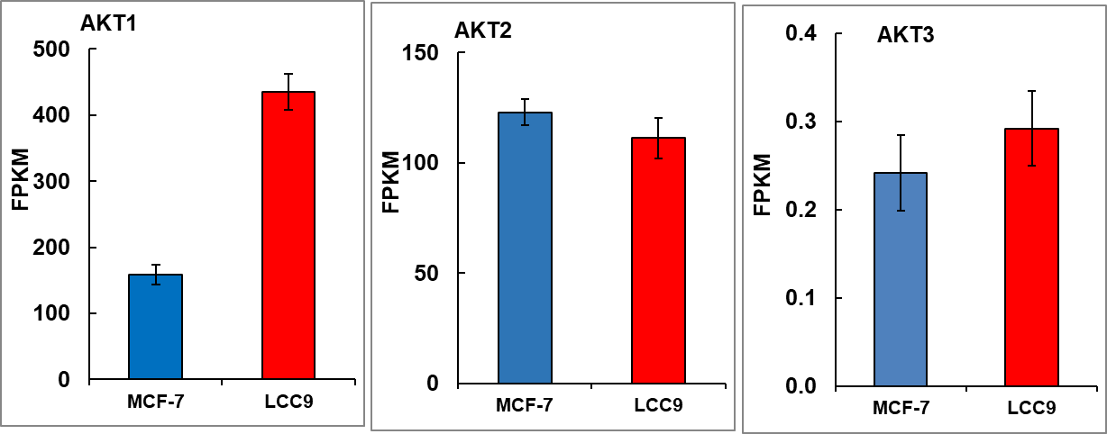
*
Supplementary Figure 14: Transcript levels of AKT1, AKT2, and AKT3 in MCF-7 and LCC9 cells from (Muluhngwi et al., Klinge Sci Rep. 2017, GEO GSE81620 ), *p = 0.034, Two-tailed t-test.

Slide 16

MCF-7-A2B1
LCC9
C C siC siC siA2B1 C C siC siC siA2B1
MW kDa
P-ser118 ERα
ERα
Ponceau S staining
-75
-50
1.5
control
siControl
siA2B1
1.5
control
siControl
siA2B1
1.0
1.0
Relative ERα/Ponceau S
Relative p-ser-118 ERα/ERα
0.5
0.5
0.0
0.0
MCF-7-A2B1
LCC9
MCF-7-A2B1
LCC9
Supplementary Figure 15: Transient knockdown of HNRNPA2B1 reduces P-ser118 ERα/ERα ratio in MCF-7-A2B1 and LCC9 cells. WCE were isolated from untransfected MCF-7-A2B1 or LCC9 cells (C, Control), siControl or siHNRNPA2B1 (siA2B1)-72 h after transfection. WCE (30 µg protein) were separated by 10% SDS-PAGE and immunoblotted for phospho-ser118 ERα. The blot was stained for Ponceau S and the greyscale image cropped to 75-50 kDa for protein loading normalization. The blot was stripped and re-probed for ERα. Data in B) are ERα/Ponceau S signal intensity in each lane. Data in C) are the P-ERα/ERα values plotted. Because there are only 2 values (from 2 transfections), statistical analysis was not performed. The data reflect the decrease in ERα seen in Fig. 12 with siA2B1 transfection, but suggest an ~ 20% reduction in p-ser-ERα/total ERα with siA2B1 transfection.

Slide 17
A
B
1.5
1.5
***
***
***
***
***
***
1.0
1.0
Relative Cell Viability
Relative Cell Viability
0.5
0.5
**
0.0
0.0
MCF-7
MCF-7
A2B1
LCC9
MCF-7
MCF-7
A2B1
LCC9
Wortmannin + + +
PD98059 + + +
Supplementary Figure 16: Wortmannin and PD98059 inhibit cell viability. MCC-7, MCF-7-A2B1,and LCC9 cells were serum starved for 48 h prior to treatment with DMSO (vehicle control), 100 nM Wortmannin, or 50 µM PD98059 for 5 d with medium/treatment changed every 48 h. Values are from four independent MTT assays were performed and data are summarized here. ***P < 0.0001 and ** P < 0.01 as determined by two-way ANOVA and Tukey’s multiple comparisons test.

Slide 18
Supplementary Figure 17: Pearson correlation between ESR1 and miR-222-3p expression in MCF-7-A2B1 cells was calculated in GraphPad Prim. r = -0.97, Two-tailed p = 0.0010, r² = 0.9480.

Slide 19
A
ESR1
*
B
1.0
0.5
LOG₂ (FOLD)
0.0
-0.5
C
-1.0
siControl + + +
siHNRNPA2B1 + + +
MCF-7
LCC9
LY2
Supplementary Figure 18: siHNRNPA2B1 transfection of MCF-7, LCC9, or LY2 cells did not affect ESR1 transcript expression. A) Data are qRT-PCR of ESR1 relative to GAPDH. Values are from 14 separate miRNA extractions. * p < 0.05 in one-way ANOVA followed by Tukey’s post hoc test. B) WCE were isolated from untransfected MCF-7 cells (Control), siControl or siHNRNPA2B1 (siA2B1)-transfected MCF-7 cells after the indicated time of transfection. WCE (20 µg protein) were separated by 10% SDS-PAGE and immunoblotted for ERα. The blot was stripped and re-probed for α–tubulin for normalization. Data in C) are summarized from 4 separate MCF-7-A2B1 cell lysates and from 4 separate transfection experiments. ERα/α-tubulin were normalized to MCF-7 (set to 1) in each experiment for comparisons between separate western blots (Relative ER α). *P < 0.005 vs. MCF-7 or vs. MCF-7-A2B1 (dotted line), as indicted, in a one-way ANOVA followed by Tukey’s post hoc test.

Slide 20
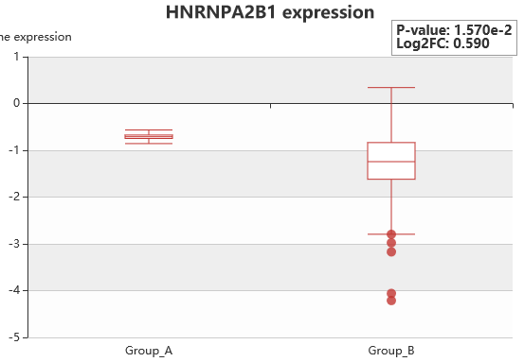
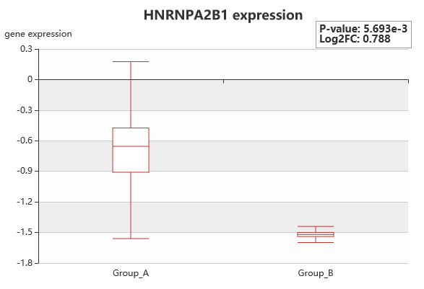
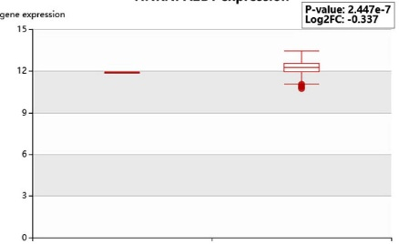
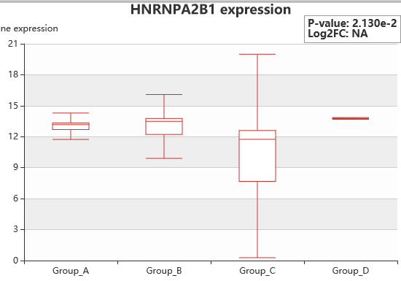
A
C
Primary tumors with metastasis
Primary tumors without metastasis
Brain metastasis
LN metastasis
B
D
Primary tumors with metastasis
Primary tumors without metastasis
Supplementary Figure 19: A2B1 expression is higher in breast tumors with metastasis and in distant metastasis, but not lymph node (LN) metastasis. Data are from HCMDB: the human cancer metastasis database. A and B compare primary tumors with metastasis vs. without metastasis. P values in C and D are compared to the primary tumor.
liver
lung
LN metastasis
spleen

Slide 21
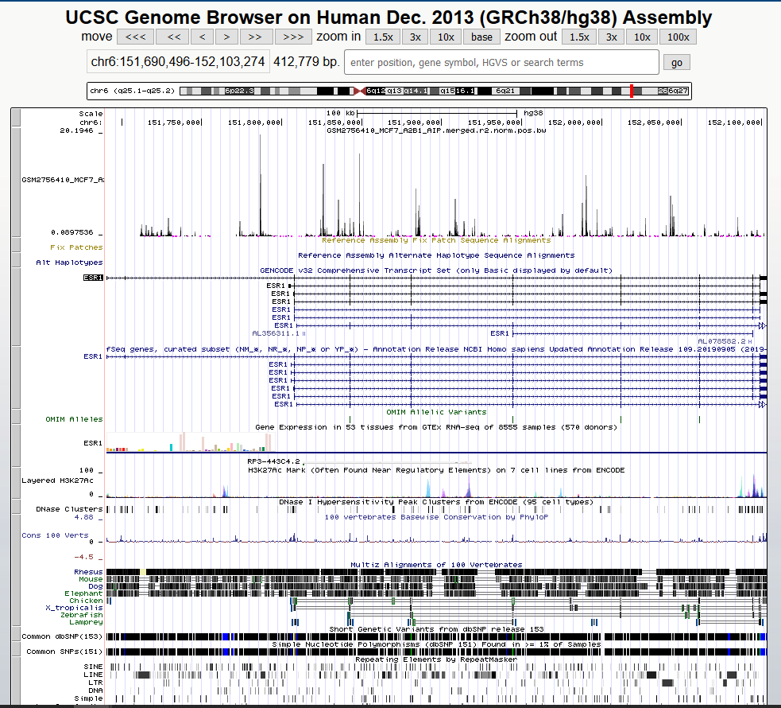
ESR1
Supplementary Figure 20: UCSC genome browser view for ESR1 with data eCLIP analysis of HNRNPA2B1 in MCF-7 human breast cancer cells (GEO # GSE103165). These data reveal a number of HNRNPA2B1 binding peaks upstream and within the ESR1 gene, including intronic regions

