Slide 1
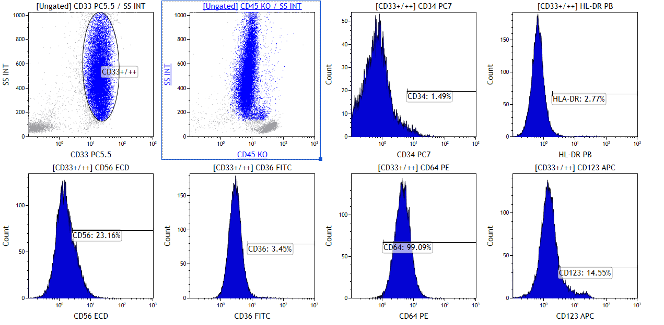
Suppl. Fig.1A

Slide 2
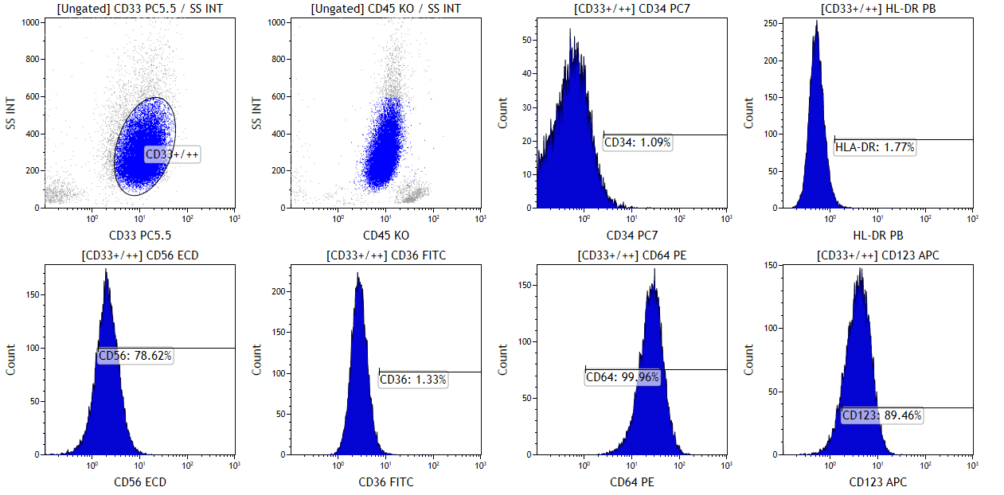
Suppl. Fig.1B

Slide 3
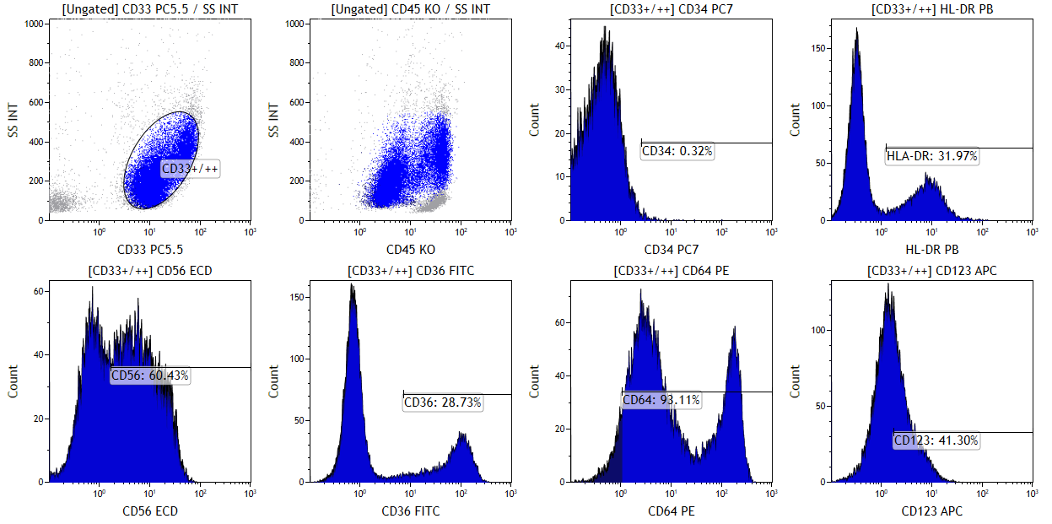
Suppl. Fig.1C

Slide 4
Suppl.Fig 1
Example of basic analysis of marker expression in panel AML 2.
After dead cells were excluded the gate was set on CD33+/++ cells independent of scatter (upper panel left). Upper middle panel shows backgating of the CD33+/++ gate on SSC/CD45 plot. Percentages of leukemic cells positive for various markers were analysed using histograms with the linear gate set using the level of autofluorescence and/or negative populations present in the sample as cut-off on the left. A case of hypergranular APL is shown in A, a hypogranular APL in B and a NPM-1+ AML with myelomonocytic pattern in C.

