Slide 1
Unbiased screening identifies functional differences in NK cells after early life psycho-sociological stress
Sara B. Fernandes^{1,2}, Neha D. Patil^{1,2}, Sophie Meriaux¹, Maud Theresine¹, Claude. P. Muller¹, Fleur A.D. Leenen^{1,3}, Martha M.C. Elwenspoek^{1,4} , Jacques Zimmer^{1,2}, Jonathan Turner^{1 *}

Slide 2
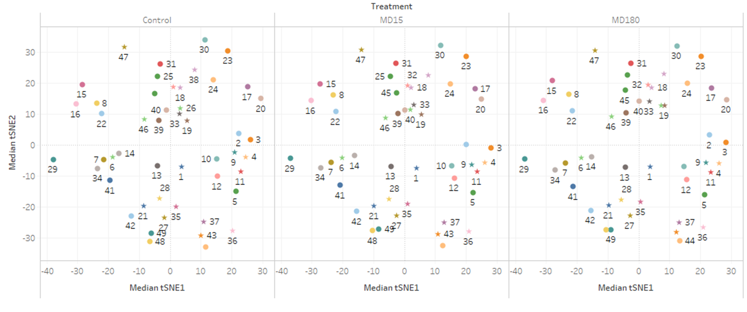
Supplementary figure 1: viSNE clusters definition based on the used markers. Clusters colored by CD3, CD4 and CD8 cell markers to identify immune populations associated. Blue to orange: low to high expression of the marker.

Slide 3
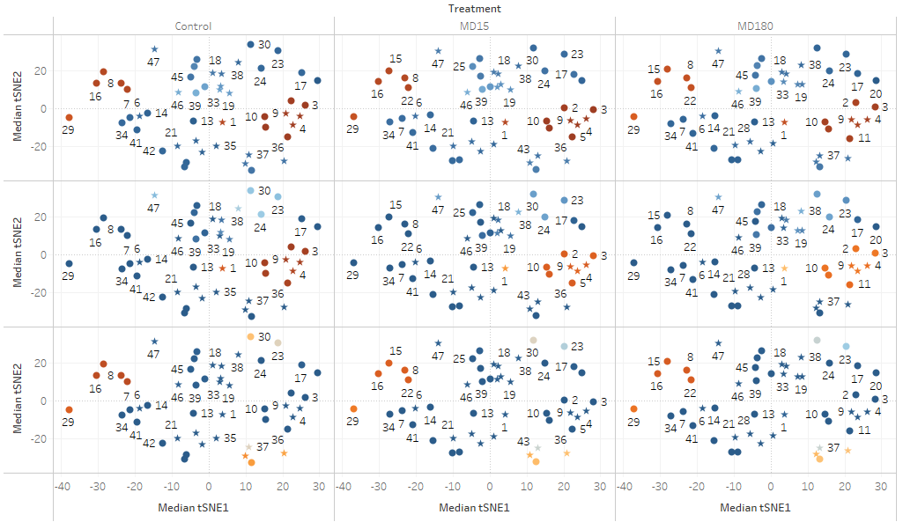
Supplementary figure 1: viSNE clusters definition based on the used markers. Clusters colored by CD3, CD4 and CD8 cell markers to identify immune populations associated. Blue to orange: low to high expression of the marker.
Colored by CD3
Colored by CD4
Colored by CD8

Slide 4
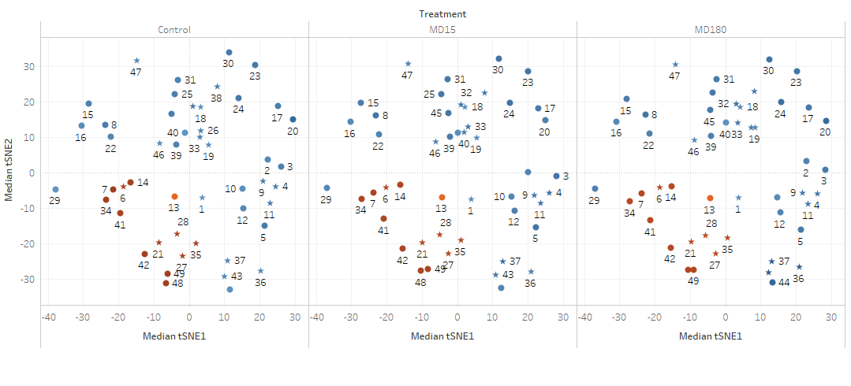
Supplementary figure 2: Clusters colored by CD45RA, CD11b/c, CD25 and FoxP3 cell markers to identify immune populations associated. Blue to orange: low to high expression of the marker.
Colored by CD45RA

Slide 5
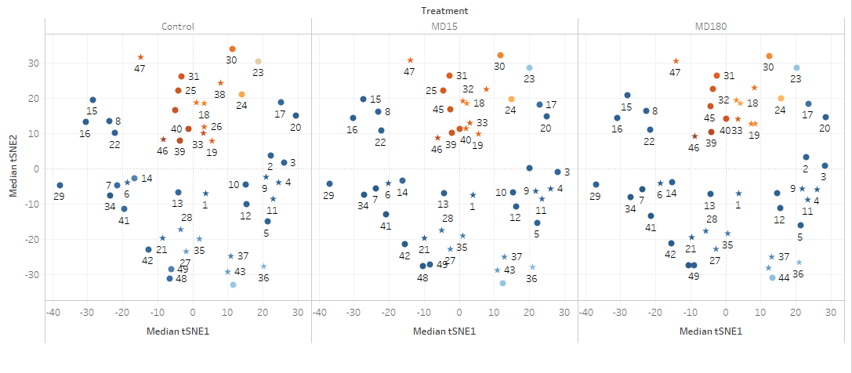
Supplementary figure 2: Clusters colored by CD45RA, CD11b/c, CD25 and FoxP3 cell markers to identify immune populations associated. Blue to orange: low to high expression of the marker.
Colored by CD11b/c

Slide 6
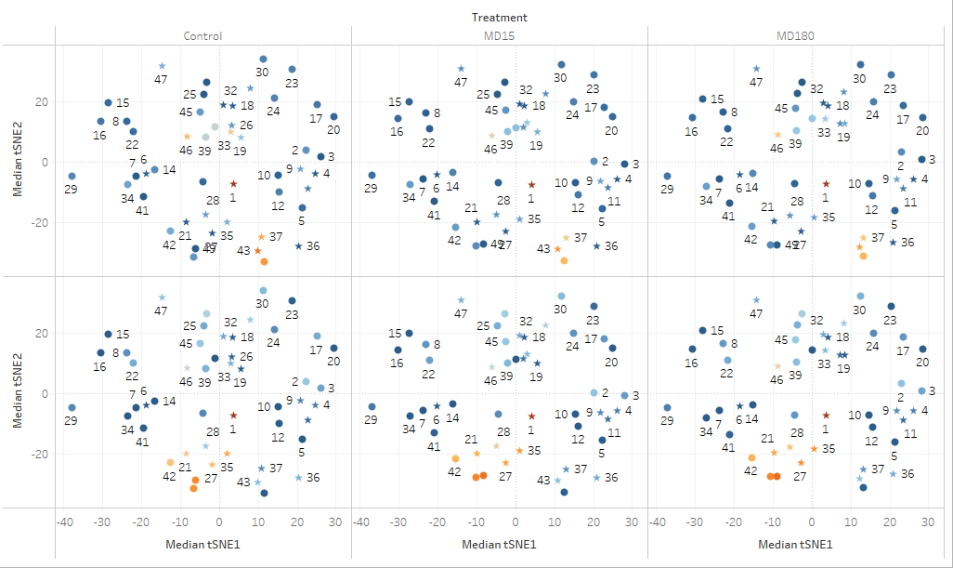
Supplementary figure 2: Clusters colored by CD45RA, CD11b/c, CD25 and FoxP3 cell markers to identify immune populations associated. Blue to orange: low to high expression of the marker.
Colored by CD25
Colored by FoxP3

Slide 7
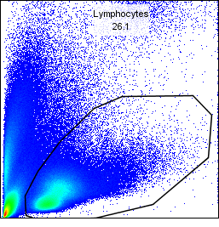
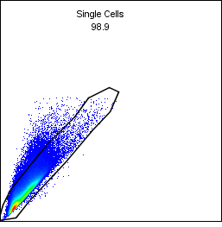
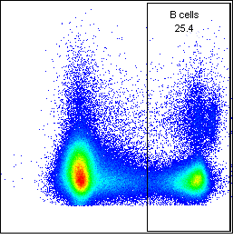
Supplementary figure 3: Flow cytometry gating strategy for quantification of long-term changes in the immune system after maternal deprivation (Figure 3 all panels).
FSC-H
FSC-H
FSC-H
SSC-H
FSC-A
CD45RA

Slide 8
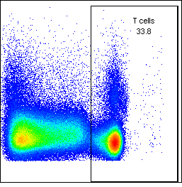
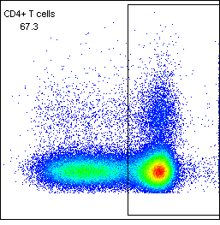
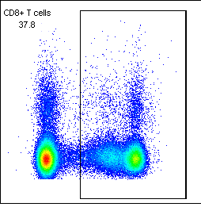
Supplementary figure 3: Flow cytometry gating strategy for quantification of long-term changes in the immune system after maternal deprivation (Figure 3A).
FSC-H
FSC-H
FSC-H
CD3
CD4
CD8

Slide 9
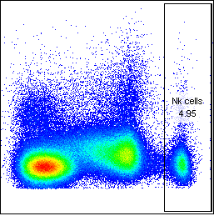
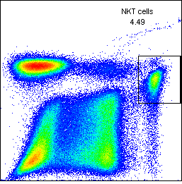
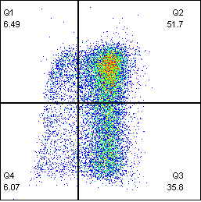
Supplementary figure 3: Flow cytometry gating strategy for quantification of long-term changes in the immune system after maternal deprivation (Figure 2B/C).
FSC-H
CD3
CD4
CD161a
CD161a
CD8

Slide 10
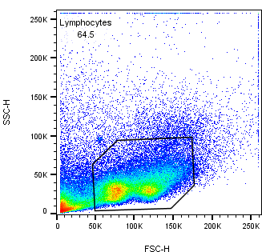
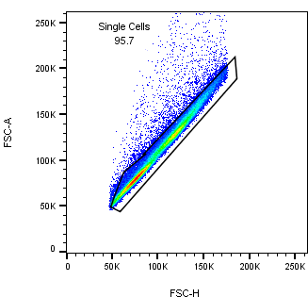
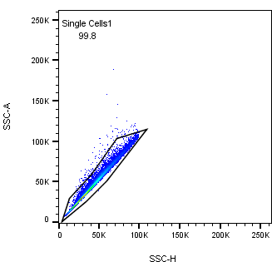
Supplementary figure 4: Flow cytometry gating strategy for the quantification of NK cell maturation state (Figure 4).

Slide 11
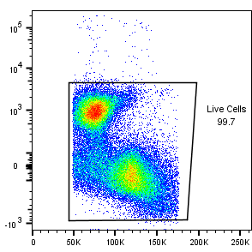
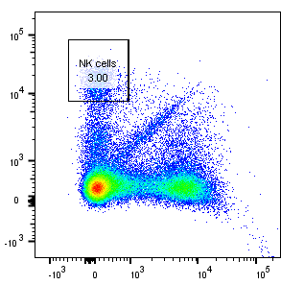
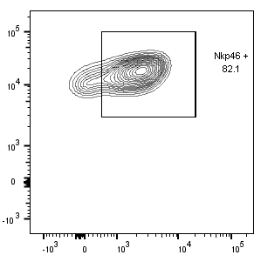
Supplementary figure 4: Flow cytometry gating strategy for the quantification of NK cell maturation state.
Live/Dead
NKR-P1 (CD161a)
NKR-P1 (CD161a)
FSC-H
CD3
NKp46

Slide 12
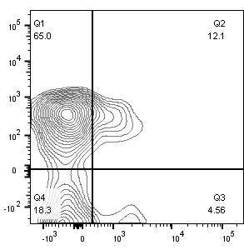

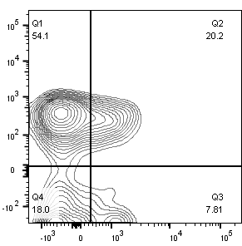
Supplementary figure 4: Flow cytometry gating strategy for the quantification of NK cell maturation state.
Control
MD₁₅
MD₁₈₀
CD27
CD11b
Q1: CD27+, CD11b-
Q2: CD27+, CD11b +
Q3: CD27-, CD11b +
Q4: CD27-, CD11b -

Slide 13
Supplementary figure 5: Correlation analysis between CMV titers and cytotoxic response of NK cells of institutionalized individuals. .

Slide 14
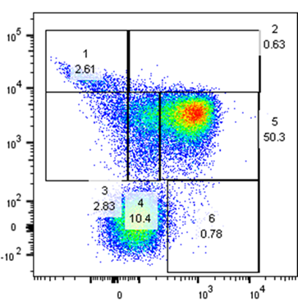
Supplementary figure 6: (A): representative image of the NK cell population gating strategy: 1– CD56brightCD16-; 2 –CD56brightCD16+; 3- CD56dimCD16+; 4– CD56dimCD16dim; 5- CD56dimCD16bright; 6 – CD56-CD16bright. Rest of the figures show the release of IFN-γ and CD107a by the different NK cell populations. No significant differences were found. Data is presented as mean ± SEM of 14 donor per group.

