Slide 1
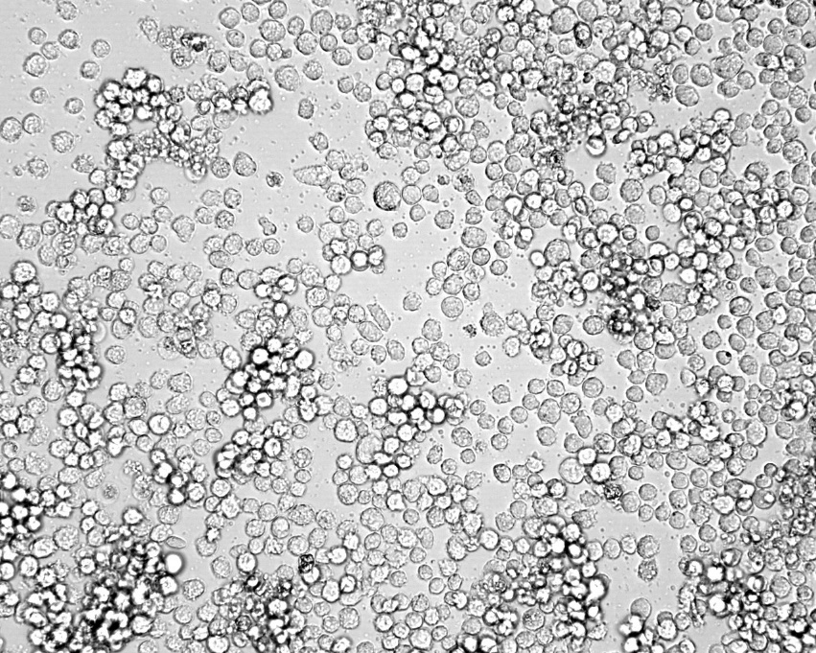
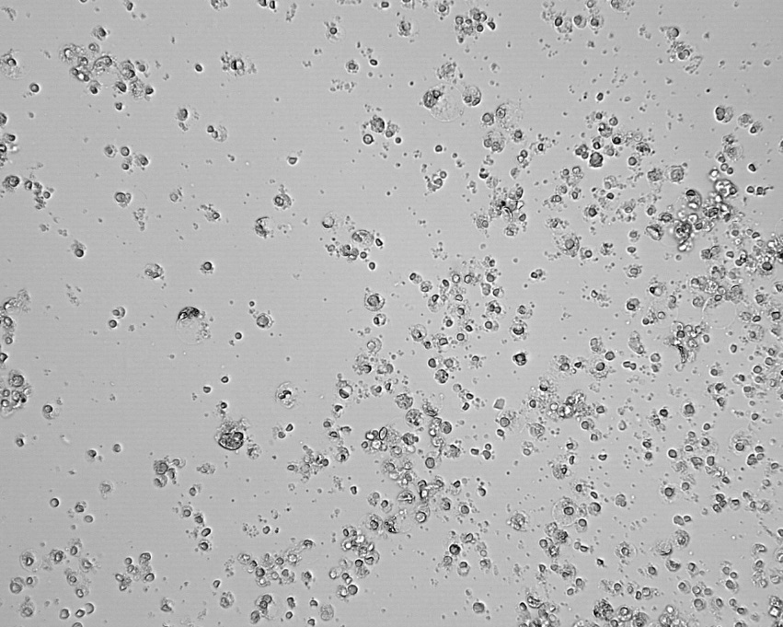
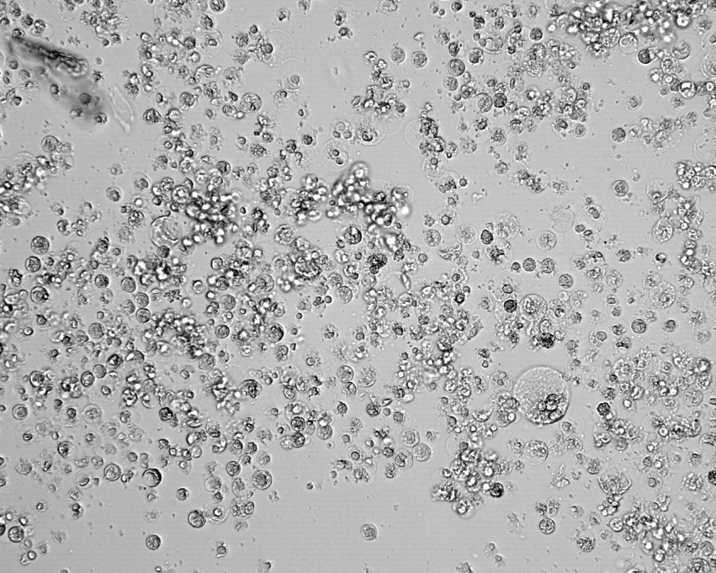
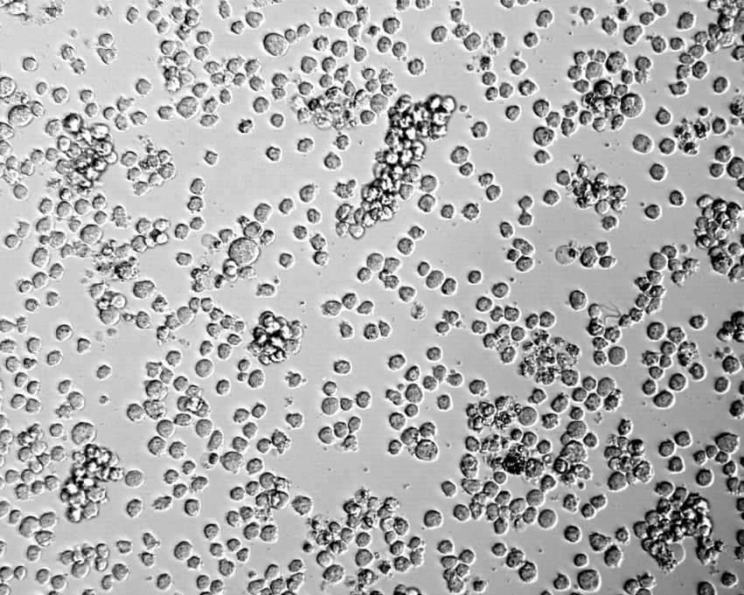
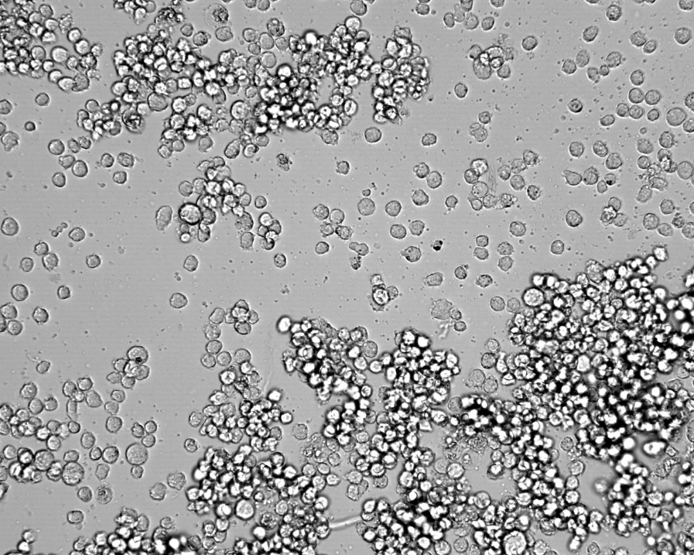
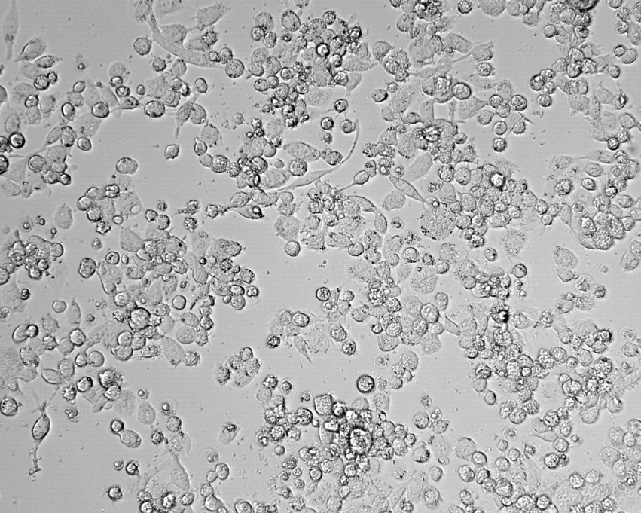
Additional figure 1: Phase light microscopy of THP-1 cells.
Control
1000 µg/ml
200 µg/ml
50 µg/ml
10 µg /ml
PMA(200 µg /ml)
Legend; individual panels are of control cells or various concentration of arecoline studied at 48 hours

