Slide 1
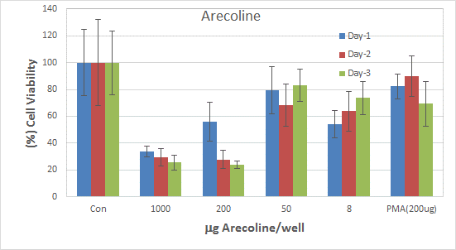
Additional figure 2: MTT-Cell proliferation assay

