Slide 1


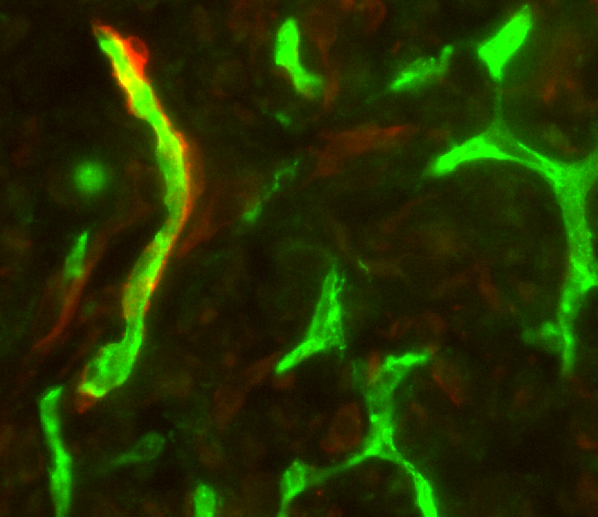
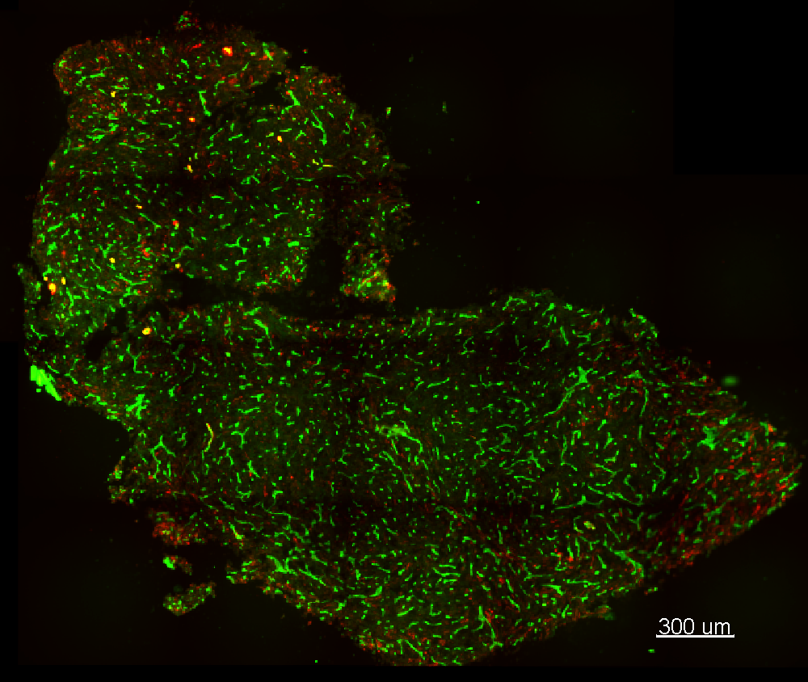
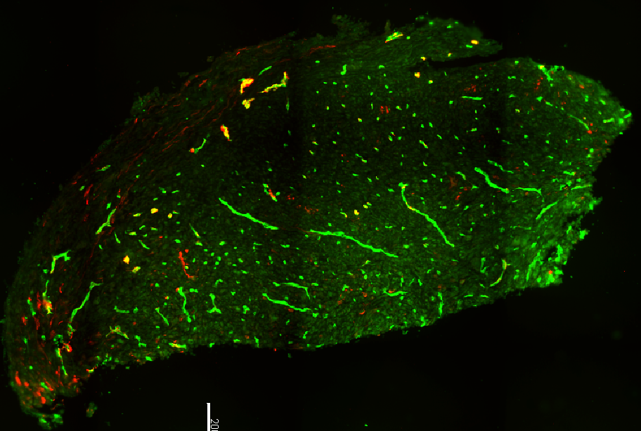
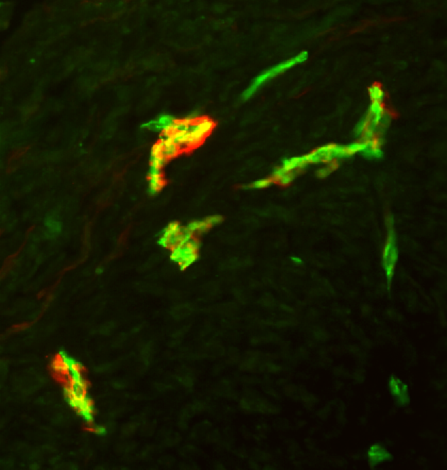
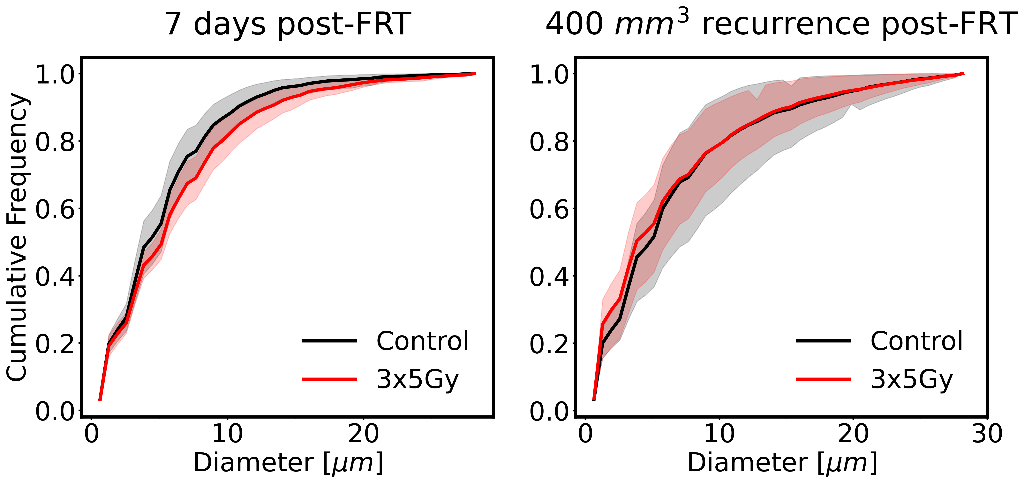
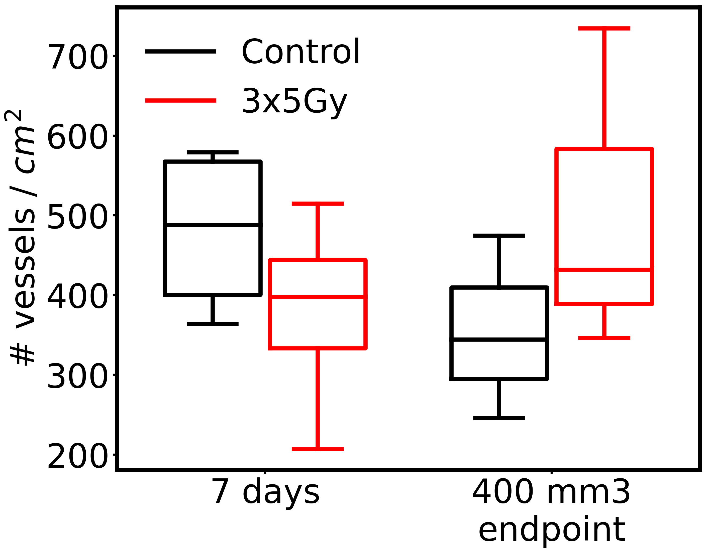
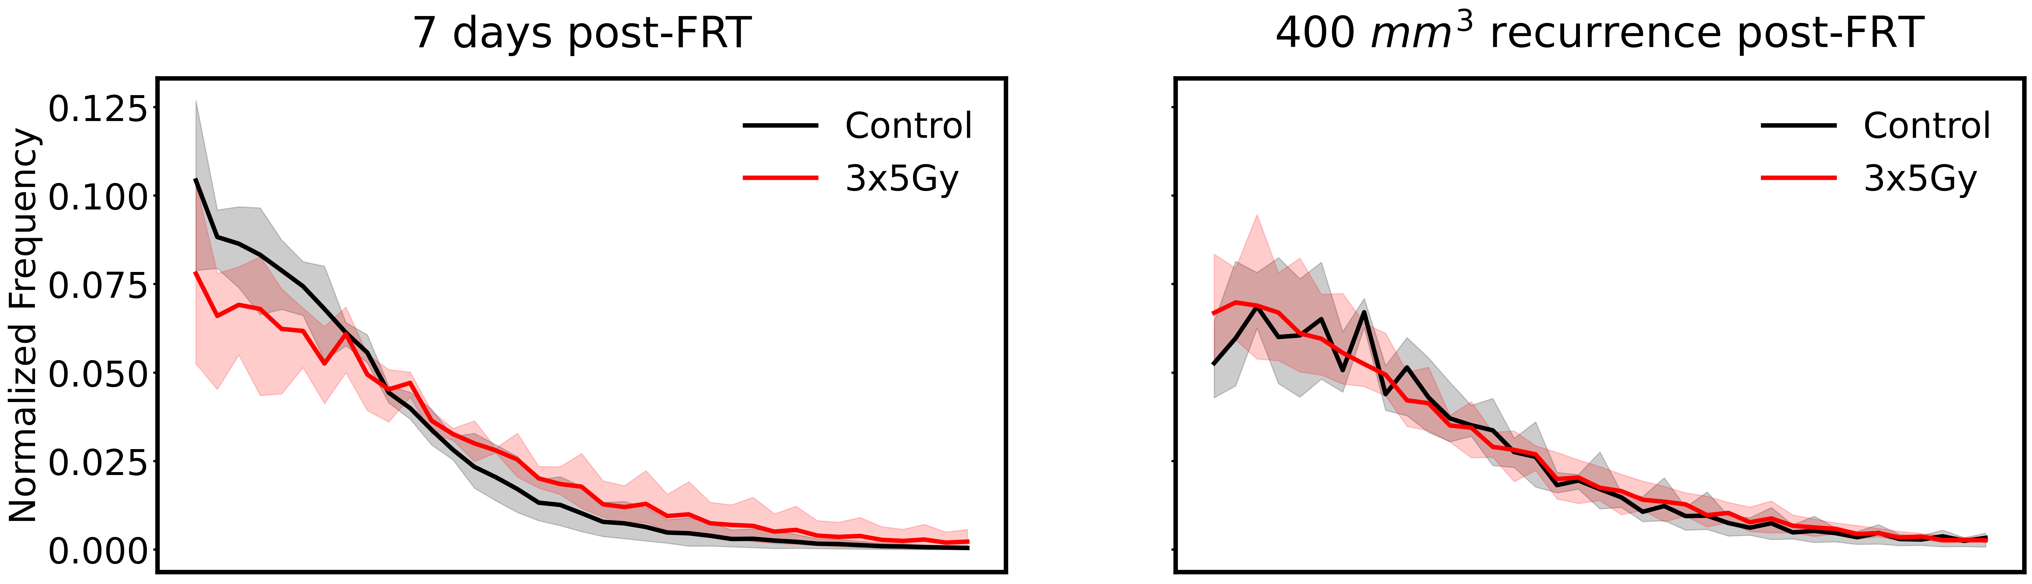
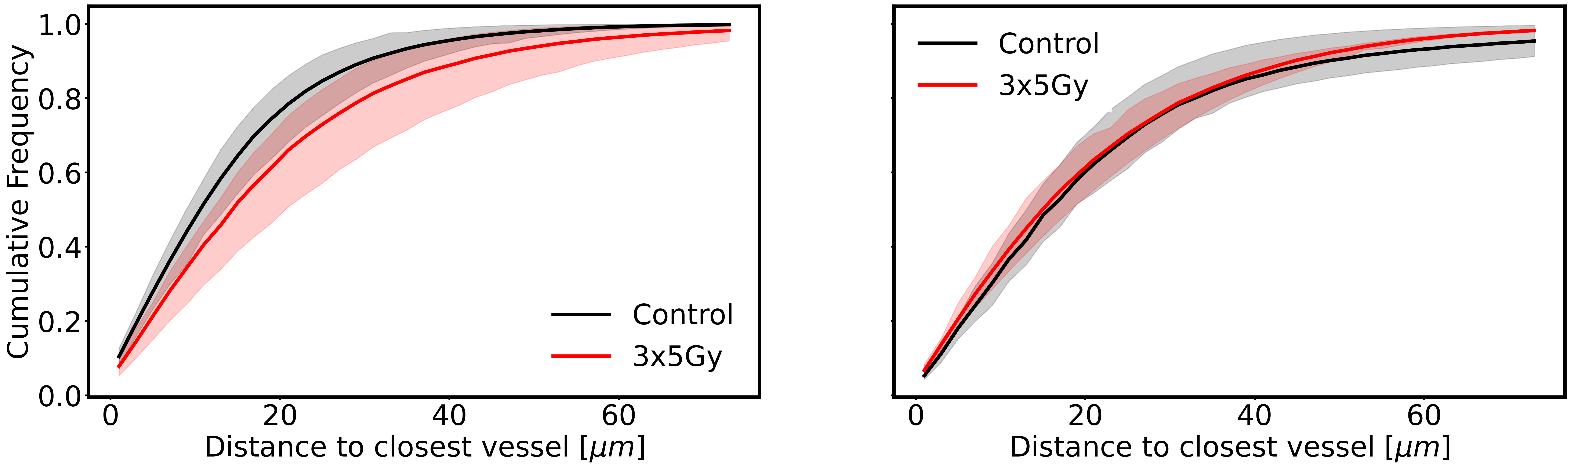
A
Supplementary Figure 2
~100 mm³ tumour
Control untreated
~ 400 mm³ tumour
5 Gy 5 Gy 5 Gy
D1 D2 D3
D7 analysis
400 mm³ analysis
B
Control untreated
B
αSMA positive pericyte
Absence of αSMA positive pericyte
20 µm
300 µm
300 µm
7 days post-FRT
C
αSMA positive pericyte
αSMA
PECAM-1 [CD31]
200 µm
αSMA
CD31 (PECAM-1)
30 µm
200 µm
C
7 days post-FRT
400 mm³ recurrence post-FRT
D
Control
FRT
Control
FRT
Control
FRT
p = 0.28
p = 0.35
E
7 days post-FRT
400mm³ recurrence post-FRT
Control
FRT
Control
FRT
Control
FRT
Control
FRT
Control
FRT

