Slide 1
Supplementary Figures 1‐11
The HECT type E3 ligase Itch is a negative regulator of hematopoietic stem cell homeostasis and functions

Slide 2




a
10
b
10
8
*
8
Target/ HPRT
Itch/ HPRT
6
6
*
4
4
2
2
0
c-Cbl
Itch
0
LSK
Cbl-B
CD4
c
60
Cells (× 10⁶)
40
20
0
Itch^{+/+}
Itch–/–
Supplementary Figure 1. Expression of candidate E3 ubiquitin ligases in HSCs.
c-Cbl, Cbl-B and Itch levels assayed by real-time PCR analysis in LSK (Lin⁻Sca1⁺c-Kit⁺) cells from wild-type and Itch–/– mice. Shown are the mean values of duplicate samples. Input cDNA quantity was normalised according to HPRT expression levels. Data are representative of 2 independent experiments.
Itch levels assayed by real-time PCR analysis in LSK cells and CD4 T (spleen) cells from wild-type and Itch–/– mice. Shown are the mean values of duplicate samples. Input cDNA quantity was normalised according to HPRT expression levels. Data are representative of 2 independent experiments.
Absolute numbers of total BM cells in wild-type and Itch–/– mice. Each group contains n=5 mice, age 4 weeks. Data are representative of 3 independent experiments.

Slide 3

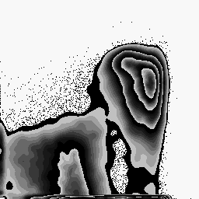

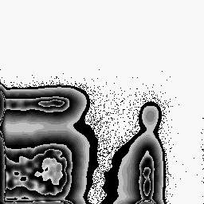


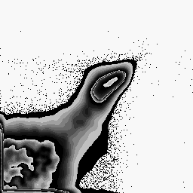
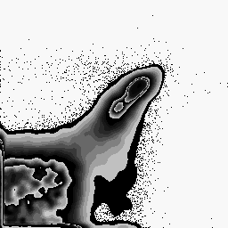


a
d
Itch^{+/+}
Itch–/–
Itch^{+/+}
Itch–/–
10⁵
52
49
 |  | 9.7
10⁵
15
 |  | 10
19
 |  | 14
10⁴
10⁴
10³
10³
CD11b
10²
0
CD4
10²
0
8.2
0 10² 10³ 10⁴ 10⁵
0 10² 10³ 10⁴ 10⁵
Gr1
CD8
b
Itch^{+/+}
Itch–/–
60
e
7.6
6.4
16
Itch^{+/+}
40
Cells (× 10⁶)
12
Itch–/–
Cells
20
8
0
4
0 10² 10³ 10⁴ 10⁵
0
TER119
f
GMP
CMP
MEP
c
Itch^{+/+}
Itch–/–
10⁵
22
17.6
 |  |  | 3.2
1.6
1.2
0.8
CLP
10⁴
Cells (× 10⁴)
10³
CD19
10²
0
0.4
2.9
0
0 10² 10³ 10⁴ 10⁵
B220
Itch^{+/+}
Itch–/–
Supplementary Figure 2. Myeloid and lymphoid differentiation in Itch–/– mice.
(a-d) Distribution of myeloid (a), erythroid (b), B lineage (c) cells in the BM and T lineage cells in the spleen
(d) of wild-type and Itch–/– mice at 4 weeks of age.
(e, f) Absolute numbers of Myeloid (e) progenitors (Common Myeloid Progenitor; CMP, Granulocyte Macrophage Progenitor; GMP, & Megakaryocyte Erythrocyte Progenitor; MEP) and lymphoid (f) progenitors (Common lymphoid Progenitor; CLP) in the BM of wild-type and Itch–/– mice. Each group contains n=5 mice, age 4 weeks. Data are representative of 3 independent experiments.

Slide 4
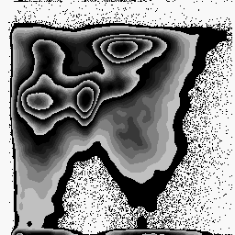
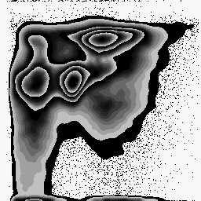
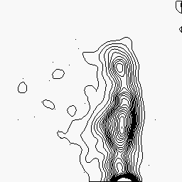
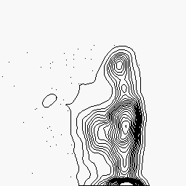
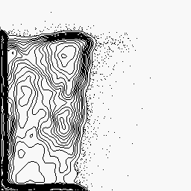
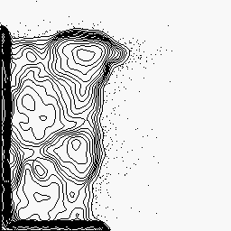



a
Itch^{+/+}
Itch–/–
b
Itch^{+/+}
Itch–/–
10⁵
10⁵
2.3
17
2.4
12
10⁴
Gated on LSK
10⁴
10³
10³
10²
0
G1
7.3
G1
6.5
CD150
10²
0
Lin
76
83
0
FSc
25
50
75
100
0 10²
CD48
10³
10⁴
10⁵
10⁵
50
40
100
*
1
3.5
80
Itch^{+/+} Itch^{-/-}
10⁴
Cells (× 10³)
60
G1
10³
40
10²
0.36
0.62
20
*
*
c-Kit
0
0
0 10²
10³
10⁴
10⁵
CD150⁺ CD48⁻ LSK
CD150⁺ CD48⁺ LSK
CD150⁻ CD48⁺ LSK
Sca 1
c
15
Itch/HPRT
10
5
0
*
BM-HSC
FL-HSC
Supplementary Figure 3. Increased frequencies of HSCs in the Itch–/– neonatal liver.
Distribution of lin⁻ (top) LSK (bottom) cells in wild-type and Itch–/– neonatal liver (d2). Data are representative of 3 independent experiments.
Distribution (top) and absolute numbers (bottom) of LSK subsets in wild-type and Itch–/– neonatal liver (n=5)
based on CD150 and CD48 expression. Data are representative of 3 independent experiments.
Itch levels assayed by real-time PCR analysis in LSK cells from the BM and FL of wild-type and Itch–/– mice. Shown are the mean values of duplicate samples. Input cDNA quantity was normalised according to HPRT expression levels. Data are representative of 2 independent experiments.

Slide 5







a
b
60
50
40
30
20
10
0
50
Cells (× 10⁶)
40
Cells (× 10⁶)
30
20
10
Itch^{+/+}
Itch^{-/-}
0
Itch^{+/+}
Itch^{-/-}
300
*
200
*
Cells (× 10³)
200
Cells (× 10³)
150
100
100
50
0
Itch^{+/+}
Itch^{-/-}
0
Itch^{+/+}
Itch^{-/-}
Supplementary Figure 4. Increased HSC pool in Itch–/– BM is cell intrinsic.
Absolute numbers of donor (CD45.2⁺) derived total BM cells (top) and LSK cells (bottom) in recipients that were transplanted with LSK cells from wild-type and Itch–/– mice. Each group contains n=5 mice. Data are representative of 2 independent experiments.
Absolute numbers of donor (CD45.2⁺) derived total BM cells (top) and LSK cells (bottom) in recipients that were transplanted with BM cells from wild-type and Itch–/– mice. Each group contains n=5 mice. Data are representative of 2 independent experiments.

Slide 6













a
60
4 weeks
Donor derived cells (%)
50
8 weeks
40
12 weeks
30
24 weeks
20
10
0
Itch^{+/+}
Itch^{-/-}
Itch^{+/+}
Itch^{-/-} Itch^{+/+}
1:10
Donor/ Competitor
Itch^{-/-}
Itch^{+/+}
Itch^{-/-}
1:20
1:1
20:1
b
c
d
100
Itch
+/+
100
Itch^{+/+} Itch^{-/-}
100
Itch^{+/+} Itch^{-/-}
CD11b⁺ cells (%)
75
Itch^{-/-}
CD19⁺ cells (%)
CD3ε⁺ cells (%)
75
75
50
50
50
25
25
25
0
4
8 12
Time (w)
24
0
4
8 12
Time (w)
24
0
4
8 12
Time (w)
24
Supplementary Figure 5. Multi-lineage differentiation capacity of Itch–/– LSK cells.
(a) Donor (CD45.2⁺) derived total BM cells in wild-type (CD45.1⁺) recipients (n=10). Donor LSK cells either from wild-type or Itch–/– (CD45.2⁺) mice were mixed with indicated ratios of wild-type competitor (CD45.1⁺) cells and transplanted. Data are representative of 2 independent experiments.
(b-d) Donor (CD45.2⁺) derived myeloid (b) B (c) and T (d) lineage cells in wild-type (CD45.1⁺) recipients. Donor LSK cells either from wild-type or Itch–/– (CD45.2⁺) mice were mixed with equal ratios of wild-type competitor (CD45.1⁺) cells and transplanted. Data are representative of 2 independent experiments.

Slide 7



a
100
Itch^{+/+} Itch‐/‐
80
Viability (%)
60
40
20
0
-
SCF
IL-3
IL-6
Flt3L
TPO
SCF+ IL-3
SCF+ IL-6
SCF+
Flt3L
SCF+ TPO
SCF+TPO+ IL-3+IL-6+
Flt3L
b
35
30
Itch^{+/+}
*
25
Itch‐/‐
Cells (× 10⁵)
20
15
10
5
0
-
SCF
IL-3
IL-6
Flt3L
TPO
SCF+ IL-3
SCF+ IL-6
SCF+
Flt3L
SCF+ TPO
SCF+TPO+ IL-3+IL-6+
Flt3L
Supplementary Figure 6. Viability and proliferation of Itch–/– HSCs in-vitro.
Viability of CD150⁺CD48⁻LSK cells from wild-type and Itch–/– mice in the presence of indicated cytokines.
Absolute numbers of CD150⁺CD48⁻LSK cells from wild-type and Itch–/– mice after 10 days of in-vitro
culture in the presence of indicated cytokines.
Shown are the mean values of duplicate samples. Data are representative of 2 independent experiments.

Slide 8


Itch^{+/+} Itch^{-/-}
300
*
200
Cells (× 10³)
100
*
0
PBS
Day 2(5-FU)
Day 8(5-FU)
Supplementary Figure 7. Frequencies of LSK cells following 5-FU injection.
Absolute numbers of BM LSK cells from wild-type and Itch–/– mice (n=3) following 5FU injections. Data are representative of 2 independent experiments.

Slide 9


a
Isotype
Notch1
80
60
40
20
0
Cells
0 10² 10³ 10⁴
Fluorescence
10⁵
Itch^{+/+}
Itch^{-/-}
b
400
*
300
200
100
0
GMFI
Itch^{+/+}
Itch^{-/-}
Supplementary Figure 8. Notch1 expression levels in HSCs of FL (E15).
Intracellular Notch1 expression in CD150⁺CD48⁻LSK cells from wild-type and Itch–/– fetal liver (E15). Cells treated with isotype (left) served as controls.
Geo Mean Fluorescence Intensities (GMFI) of histograms shown in a. Shown are the average intensities
of Notch1 protein expression from 3 independent experiments.

Slide 10
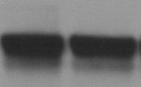






Itch^{+/+}
Itch–/–
Itch^{+/+}
Itch–/–
c-Jun
Fyn
JunB
PLCγ1
Smad2
p73
Itch^{+/+}
Itch–/–
Actin
Supplementary Figure 9. Expression levels of Itch target proteins in Itch–/– HPCs.
Normal expression levels of c-Jun, Jun B, Smad2, Fyn, PLC1and p73 proteins in the lin⁻ BM cells from wild-type and Itch–/– mice. Data are representative of 2 independent experiments.

Slide 11






a
5
Itch^{+/+} Itch–/–
4
Target/ HPRT
3
2
1
0
Hes2
Hes3
Hes5
Hes7
Hey1
Hey2
HeyL
b
c
8
*
4
Itch^{+/+} Itch–/–
Itch^{+/+}
Target/ HPRT
6
3
Itch–/–
Target/ HPRT
4
2
2
1
0
Runx1
Pax6
Sox9
Myf5
Nrarp Deltex1
0
Id1
Id2
Id3
GATA3 Notch2 Notch3
Supplementary Figure 10. Expression levels of Notch target proteins in Itch–/– HSCs.
(a-c) Expression levels of Notch1 targets assayed by real-time PCR analysis in LSK cells from wild-type and Itch–/– mice. Shown are the mean values of duplicate samples. Input cDNA quantity was normalised according to HPRT expression levels. Data are representative of 2 independent experiments.

Slide 12









a
b
3
Control ShRNA
Notch1 ShRNA
Notch1/HPRT
Notch1
2
*
1
Hes1
*
c-Myc
0
Control
Notch1
Notch1
Actin
Untransduced
ShRNA
ShRNA1
ShRNA2
c
140
120
100
80
60
40
20
0
Control ShRNA Notch1 ShRNA
Cells (× 10⁶)
*
*
*
Total Thymocytes
DN cells
DP cells
Supplementary Figure 11. Validation of Notch1 specific shRNA.
Reduced expression levels of Notch1 assayed by real-time PCR analysis in LSK cells expressing Notch1 shRNAs. Cells expressing control shRNA served as controls. Shown are the mean values of duplicate samples. Input cDNA quantity was normalised according to HPRT expression levels. Data are representative of 2 independent experiments.
Notch1, Hes1 and c-Myc protein levels in wild-type hematopoietic cells either expressing Notch1 specific shRNA or control shRNA. Data are representative of 2 independent experiments.
Absolute numbers of indicated thymic subsets in recipients (n=5), after twelve weeks of transplantation, that were transplanted with wild-type LSK cells either expressing Notch1 specific shRNA or control shRNA. Data are representative of 2 independent experiments.

