Slide 1
Fig 6D

Slide 2
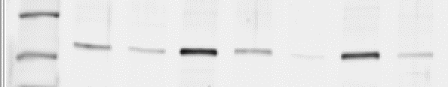
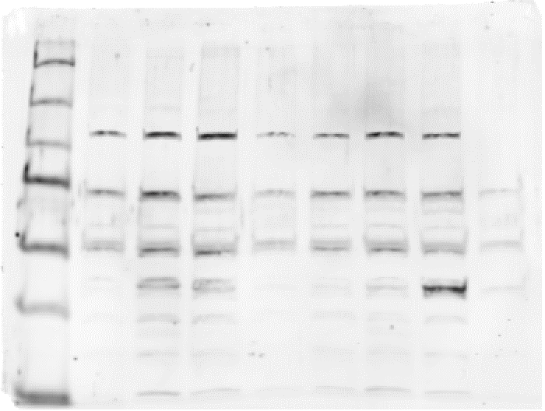
Fig 6D– Akt blots
Cropped area indicated in red
Pos control hela lysate
Gel #1 pAkt T308
Sperm lysates
Sperm lysates
Pos control hela lysate
Gel #2 Total Akt

Slide 3
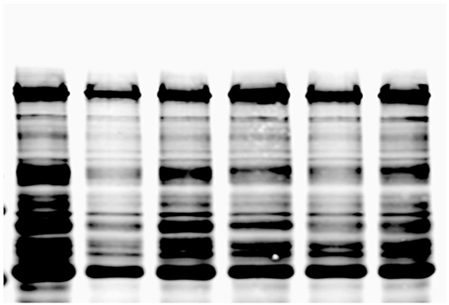


Fig 6D– pPKA substrate (top) and His (middle) and blots

