Slide 1
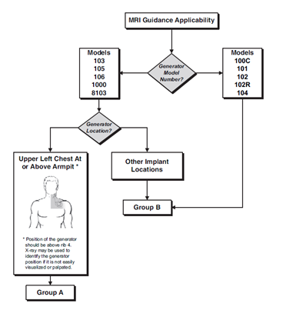
Supplemental materials Figure 2: MRI Guidance Applicability Flowchart. Excerpt from the LivaNova PLC MRI Labelling (MRI with the VNS Therapy® System; page 5; October 2019).

